Slide 1
Development of a 20 GS/s Sampling Chip in 130nm CMOS Technology
2009 IEEE Nuclear Science Symposium, Orlando, Florida,
October 28th 2009
Jean-Francois Genat
On behalf of
Mircea Bogdan¹, Henry J. Frisch¹, Herve Grabas³, Mary K. Heintz¹, Samuel Meehan¹,
Eric Oberla¹, Larry Ruckman², Fukun Tang¹, Gary Varner²
- University of Chicago, Enrico Fermi Institute,
- University of Hawai’I
- Ecole Superieure d’Electricite, France

Slide 2
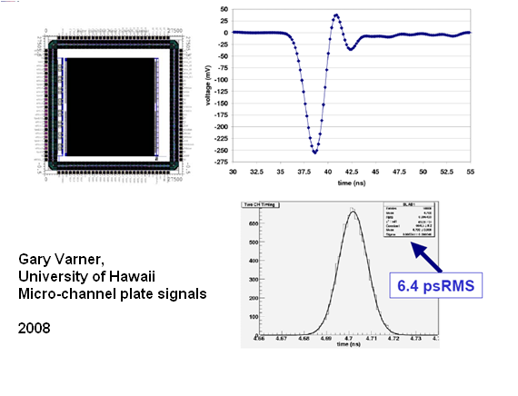
Motivation: Picosecond timing
Fast sampling allows reconstructing the time of arrival of a fast detector signal to a few picoseconds knowing the pulse waveform.
Lab3 Switched Capacitor Array ASIC
250nm CMOS technology

Slide 3
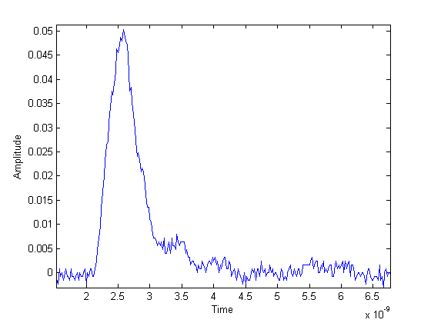
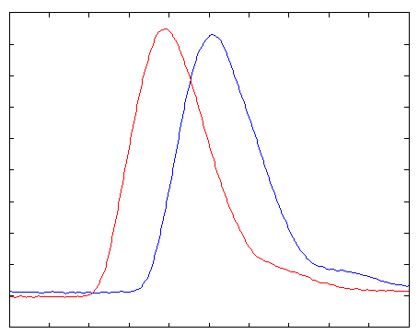
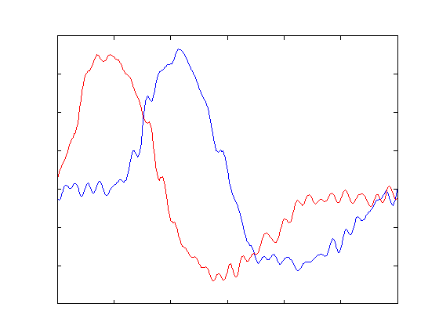
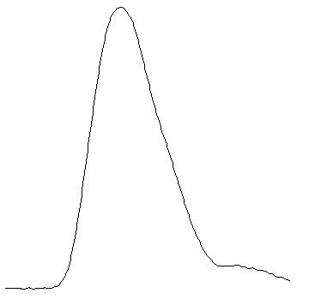
Pulse Sampling and Waveform Analysis
Fit to waveform
and derivative
templates
Pico-second Timing

Slide 4
Sampling both ends of a delay line
coupled to a Micro-Channel Plate detector
2 picoseconds; 100 microns (20 GS/s sampling oscilloscope)
With Edward May and Eugene Yurtsev (ANL)

Slide 5
Prototype Sampling ASIC Minimum specifications
Sampling rate 10-20 GS/s
Analog Bandwidth 1.5 GHz
Dynamic range 0.8 V
Crosstalk 1%
Maximum read clock 40 MHz
Conversion clock Adjustable 1-2 GHz internal ring oscillator. Minimum conversion time 2us.
Readout time 4 x 256 x 25 ns=25.6 μs
Power 40 mW / channel
Power supply 1.2 V
Process IBM 8RF-DM (130nm CMOS)

Slide 6
Project Milestones
- Design started by fall 2008
- Sent to MOSIS Jul 28th
- Received October 21st …
- First test results today … …

Slide 7
Architecture
Clock
Timing Generator
Sampling Window
Ch 0
Channel # 0 (256 sampling caps + 12-b ADC)
Read
control
Ch 1
Analog in
Ch 2
Ch 3
Channel # 3
Digital
out
Channel #4 (Sampling window)
Read

Slide 8
Modes
-1 Write: The timing generator runs continuously, outputs 256 phases 100ps spaced.
Each phase (sampling window) controls a write switch.
The sampling window’s width is programmable (250ps-2ns)
40 MHz Clk
100ps
A/D converters
Analog
input
Digital
output
Mux
-2 A/D Conversion takes place upon a trigger that opens all the write switches
and starts 4 x 256 A/D conversions in parallel (common single ramp)
Data are available at after 2 μs (1-2GHz counters)
-3 Read occurs after A/D conversion

Slide 9
Prototype ASIC’s Functions
The chip includes
- 4 channels of full sampling (256 cells)
- 1 channel of sampling cell to observe the sampling timing
Test structures:
- Sampling cell,
- ADC comparator,
- ADC Ring Oscillator clock

Slide 10
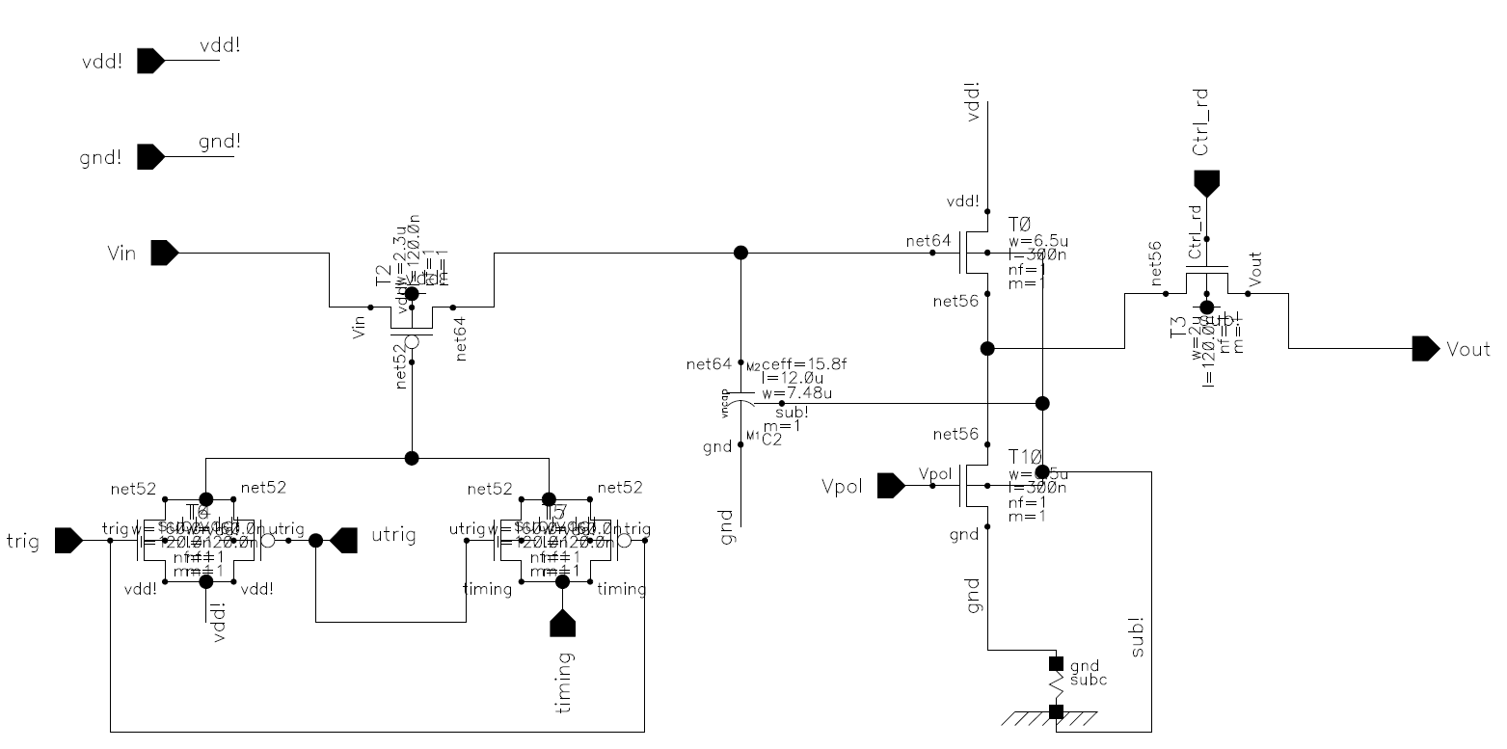
Sampling cell
Input switch
Storage capacitance & Nfet
Output switch
²
Sampling Capacitance
40fF
Switch resistance:
1kΩ
1-cell bandwidth:
1/2πRC = 10GHz
Analog bandwidth
1-3GHz
Current source
Multiplexer
Schematic
Write switch Read switch
Layout

Slide 11
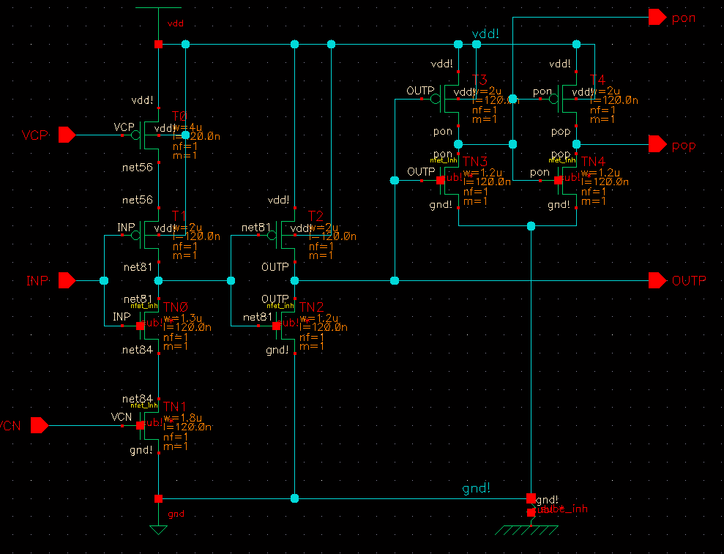
Timing Generator
- 256 voltage controlled delay cells of 100-200ps
- 40 MHz clock propagated through
Voltage Controlled Delay Cell
Test structure: Ring Oscillator made of two delay cells + inverter

Slide 12
ADC
Wilkinson:
All cells digitized in one conversion cycle
- Ramp genetaror
Comparators
Counter
Clocked by the ring oscillator at 1-2 GHz
Test structure: Ring Oscillator, Comparator

Slide 13
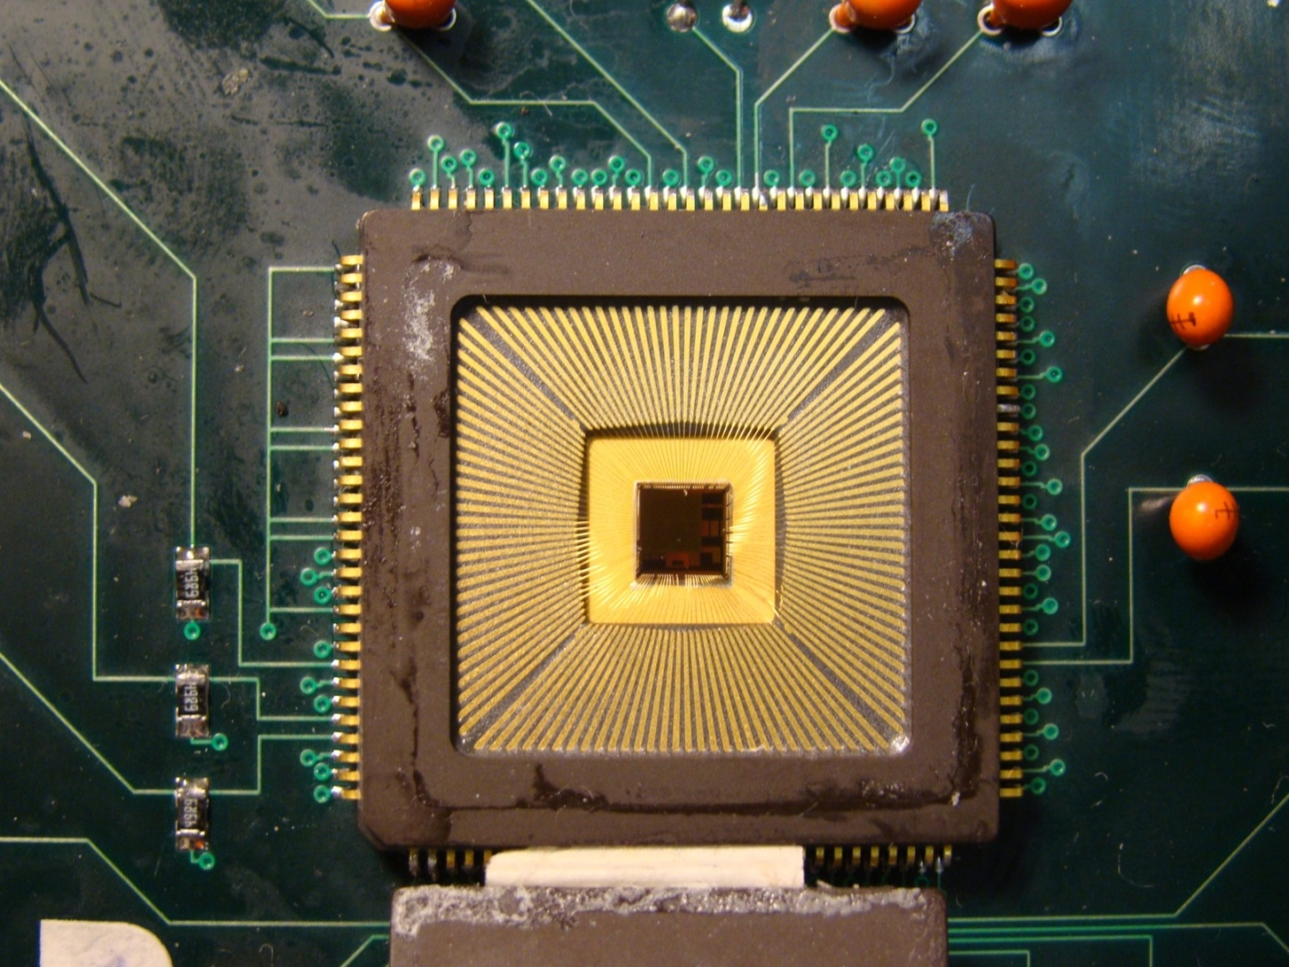
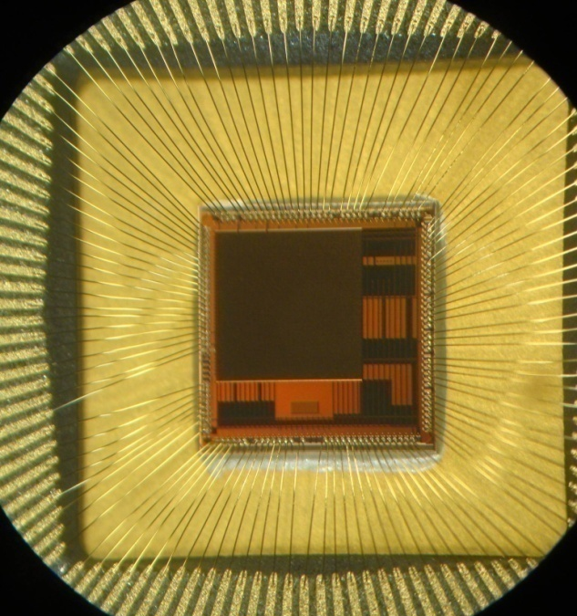
ASIC pictures
Received October 21st 2009
Die to be bump bonded

Slide 14
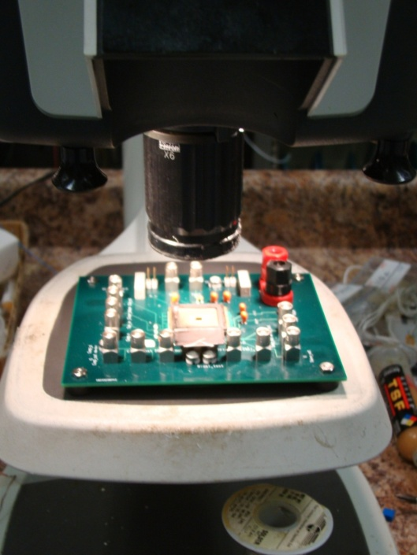
Tests
- First tests (presented here)
- Packaged chips
- DC power vs biases,
- Sampling cell response vs input
- ADC’s comparator
- Leakages (voltage droop)
- Readout, token passing
Fine tests
- Chip on board (wire-bonding)
- Sampling cell vs sampling window
- ADC
- Max sampling speed
- Linearities, dynamic range, readout speed.
Notes:
14

Slide 15
Test Results -1
DC power
- Chip is drawing 250 mA @ 1.2 V due to floating substrate !
to be fixed at MOSIS this week.
- Powers drawn from test structures vs DC bias control voltages are ok.
10/28/09
genat@hep.uchicago.edu
15

Slide 16
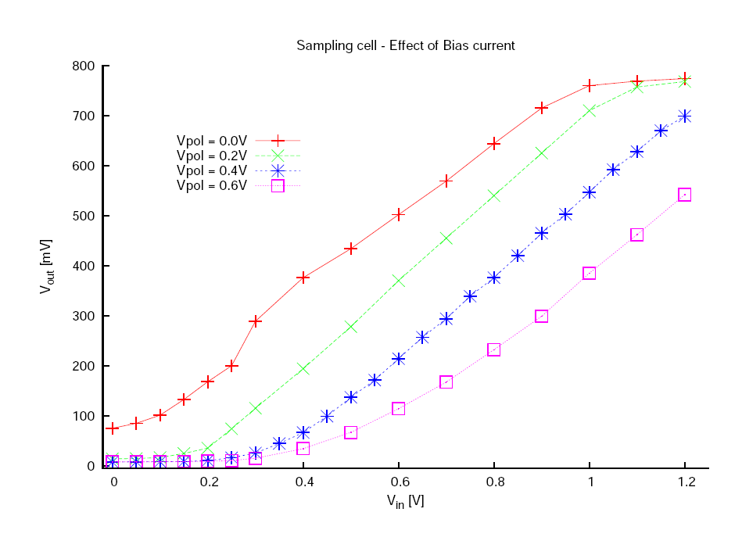
Test Results -2
Sampling Cell
Ok, but unexpected saturation for large V_{in} (Vpol = 0,0.2 V)
Very close
to simulation
(Next slide)

Slide 17
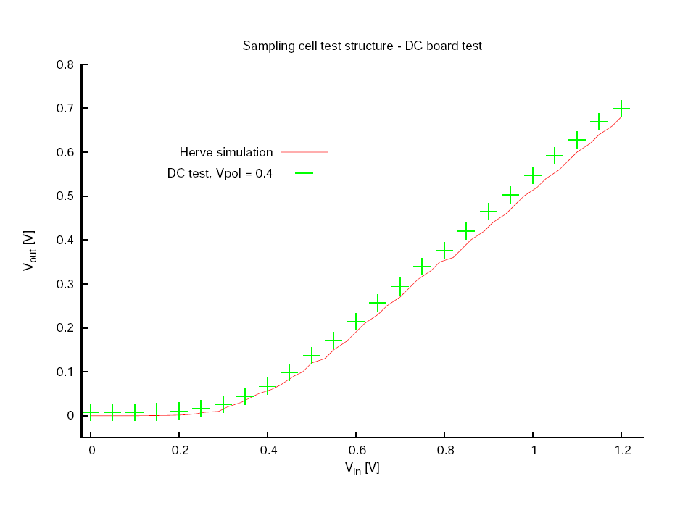
Test Results -2
Sampling Cell
Very close to the
simulation
10/28/09
genat@hep.uchicago.edu
17

Slide 18
Test Results -2
Sampling Cell
Switch Leakage
1 - input LOW, write switch CLOSED
2 - input HI, switch CLOSED
3 - input HI, switch OPEN
4 - input LOW, switch OPEN
Leakage current is 7 pA
Much smaller than in simulation
Write switch Read switch
1
2
3
4

Slide 19
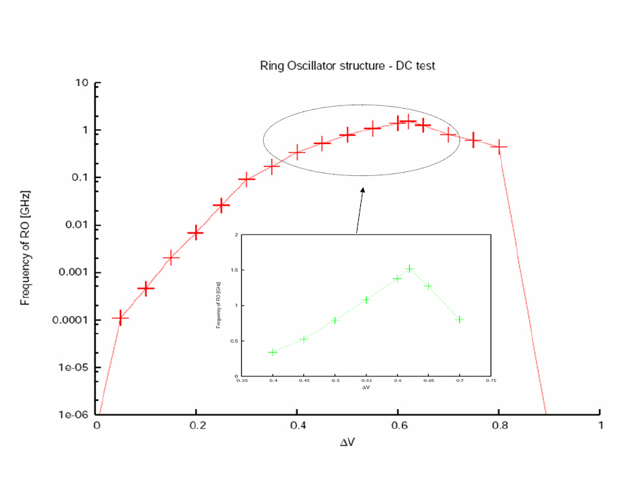
Test Results -3
Ring Oscillator
- Measured up to 1.5 GHz
- Observation limited by the12 bit counter used for test purposes.
- Can run presumably faster internally

Slide 20
Test Results -4
Comparator
The good news:
- switches as expected
Not so clear:
- doesn’t reach +1.2 V
Due to the floating substrate ?

Slide 21
Test Results -5
Readout Token
Read clock of 400 KHz
Token In
Clock pulse through a shift register
Token Out
Output after token passed to 256 registers (one clock period per register).
Output measured delayed as expected,
Digital data can be readout
.

Slide 22
Tests Summary
Most of the test structures have been tested as expected from simulations in terms of:
- Dynamic range:
Sampling cell runs ok within 0-700mV as simulated
- Speed:
Up to 1.5 GHz ring oscillator
- ADC :
Comparator
- Readout logic
No reason why the full sampling channels would not work

Slide 23
Conclusion
- Tests from the test structures give mainly the expected results, even with a floating substrate !
- Next tests of the four channels should demonstrate that the ASIC is fully functional

Slide 24
Future Plans
- Experience from the first ASIC
- Include low jitter PLL
- Improve analog bandwidth
- Improve sampling rate

Slide 25
Extra slides

Slide 26
Future Plans
- Experience from the first ASIC
- Include low jitter PLL
- Improve analog bandwidth
- Improve sampling rate

Slide 27
Test Results 2
Sampling Cell
Very close to the
simulation
10/28/09
genat@hep.uchicago.edu

Slide 28
DC, AC, Anodes Tests (see also Eric’s document)
- DC tests (Chicago)
Card under design (started routing)
- No s/w needed
- DC power vs biases, ring oscillator frequency, ADC ramp monitoring, token passing
AC tests (Hawaii)
- Chip on board (wire-bonding)
- DACs,
- FPGA,
- USB interface (in the FPGA),
- Fast pulser, (IEEE488 to PC)
- F/w and s/w: load FPGA, program and trigger pulser, control DACs,
read digital data, manage results, (LabView ?)
Functional and parametric tests:
- Sampling cell output vs input and sampling window
- Max sampling speed
- Leakages (voltage droop)
- Linearities, dynamic range, readout speed.
Notes:
28

Slide 29
Delay generator (1 / 256 cells)
75-100ps/cell
ANT Workshop Aug. 13-15th 2009 UHM

Slide 30
Packaged chip test board
Flip-Chip is expensive, need to make sure it’s a good investment.
DC board is simple and relatively cheap.
Measure power, DC operating points
Observe functionality:
- Comparator
- Sampling Cell
- Ring Oscillator and 12 bit counter
- Token Readout
- ADCs Ramp Generator
Compare results to simulation

