Slide 1
Tray Factory Considerations
Jean-Francois Genat
UC
LAPD Collaboration Meeting, June 10-11th 2010, Argonne.

Slide 2
Outline
- Tile and Tray
- On-Tray electronics
- Tray assembly
- Plans
LAPD Collaboration Meeting, June 10-11th 2010, Argonne.

Slide 3
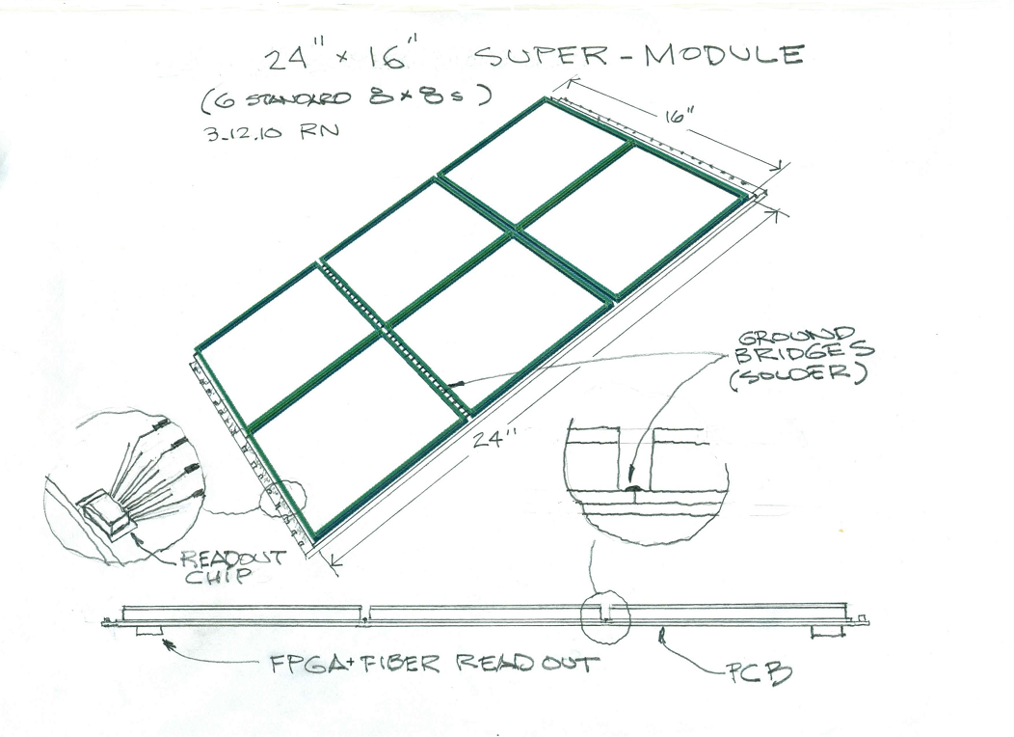
Tiles and Tray
From Rich Northrop
6-Tiles Trays
LAPD Collaboration Meeting, June 10-11th 2010, Argonne.

Slide 4
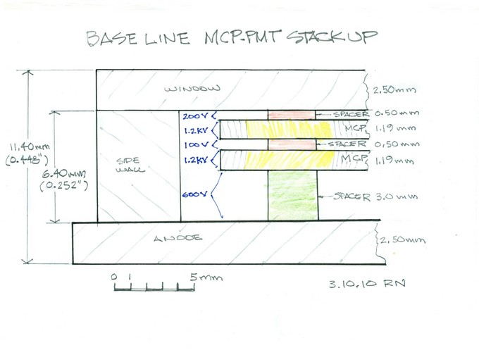
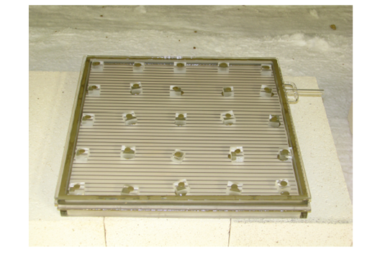
Tile structure
From Joe Gregar
From Rich Northrop (vertical dimensions not final)
Inside out: grounded anode strips on top of glass
HV divider uses spacers as passive components.
Single HV connection on top
LAPD Collaboration Meeting, June 10-11th 2010, Argonne.

Slide 5
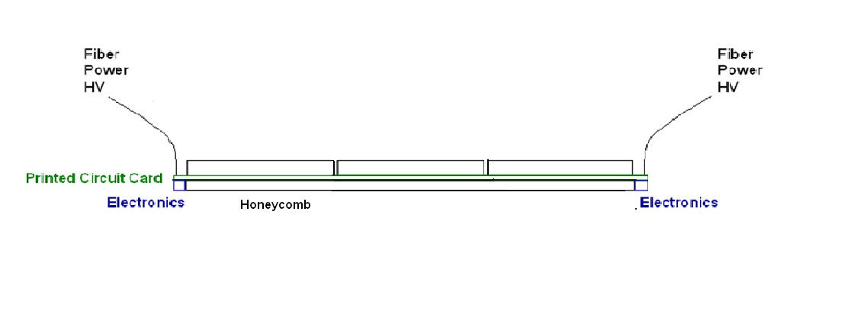
Tray structure
2-Tile tray
LAPD Collaboration Meeting, June 10-11th 2010, Argonne.

Slide 6
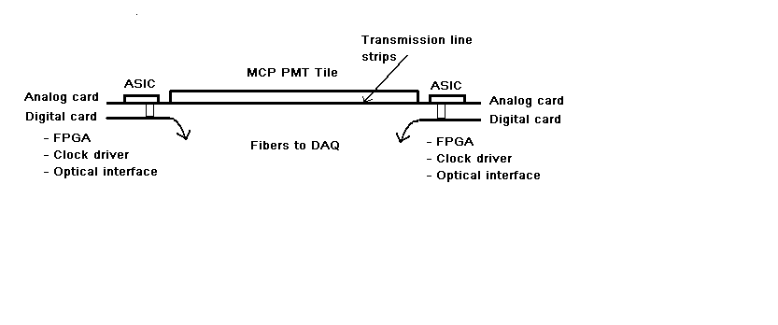
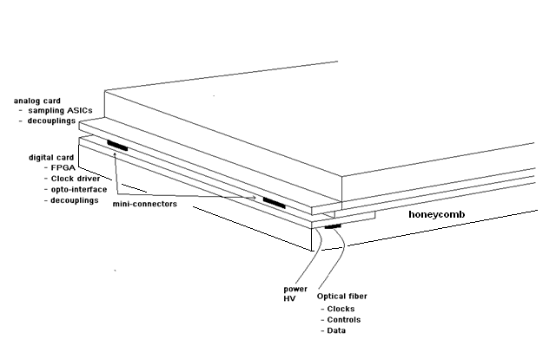
Tray overall layout
LAPD Collaboration Meeting, June 10-11th 2010, Argonne.

Slide 7
On Tray Electronics - Analog board - Front-end Chips - Jitter cleaner(s) - LV decouplings caps - Interface connector to digital board - Digital board - FPGA - Optical interfaces to DAQ - LV decouplings caps - Interface connector to analog board - High Voltages - One single HV access to tile on top - One SHV single access/tray - Teflon insulated HV wires running on-tray - Single RC decoupling for each tile
LAPD Collaboration Meeting, June 10-11th 2010, Argonne.

Slide 8
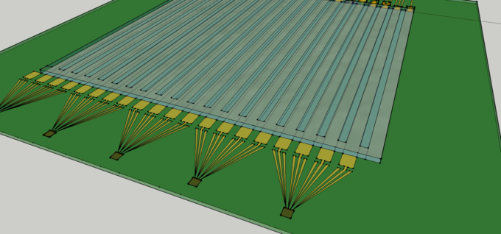
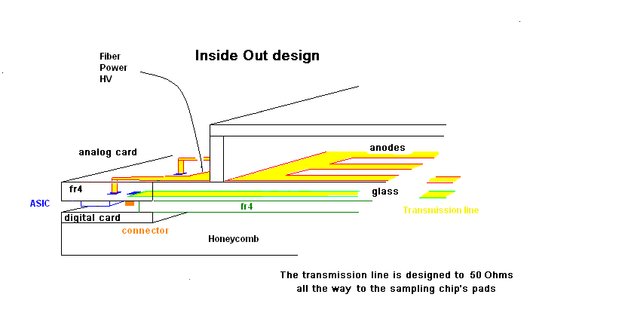
Electronics layout
See Eric Oberla and Herve Grabas talks
LAPD Collaboration Meeting, June 10-11th 2010, Argonne.

Slide 9
Tray assembly
Tile to PCB: Double sticky tape
PCB to Honeycomb: Double sticky tape
Anode plane to anode plane: Copper foil soldered
LAPD Collaboration Meeting, June 10-11th 2010, Argonne.

Slide 10
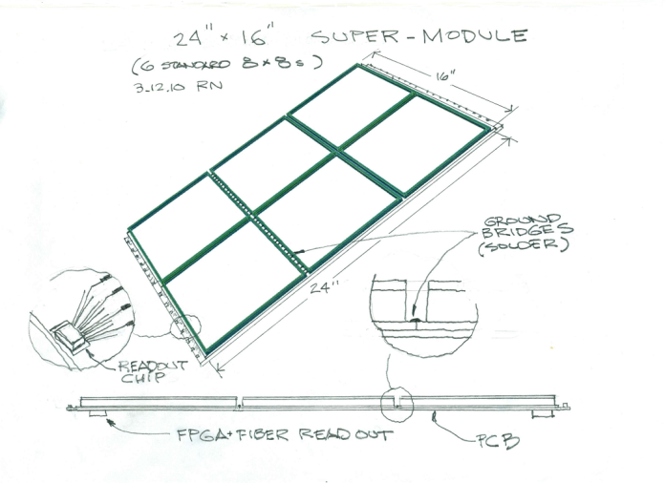
Ballpark for costs Estimation for 15 x 6-tile trays (MCP not included) of 16 “ x 24 “ (equivalent to a 22” diameter PMT) Sampling ASIC: 10 $/ch 64-channel/row (16 chips) ASICs 1,300 $ Glass = 3,000 $ (Rich Northrop) Honeycomb+ PCB = 600 $ (Rich Northrop) Total = 5,000 $ x 4 (Henry’s factor) <= 20 k$
LAPD Collaboration Meeting, June 10-11th 2010, Argonne.

Slide 11
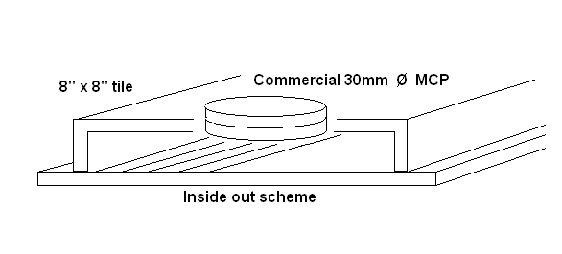
Plans towards a tray
First tests with a small (30mm diameter) commercial MCP in vacuum,
read with the 8” x 8” inside-out transmission lines scheme
Tests with a laser with or without a photo-cathode
Check the signals at two ends
-First: SMAs + oscilloscope,
- Actual cards with sampling ASICs and FPGA
Need :
- The MCP
- A fully functional tray (vacuum, HV access on top , anodes).
- The ALD processed spacers for HV distribution.
LAPD Collaboration Meeting, June 10-11th 2010, Argonne.

Slide 12
Extra slides

Slide 13
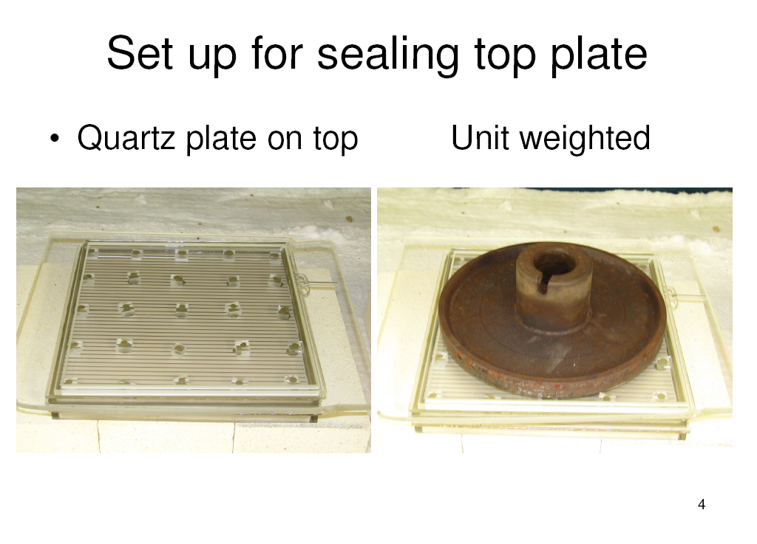
LAPD Collaboration Meeting, June 10-11th 2010, Argonne.

Slide 14
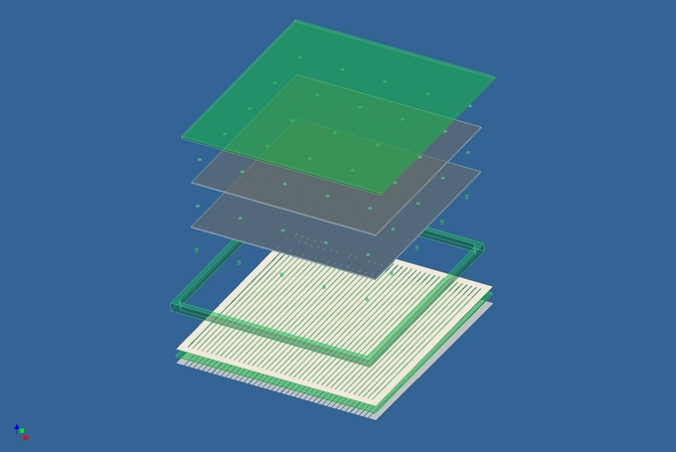
Tile assembly
Inside out structure
LAPD Collaboration Meeting, June 10-11th 2010, Argonne.

Slide 15
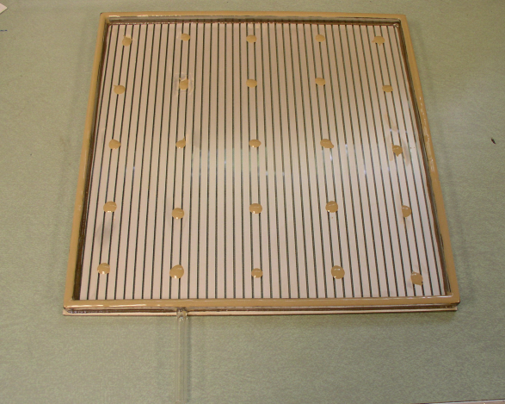
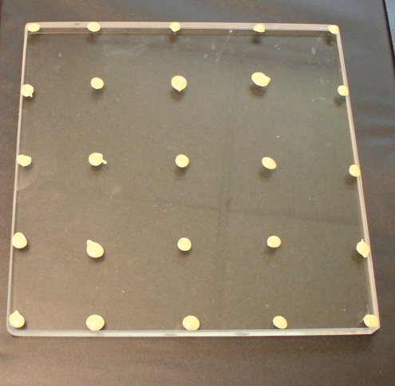
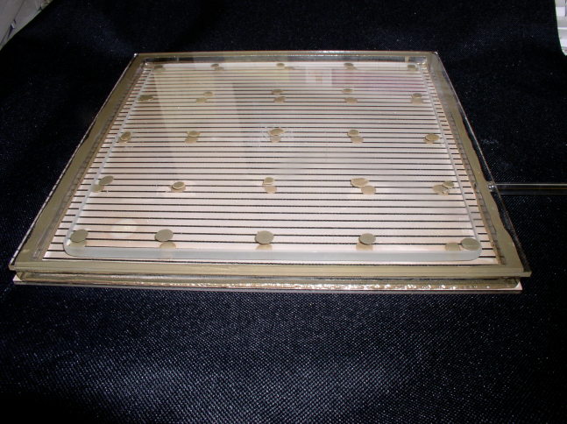
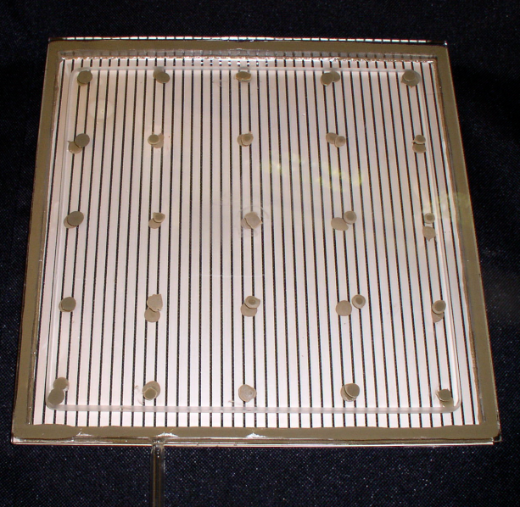
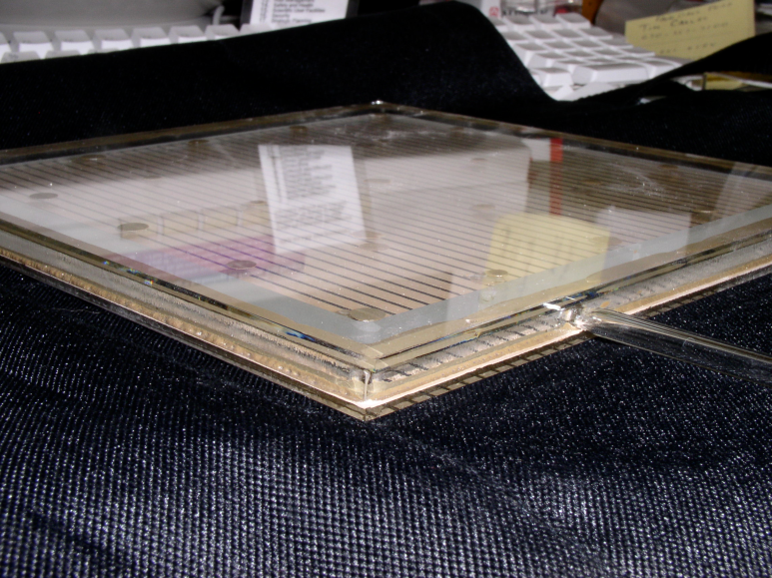
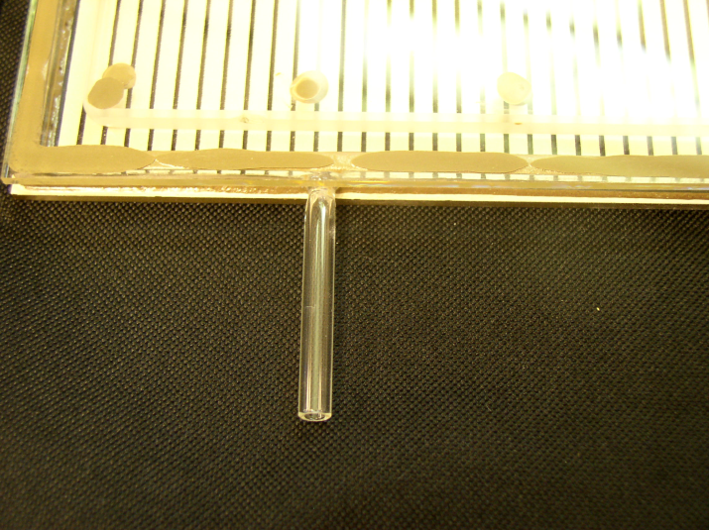
First Glass Box (May 18th J. Gregar)
LAPD Collaboration Meeting, June 10-11th 2010, Argonne.

