Slide 1
New Test Facilities at Argonne
LAPPD Collaboration meeting
June 10 2010
Matt Wetstein, Bernhard Adams, Matthieu Chollet

Slide 2
Sector 7 beamline at the APS
Current status of MCP testing
Next step
New facility

Slide 3
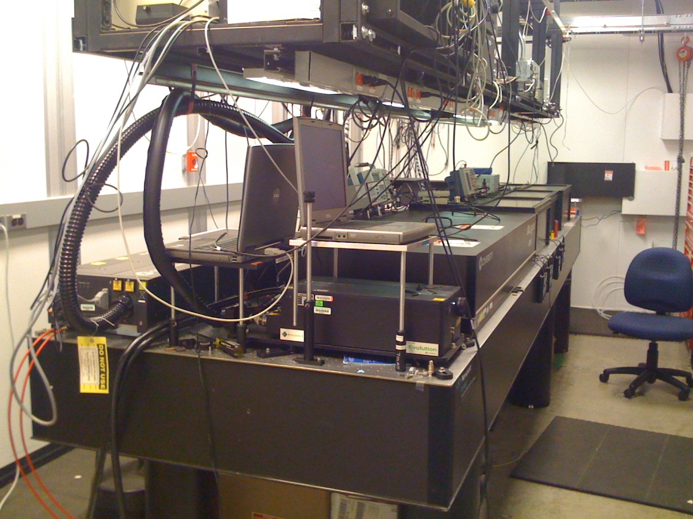
APS Sector 7
E
D
C
B
A
Ti:Sapphire Femto-second Laser
800 nm (near infrared)
2.5W average output power
1 or 5 KHz repetition rate
55 fs pulses

Slide 4
measures the optical and electronic characteristics of MCP/Photocathode/stripline assemblies simultaneously with precision timing and gain in realistic operating conditions.
•Working with ALD functionalized MCP’s
•Working with stripline anode structure similar to final product
• Understand what MCP chemistry work
•Photon counting, pulse height distributions, amplification curves
•Image profile, position resolution, signal shape, uniformity
•I/V curves, dark current, technical issues
• Advanced Characterization in the time domain
•Transit time spread, arrival time, first strike problem
• Full sized testing

Slide 5
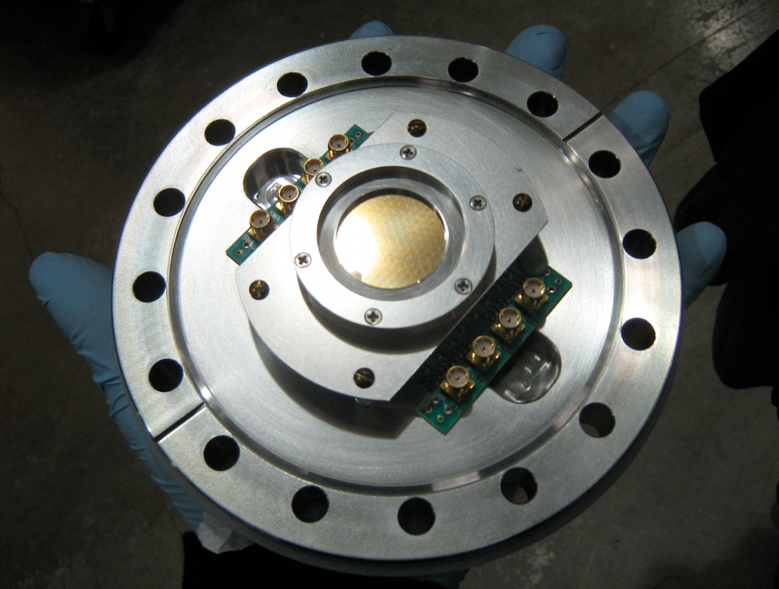
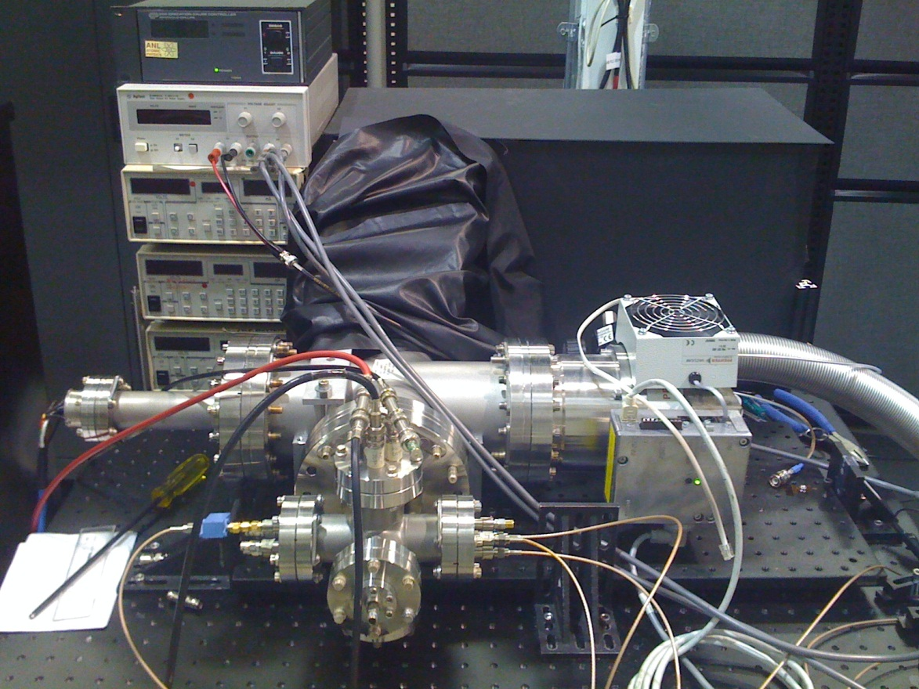
Test setup:

Slide 6
Laser setup:
Test Chamber
BBO crystals
Flip mirror
800, 400nm rejection mirrors
UV
LED
Reference Diode

Slide 7
Achievements:
A working characterization system built from scratch.
Developed methodology for UV-LED and laser based MCP Measurements
Demonstration of enhanced amplification with high SEE ALD coating on
commercial MCP.
First measurements of a working Argonne MCP pair.
Stronger collaboration with fabrication, simulation, and testing groups.
Faster turn-around and feedback.

Slide 8
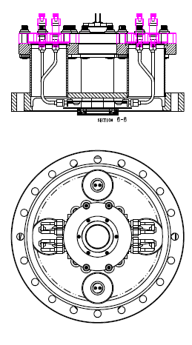
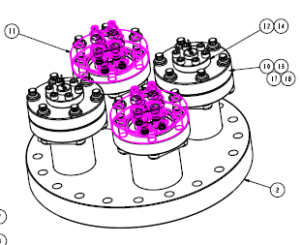
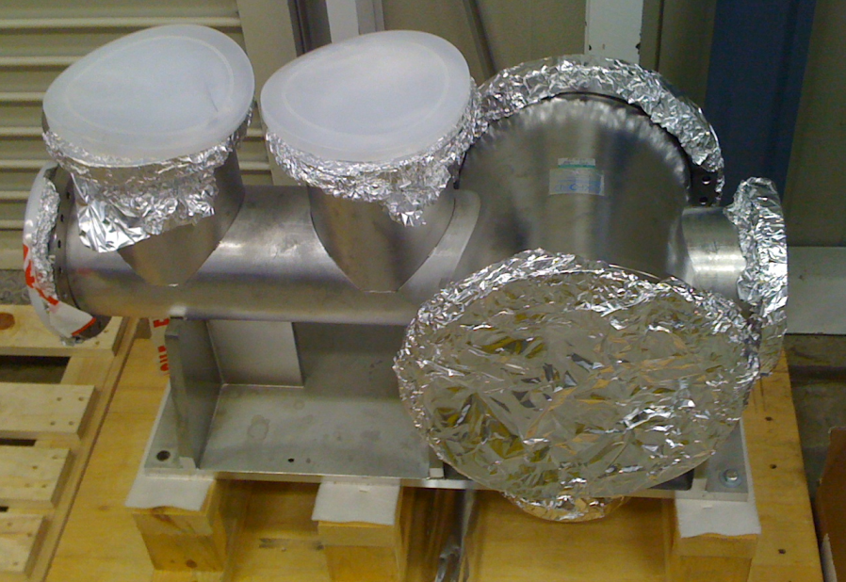
Next step:
B-Flange Status:
We have:
Flange
Adaptor flange to fit current chamber
parts for 2-3 complete MCP sample holders
Automation:
Voltage scan/data acquisition script
WIENER power supply...ordered (not sure of lead time...)
Large Chamber
What we critically need:
Photocathode (being built)
Fixtures to attach sample holder to B flange (being ordered)
spacers to apply bias voltages across inter-MCP gap and PC gap (need to finish design and have built)
A way to take the adapted B flange on and off the small chamber (rubber gasket)
signal board with parallel connectors (being built)
Hoping to ramp this us in the next few weeks…

Slide 9
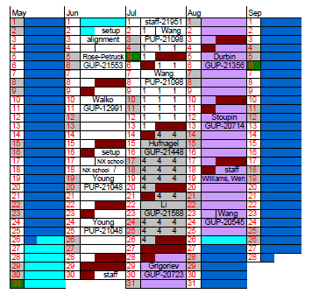
Parasitic use of the beamline laser
3 months experiments
Laser available only during 1 month shutdown time
E
D
C

Slide 10
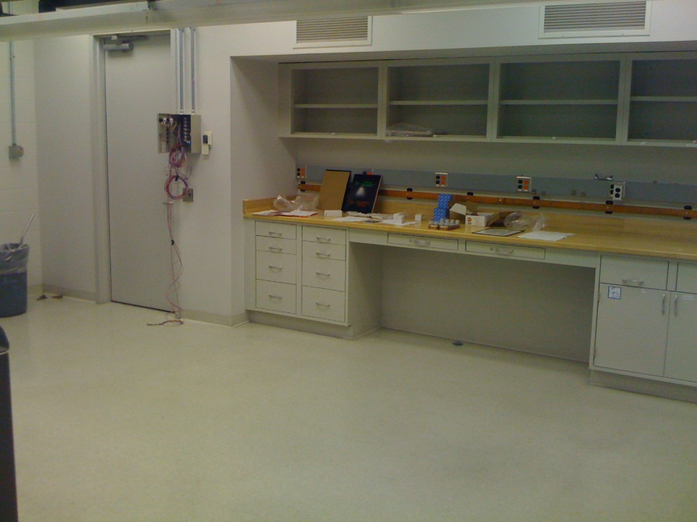
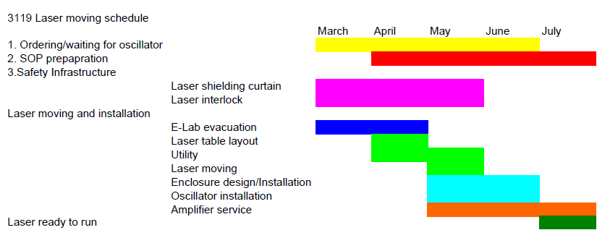
New laser room:
Class 3B Laser:
800nm
<1w average output power
50 fs pulse @ 1 KHz

Slide 11
Double pulse excitation:
Relaxation time measurement
Equivalent circuit of a pore
λ/4
λ/4
IR
UV
MCP

Slide 12
Conclusion
Methodology for MCP characterization
Automated measurements is on the way.
Database to keep track of samples and test results
Update of test setup with B-flange
Ready the big chamber for real size test

