Slide 1
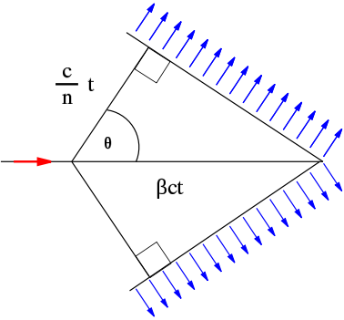
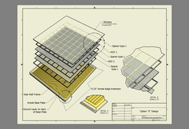
Plasmonic Photocathodes
β = v_{p} / c
Cherenkov Radiation
Photocathode
hυ-> e-
Ag Particles
Ag Arrays
Ag Films
Pellin

Slide 2
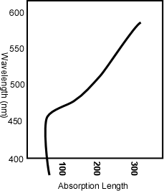
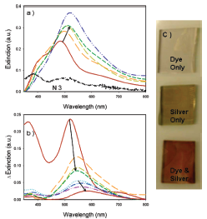
The Problem With Photocathodes – Photon Absorption Length vs Electron escape depth
Key Factors in optimizing Cathode Efficiency
Window should be transparent
Photocathode should absorb and produce an electron in the solid
Electron should be close to the surface
Surface work function should allow the “excited” electron to escape (but not all the rest of the electrons.
1 monolayer dye
Window
Empty States
hν
Φ
No States
Filled States

Slide 3
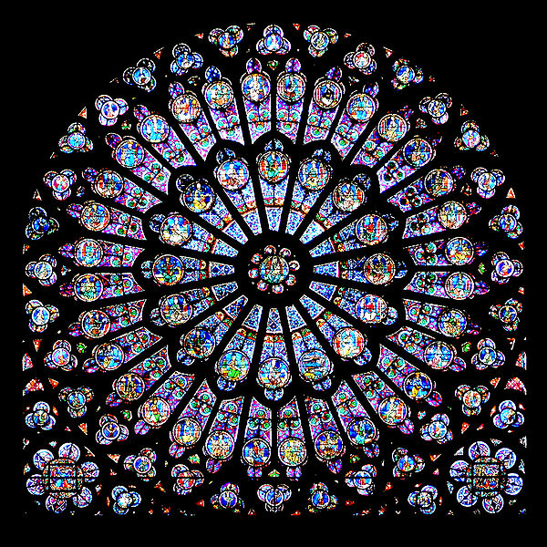
Plasmon – What is it?
In a conductor, the free electrons move around the fixed ionic cores to cancel externally applied fields.
Oscillatory fields like light waves have resonance conditions. These conditions dominate the absorption properties of good metals.
The proper resonance conditions depend of particle size or surface features.
For visible light this is <400 nm.
Gothic stained glass rose window of Notre-Dame de Paris. The colors were achieved by colloids of gold nano-particles

Slide 4
Plasmonics with particles
1 monolayer dye
No polarization or angle dependence
Color dependence controlled by particle size
AgCl solution bubbled with H₂
Dye Absorption
Spectrum
Dye Absorption
Spectrum with 20 nm Ag

Slide 5
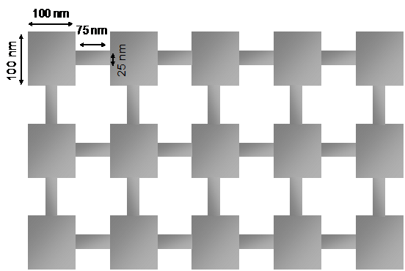
Ag Films – Transparent Conductors + Plasmonics!
TOP View
Side View
100 nm
25 nm
75 nm
50 nm
Glass

Slide 6
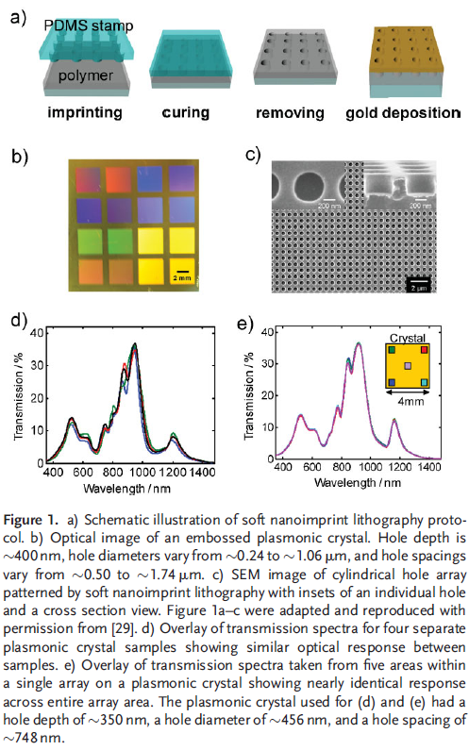
Stamps
How to make a cheap array- PDMS stamps
Now proposed for solar cell implementation

Slide 7
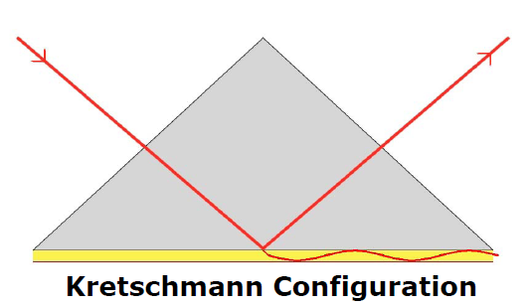
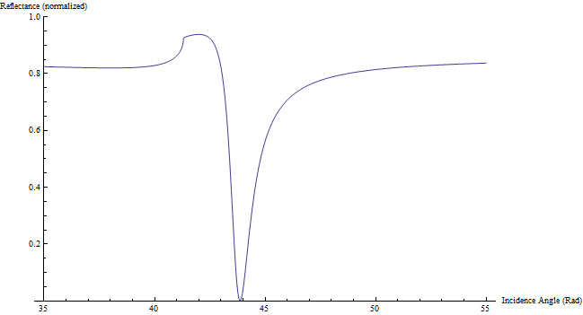
Surface Polarized Plasmons (SPP’s)
Resonance Conditions for flat films (momentums must be matched)

Slide 8
The main (only) idea to use the unique aspects of Cherenkov light
Reflected 450 nm light
w/out Gold Film
BK7
glass
with Gold Film (50 nm)

Slide 9
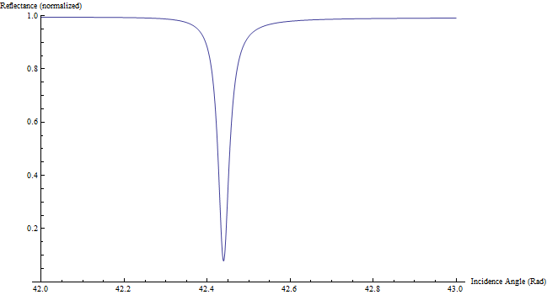
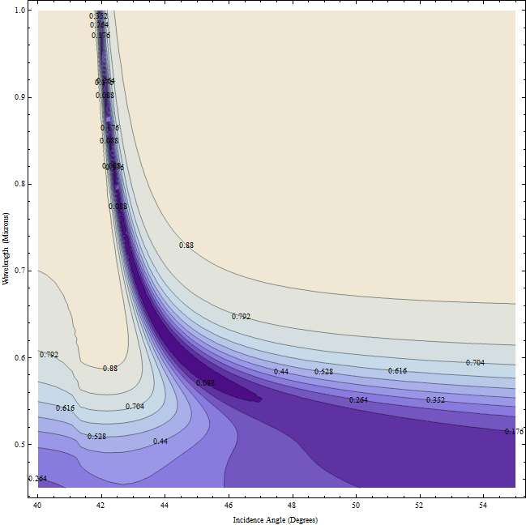
A photocathode
β = v_{p} / c
e⁻

