Slide 1
AAO MCP substrates development at Synkera
Cumulative status update
Oct. 10, 2009 - June 11, 2010
LAPPD MCP Review
ANL, Chicago IL
June 11, 2010
© 2006-2010 Synkera Technologies, Inc.

Slide 2
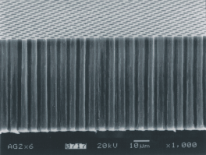
AAO as MCP substrate
intrinsic pores
micromachined channels
Synkera
Synkera
generic AAO
glass MCPs
0.01 0.1 0.5 1 5 10 µm
related effort

Slide 3
AAO as MCP substrate
intrinsic pores
micromachined channels
Synkera
Synkera
generic AAO
glass MCPs
0.01 0.1 0.5 1 5 10 µm
LAPPD
related effort

Slide 4
AAO as MCP substrate
intrinsic pores
micromachined channels
Synkera
Synkera
generic AAO
glass MCPs
0.01 0.1 0.5 1 5 10 µm
Main challenges:
  implementing .5 – 2 µm diameter uniform channels: stable anodization at 400-600 V
  scale to dimensions and formats of detector targeted by LAPPD
  scale to high-volume manufacturing at targeted cost

Slide 5
Synkera LAPPD subcontract
Overall goal: develop ceramic MCP substrates for low-cost large-area detectors
The project benefits from prior and related IP, established facilities, on-going R&D, and scale-up efforts at Synkera.
Year 1 – Development of Required Channel Structure
  Objective: maximize the channel diameter and enable a funnel-shaped opening, while maintaining well-aligned channels.
  Deliverables / targets:
    Demonstrate AAO with channel diameter ≥0.5 µm, OAR ≥60%, L/D of 50-100
    MCP substrates for LAPPD team (32.8 mm, qty≥15) targeting above specs
    Initial cost projections for 8”x8” AAO substrates
Year 2 Option – Support of MCP Development and Scale-Up
  Objective: enable targeted MCP performance via development of AAO substrates; limited scale-up to validate the size (8”x8”) and cost reduction potential.
  Deliverables / targets:
    Demonstrate channel diameter ≥0.7 µm, funnel-shaped opening, OAR≥65%, and L/D 50-100
    MCP substrates for LAPPD team (32.8 mm, qty ≥ 40) targeting above specs
    Optional: scaled 8”x8” “demo” substrates
    Validated cost projections for 8”x8” AAO substrates

Slide 6
Year 1 summary to-date
  Task 1: Develop targeted AAO structure - COMPLETED
    new processes for high-voltage anodization (up to 500V) validated
      voltage ramp eliminated
      improved (yet not perfect) pore uniformity and alignment
    targeted AAO parameters demonstrated in small samples
      pore period >1µm and diameter ~0.5 µm
      thickness of 0.02 - 0.1 mm and L/D = 40 – 100
  Task 2: Deliver 33 mm prototypes - IN PROGRESS
    equipment, tooling & processes scaled up to 33 mm
    etching and annealing validated in 33 mm
    fabrication of 2nd and 3rd prototype batches in progress
      Batch 1: 4 substrates Ø32.8 mm delivered to ANL, 2 substrates Ø25 mm – to Arradiance
      Batch 2: 3 substrates delivered to ANL
      4 substrates are being fabricated for Arradiance, to be delivered by mid-June
      Batch 3: 6 substrates in processing; to be delivered by the end of Year 1
  Task 3: Cost analysis - IN PROGRESS
    initial cost analysis performed, to be updated

Slide 7
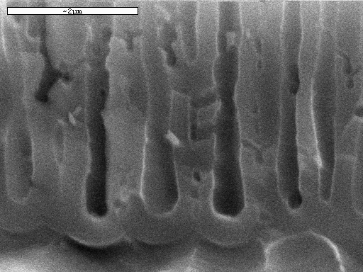
Task 1: demonstrating AAO structure

Slide 8
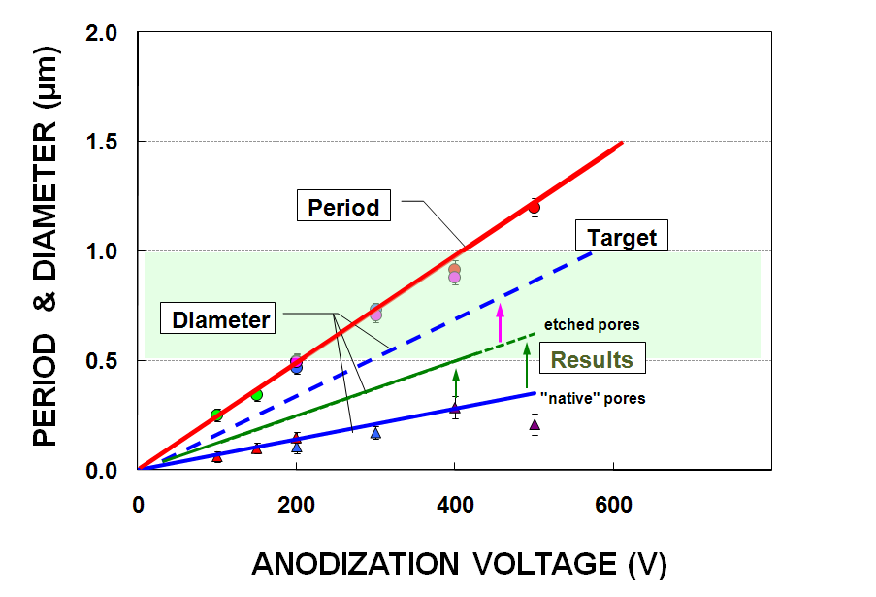
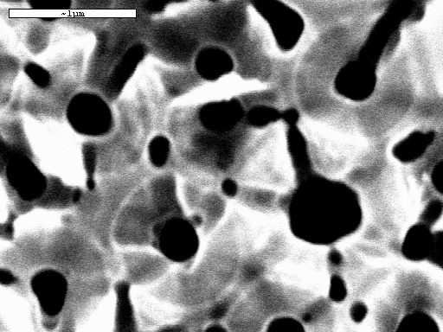
Achieving channel diameter ≥ 0.5 µm
Pore period:
  Proportional to anodization voltage
  Does not depend on electrolyte, temperature
Pore diameter:
  Increases with voltage, [H⁺] and temp.
Starting point: patent-pending electrolytes & procedures developed in 2006 – 2009
(in part under NSF SBIR funding)

Slide 9


Voltage ramp and non-uniformity of channel period
  AAO pore period ~ V
  V ramp leads to smaller pores at the surface and non-functional MCP substrate

Slide 10
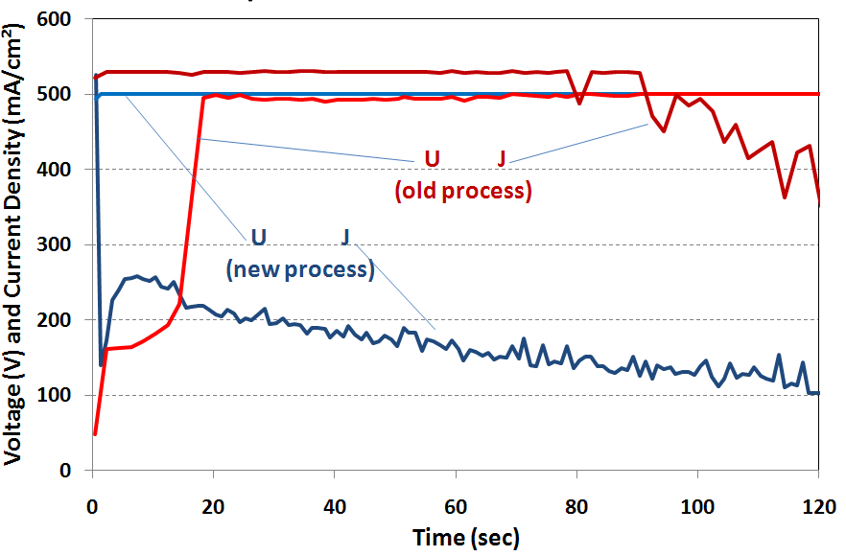
High-voltage anodization
  for the first time, no voltage ramp even at 500V
  reduced current density and oscillations - slower growth rate and better structure
  yet process somewhat unstable, arching was observed

Slide 11
Voltage ramp: smaller pores on the solution side
With voltage ramp Voltage ramp eliminated
solution
side
barrier
layer
side

Slide 12
Task 2: Fabrication of MCP substrates
Status
  dedicated anodization setup built; up to 600V
  400 V process selected for initial scaling to 32.8 mm
  11 substrates Ø32.8 mm total delivered; 6 more in processing
Challenges in further scaling high-voltage processing
  voltage ramp problem worsens with larger size due to high current
  growing required thickness with well-aligned and uniform channels
Approaches to mitigate have been verified
  using novel electrolytes & regimes developed under related NSF project
  adequate masking/protecting of Al surface to avoid breakdown & arching
  using different chemistries and/or conditions at different AN stages

Slide 13
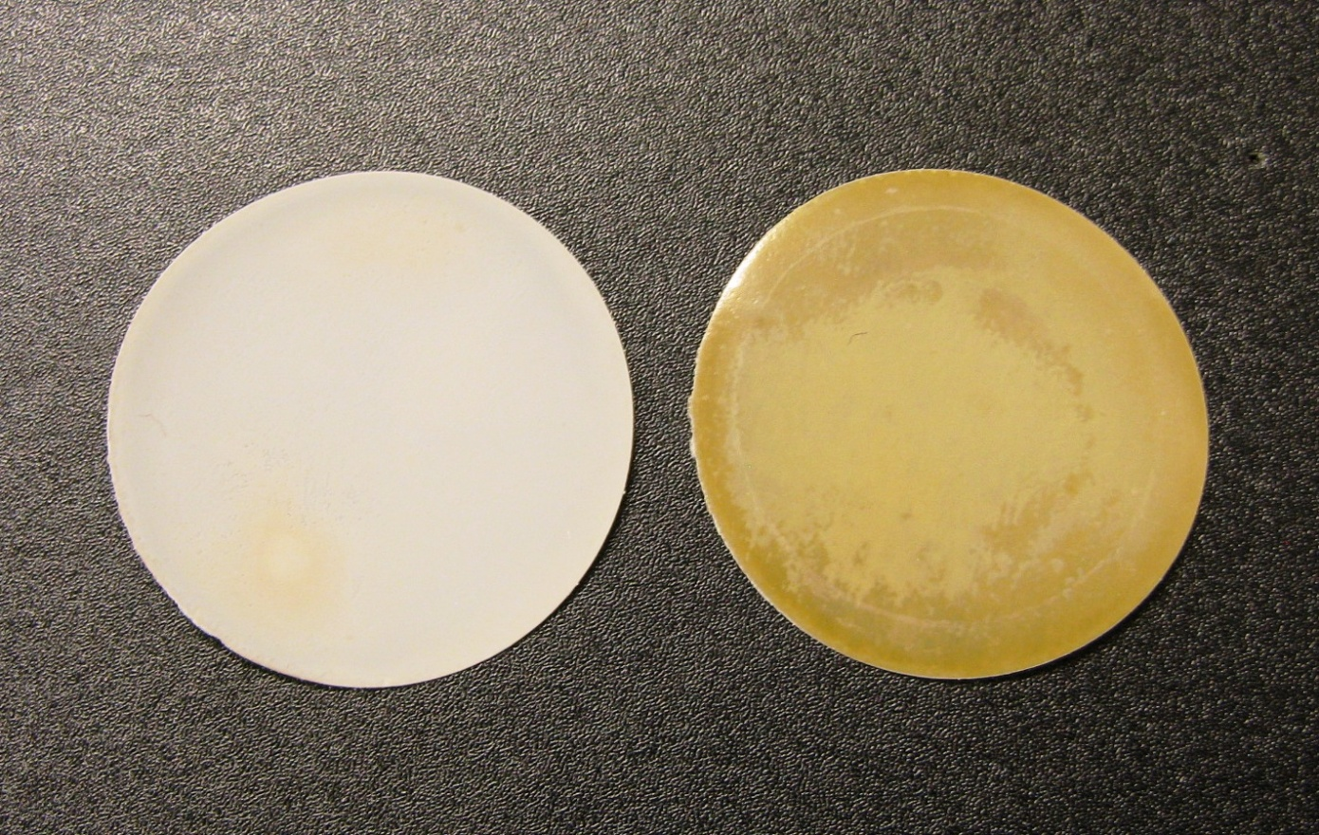
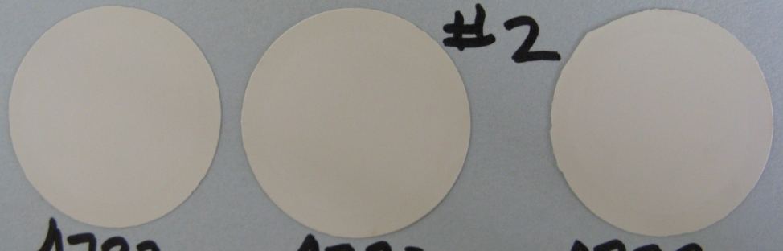
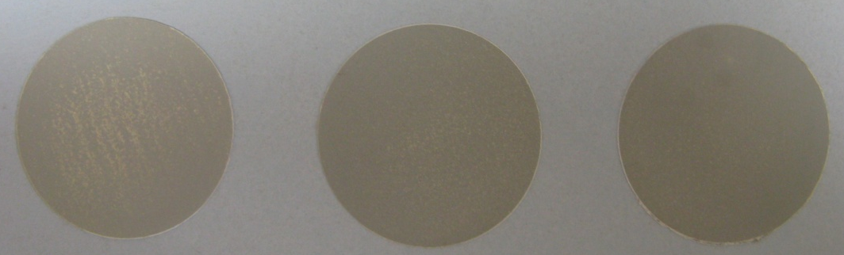
Prototypes for LAPPD team
Overall size: 32.8 mm
Active area: 24.5 mm
Thickness : 100 µm
Pore Period: 1 – 1.2 µm (400V)
Pore Diam.: 0.5 µm targeted
OAR: TBD
Annealing: 500°C
Batch 1:
  V ramp; surface has smaller channels
  opposite sides look different due to differences in surface morphology and residue from processing
Batch 2:
  improved processing
  V ramp eliminated
  more uniform surface than in Batch 1
Batch 1
Batch 2
barrier layer side
solution
side
barrier layer side solution side

Slide 14
ALD and testing to date
Main goal of working with Batch 1 prototypes: resistance modification of AAO MCP substrates with intrinsic pores
ANL
  ALD of functional coating done on Batch 1 substrates
  resistance in Gohm-Tohm range is higher than targeted
Arradiance Inc.
  ALD of functional coating done on Batch 1 substrate
  resistance of 100 Mohm in the targeted range achieved
  no gain
  Challenges to overcome
  further increase channel diameter from 0.5 to ≥0.7 µm: anodization at 500-600 V
  better pore organization and alignment: optimizing anodization conditions

Slide 15
Task 3: Cost projection
Assumptions:
  Rough estimate for current AAO membranes (conventional processing)
  Price per area is based on 1” units
  With larger size, lower cost per unit area is projected (less handling)
Projections:
  Cum. annual area <1 m² 10 m² 100 m² 1000 m²
  Cum. annual 8”x8” units <24 240 2,400 24,000
  Price, per cm²: <$20 $5-$10 $1-$3 <$1
  (for small format)
  Est. price for 8”x8” AAO: $1.2-2.5K $0.75K-1K $200-$700 <$200
  (current)
Projections for high voltage will be updated based on selected processing routes.

Slide 16
Future work
Remaining for Year 1
  deliver remaining Batch 2 substrates to LAPPD team
  using ALD/testing results as feedback, produce and deliver Batch 3 substrates with larger channel diameter and improved channel uniformity and alignment (moving into Year 2 objectives)
Year 2 – Functional MCPs
  demonstrate channel diameter ≥0.7 µm, funnel-shaped opening, OAR≥65%, and L/D 50-100
  MCP substrates for LAPPD team (32.8 mm, qty ≥ 40) targeting above specs
  optional: scaled 8”x8” “demo” substrates
  validate cost projections for 8”x8” AAO substrates

Slide 17
Schedule of deliverables

Slide 18
RELATED WORK AT SYNKERA

Slide 19
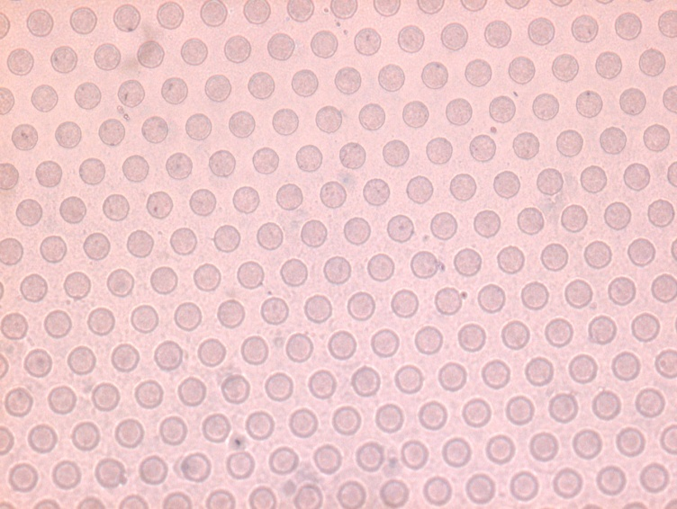
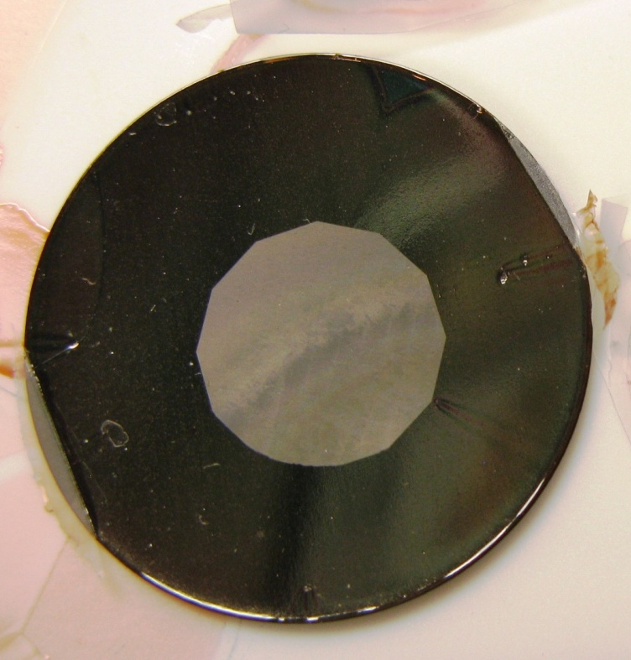
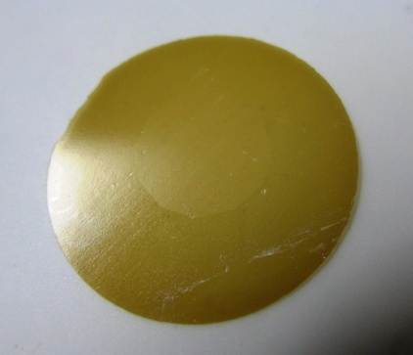
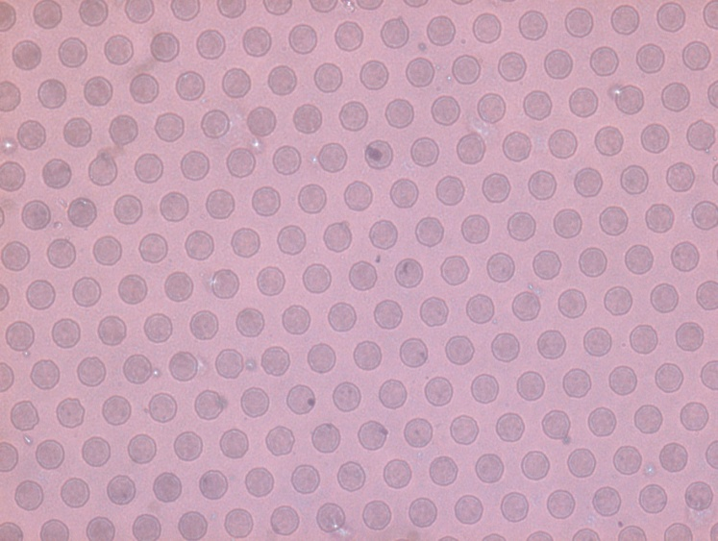
  RELATED WORK - MICROMACHINED CHANNELS
After patterning
After etching
Related work, not funded by ANL
  25 mm substrates are being prepared
  Could be transferred to 32.8 mm if needed
  Blank AAO is available for micromachining at ANL
Optical image of 10 µm
channels on both sides

Slide 20
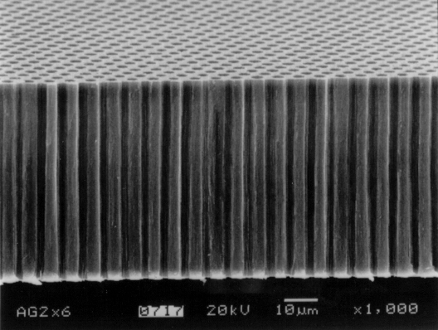
HIGH RESOLUTION CHANNELS
  Ceramic MCP substrate with ~3 µm channels, 60-100 µm thick
  Under development

Slide 21
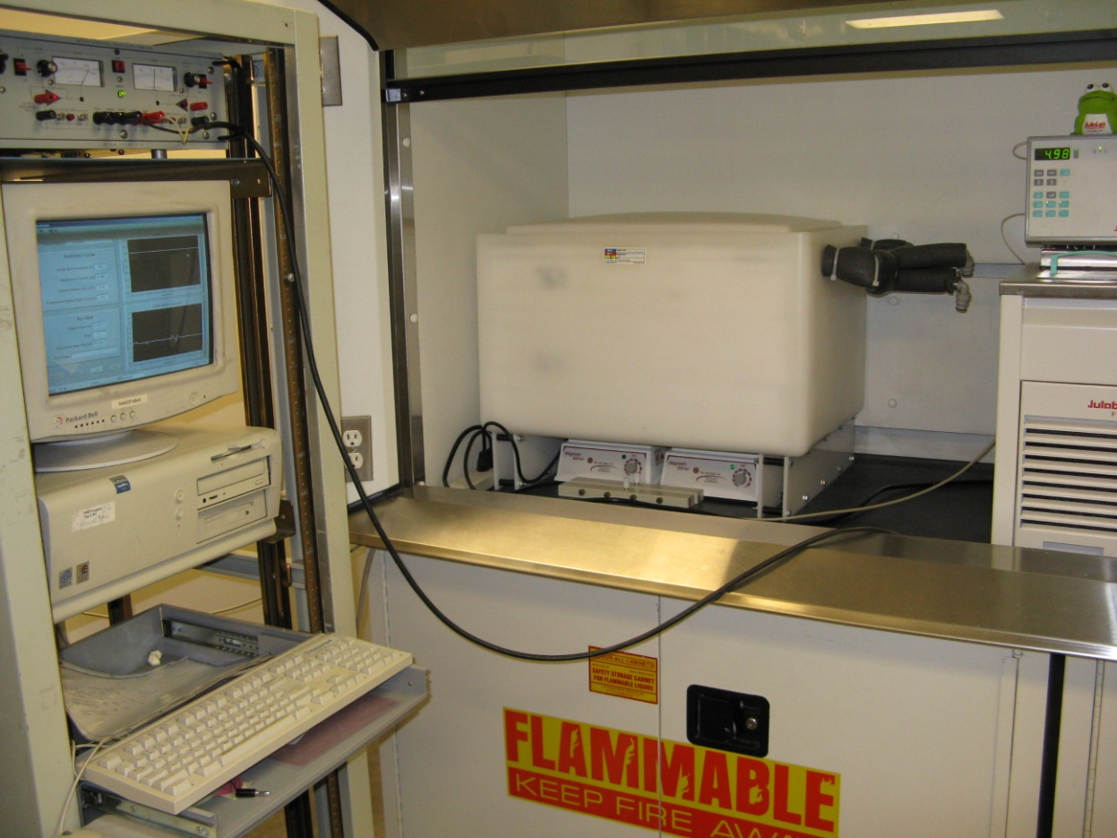
ANODIZATION FACILITY
New requirements for LAPD
  Greater power
  Greater heat load
  New process algorithms
Upgrade completed for LAPD
  New power supply
  Dedicated baths
Process control
  Voltage, current, charge, temperature
  Bath composition maintenance
Current capacity
  1 Gal bath - 1-2 of 33 mm MCPs in one run
  (process development)
  8 Gal bath - 4-8 of 33 mm MCPs in one batch
  (deliverables)

Slide 22
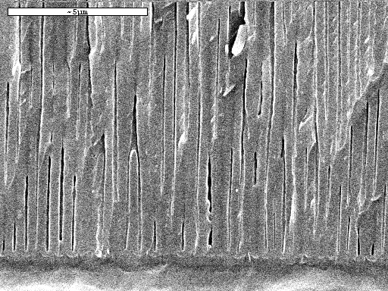
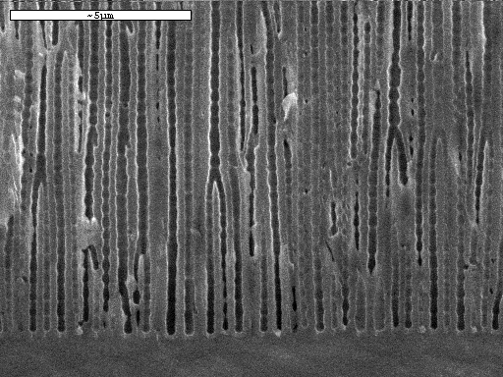
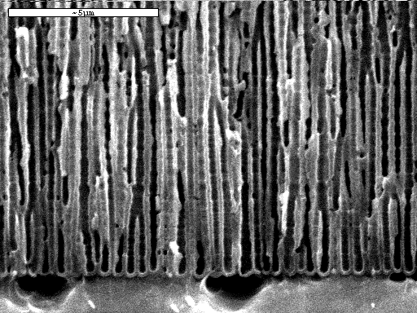
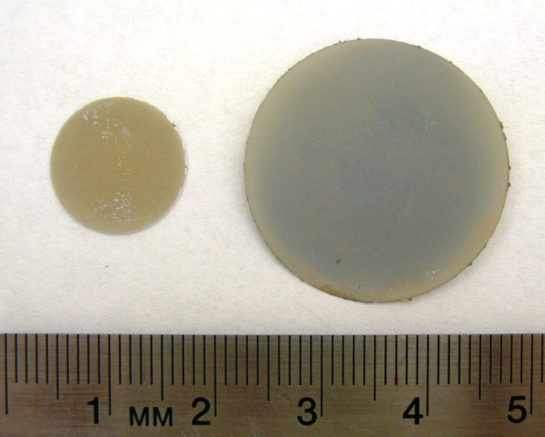
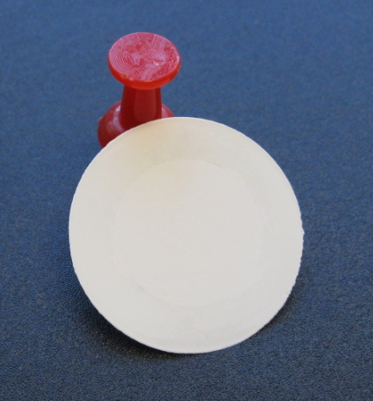
CONFORMAL CHANNEL ETCHING
As anodized 90 min 135 min

Slide 23
CHANNEL ENTRANCE SHAPE
Intrinsic funnel-like channel entrance
  Hemi-spherical AAO / Al interface
  (can be reused to make AAO)
  Localized dissolution of the pore bottom
  during separation from Al
Free-standing AAO
funnel-shape entrance
AAO on Al substrate
Separating AAO from Al
Pre-patterned Al
(precursor for new AAO)

Slide 24
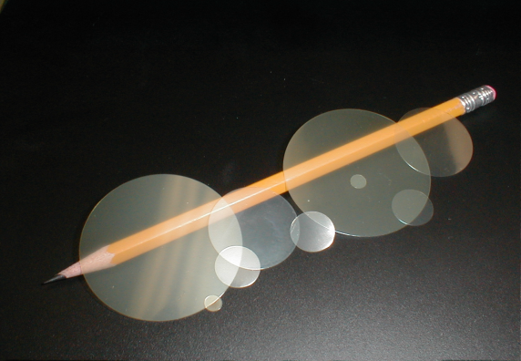
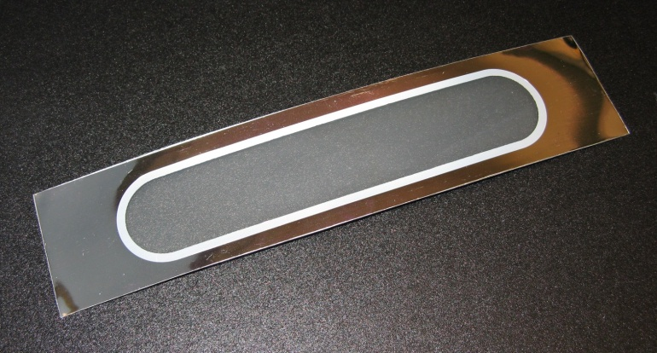
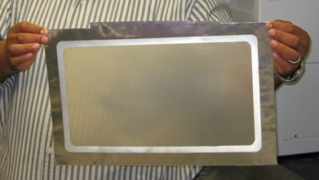
AAO SCALE-UP
25 mm
47 mm
13 mm
Free-standing AAO (“membranes”)
  Commercial production, open sales
  Volume: 100’s per week
  Size: from 3 to 150 mm (1/4 to 6”)
  Different formats and specifications
AAO membranes supported by Al rim
  Facilitates integration into modules
  Membranes up to 11x18” were produced
  Scale-up in progress for several applications,
  leveraged by related products
Scale-up emphasis
  achieving target performance in large format
  achieving required durability in a module
  scaling cost- and productivity-limiting steps
Current AAO Membrane Products
Al rim
AAO area
1” x 5”
BLANK AAO MEMBRANE WITH Al RIM
THE LARGEST AAO MEMBRANE
Active AAO area 8”x14”,
Al support is 11”x18”

