Slide 1
The 3rd-year Goals
HJF
Dec 8,2011

Slide 2
Preamble
We have been moving fast and have made major and really solid progress in all 4 areas
However, as Howard says, “it’s crunch time” – or, as Harry says `we need to produce’.

Slide 3
Slings and arrows
Insert picture of slings and arrows here…

Slide 4
Outline
Defining Minimum Set of Essential and Achievable Goals for this 3rd Year in Each of the 4 areas- Godparents and Groups
Assessing resources, funding, in each of these areas to assure success-
Defining collaborative efforts with industry to produce detectors
Identifying first-adopters and identifying and establishing markets
Identifying high-payoff areas for continuing and making them go

Slide 5
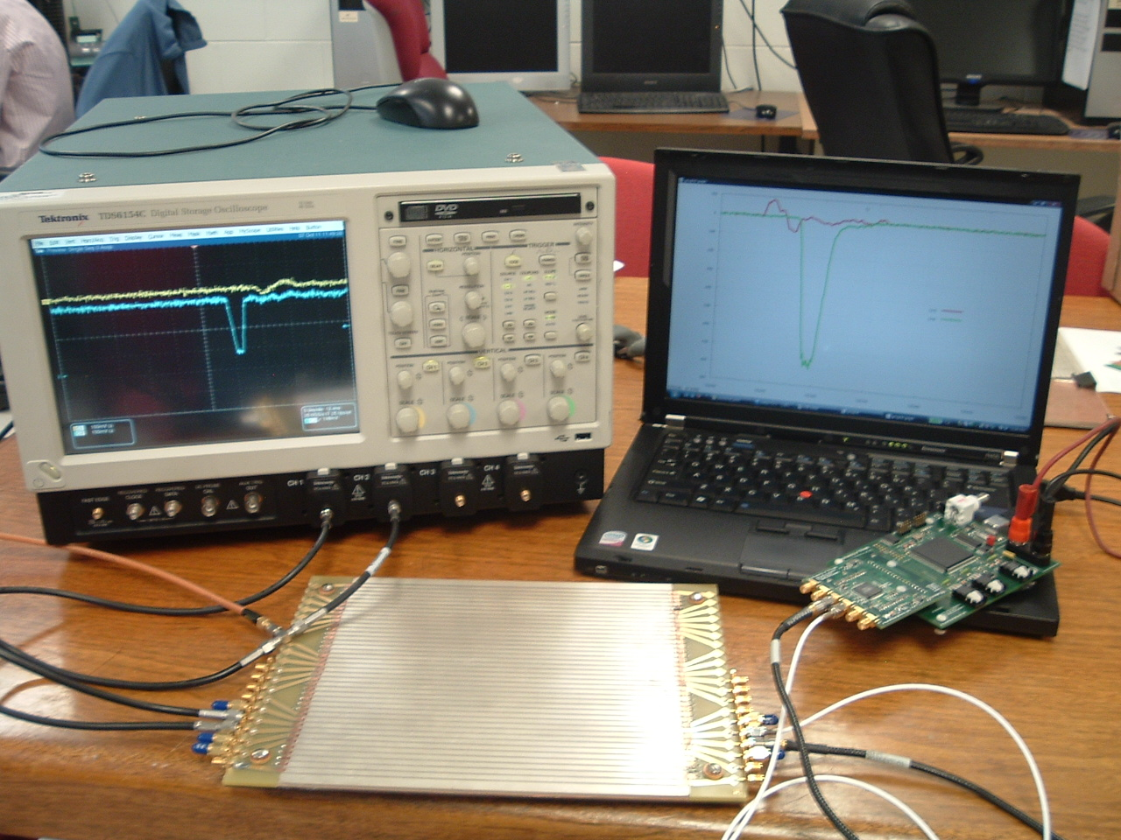
Straw Electronics 3rd Year Goals

Slide 6
Straw Electronics 3rd Year Goals
(needs discussion, dates –GP’s, gp leaders, all)
Individual boards complete (UC,Hawaii)
Vertical Slice(s)- hardware complete
Vertical Slice(s)- functioning
Vertical Slice -Demountable data through vertical slice (ANL)
Real Data through vertical slice(SSL)
Assessment of front-end needs for first-adopter applications
Papers and Documentation (plug-and-play)

Slide 7
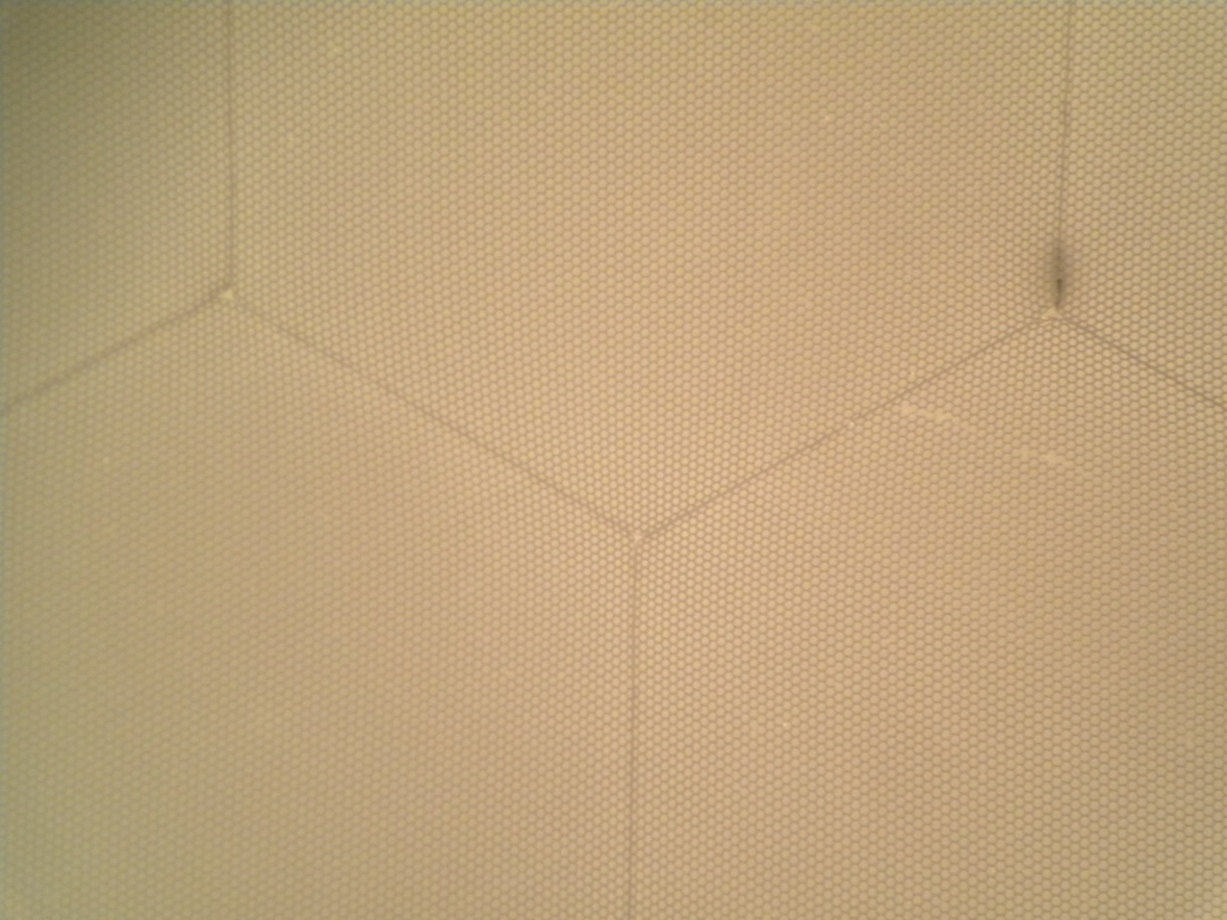
Straw MCP 3rd Year Goals
(needs discussion, dates)
80,000,137 pores
Pretty amazing, when you think about it…

Slide 8
Straw MCP 3rd Year Goals
(needs discussion, dates)
Define substrate production quality; establish production, QA, flow
Establish reproducible uniform ALD baseline production
Establish baseline electroding procedure(s) and flow
Characterize performance (testing)
Lifetest, agressive testing (robustness)
Papers, documentation

Slide 9
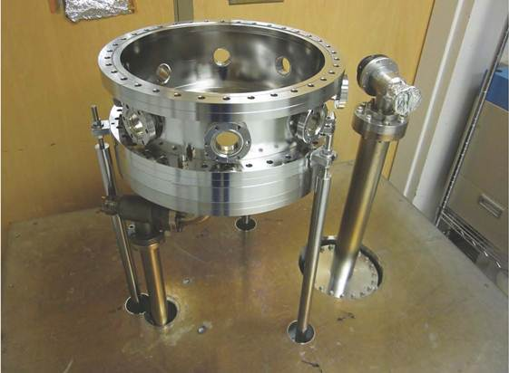
Straw Photocathode 3rd Year Goals

Slide 10
Straw Photocathode 3rd Year Goals
(needs discussion, dates)
8” bialkali cathode stand-alone (SSL)
8” bialkali cathode in big tank for transfer (SSL)
4-5” cathode in present chalice config (ANL)
Define parallel design to simplify ANL design- 1-2 Sb beads at distance, external alkali sources (make a task-force?)
Design of ANL cathode for single-tile facility (STF)
Construction, commissioning of STF
Task force on robust (gas-transfer, pump port, frit seal,re-cesiate) cathode
Papers, documentation

Slide 11
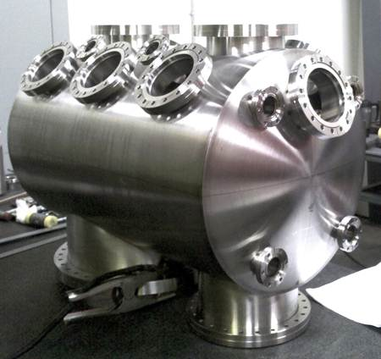
Straw Packaging 3rd Year Goals
ANL
SSL

Slide 12
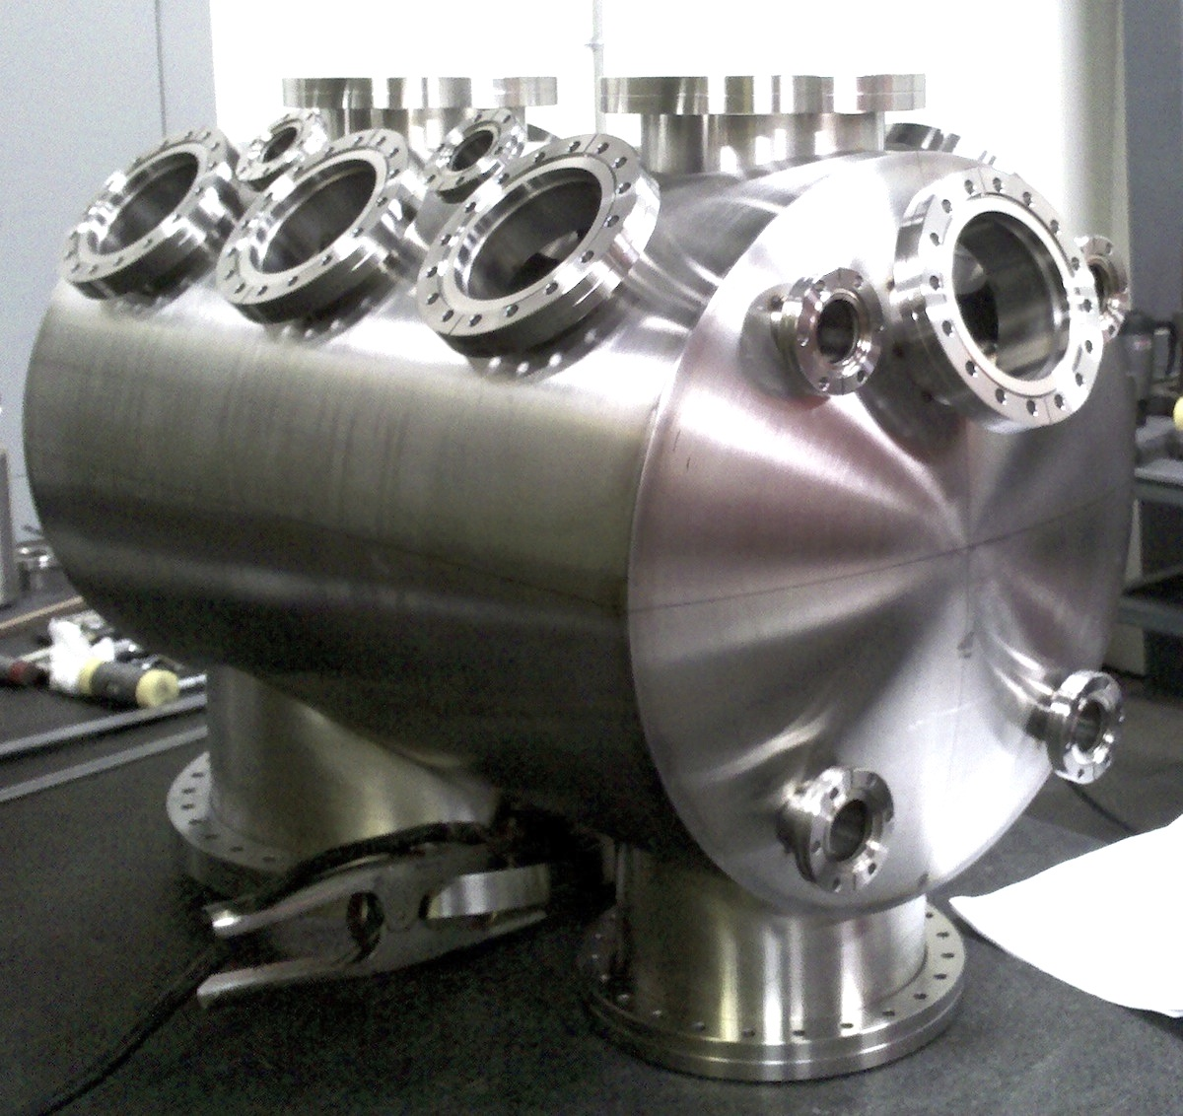
Straw Packaging 3rd Year Goals
3 parallel paths
Tile Development Facility at ANL
Production Facility at SSL/UCB
Commercial RFI for 100 tiles
(Have had one proposal for 7K- 21K tiles/yr)

Slide 13
Straw Packaging 3rd Year Goals
(needs much discussion, dates)
Complete set of parts for 8” ceramic (SSL)
First ceramic assembly, no cathode (??) (SSL)
First complete ceramic tube (SSL)
Ceramic tube with multi-channel electronics
Demo suitable for presentation (SSL)
Single-tile facility specs complete (1st review)
Single-tile facility resource-loaded design complete (2nd review) (ANL)
First sealed tile, robust (Al, other) cathode
First sealed tile, alkali cathode (ANL)
Tile suitable for presentation (ANL)

Slide 14
Straw Packaging 3rd Year Goals
Write RFI for 100- 300 tiles
Initiate conversations with vendors
Establish cost, funding profile, funding sources (including adopters)

Slide 15
First Adopters
Identifying first-adopters and identifying and establishing markets- some candidates (nothing yet is formal)-
Medical Imaging- Chicago, Strasbourg,.
HEP neutrinos- Daniel Boone
Non-proliferation/Security- LBNL, Sandia
Fixed target TOF- KOTO (JParc, JLAB)
Muon cooling- Muons,Inc
Colliders- STAR, ALICE,…

Slide 16
Parallel Efforts on Specific Applications
.
Explicit strategy for staying on task-
Multiple parallel cooperative efforts
PET
(UC/BSD, UCB, Lyon)
Collider
(UC, ANL,Saclay.
LAPD Detector Development
Muon Cooling
Muons,Inc
(SBIR)
ANL,Arradiance,Chicago,Fermilab, Hawaii,Muons,Inc,SLAC,SSL/UCB, UIUC, Wash. U
K->πνν
JPARC
Drawing Not To Scale (!)
Mass Spec
Andy Davis, Mike Pellin, Eric Oberla
Neutrinos
(Matt, Mayly, Bob, John, ..; Zelimir)
Non-proliferation
LLNL,ANL,UC
All these need work- naturally tend to lag the reality of the detector development

Slide 17
Challenge 2- Exploiting the disruptive potential (s)
Performance:
(what is the
limit?)
Cost: Can we make a truly frugal tile? (what is the limit?)

Slide 18
Exploiting the disruptive potential
Performance:what is the limit?
Resolution-
higher ABW anodes
Funnel openings, smaller pores
Opaque cathodes
Higher SEY materials; structured dynodes
Cathodes
Higher QE multi-alkalis
III-V advances (e.g. WashU, UIUC)
New technologies (UIUC)
Other? (suggestions? This is part of the fun part)

Slide 19
Exploiting the disruptive potential
Cost: Can we make a truly frugal tile? (what is the limit?)
Streamlining cost parts- substrates, electroding,…
Streamlining assembly costs (industrial partner(s))
Radical design changes (examples follow )
40 micron substrates
Single MCP plate
high-temp frit top seal
SSL-style crossed anode (4 electronics channels/tile)
Quantity production (need PET, DUSEL, or equiv driver market)

Slide 20
Challenge 3-
People, Funding, Schedule, Satisfaction, and Fun
We have done very well in these 2+ years- however we have a major transition in funding, organization, and goals to make- will take a lot of hard work and good will from everybody. It’ s an immensely talented group. Let’s go for it...

Slide 21
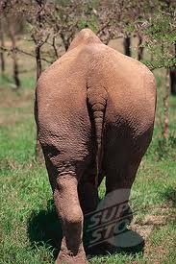
The End

