Slide 1
ALD MCP Testing at UC Berkeley
MA
Mature audiences only
Oswald Siegmund, Jason McPhate
LAPPD MCP Collaboration Meeting
9 December 2011

Slide 2
MCP Basic Goals for 33mm and 200mm
Standard 32.7mm MCP (not high local rate, ~ 1 event/pore/sec)
Plate Outside Diameter 32.7mm ± 0.1mm
L/D, Thickness 60:1, 1.2mm ±0.1mm
Center-to-Center Spacing Varies
Pore Size 20um ±0.5um
Bias Angle 8 Deg ±1 deg
Open Area ratio 60% ±5%
Resistance 500 Meg Ohm ±200 Meg Ohm
Electrode end spoiling 1 channel diameter
200mm MCP (same resistance/square, few 100µA, <1 watt)
Plate Outside Diameter 200mm ± 0.1mm
L/D, Thickness 60:1, 1.2mm ±0.1mm
Center-to-Center Spacing Varies
Pore Size 20um ±0.5um
Bias Angle 8 Deg ±1 deg
Open Area ratio 60% ±5%
Resistance 10 Meg Ohm ±3 Meg Ohm
Electrode end spoiling 1 channel diameter

Slide 3
ALD/Incom MCP Test Tasks
Full evaluations of 20µm material, 33mm
  Gain, imaging, background in singles/phosphor
  Single MCP Burn-in process
  Pairs with XDL, imaging, gain, background, PHD, uniformity
  Pair burn-in process
  High temp vac bake for tube compatibility tests, thermal coefft
  Pair MCP spacings, spacing bias, anode bias,
  for charge footprint, imaging and timing tests
8” x 8” MCPs
  Institute test detector for MCPs
  Full up evaluations of 8” MCP configurations
  Inputs for overall detector design

Slide 4
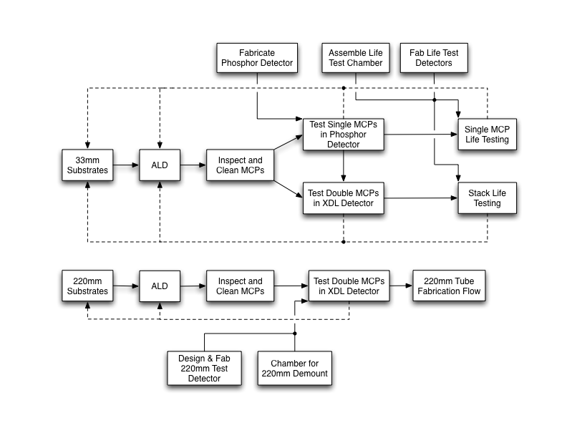
Simplified MCP Testing Flow
On going

Slide 5
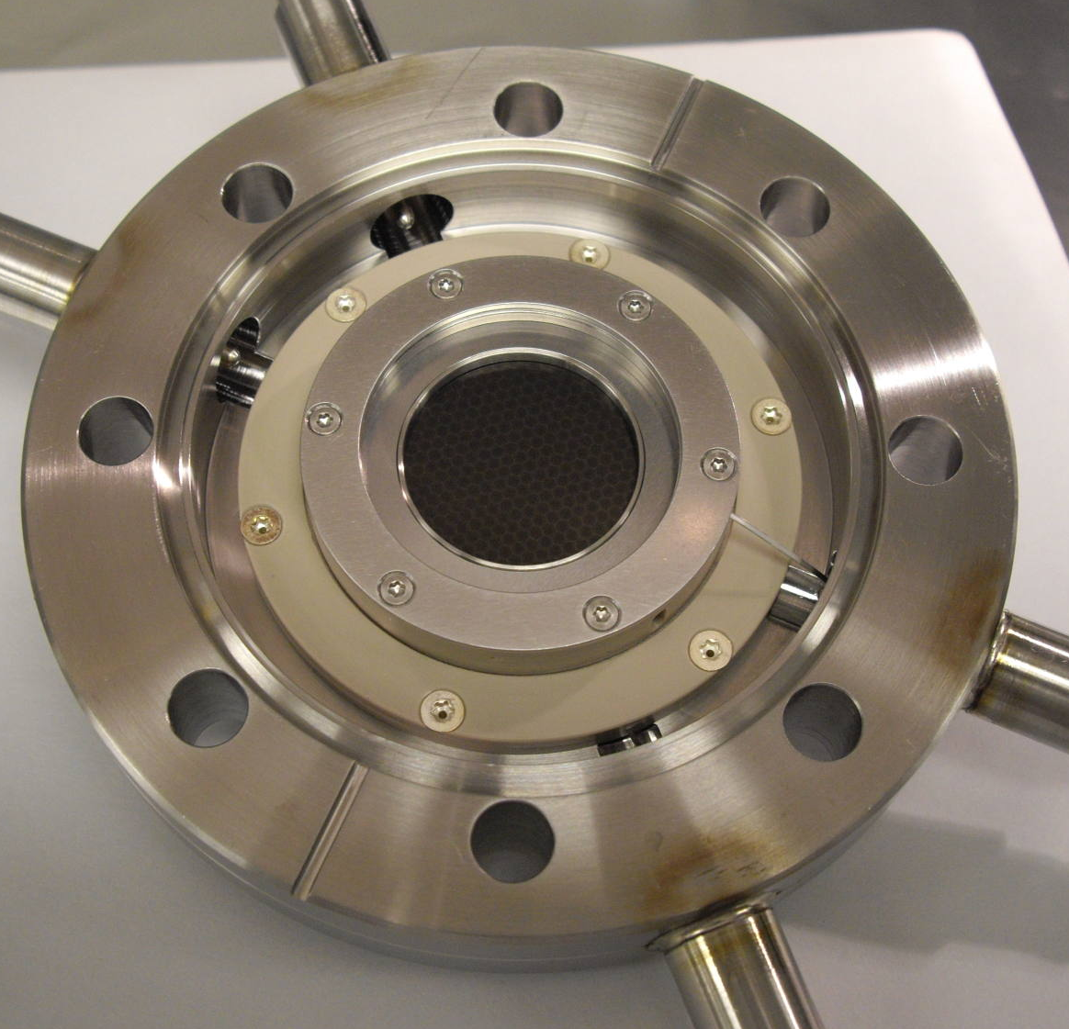
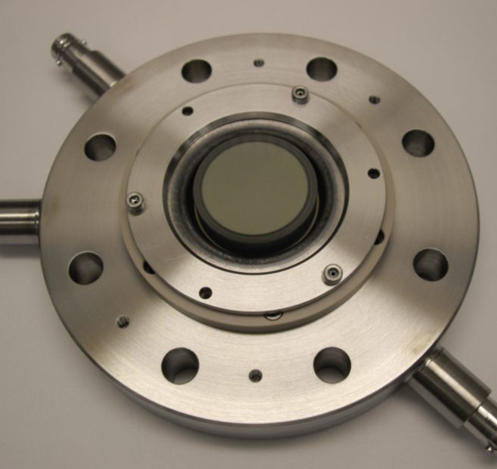
25mm XDL & Phosphor Test Detectors
33mm MCP pair and MCP single tests
25mm XDL photon counting
detector on 4.5” CF flange
25mm phosphor screen
detector on 4.5” flange,

Slide 6
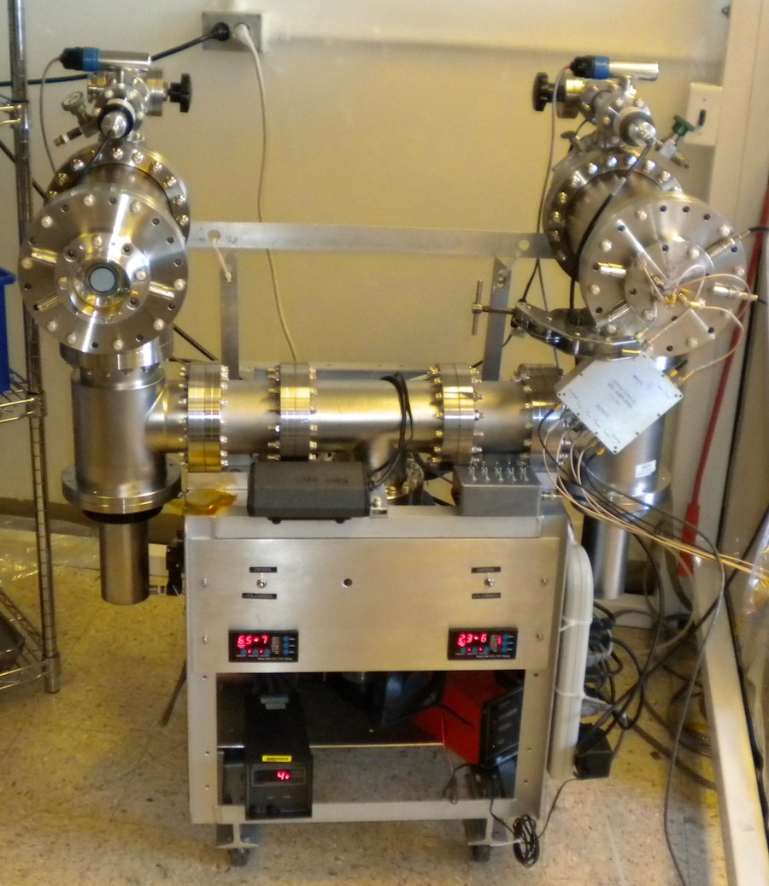
MCP Performance Test Facilities
Double chamber UHV test station
Phosphor detector on the left
XDL detector on the right
Both have support electronics
Amp/TDC and PC Acq/display
for XDL
Nikon camera or electrometer
for Phosphor

Slide 7
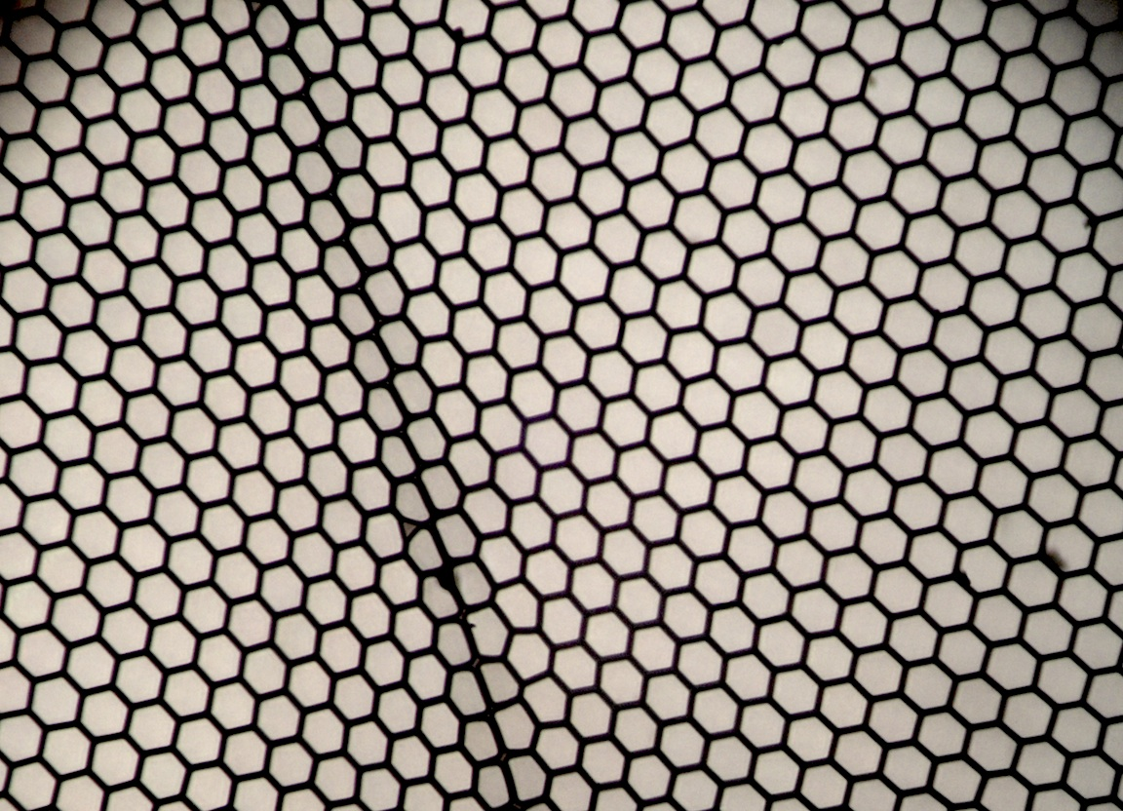
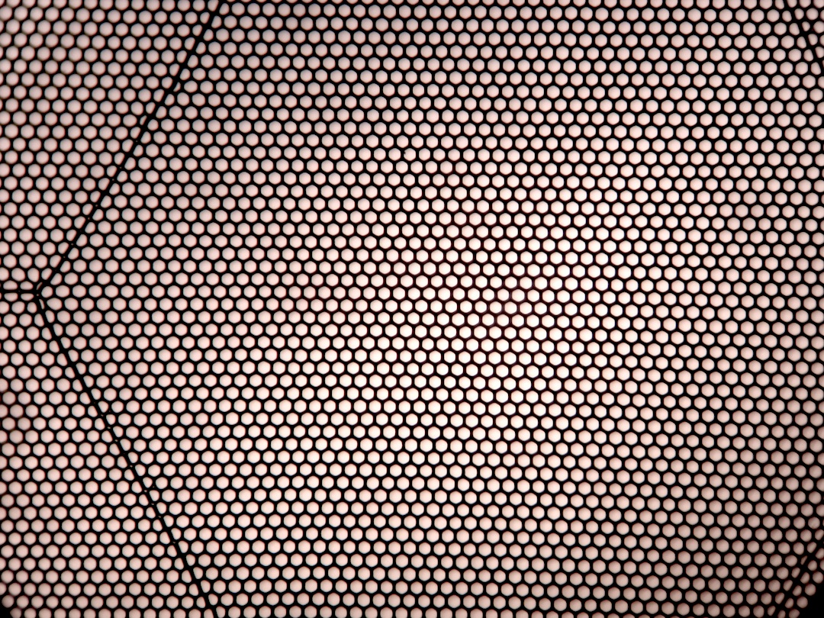
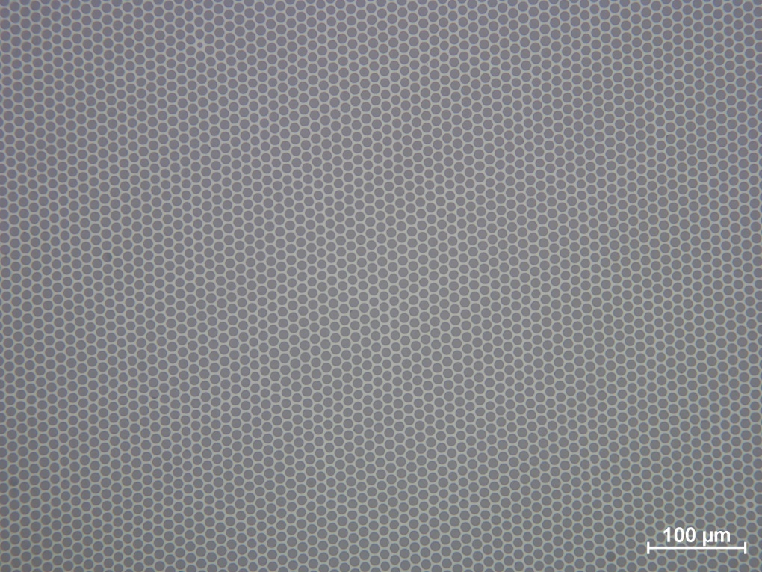
Borosilicate Substrate Atomic Layer
Deposited Microchannel Plates
Micro-capillary arrays (Incom) with 10µm, 20 µm or 40µm pores (8° bias) made with borosilicate
glass. L/d typically 60:1 but can be much larger. Open area ratios from 60% to 83%. These
are made with hollow tubes, no etching is needed. Resistive and secondary emissive layers
are applied (Argonne Lab, Arradiance) to allow these to function as MCP electron multipliers.
40µm pore borosilicate micro-
capillary MCP with 83% open area.
Photo of a 20 µm pore, 65%
open area borosilicate micro-
capillary ALD MCP (20cm).
Pore distortions at multifiber
boundaries, otherwise very uniform.
Photo of a 10 µm pore, 65% open area borosilicate micro-capillary ALD MCP.

Slide 8
Typical Gain curve Characteristic

Slide 9
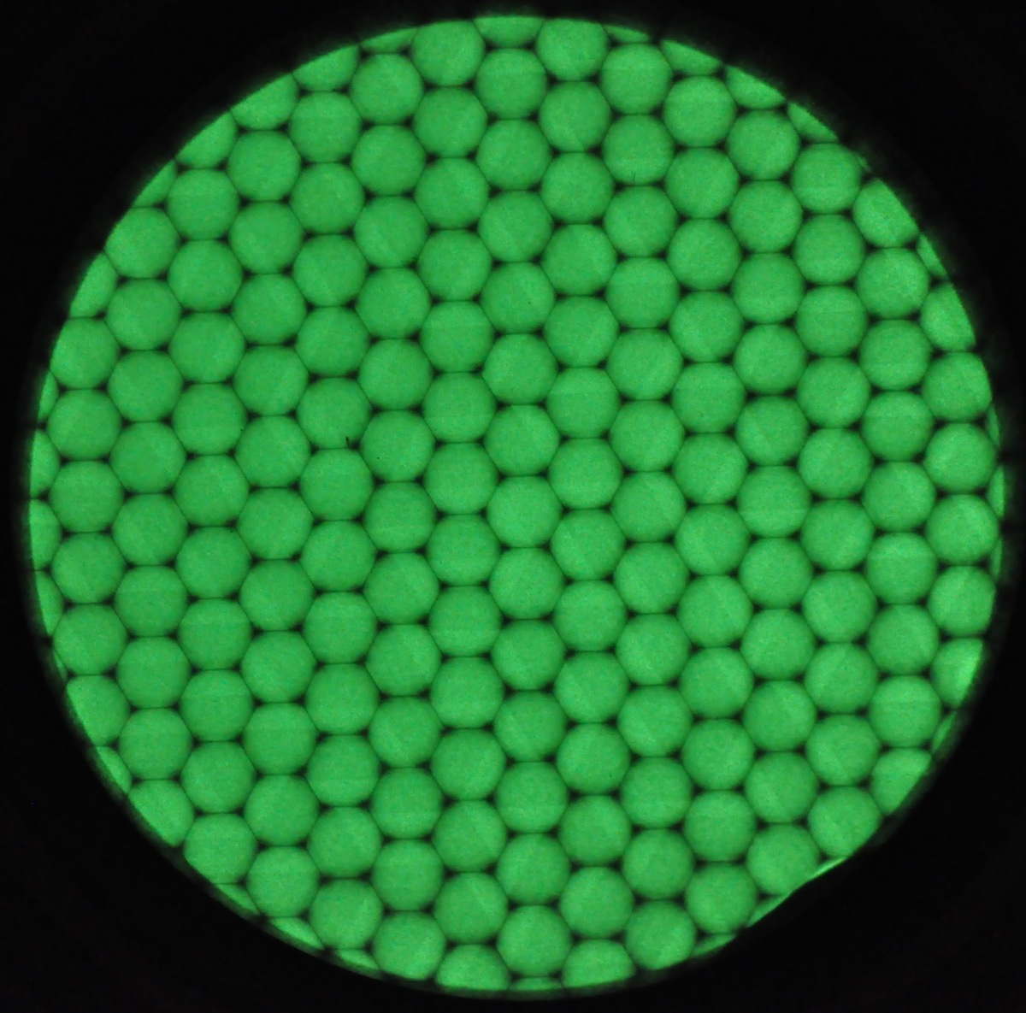
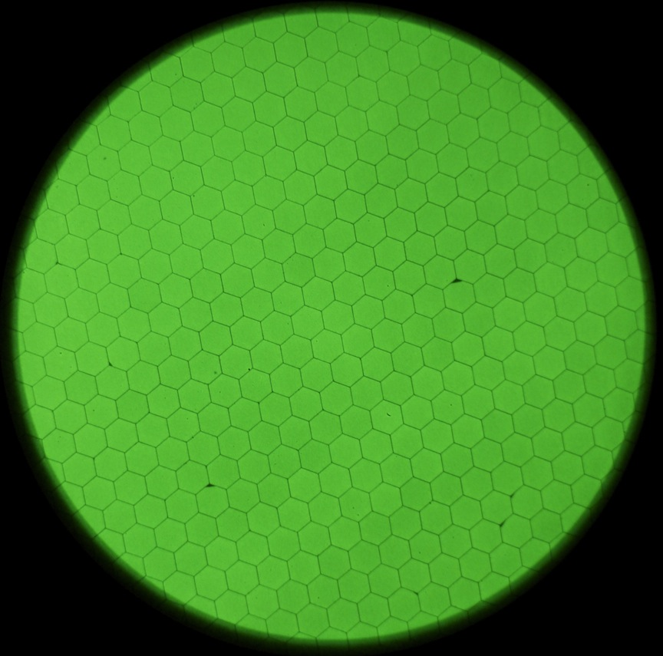
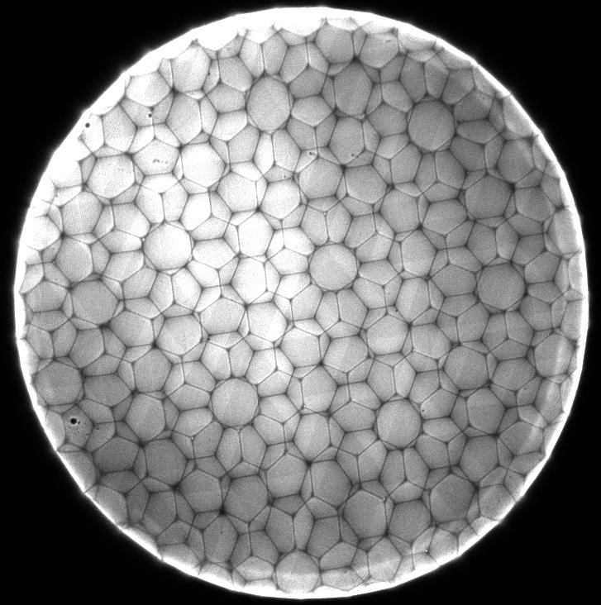
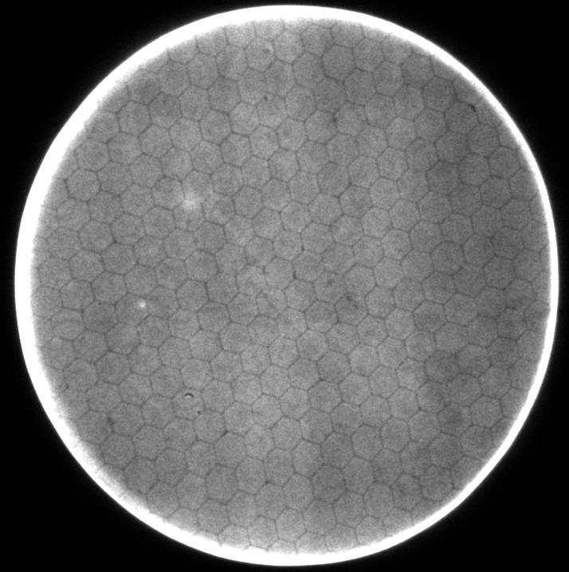
Imaging Performance of ALD MCPs, 33mm
Early 2010
Early 2011
20µm borosilicate MCP substrates, 60:1 L/d, 8 degree pore bias.
~1000v applied to each MCP.
Single MCP tests in DC amplification mode show imaging and gain very similar to conventional MCPs.
MCP pairs operated in photon counting mode also show imaging and gain very similar to conventional MCPs.
Sample performance has
improved dramatically over
the last 12 months due to process improvements.
1 MCP, Phosphor readout
UV 184nm illumination
2 MCPs, Photon counting

Slide 10
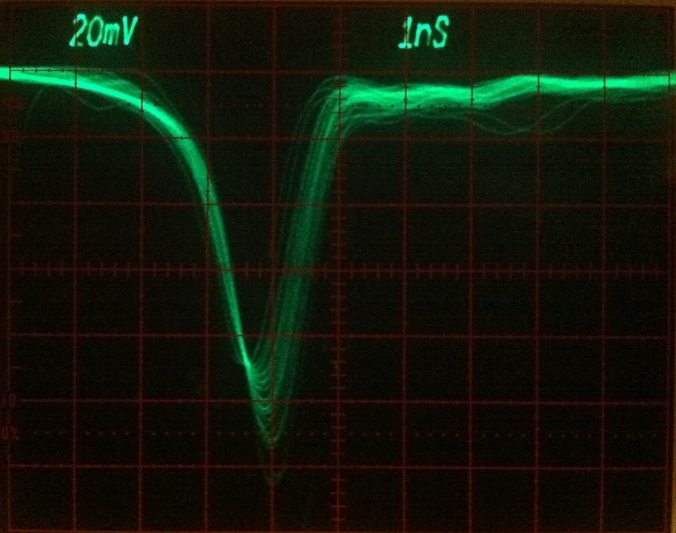
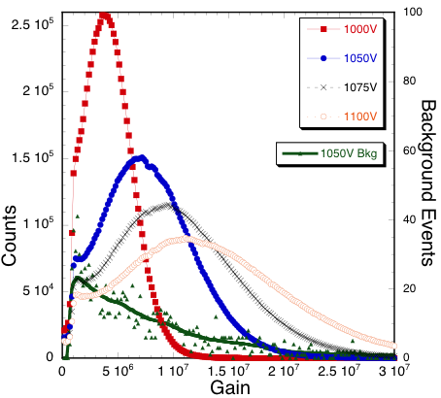
ALD-MCP Performance Tests, 33mm pairs
UV illuminated test results show similar gains to conventional MCPs, exponential gain dependence for low applied voltages, then saturation effects appear above gains of 10⁶. Pulse heights are reasonably normal for 60:1 L/d pairs.
Voltage on each MCP
ALD borosilicate MCP pair, 20µm pore, 60:1 L/d, 8° bias, 0.7mm/1000v MCP gap. Single event pulses are ~1ns wide.
~Typical response for 20µm pore MCPs.
Pulse height amplitude distributions. MCP
pair, 20µm pores, 8° bias, 60:1 L/d, 0.7mm
pair gap with 300V bias. 3000 sec background.

Slide 11
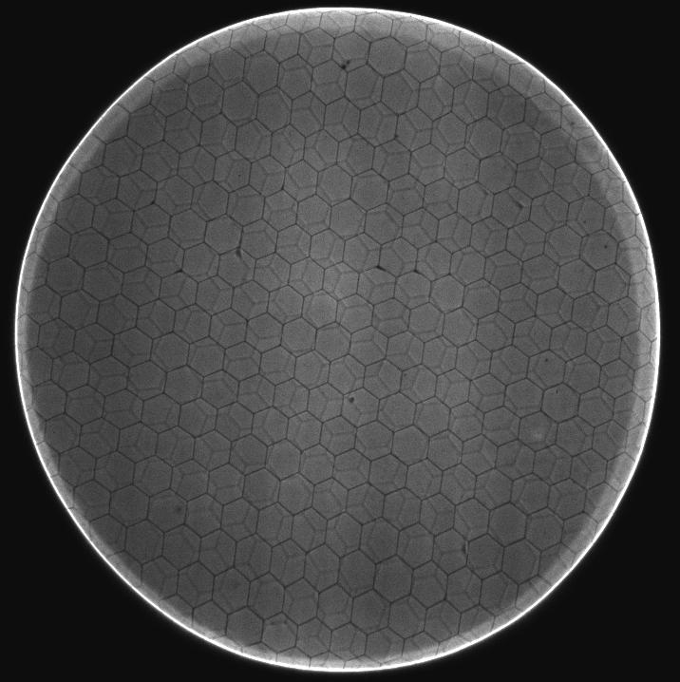
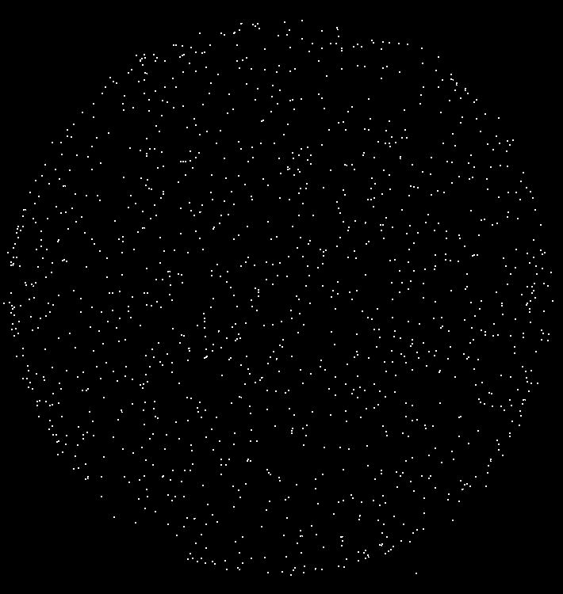
Photon Counting Imaging with MCP Pairs
MCP pair, 20µm pores, 8° bias, 60:1 L/d, 0.7mm pair gap with 300V bias.
Image of 185nm UV light, shows top MCP hex
modulation (sharp) and faint MCP hexagonal
modulation from bottom MCP. A few defects, but generally very good. Edge effects are field fringing due to the MCP support flange.
3000 sec background, 0.0845 events cm⁻² sec⁻¹ at 7 x 10⁶ gain, 1025v bias on each MCP. Get same behavior for most of the current 20µm MCPs

Slide 12
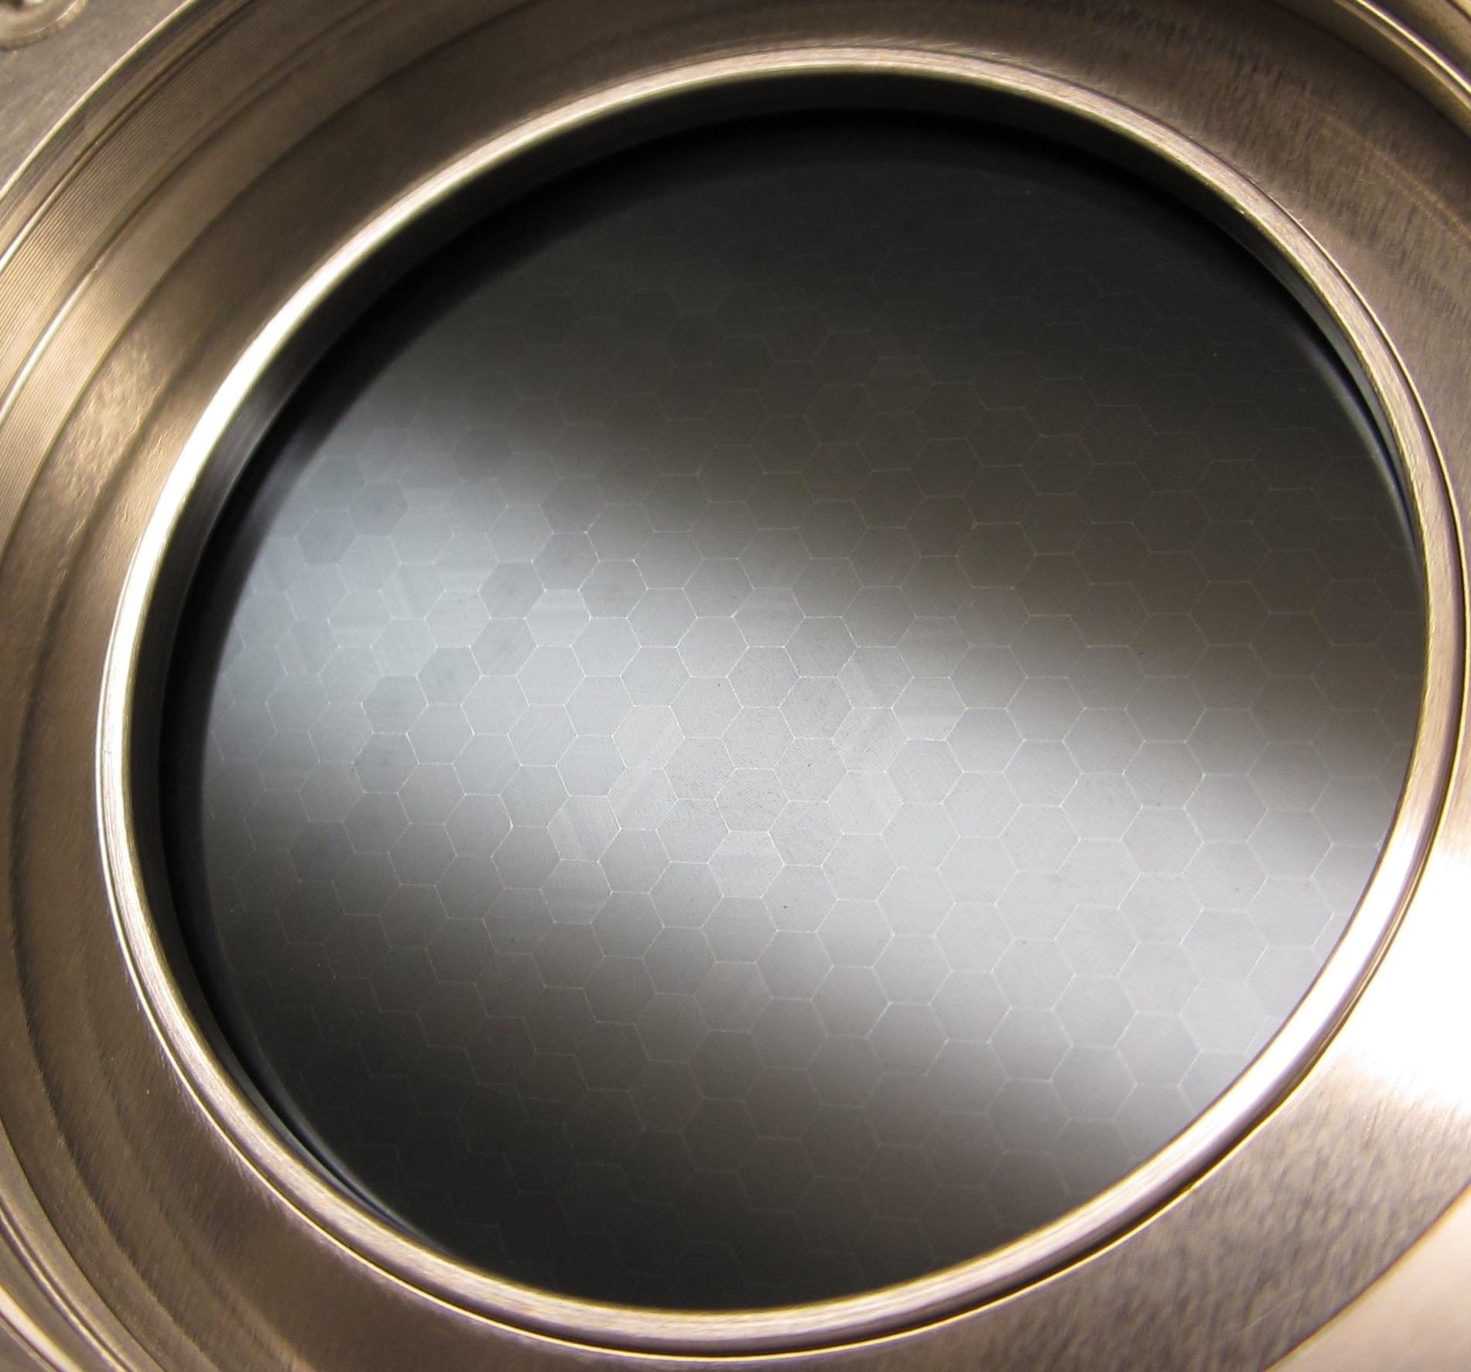
MCP Photos- Good Indicator of Issues
Multifiber Issues:-
-Linear striations inside the
multifibers, visible in photos
-Some are brighter, high
reflectivity, correspond to – low
gain – smaller open area ratio-
dark multi’s in phosphor image
-Some have visible dark spot in
middle where bright spot is in
phosphor images.

Slide 13
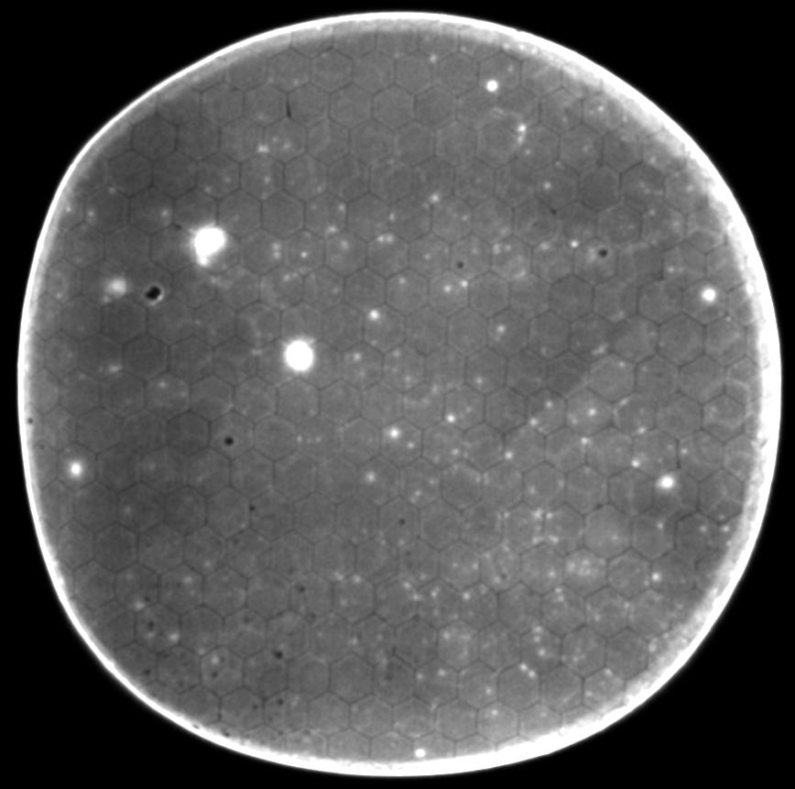
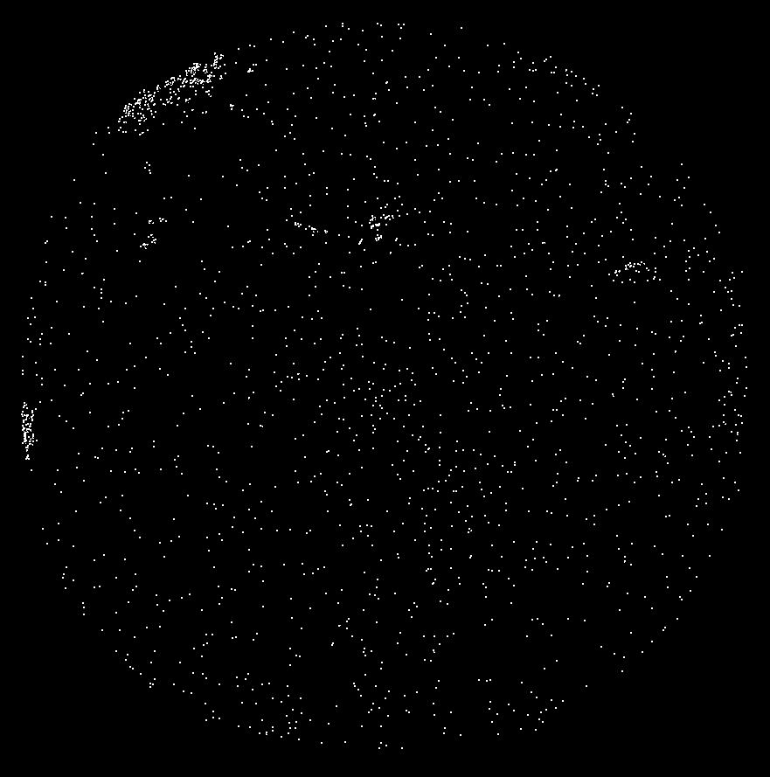
ALD Chem 3, 20µm Microchannel Plates
12317-120/117, 50MΩ/180MΩ, Pair with 0.7mm gap/400v
12317-120/117 Chem-3 background
  900v on each MCP, gain high, >10⁷. Numerous black spot defects, lots of bright spots due to removed/missing ALD layer exposing electrode material. Cleanliness issues?
100 sec background, ~4 events cm⁻² sec⁻¹.
Some hot patches, uniform background rate is 3.5 events cm⁻² sec⁻¹ ---- not very good.

Slide 14
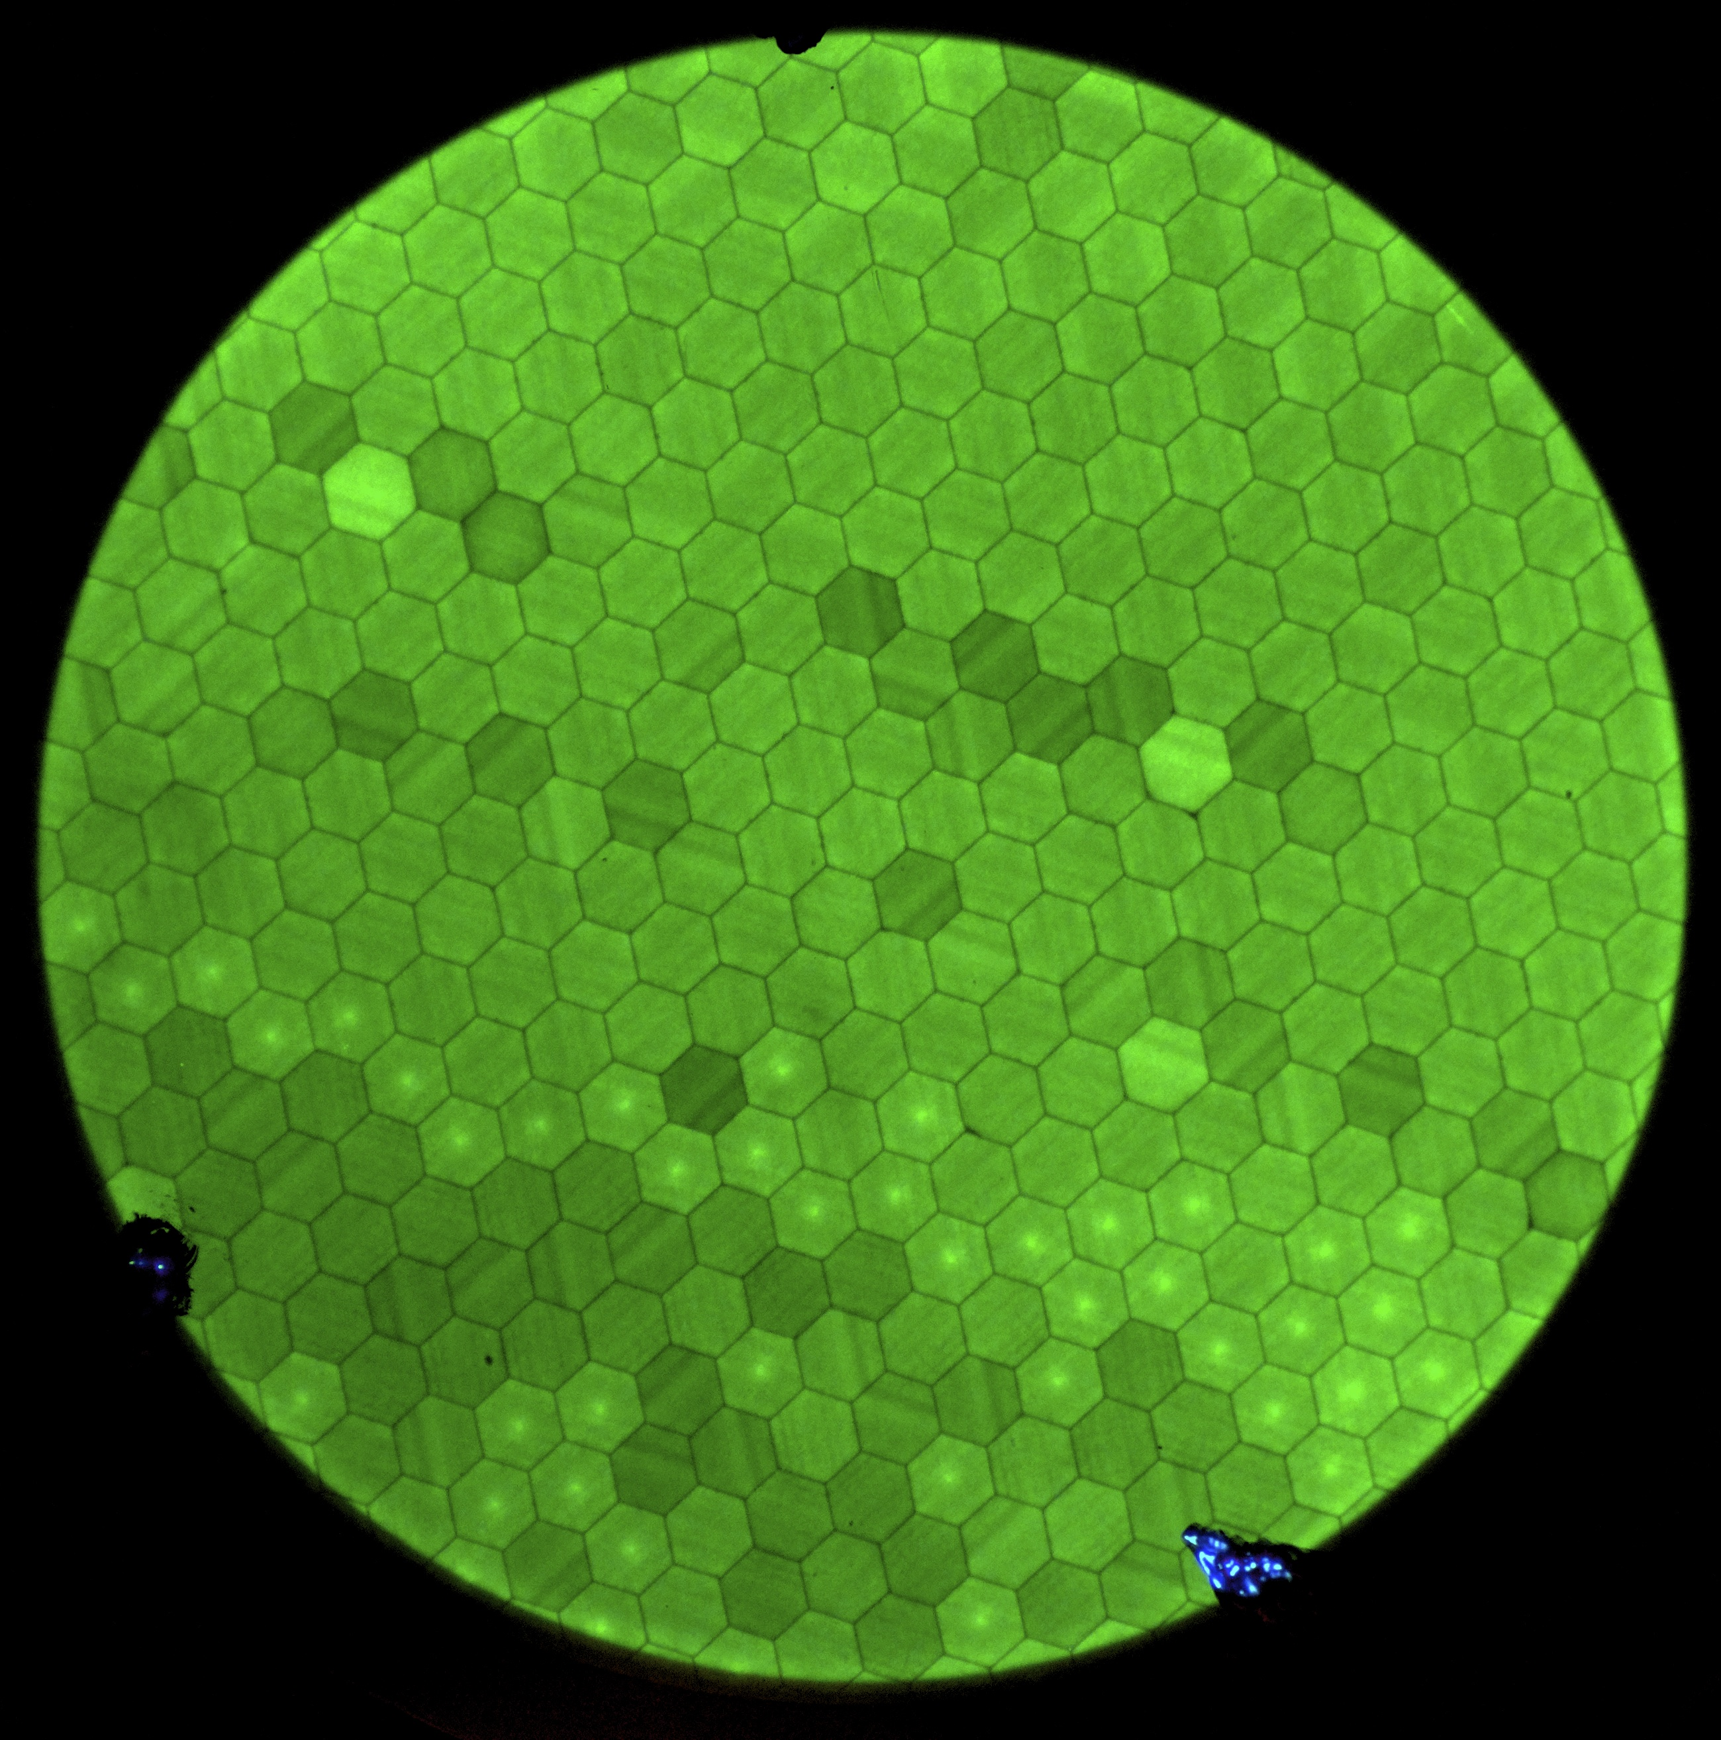
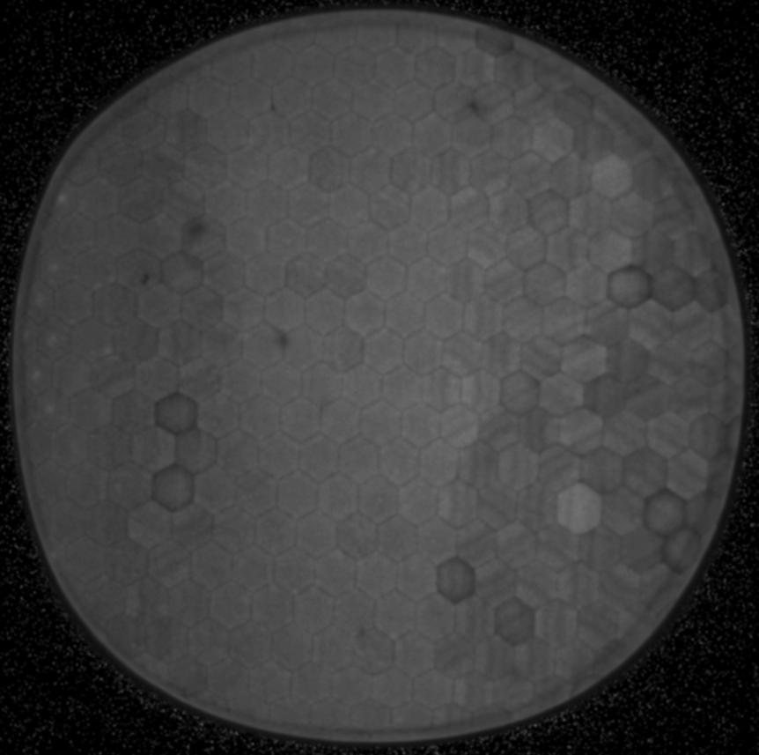
Chem-3 ALD 20µm Microchannel Plate
Previous data on 12317 boule
12317-120/117, 50MΩ/180MΩ,
Pair, 0.7mm gap/400v
20 µm pore #160 ALD MCP with NiCr electrode .
Gain map, multifiber pattern modulation, typical of 12317 boule material with pore size variations. Not a good substrate material.
#160, 12317-113, 700v MCP, earlier data shows problems with this material

Slide 15
Chem 3 Gain Characteristic
Better gain for Chem 3 than Chem 2.
Voltage for pair 164-163

Slide 16
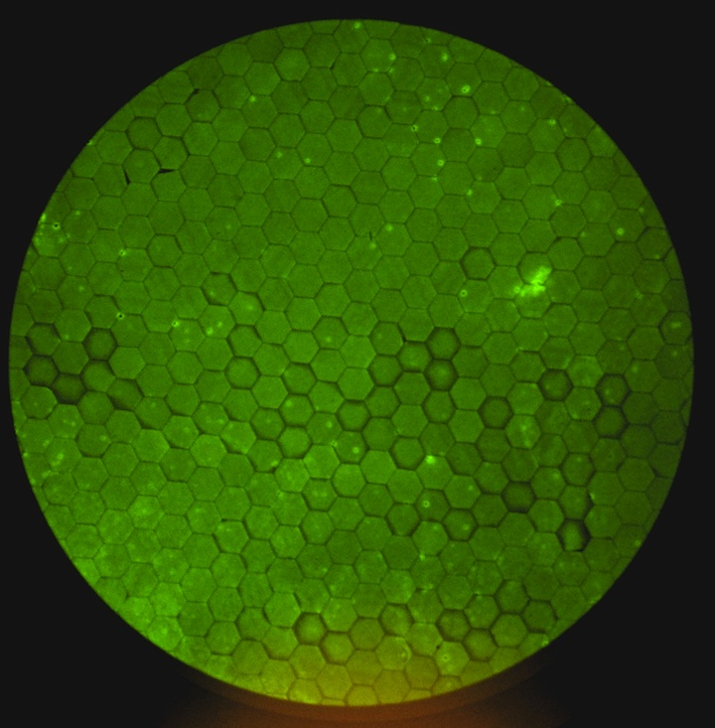
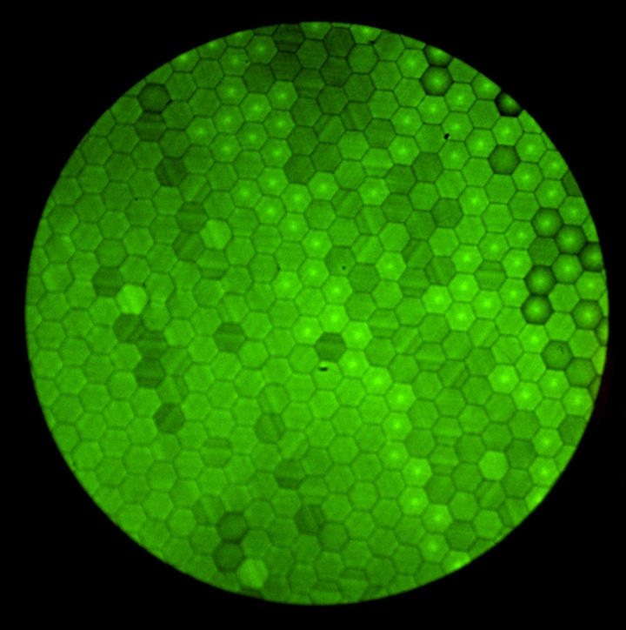
Electrode Deposition Tests 20µm MCP Chem 2
Phosphor Imaging/Gain Tests
NiCr on underneath, Chemistry 2, SEE Al₂O₃
12258-434 Vaculayer electrode
12317-132 Fermilab electrode
7.2 GΩ, output 0.46nA
1100v MCP
69 GΩ, output 1.59nA
Usually 100’s of nA
Need to do these tests with the same batch substrates. Also need lower MCP
resistance so that the gains are “normal.

Slide 17
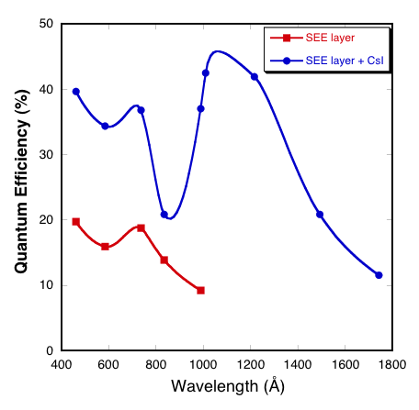
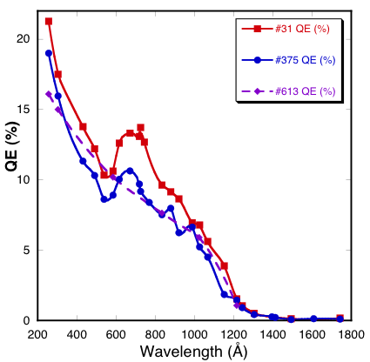
ALD-MCP Quantum Efficiency
ALD – borosilicate MCP photon counting
quantum detection efficiency, normal NiCr
electrode coating gives normal bare MCP QE.
ALD – secondary emissive layer on normal
MCP gives good “bare” QDE. CsI deposited
on this gives a good “standard” CsI QDE.
83% OAR
65% OAR
#375 & #613 MCP pairs, 20µm pores, 8° bias,
60:1 L/d, 60% OAR. #31 MCP pair, 40µm pores
8° bias, 60:1 L/d, 83% OAR, shows higher QDE.
QDE for bare MCP with ALD secondary emissive layer, and with CsI deposited on top of this.

Slide 18
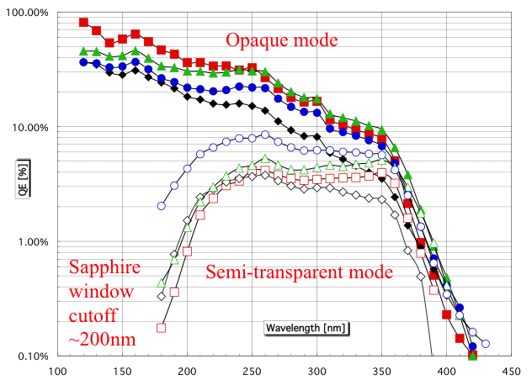
Opaque GaN Deposited on Sapphire
GaN semitransparent and opaque photocathode quantum efficiencies. The GaN is 150nm to 100nm thick with depth graded Mg concentration. The best semitransparent QE is for a substrate with only 50% GaN coverage - hence the achievable efficiency is probably closer to twice the measured values.

Slide 19
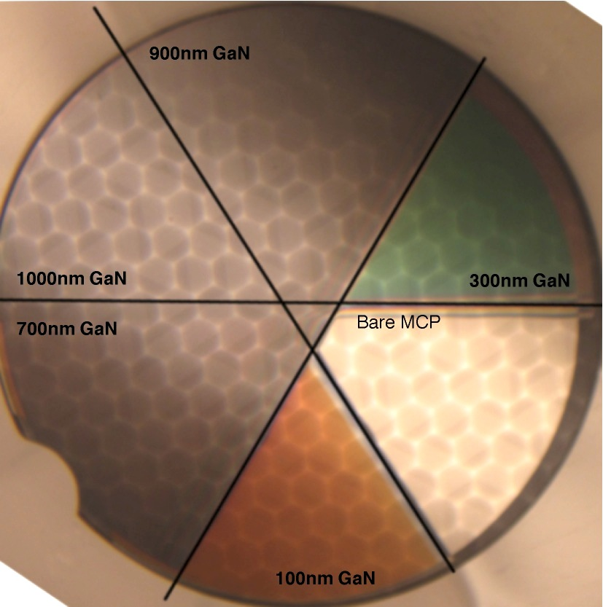
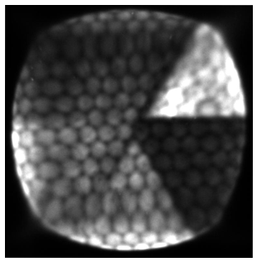
Opaque GaN Deposited on ALD MCPs
Borosilicate/ALD MCP coated by MBE with P-doped GaN/AlN of various thicknesses
(amorphous/polycrystalline) and tested in a photon counting imaging detector
10.8%
17%
10.2%
9.7%
17%
1.5%
0.2%
11%
0.75%
5.4%
9%
Integrated photon counting image using 184 nm
UV shows unprocessed GaN layer response vs
bare MCP.
QEs (@214nm UV) measured after Cs. 10º (blue)
or 45º (white) graze angle. Typical QE- thickness asymptote for opaque cathode.
Deposited by SVT associates (A. Dabiran).

Slide 20
Preconditioning Tests of 33mm
20µm Pore MCPs
Arradiance MCPs 612 and 613, 20µm, 60:1, 8° bias, completed.
ANL MCPs 164 and 163, 20µm, 60:1, 8° bias.
INCOM serial #s, 11863-99, 11863-95
Resistances 159MΩ, 138MΩ (NiCr over)
XDL detector with MCPs gapped by 0.001” spacer.
Completed 350°C bake, with RGA scans.
Scrub in progress, with RGA scans.
Have gone from 1µA to 2µA, now 3µA >2.5 C cm⁻² extracted.

Slide 21
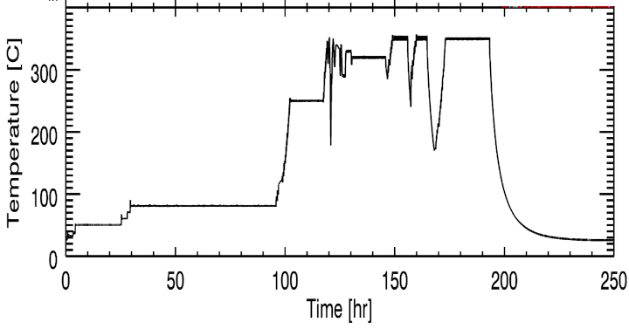
Time vs Temp vs Gas Load
Temperature controller was a bit touchy, but the profile is largely correct. Most of the gas load is the chamber, not the MCPs. However, there was some H₂ from the MCPs in pre bake tests.
Bake was on Turbo. N₂ and H₂O
mostly at turbo limit. H₂ is the major gas load at temp, and decays slowly.

Slide 22
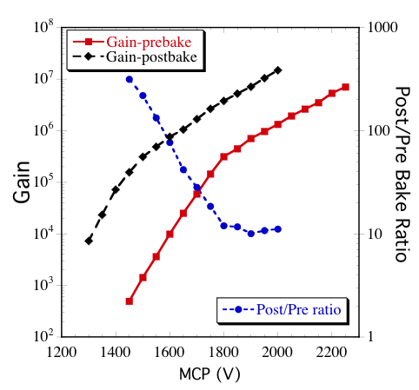
Gain/Voltage curve Pre/Post Bake
Very large gain increase after the bake.
MCPs work well otherwise in all respects after the bake.
SEE probably increases due to surface cleaning in bakeout.

Slide 23
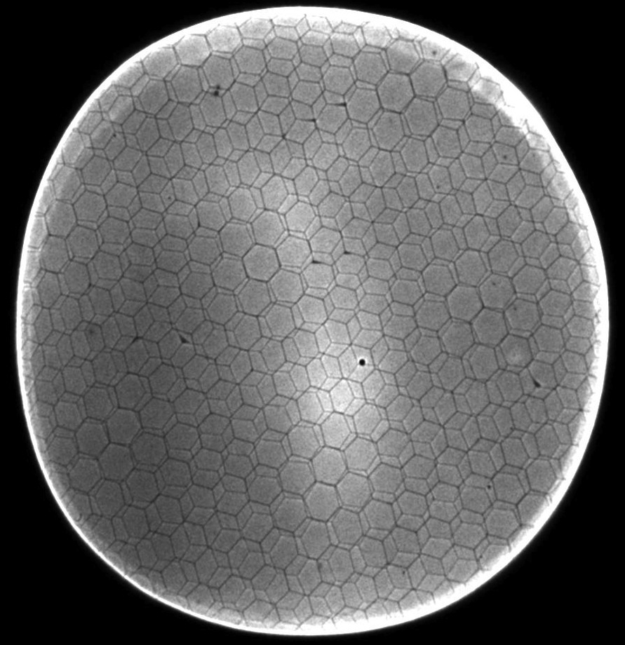
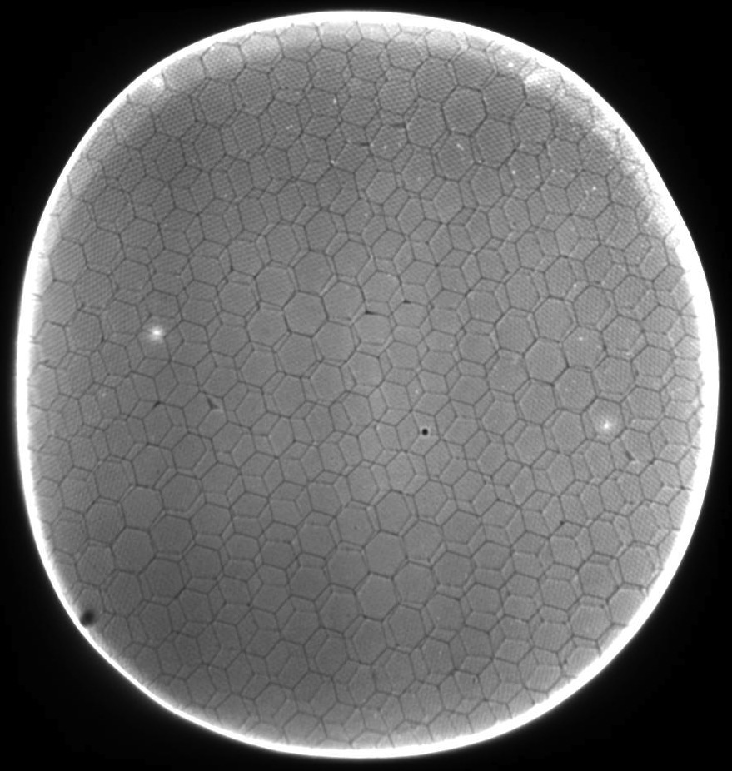
UV Imaging Response
Before and after 350°C Vacuum Bake
Pre-bake
Post-bake
185nm UV– some MCP defect spots,
UV non uniform, shows multifibers
185nm UV– some MCP defect spots,
less multifiber, some Moire.

Slide 24
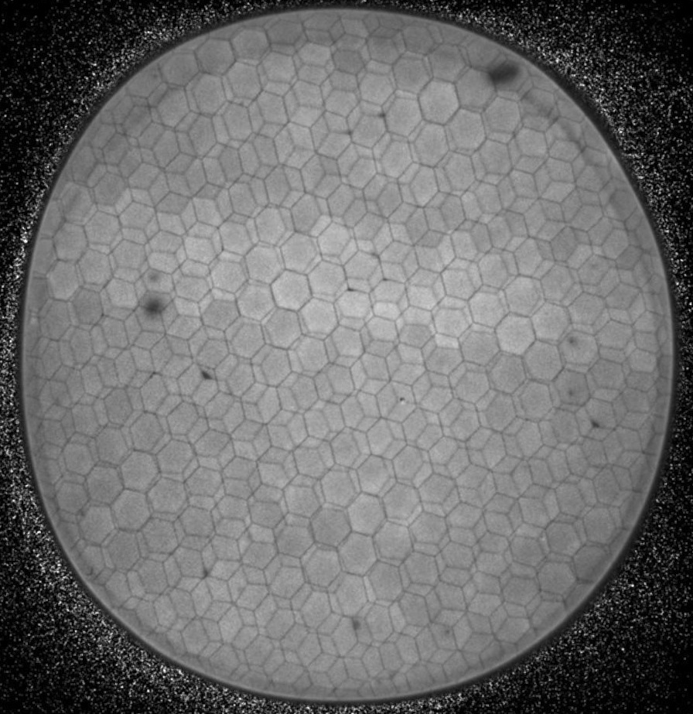
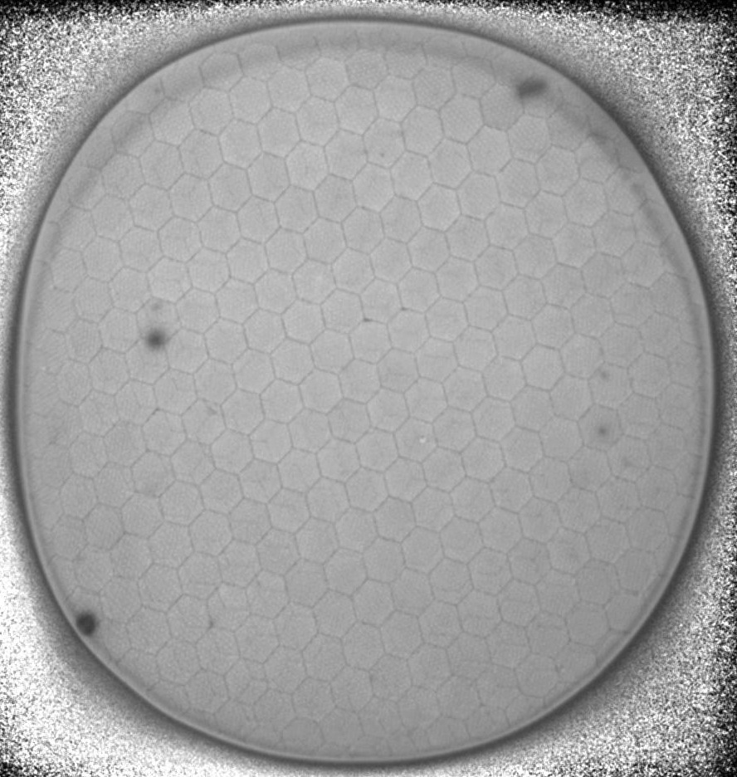
UV Gain Map Response
Before and after 350°C Vacuum Bake
Pre-bake
Post-bake
185nm UV– some MCP defect spots
UV non uniform, shows multifibers
185nm UV– same MCP defect spots
+1, less multifiber, more uniform

Slide 25
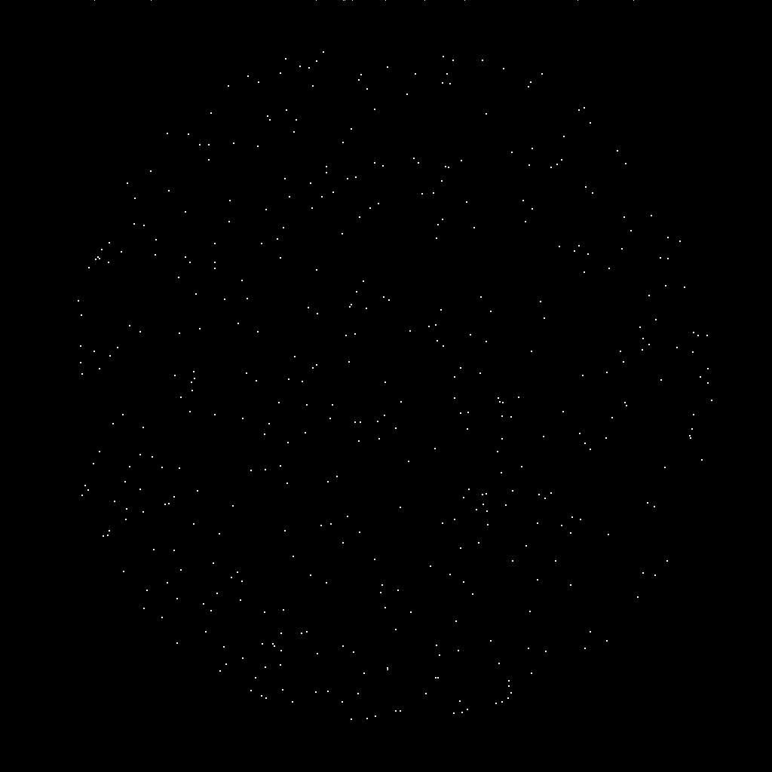
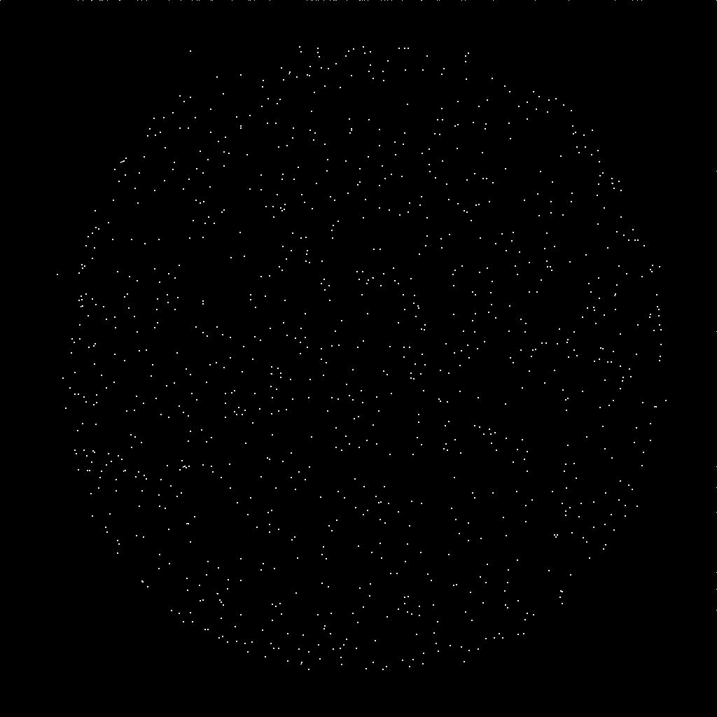
Background Behavior
Before and after 350°C Vacuum Bake
Pre-bake – 1000 sec
~0.1 events cm⁻² sec⁻¹
Post-bake –2000 sec
~0.1 events cm⁻² sec⁻¹

Slide 26
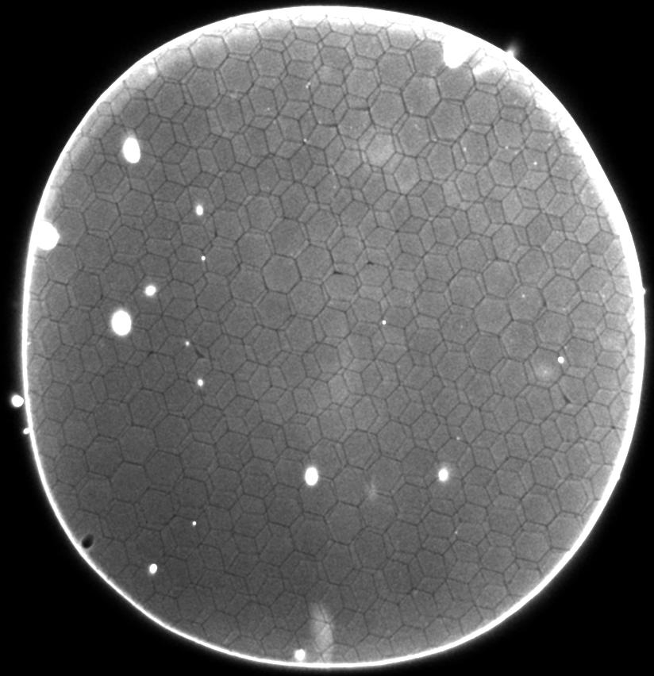
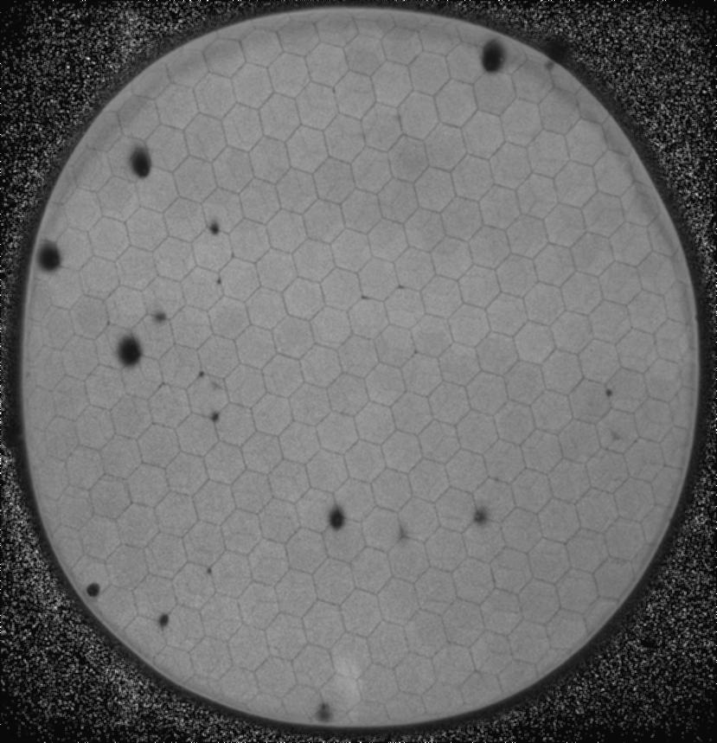
UV Gain Map/Response after ~2.5 C cm⁻² Extracted
UV response map, shows hotspots,
Mostly low gain (big area = readout).
UV GAIN map, shows hotspots,
Otherwise very flat!! Looks good.

Slide 27
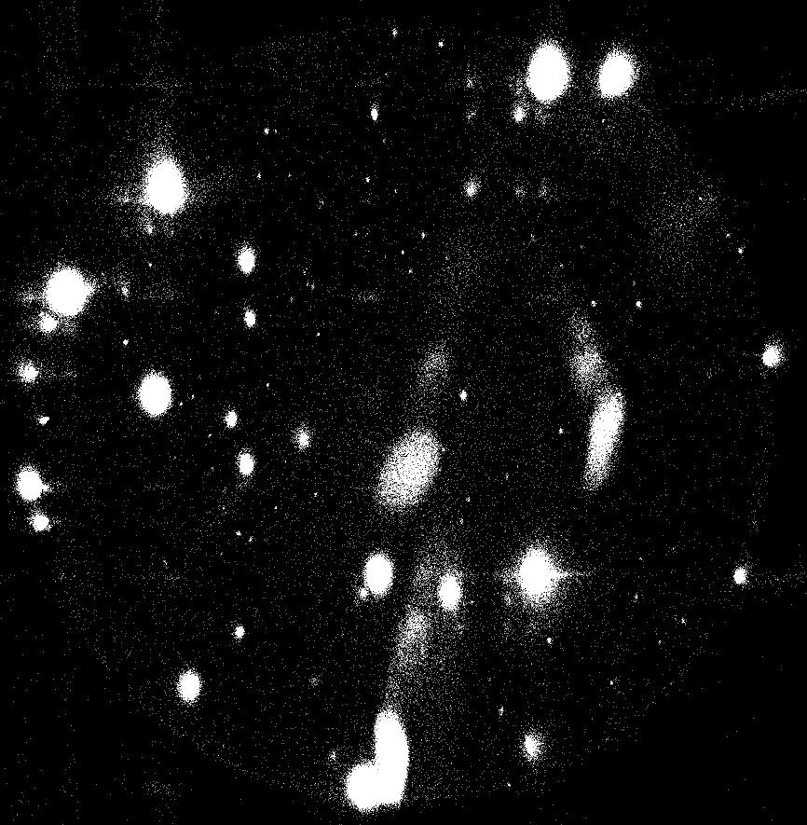
Background after ~2.5 C cm⁻² Extracted and Summary
Background rate ~3200 events/sec
average for whole area, mostly in
the hotspots.
Quiet areas are <1 event cm⁻²sec⁻¹
This is probably indicative of debris
which is at different depths within
the substrate
SUMMARY
Response and gain stays uniform
and stable,BUT ----
background gets impacted
by hotspots which are very likely
to be debris in/on the MCPs.
UV background image shows hotspots,
High gain (small points) and low gain (big blobs)

Slide 28
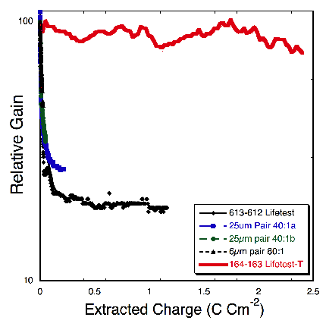
33mm ALD-MCP Preconditioning Tests
Vacuum 350°C bakeout with RGA monitoring first, then UV flood low gain, then
high current extraction “burn in” (1 – 3µA). Most recent ALD formulation:-
Gain increases by x10 during bake, after 2.5 C cm⁻² minimal gain change!
Gain curves of MCP pair (20µm pore, 60:1 L/d, 8° bias) at stages during preconditioning. Outgas during burn-in < 4 x 10⁻¹⁰ torr H₂.
UV scrub of ALD MCP pairs 613-613 &164-163, (20µm pore, 60:1 L/d, 8° bias) compared with conventional MCPs.

Slide 29
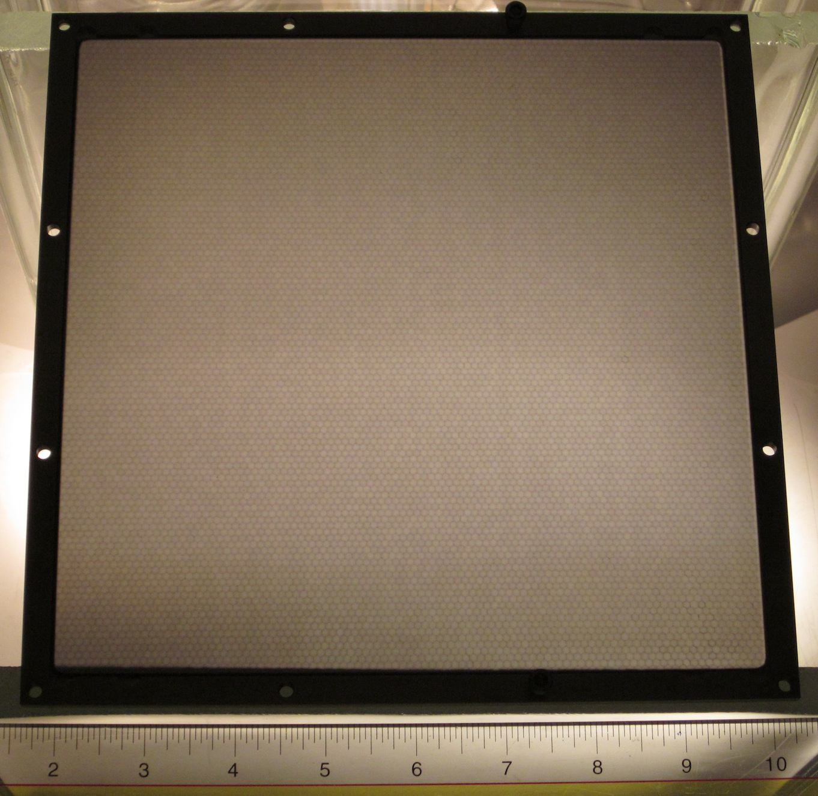
8” 40µm MCP Substrates
Electroded 8” substrate 2000Å inconel 600 on both sides. 1 done, 1 half done, 2.5 sides to
go on the 4 substrates.
Transmission backlight shows good overall uniformity, and better quality than earlier substrates.

Slide 30
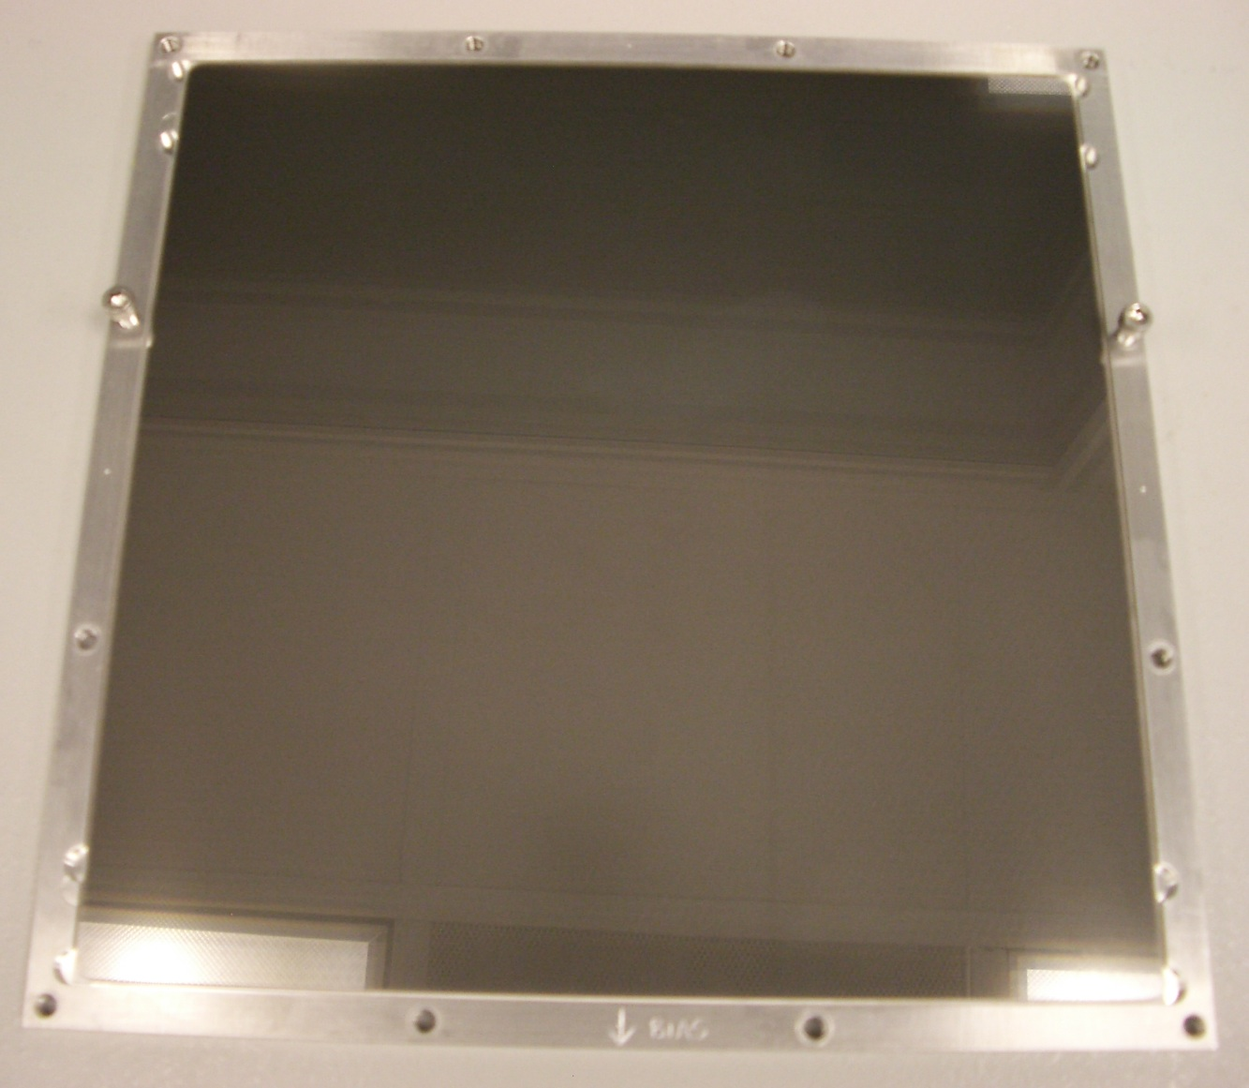
8” 40µm MCP Substrates
Electrode is nicely reflective –focus on ceiling

Slide 31
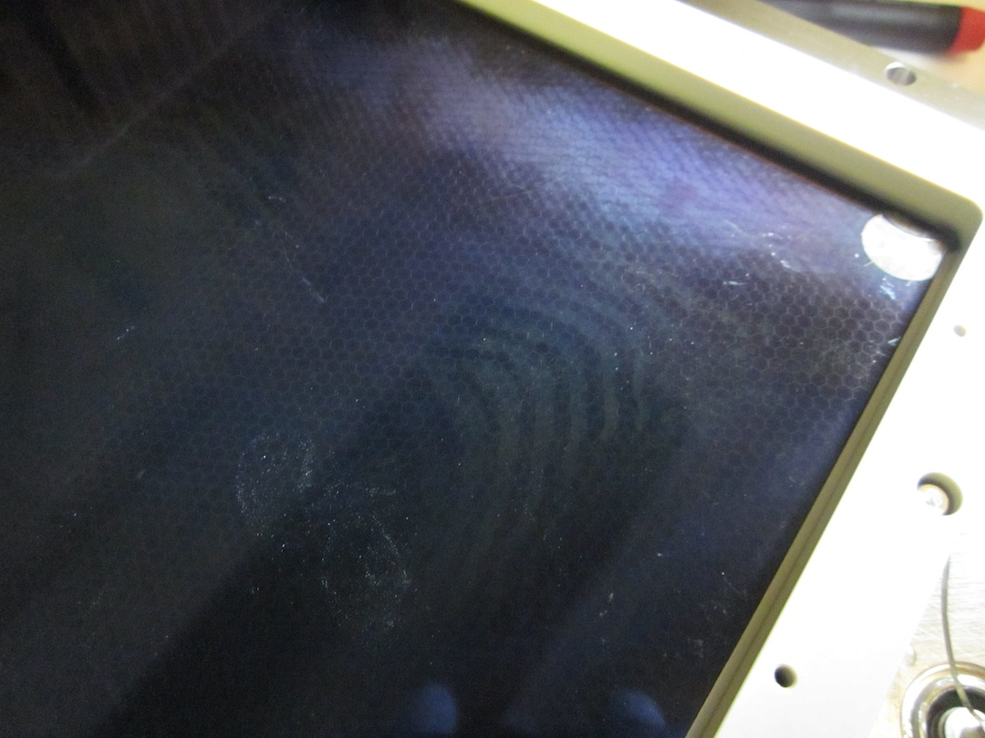
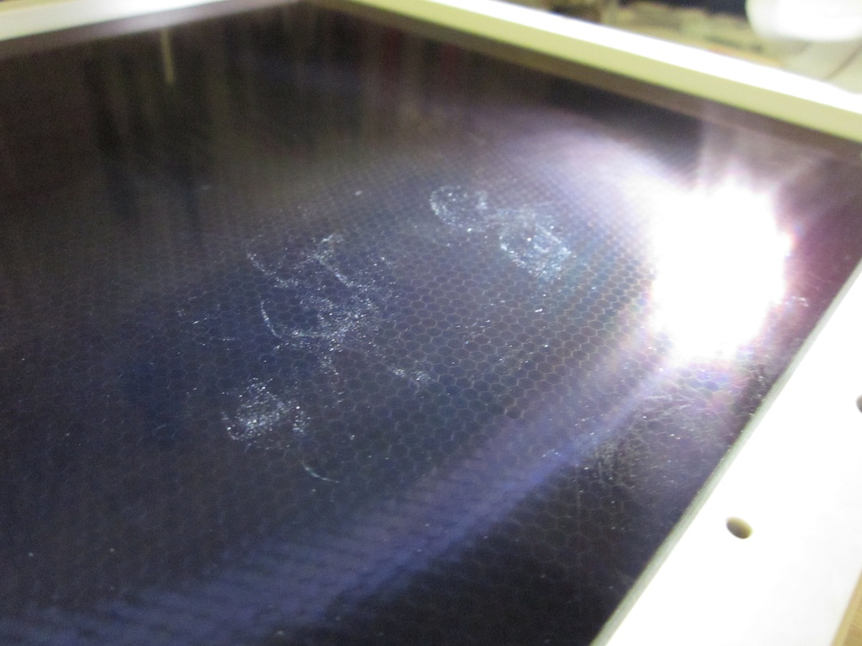
8” 40µm MCP Pair Visuals
Bottom MCP, ALD over – fringes visible
Hands-Off! - Prints have been
Submitted to FBI database

Slide 32
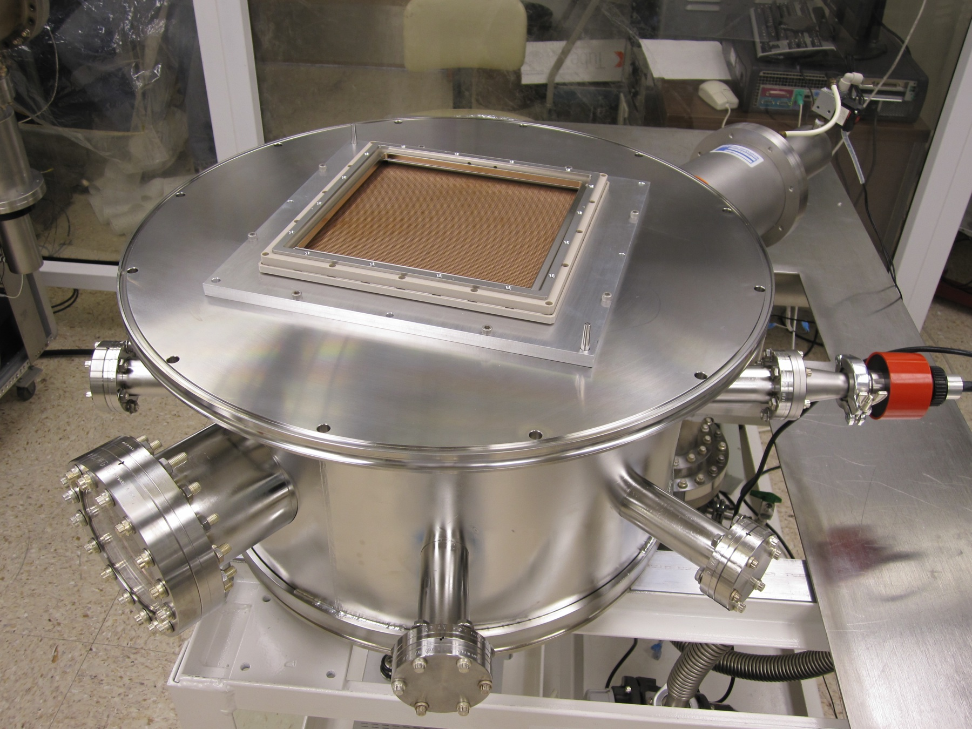
8” MCP Test Detector Vacuum System
Vacuum test chamber system for testing the 8” MCPs is finished and operational
The cross delay line is exactly as models predicted, ~250ns delay. We expect to
achieve <200µm spatial resolution for evaluation of 8” MCPs. All the electronics
is in place for data recording.

Slide 33
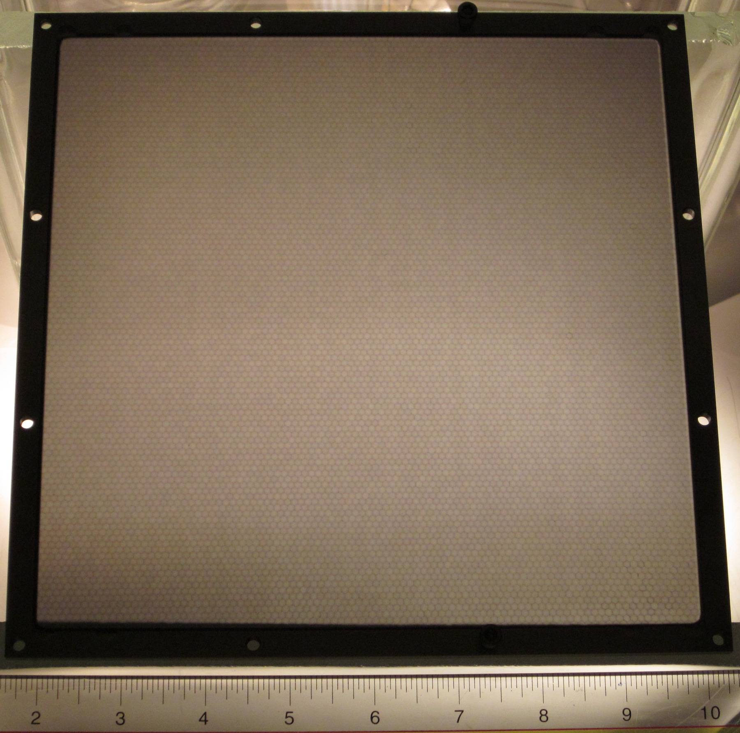
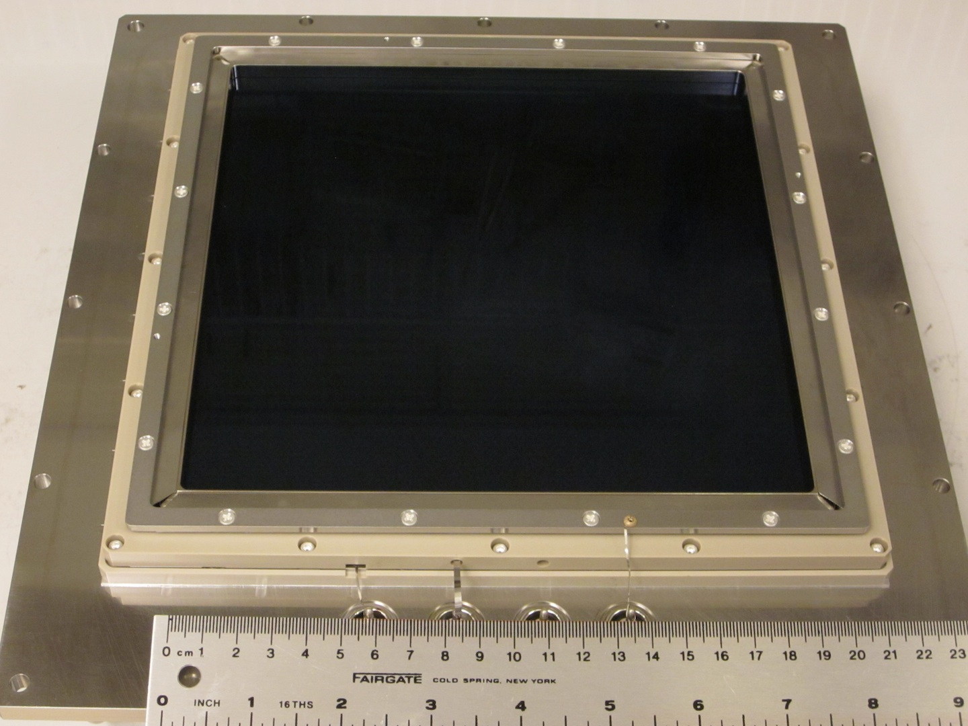
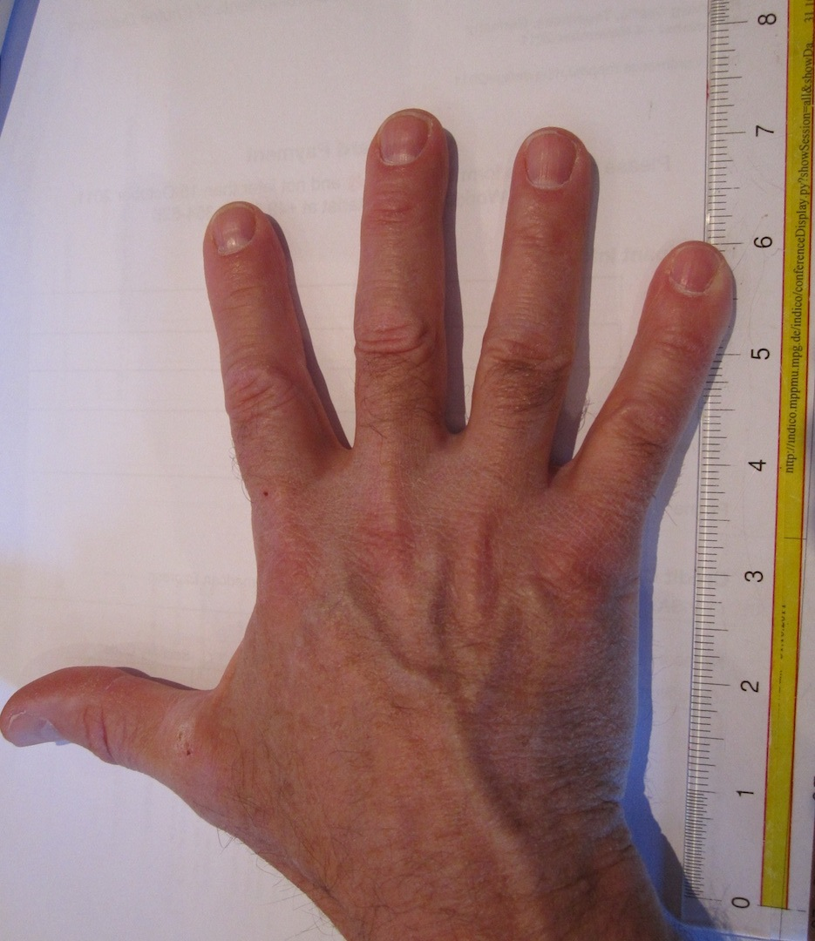
Progress with 20cm MCP Development
A small number of 20cm MCP substrates have been functionalized by ALD at ANL and electroded at UCB-SSL. One pair has been tested in a detector specifically built for evaluation of their performance. Mechanical quality not the best, due to much handling.
20cm electroded ALD 40µm pore MCP pair in detector assembly with a cross delay line imaging readout. Bottom MCP corner broken off!
20cm MCP showing the multifiber stacking arrangement, 40µm pore, 8° bias.

Slide 34
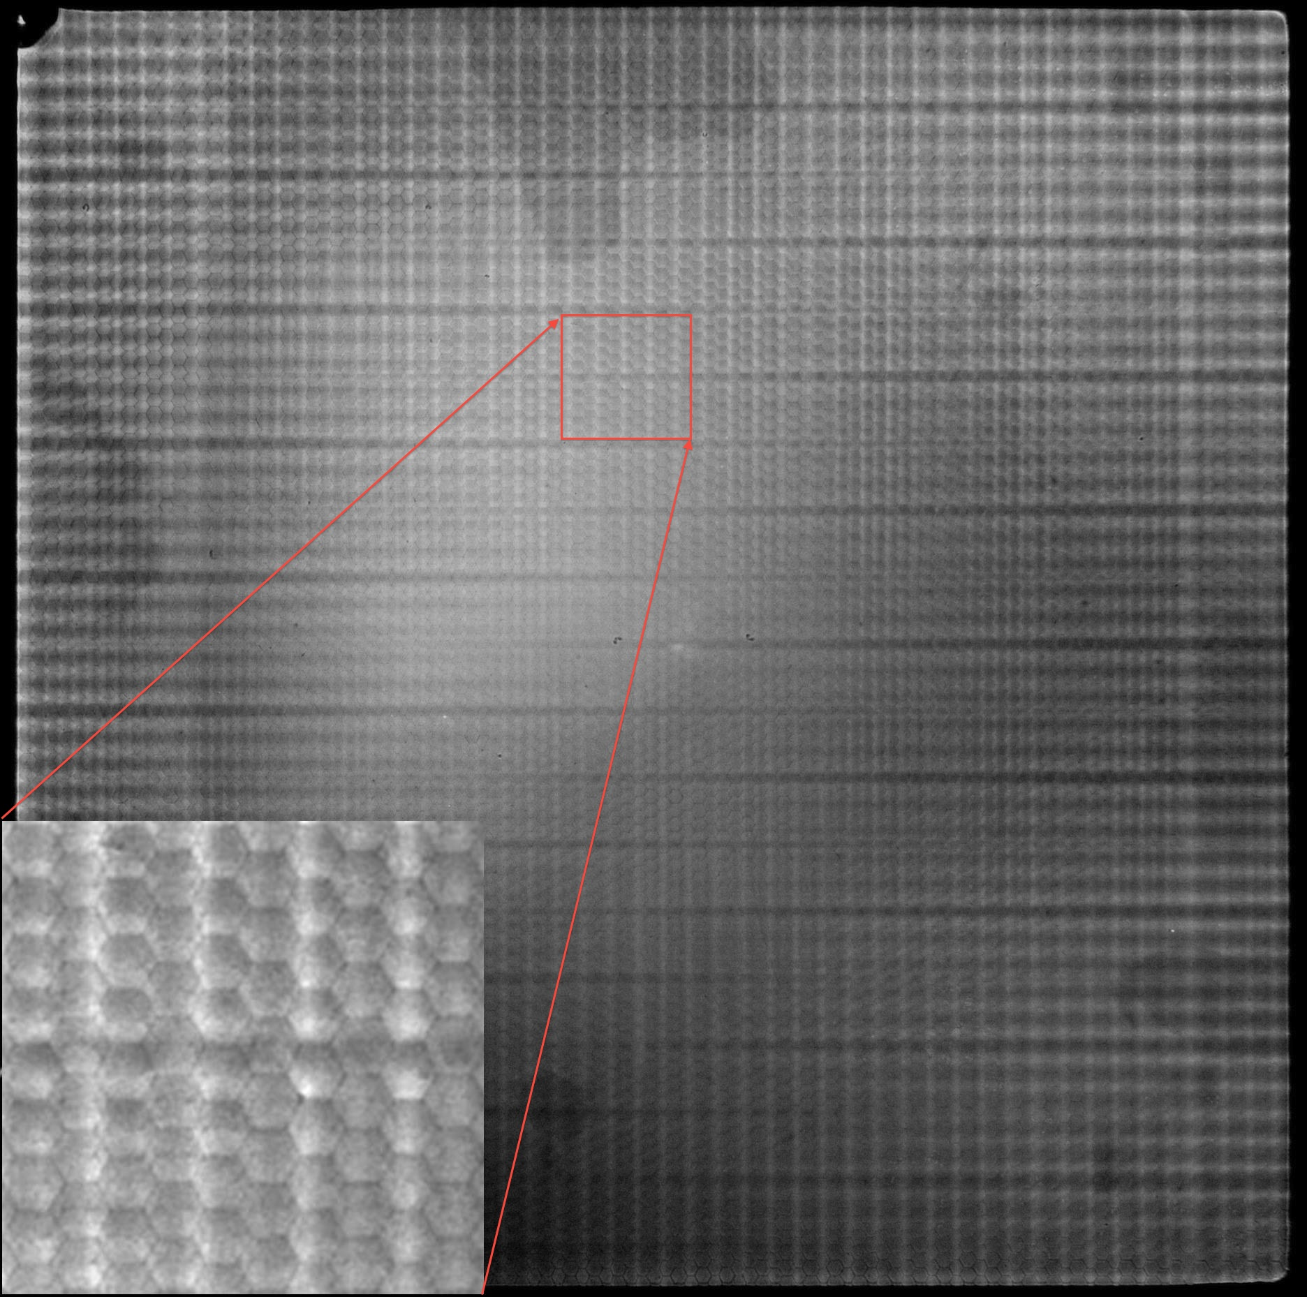
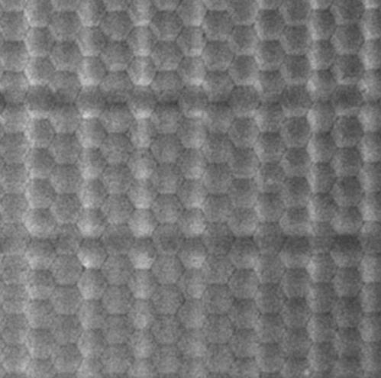
Photon Imaging 20cm, 40µm pore ALD-MCP Pair
Image section showing the MCP multifibers
20cm MCP pair image with 185nm UV illumination
40µm pore, 40:1 L/d ALD-MCP pair, 0.7mm gap/400v. Striping is due to the anode period modulation as the charge cloud sizes are too small. However, this is the FIRST attempt at 20cm MCP ALD imaging without any opportunity for optimization.

Slide 35
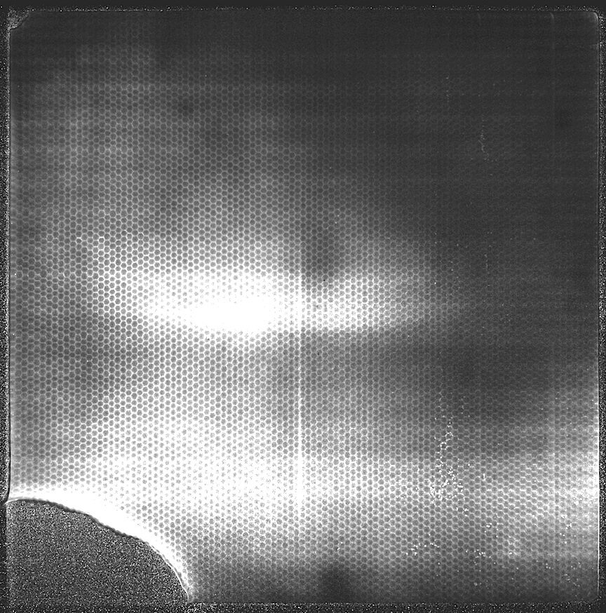


Testing of 20cm, 40µm pore ALD-MCP Gain
Mean gain ~4 x 10⁶
Relative gain
X slice histogram, has overall gain variation
and shows the multi-fiber edge gain changes
Relative gain
20cm MCP pair average gain map image
Y slice histogram, shows gain variation
40µm pore, 60:1 L/d ALD-MCP pair. Average gain image map shows the MCP gain variations are significant. However, ALD improvements are underway -- much better coating uniformity has been achieved in system tests - just need to optimize now.

Slide 36



Background, 20cm, 40µm pore ALD-MCP Pair
Image section showing a “warm” spot
Area, 0.075
cnts sec⁻¹ cm⁻²
Spot histograms, shows
~100µm FWHM resolution
20cm MCP pair background, 2000 sec, 0.24 cnts sec⁻¹ cm⁻²
40µm pore, 40:1 L/d ALD-MCP pair, 0.7mm gap/400v. Shows field emission and hotspots – needs cleaning/cleanup. BUT – background still very low !! Spatial resolution is ~100µm FHWM for small hotspot (single active pore!?). 2k x 2k resels!

Slide 37
Borosilicate ALD MCP Summary
ALD functionalized MCPs using borosilicate glass microcapillary
arrays have been successfully made in 33mm and 20cm formats
with 20µm and 40µm pores and 8° bias.
Many of the performance characteristics are similar to standard
commercial MCPs both in analog and photon counting modes.
MCP preconditioning shows very good gain, low outgas and
good stability with implications for tube fabrication & lifetimes.
Background rates are low, <0.1 events cm⁻² sec⁻¹.
With large MCPs fabrication of 20cm sealed tube is possible.
Semitransparent Bialkali (25%) cathodes on Borofloat-33.
Opaque GaN cathodes with high QE can be made on MCP.
High 80%+ OAR gives better UV QE + better electron efficiency?!

