Slide 1
20cm Sealed Tube Facility at SSL
Ossy Siegmund,
Experimental Astrophysics Group,
Space Sciences Laboratory,
U. California at Berkeley

Slide 2
8” Sealed Tube Resources at SSL
SPECIFIC FACILITY SAMPLE SIZE LARGE 8.6” SIZE
Precision Wet Cleaning In Service In Service
Vacuum Baking In Service In Assembly
N₂ & Vacuum Storage In Service In Service
Hi-Pot Station In Service In Service
Plasma Cleaning In Service In Service
Helium Leak Checker In Service Use RGA
Electrode Evaporation In Service In Service
1.2” PC Process Chamber In Service
8.6” Cathode/seal/test Chamber Commissioned
8.6” Full Process Chamber In final assembly

Slide 3
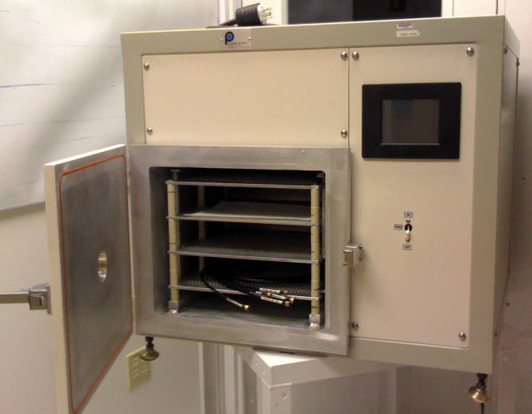
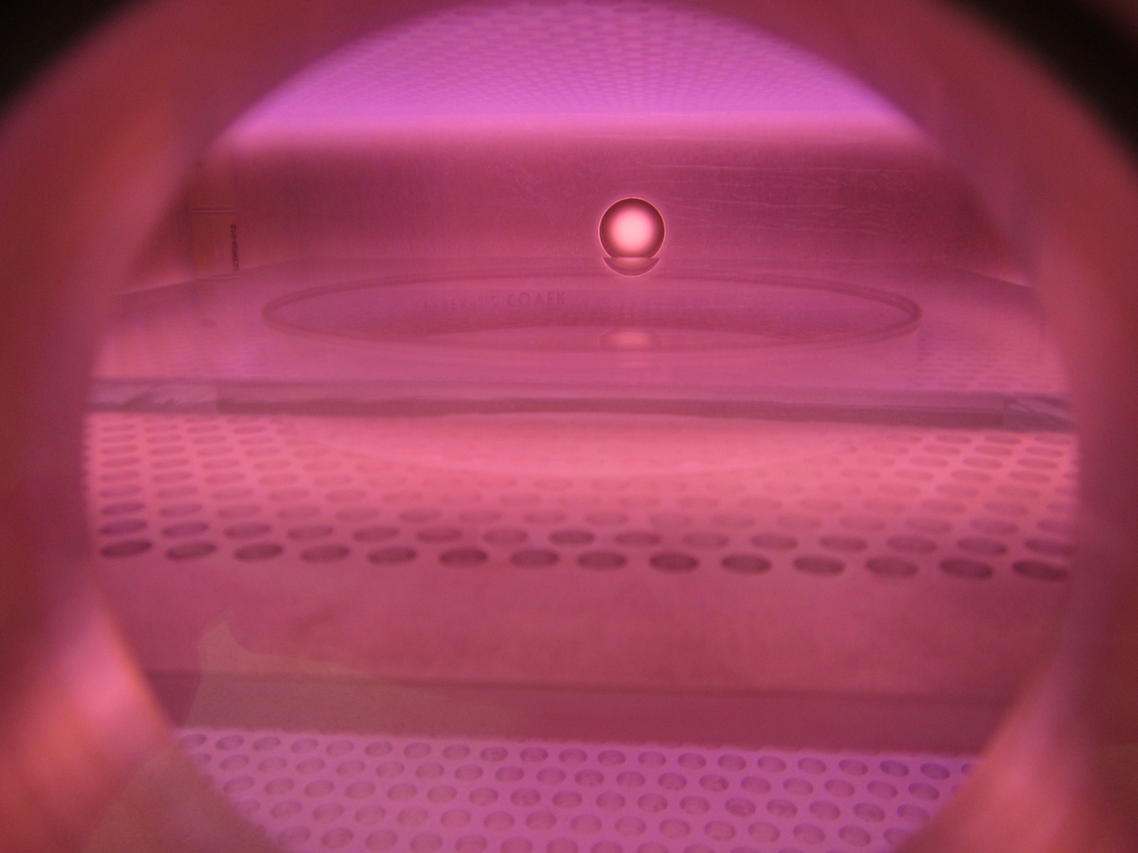
Plasma Etcher
Plasma etcher commissioned
Vital for cleaning windows.
Has been tested with, oxygen, argon and hydrogen gases.
3

Slide 4
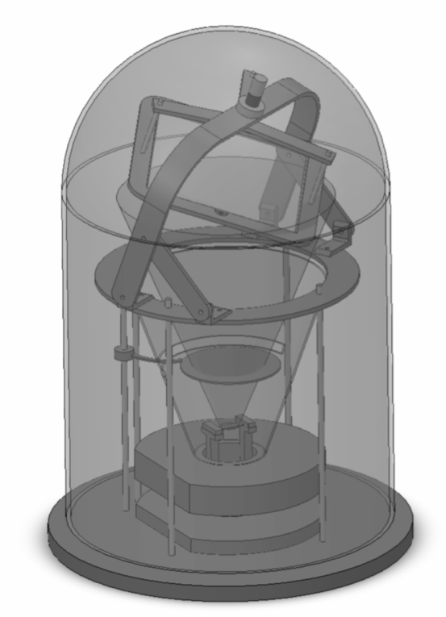
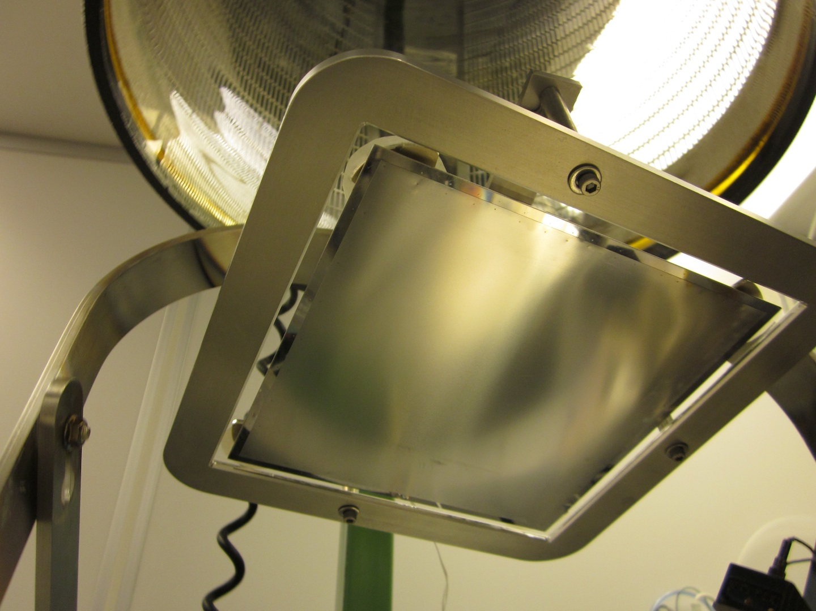
Evaporator accommodates 8.7” windows
In operation for NiCr/Cu evaporation tooling for 8.7” windows

Slide 5
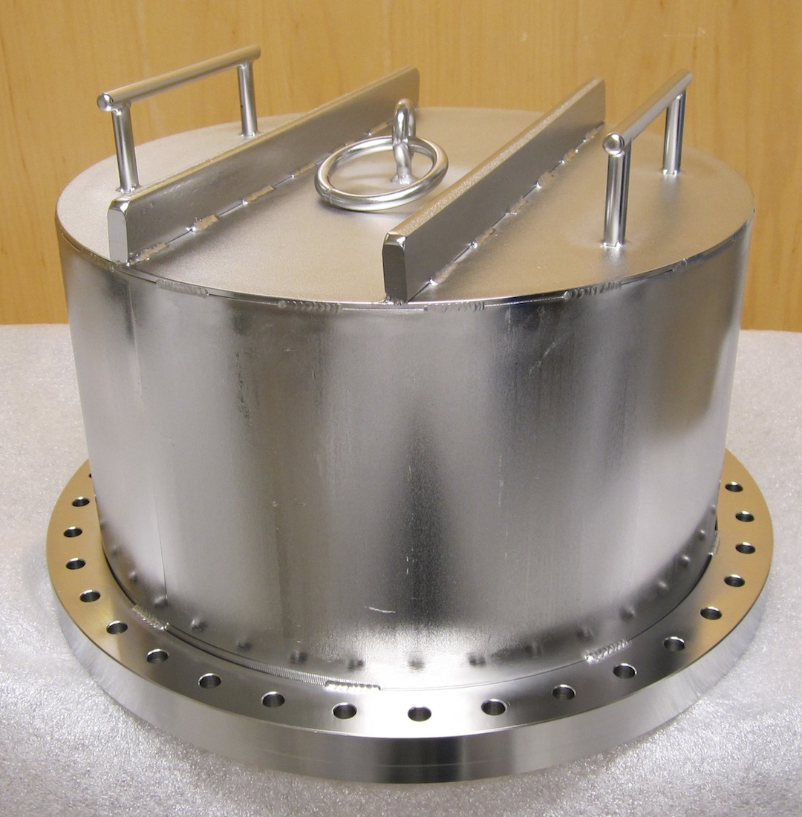
Large Vacuum Bake Chamber
To be used for parts preconditioning
Stand ready
Have base flange, needs mods
Heaters and insulation spec’d
Thermal control system spec’d
Will get on short turnaround
finish assembly and commission.
Use for tube assembly pre-bake

Slide 6
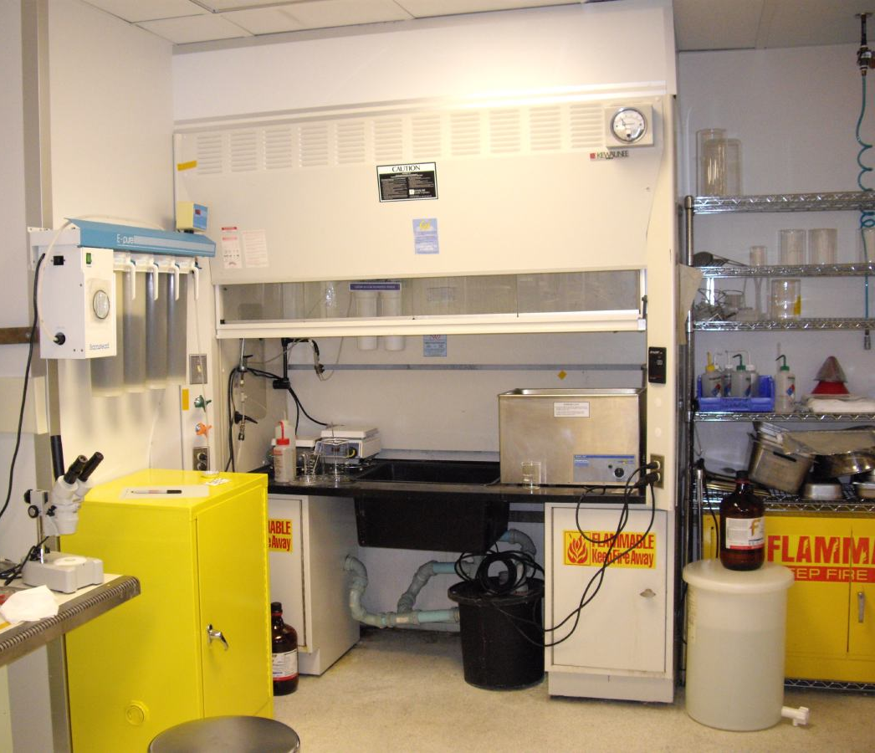
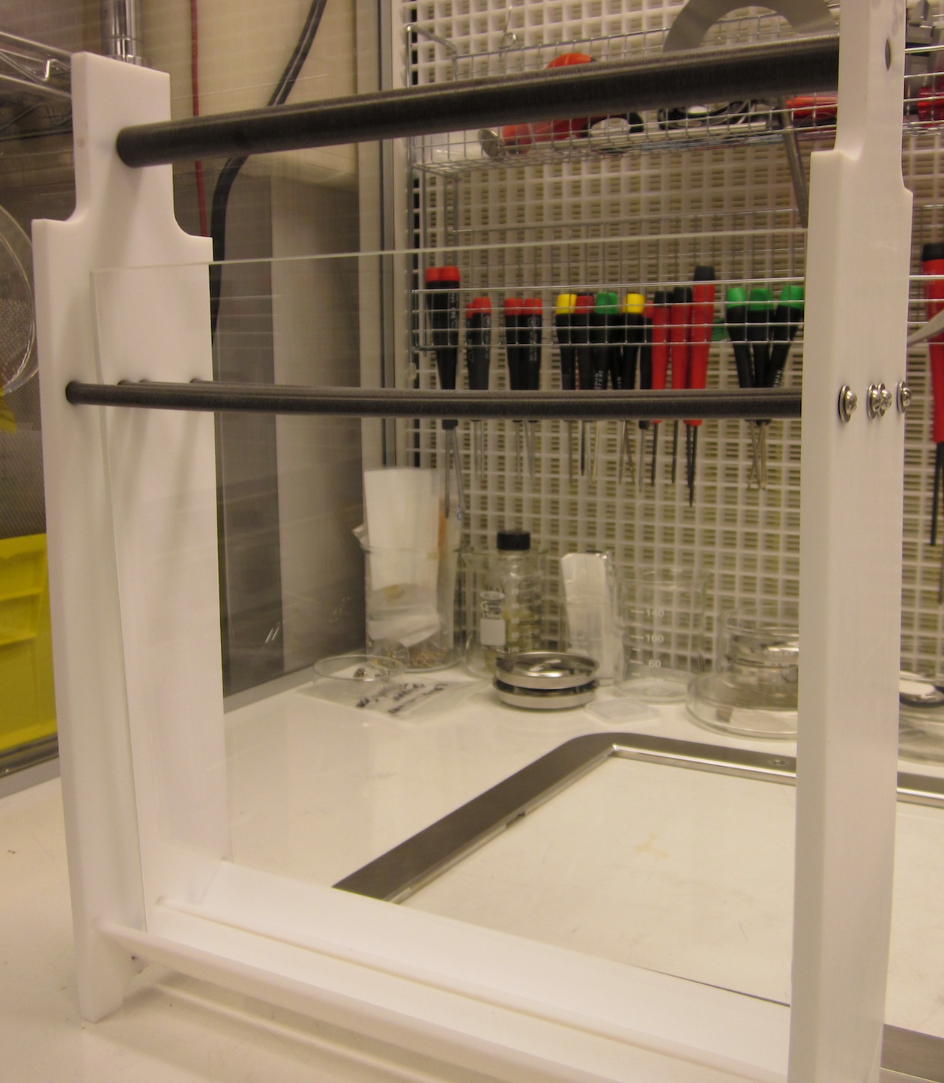
Precision Wet Cleaning
Ultrasonic, chemicals, oven, DI etc available
Wet cleaning station
Jig for window/MCP wet cleaning

Slide 7
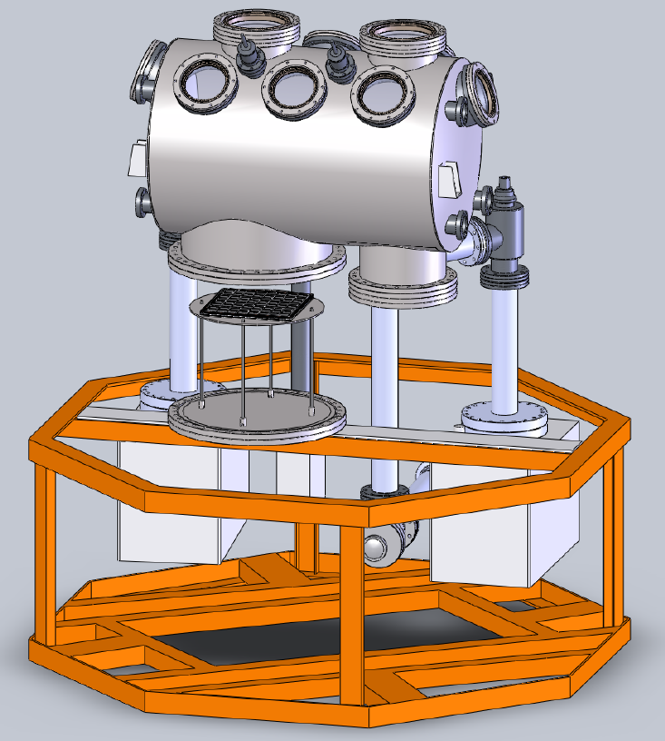
Large Process Chamber Design
Multiple Viewports
Vacuum Chamber 18” O.D x 30” Long
Multi- Motion Manipulator Arms
All-Metal Valves to Three Pumping Ports
14” Access Tube
Detector Body Stack on 16.5” CF Flange
8” P-C Forming Well Tube
Two UHV Ion Pumps

Slide 8
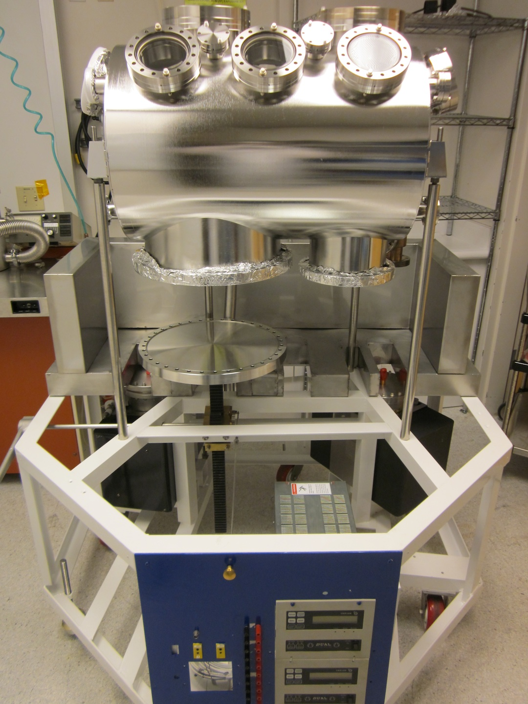
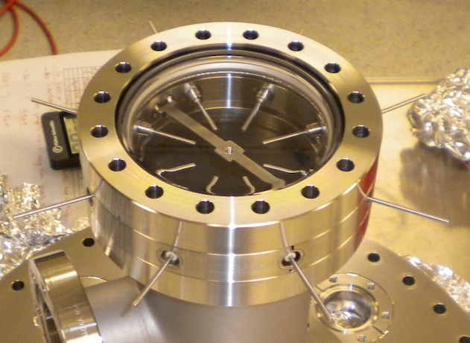
Large Process Chamber
Chamber Construction.
Chamber on process cart with:-
Viewports
Tube support flange
Loading jack
two ion pumps,
Pump controllers
Alkali sources

Slide 9
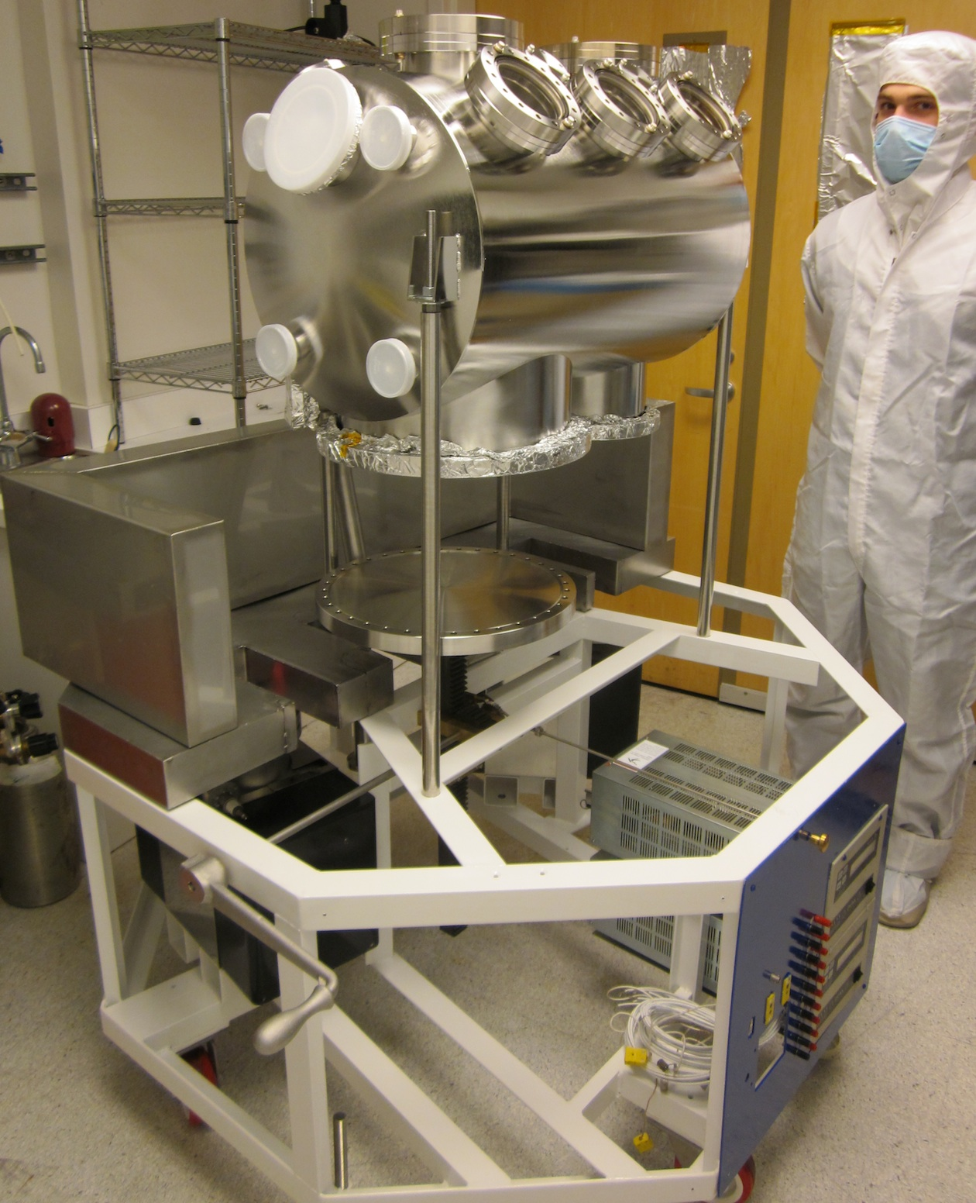
Large Process Chamber
Chamber on process cart with:-
Support/translation ports
Oven base support/insulator
Half of insulator support base
Alkali power leads
Base frame with rollers

Slide 10
Oven for Test/Process Station.
Oven accommodates Large Format Inside Envelope: 36” x 30” x 25” High
Defines Large Chamber Limits
Cathode station controls alkali metal deposition, and monitors cathode response
10

Slide 11
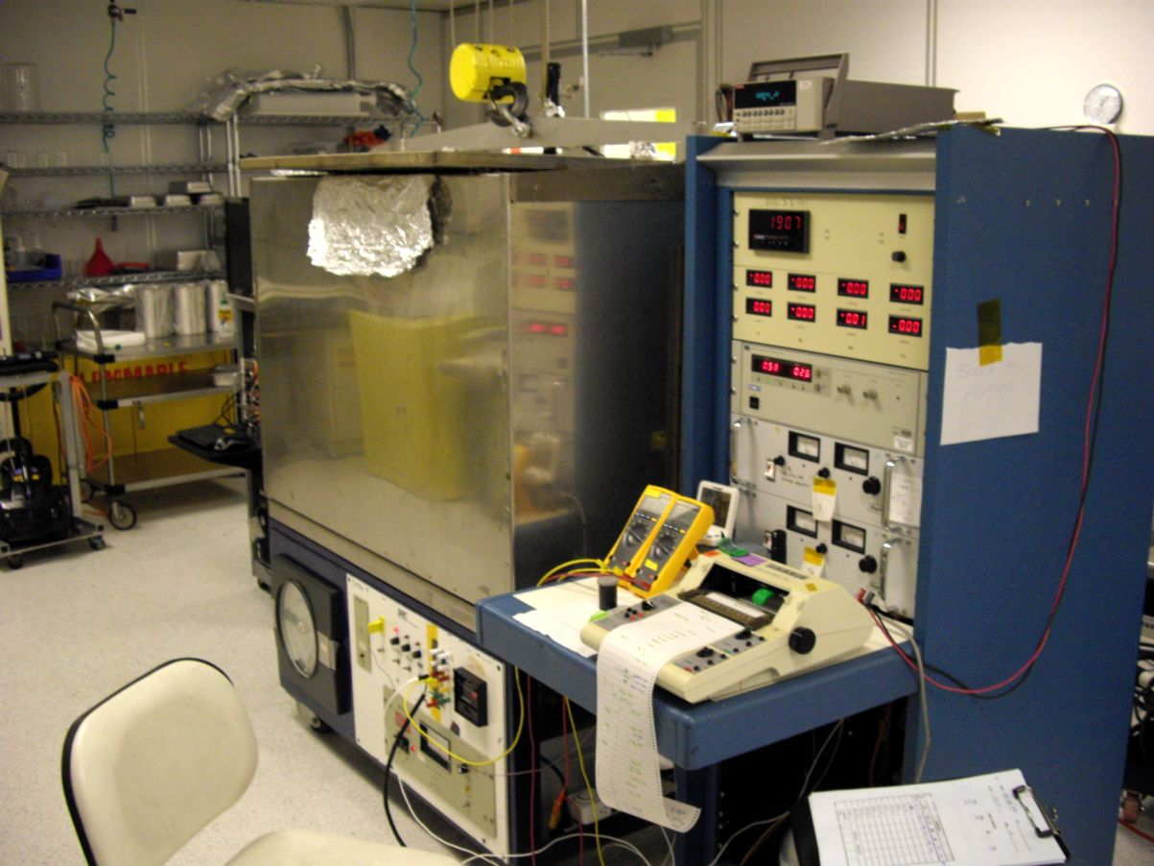
Tube Test/Process Station.
Use existing:-
Electrometer for cathode signal.
Power controls for alkalis.
Monochromatic LED’s
for response measurements.
NIST photodiodes for QE test.
Need:-
RGA for gas monitoring.
Large turbo/scroll station for servicing/bakeout support.
Large tube station replaces existing process station
11

Slide 12
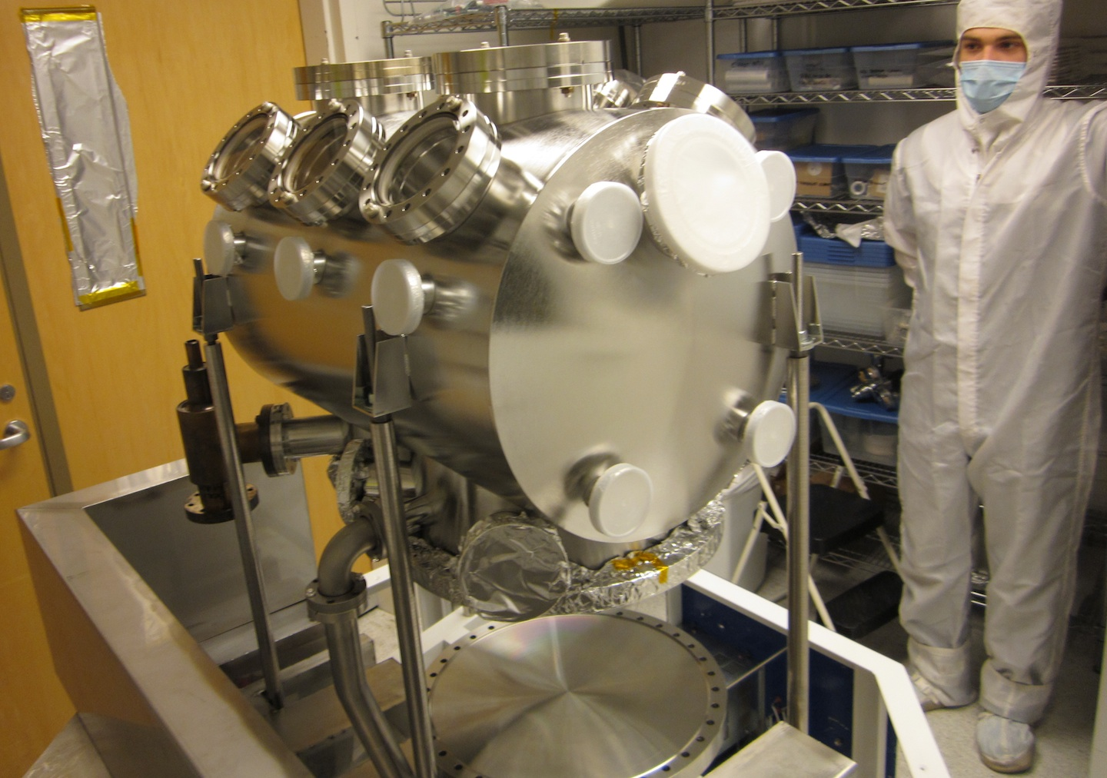
Large Process Chamber
Ion pump ports
Manipulator ports
Rough port
RGA port
Need to finish internal fixtures:- transport, covers, forming well

