Slide 1
Promising Directions for Developing Nano-structured Photocathodes
Michael Pellin
Argonne Distinguished Fellow
Director, Materials Science Division
Thomas Prolier, Jeff Elam, Alex Martinson
Stacey Standridge (NU), Joe Hupp (NU)
1st Workshop on Photo-cathodes: 300nm-500nm
July 20-21, 2009: University of Chicago

Slide 2
Outline
Issues Arising
Atomic Layer Deposition (Synthesis)
Barrier Layers
Layered Thin Films
Plasmon Enhanced Absorption

Slide 3
Photocathode Issues
Conductivity
Balancing Absorption and Electron Collection
  Photon Absorption Lengths are long
    Nanostructuring
    Plasmonics
  Electron Diffusion Lengths are short

Slide 4
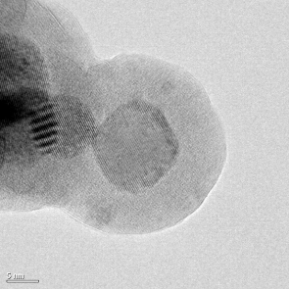
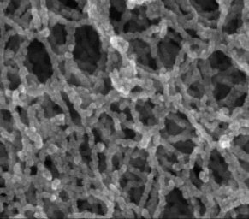
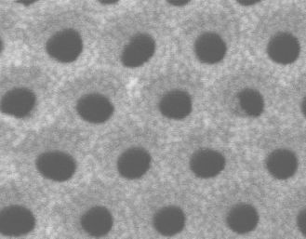
Atomic Layer Deposition (ALD)
Layer-by-layer thin film synthesis method
Atomic level control over thickness and composition (even on very large areas)
Precise coatings on 3-D objects
Some unique possibilities for morphology control

Slide 5
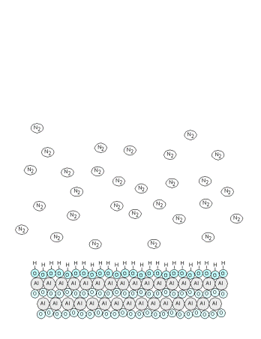

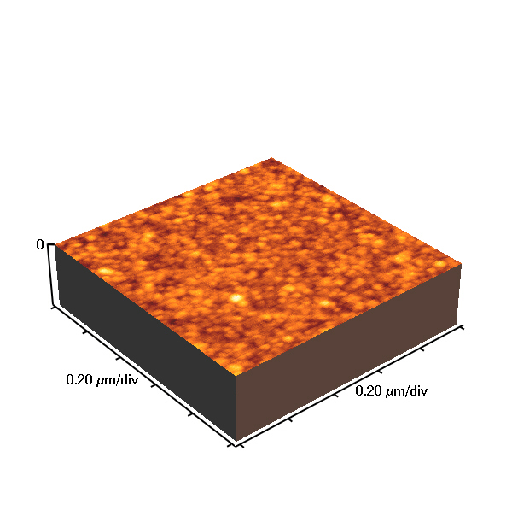
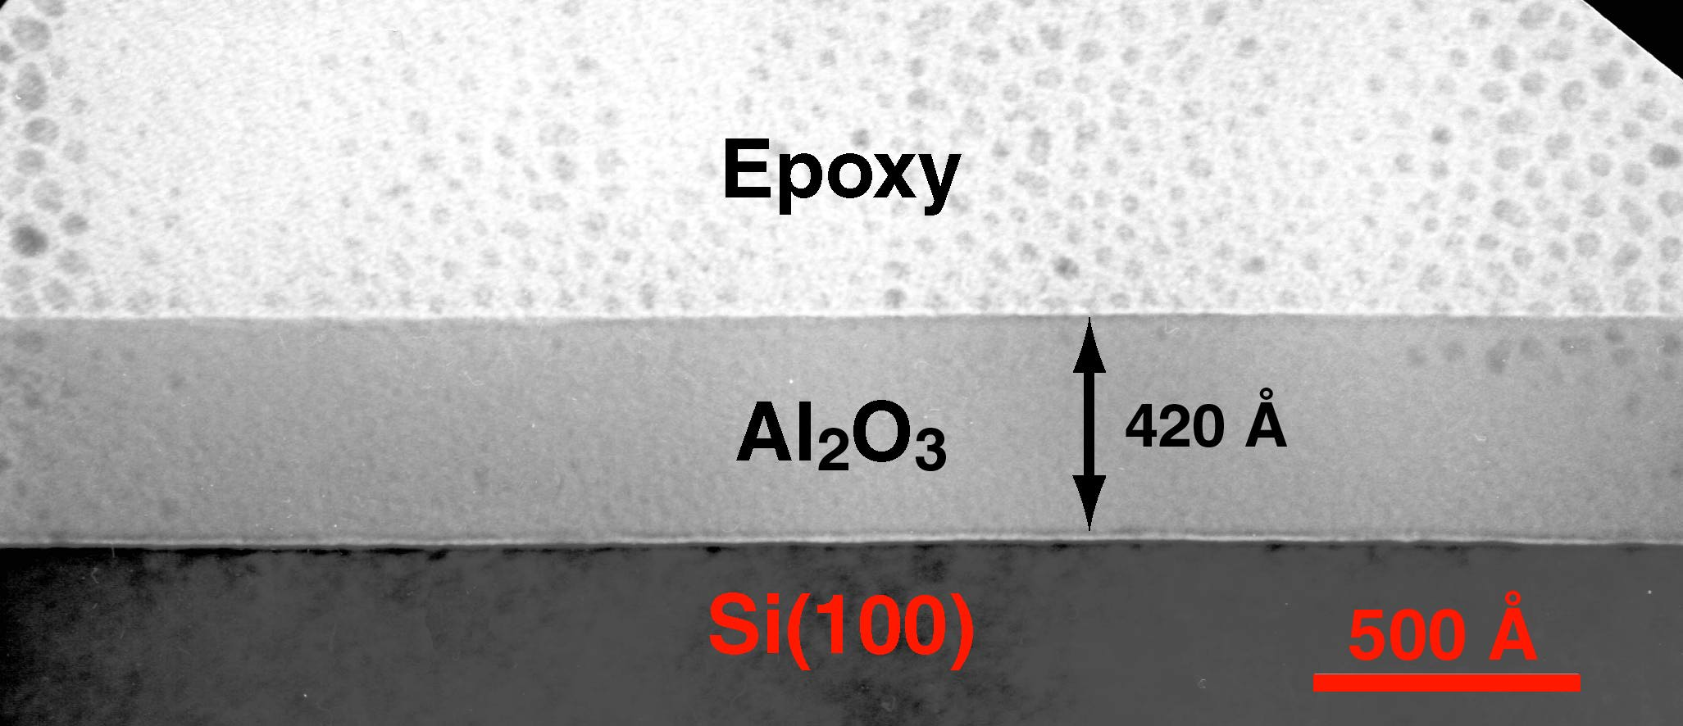

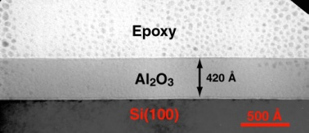
ALD Reaction Scheme
Ellipsometry
Atomic Force Microscopy
ALD involves the use of a pair of reagents.
  each reacts with the surface completely
  each will not react with itself
This setup eliminates line of site requirments
Application of this AB Scheme
  Reforms the surface
  Adds precisely 1 monolayer
Pulsed Valves allow atomic layer precision in growth
Viscous flow (~1 torr) allows rapid growth
  ~1 μm / 1-4 hours
4000
3500
No uniform line of sight requirement!
Errors do not accumulate with film thickness.
μm’s in 1-3 hrs
Pinholes seem to be removed.
Single Cell, 9 cell, re-entrant, in situ
3000
2500
Thickness (Å)
2000
1500
1000
500
0
Seagate, Stephen Ferro
0
500
1000
1500
2000
2500
3000
RMS Roughness = 4 Å (3000 Cycles)
ALD Films Flat, Pinhole free
AB Cycles
Flat, Pinhole-Free Film
Film growth is linear with AB Cycles

Slide 6
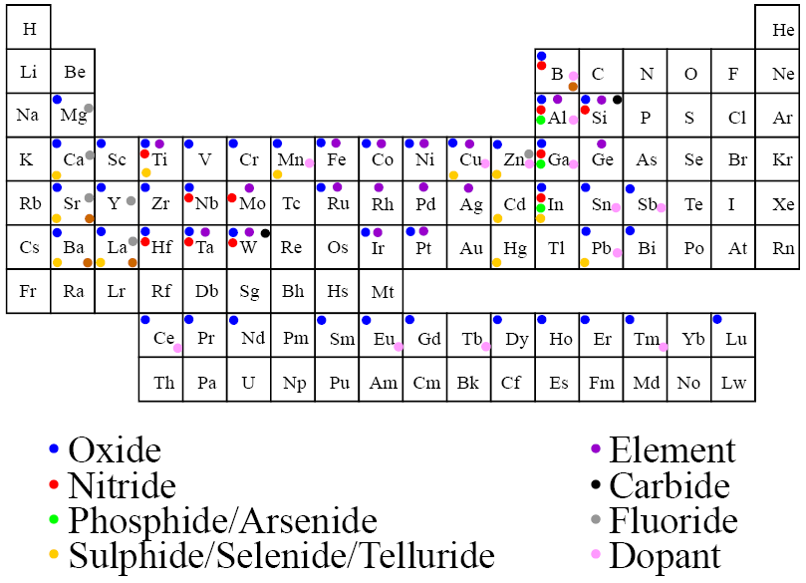
ALD Thin Film Materials

Slide 7
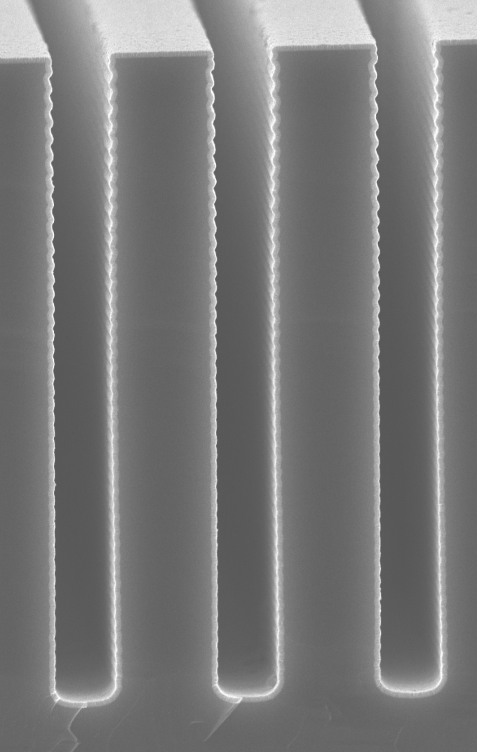
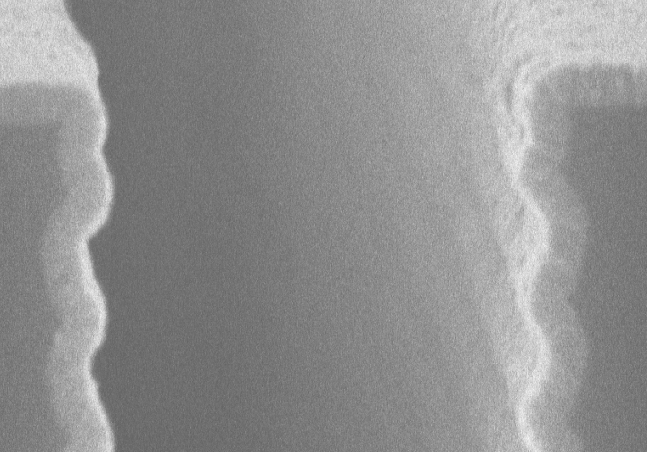
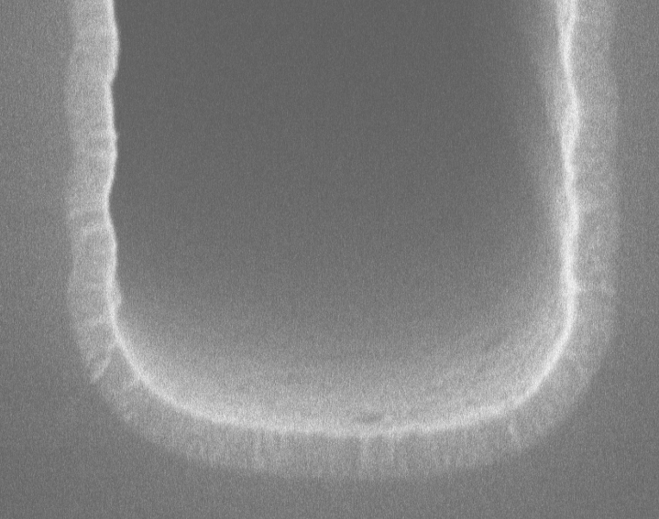
ZnO in Silicon High Aspect Ratio Trench
1 μm
ZnO
Si
200 nm
ALD is very good at coating non-planar surfaces

Slide 8
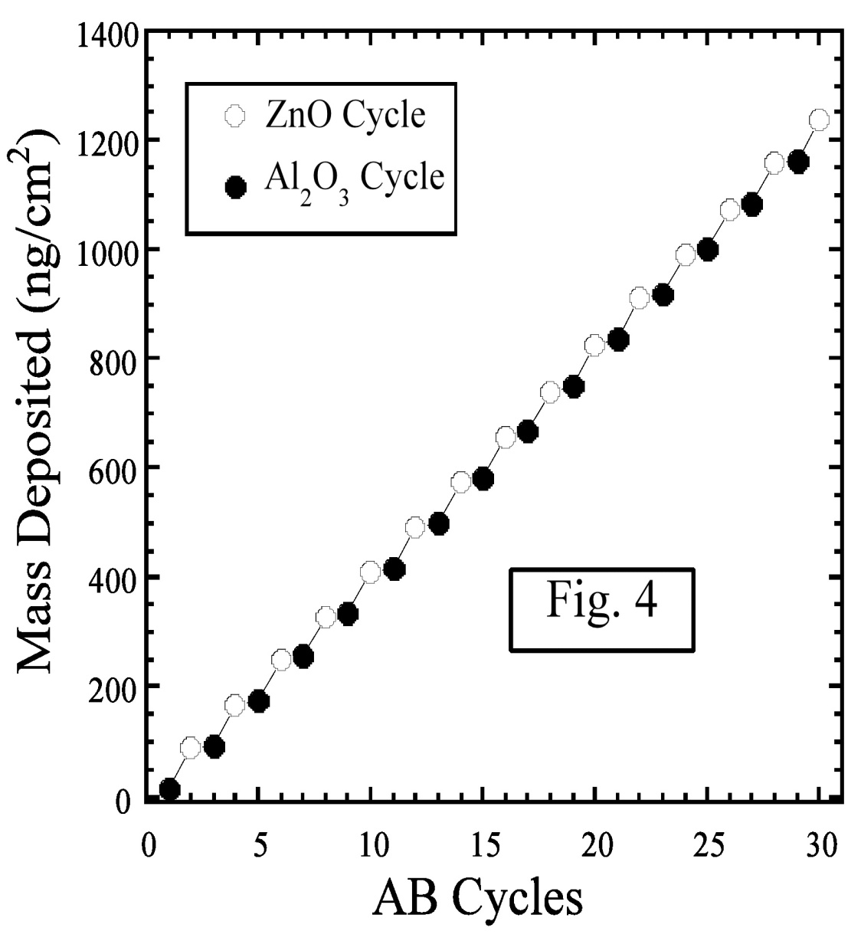
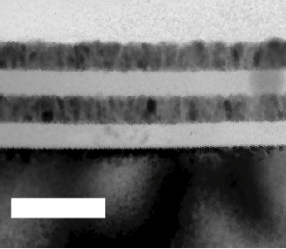
Mixed Oxide Deposition: Layer by Layer
Mixed Layer Growth
Layer by Layer
note “steps”
atomic layer sequence
“digitally” controlled
ZnO
[(CH₃CH₂)₂Zn
// H₂O]
[(CH₃)₃Al // H₂O]
Al₂O₃
ZnO
Al₂O₃
Mixed Layers w/ atomic precision
Low Temperature Growth
Transparent
Uniform
Even particles in pores can be
coated.
100 nm
Films Have Tunable Resistivity, Refractive Index, Surface Roughness, etc.

Slide 9
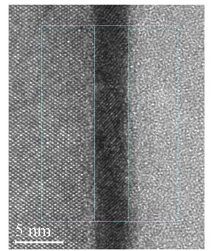
ALD: Abrupt Semiconductor Dielectric Boundaries
Semiconductor Industry – a clue
  Silicon is reactive but oxide is simple and passivates well (but has a low dielectric constant)
  Gate dielectric oxides are now being used on Si
  metal (and being produced by ALD
  20 m² / batch)
Si
Epoxy
HfO₂

Slide 10
Components of ALD System
Precursors
Valves
Carrier Gas
A
B
Heated Substrates
N₂
Flow
Reaction Chamber
Flow
Heaters
Pump
Equipment is simple
Scale up is straightforward

Slide 11
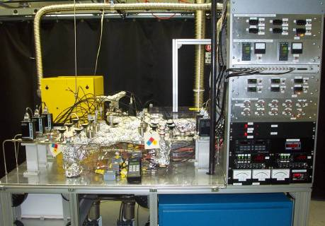
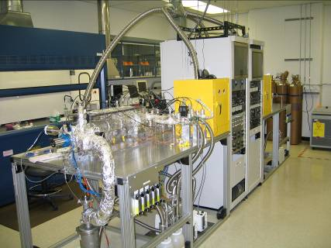
ALD Viscous Flow Reactors at ANL
10 chemical precursor channels
  gas, liquid, or solid
  precursor temperature to 300°C
  ozone generator
Reaction temperature to 500°C (1000°C)
In-situ measurements
  thickness (quartz microbalance)
  gas analysis (mass spectrometer)
Coat flat substrates (Si), porous membranes, powders, etc.

Slide 12
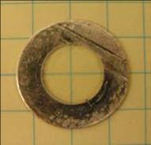
Anodic Aluminum Oxide Membrane Properties
High Surface area substrates for increased absorption
Typical membrane properties
Membrane thickness = 75 μm
Conductance ~ 0.2 sccm/torr (N₂ @ 1 atm)
Surface area of a single membrane ~ 0.05 m²
Histogram of particle diameters
obtained by image particle analysis
Pore Density 154 pores/mm²
FWHM 3.8 nm
Mean dia. 56 nm

Slide 13
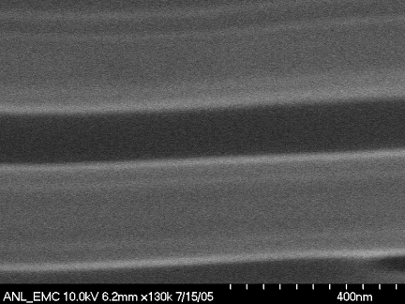
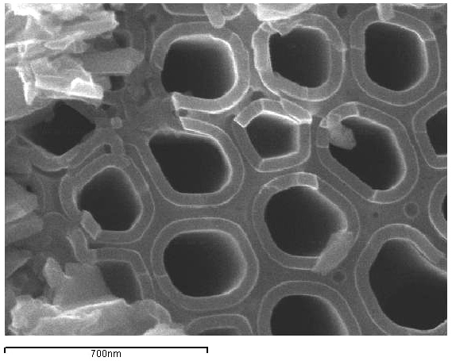
Combining AAO and ALD
Conformal deposition of a wide variety of metals and metal oxides
Extraordinary control over layer thickness
pore
TiO₂
Al₂O₃ pore wall
TiO₂

Slide 14
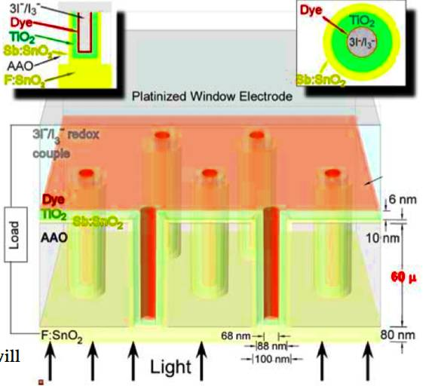
AAO/ALD Electrode Design Incorporating Transparent Conducting Oxide (TCO)
Key feature:
w/o TCO ➔ 60 μm
e⁻ path thru semi-
conductor: longitudinal transport
with TCO ➔ 6 nm
e⁻ path thru semi-
conductor: radial transport

Slide 15
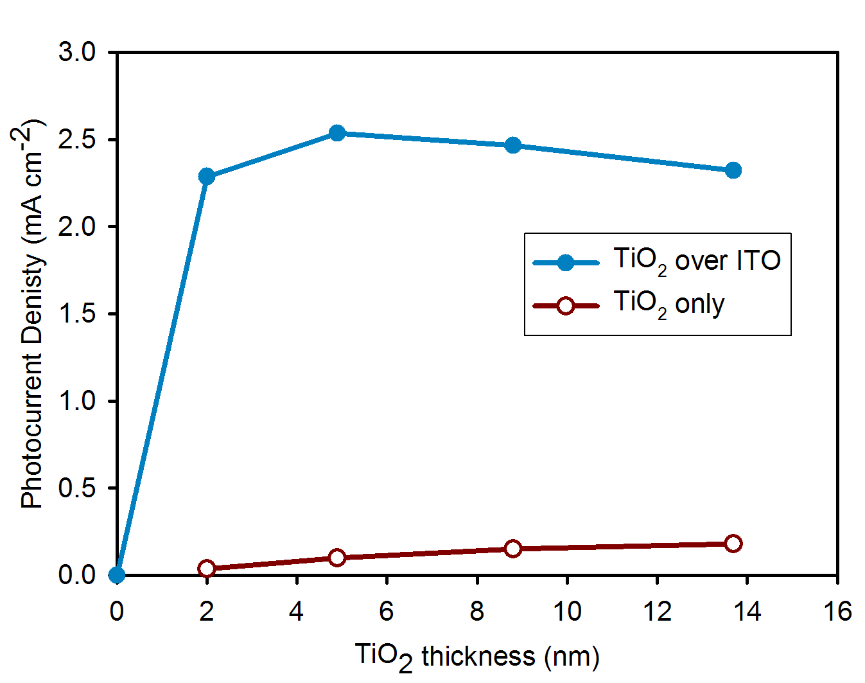
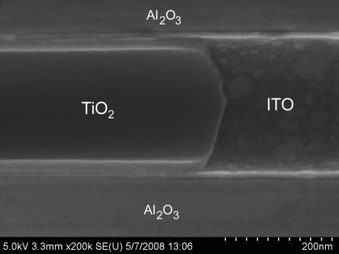
Enhanced Performance From Radial Charge Collection
Higher photocurrents (x20) with interdigitated TCO
Radial charge collection:
  Accelerates electron transport
  Reduces electron-hole recombination

Slide 16
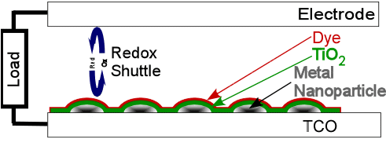
Plasmonic Photocathode Demonstration
Fig. 18. A schematic representation of field enhanced metal nanoparticle solar cell geometry is shown. In this design, serve only as plasmonic amplifiers. In future designs, interconnected particle arrays will also serve as current collectors, enabling the TCO to be omitted.
Figure 1. Plasmonic energy transfer scheme. Ag plasmonic absorbers are excited by the absorption of a photon. Excitation is short lived in a plasmon normally with internal conversion losing the excitation to heat in a few 10’s of fs.** In a solar cell, a second route to de-excitation of the plasmon is energy transfer to a nearby dye (k₁). Rapidly this excitation results in electron transfer to the wide band gap semiconductor, k₂, ( ~ 3 fs)* or intersystem crossing to a triplet dye state and then e transfer.

Slide 17
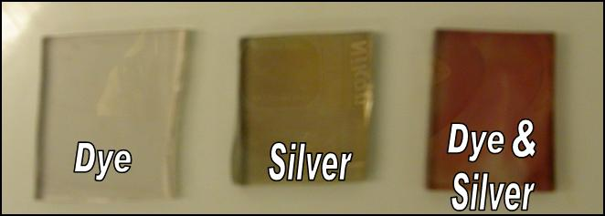
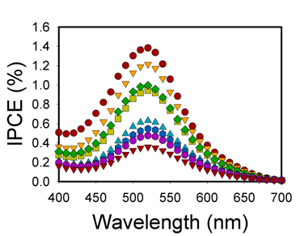
Plasmonic Absorption Enhancement
Fig. 16. a) N719 dye on low-area (flat) TiO₂ electrode, b) silver nanoparticle-coated, low-area (flat) TiO₂ electrode, c) N719 dye on TiO₂ (ALD)-coated silver nanoparticle layer on electrode. Quantitative measurements indicated ca. 5 to 7 fold enhancement in dye absorption in the presence of silver particles.
Fig.17. Plasmonic enhancement of photocurrent generation for a nominally flat photoelectrode featuring ALD coated (TiO₂) silver nanoparticles as amplifiers. Currents are lowest with thick ALD coatings (little plasmon amplification) and highest with thin ALD coatings (substantial plasmon amplification).

Slide 18
Combination Contact and Enahncer
Fig. 20. Interconnected metal particle arrays for combined light enhancement and electron collection. Schematic A) top view; b) side view, c) SEM image of a test Ag structure.

Slide 19
Internal Stripes
Internal Stripe Deposition Concept
Objective : deposit specified surface species at arbitrary depths in the membrane. Several schemes are possible to achieve this:
In A, additional pore narrowing must be tolerated which is undesirable because the diffusion depth is a strong function of pore diameter.
Scheme B not effective for many subsequent ALD cycles; difficult to achieve complete passivation and inertness to oxidizer.
Scheme C:
This scheme is implemented in three steps:
d₁
alkane
terminated
1
Me
Me
Me
Me
Me
Me
Al
Al
Al
Al
Al
Al
H
H
H
H
H
H
H
H
H
O
O
O
O
O
O
O
O
O
O
O
O
O
O
O
O
Al₂O₃
Masking Stripe
trimethyl aluminum exposure
Pore wall
ZnO
d₁
d₂
2
Me
Me
Me
Me
Me
Me
Et
Et
Et
Et
Et
Et
Al
Al
Al
Al
Al
Al
Zn
Zn
Zn
Zn
Zn
Zn
H
H
H
O
O
O
O
O
O
O
O
O
O
O
O
O
O
O
O
Scheme A
Overcoating
Scheme B
Permanent
Passivation
(silane treatment)
Scheme C
Concurrent
2-stripe
growth
Internal Stripe
diethyl zinc exposure
3
H
H
H
H
H
H
H
H
H
H
H
H
O
O
O
O
O
O
O
O
O
O
O
O
Al
Al
Al
Al
Al
Al
Zn
Zn
Zn
Zn
Zn
Zn
H
H
H
O
O
O
O
O
O
O
O
O
O
O
O
O
O
O
O
Oxidation
water exposure
d (depth into pore from membrane surface)

Slide 20
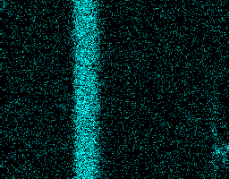
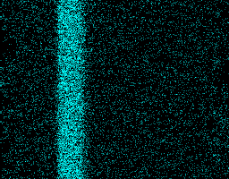
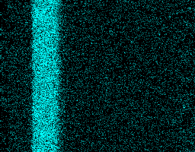
Internal ZnO Stripes Positioning
Depth Positioning
The TMA mask stripe depth was varied keeping all other growth parameters constant
Timing: 20c(x-5-4-10-5-15) (TMA-purge-DEZ-purge-H₂O-purge)
The delay caused by the increasing depth of the passivating stripe causes a narrowing of the Zn stripe width.
1.5 sec
Zn Lα
1.0 sec
0.5 sec

Slide 21
Benefits of Argonne Nanostructured PV Technology
Lower manufacturing cost than other PV technologies
Non-vacuum, low temperature fabrication
Very tolerant to impurities (no clean room necessary) – light absorption and charge separation occur close to interface
Inexpensive, abundant, benign materials (e.g. TiO₂, ZnO)
Robust nanoscale process

