Slide 1
In Situ Measurement Tools
(for Monitoring and Understanding
Photocathode Growth)
Jeffrey W. Elam
Argonne National Laboratory
Second Workshop on Photocathodes: 300-500nm
June 29-30, 2012, Enrico Fermi Institute, University of Chicago
Notes:
4

Slide 2
Outline
Quantum yield (or photocurrent)
  Extremely relevant, but insight?...
Quartz crystal microbalance
Ellipsometry
X-ray methods
  Fluorescence
  Reflectivity
  Absorption

Slide 3
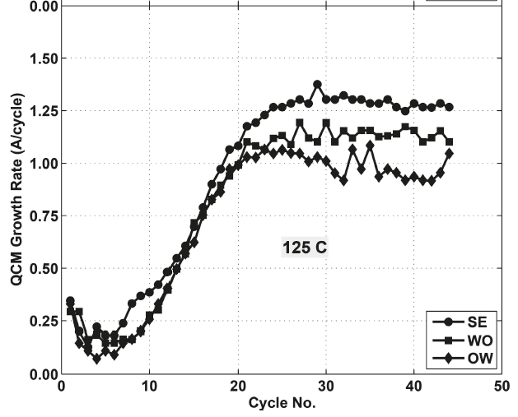
In Situ QCM during Atomic Layer Deposition of In₂O₃
~0.01 ML sensitivity
Real time, in situ
Directly measures mass (ng/cm²)
Assume density to get film thickness
Reveals nucleation and growth regimes
Sensitive to temperature

Slide 4
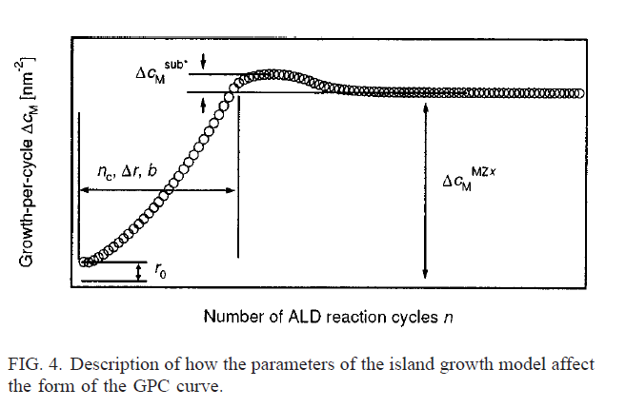
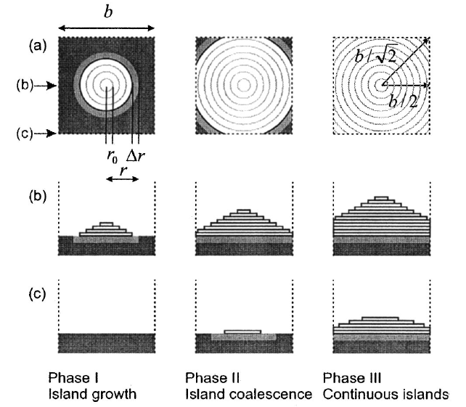
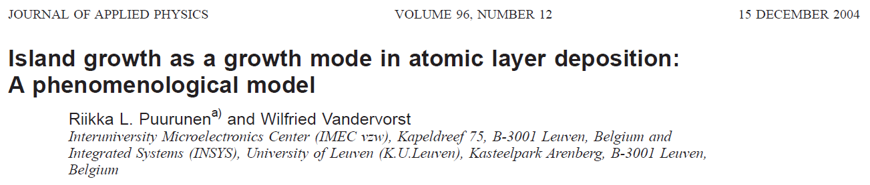
Island Growth (Volmer-Weber) Monitored by QCM
In situ QCM can reveal photocathode growth mode

Slide 5
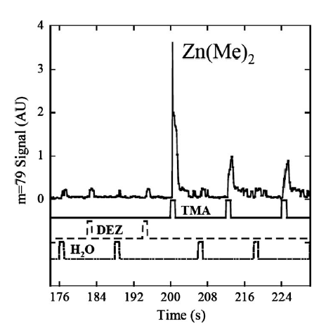
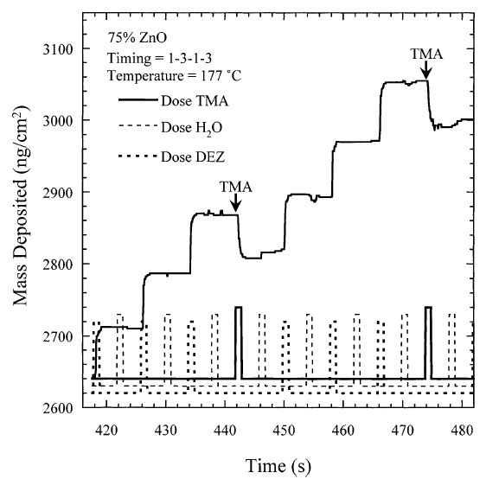
In Situ Measurements During ZnO-Al₂O₃ Alloy ALD
QCM Can Reveal Surface Chemical Processes
QCM
QMS
QCM shows removal of material during TMA exposures
QMS shows Zn(Me)₂ during TMA exposures
Etching: ZnO + Al(Me)₃ (g) → AlOMe + Zn(Me)₂ (g)

Slide 6
Temperature Sensitivity of QCM Crystals
(Assumed density = 3 g/cc)
QCM can be extremely sensitive to temperature
Temperature-compensated crystals help

Slide 7
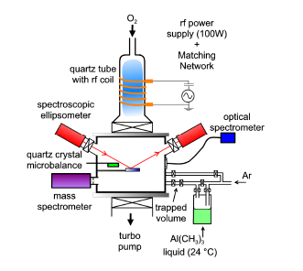
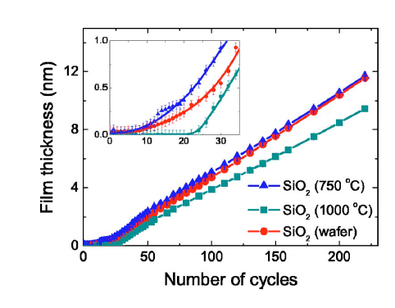
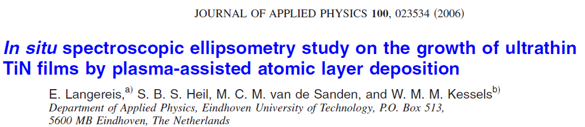
In Situ Spectroscopic Ellipsometry (SE)
TiN ALD
Sub-ML sensitivity
Insensitive to temperature
Can extract thickness, density, roughness, conductivity…
Model dependent
Useless for opaque films

Slide 8
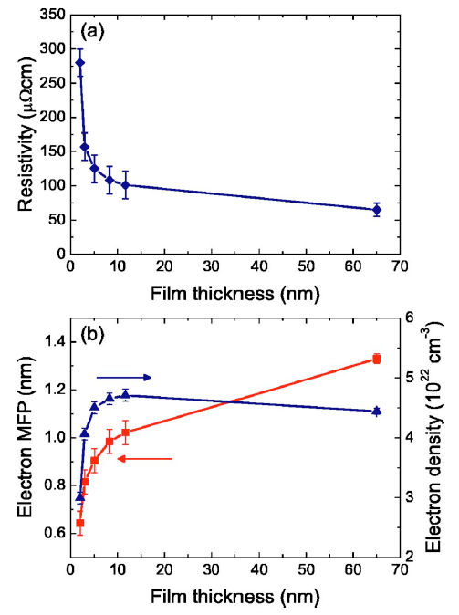
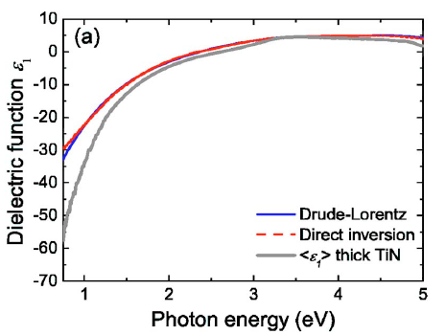

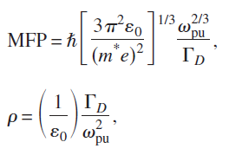
Modeling of Ellipsometric Data to Obtain Electrical Properties of Film

Slide 9
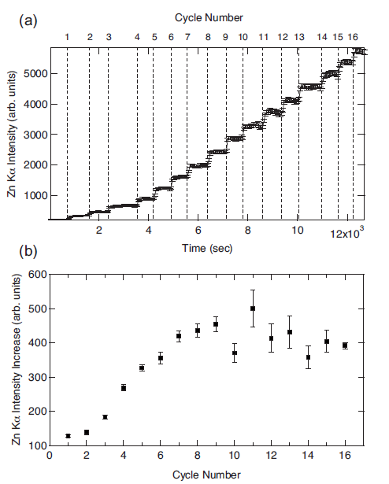
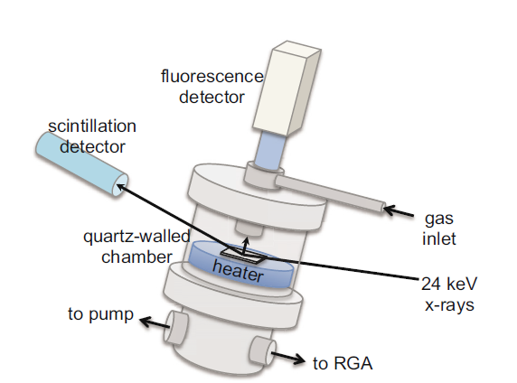
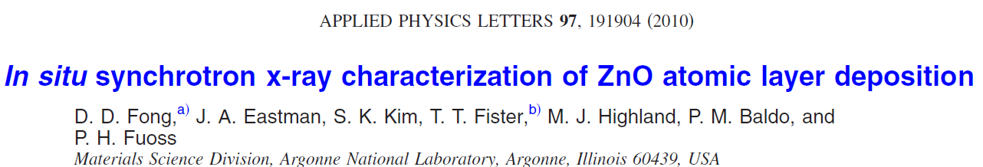
X-ray Fluorescence
ZnO ALD

Slide 10
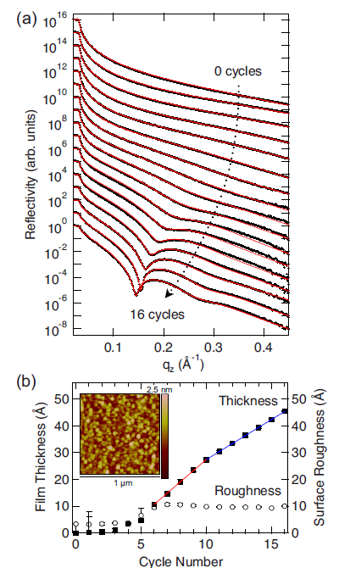
X-Ray Reflectivity
ZnO ALD
Sub-ML sensitivity
Insensitive to temperature
Transparent or opaque filsm
Can extract thickness, density, roughness …
Model dependent

Slide 11
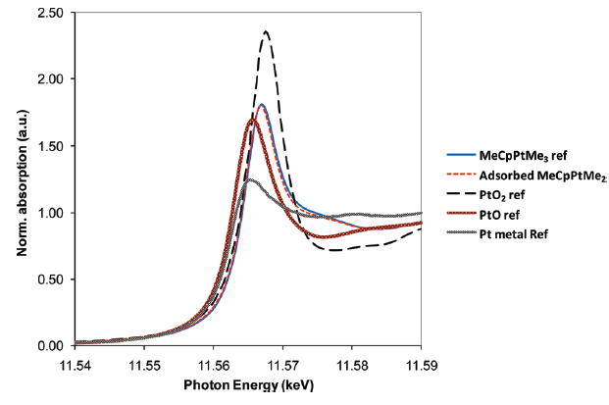
In Situ X-Ray Absorption Spectroscopy During Pt ALD
W. Setthapun et. al., J. Phys. Chem. C, 114 (21), pp 9758–9771,(2010).
Pt Bonding
Pt Loading
XANES
Pt L3 edge
EXAFS
(Fourier Transform, Model)
Nearest Neighbors, Pt Particle Size

Slide 12
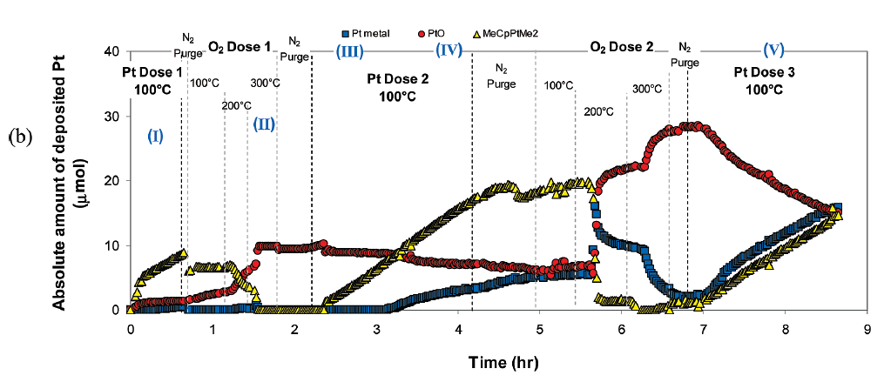
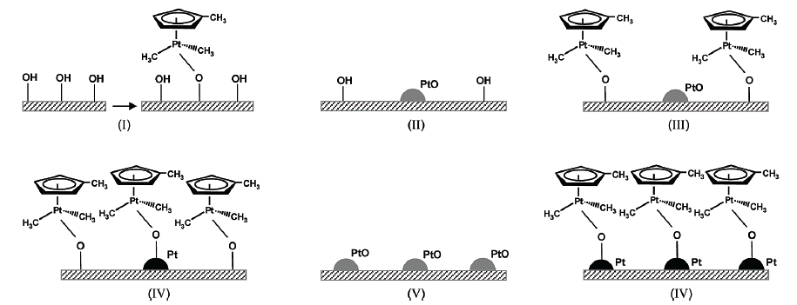
X-Ray Absorption
Pt ALD
3K + Sb → 3K⁺ + Sb³⁻

