Slide 1

Determining Parameters in the Spicer-Model and Predicted Maximum QE
John Smedley

Slide 2
Reference Material
Much of this talk comes from a course on Cathode Physics Matt Poelker and I taught at the US Particle Accelerator School
http://uspas.fnal.gov/materials/12UTA/UTA_Cathode.shtml
Modern Theory and Applications of Photocathodes
W.E. Spicer & A. Herrera-Gómez
SAC-PUB-6306 (1993)
Great Surface Science Resource:
http://www.philiphofmann.net/surflec3/index.html

Slide 3
Electronic structure of Materials
In an atom, electrons are bound in states of defined energy
In a molecule, these states are split into rotation and vibration levels, allowing the valence electrons to have a range of discrete values
In a solid, these levels merge, forming bands of allowed energies, with gaps between them. In general these bands confine both the energy and linear momentum of the electrons. These bands have an Electron Density of States (EDoS) that governs the probability of electron transitions.
For now, we will be concerned with the energy DoS, and not worry about momentum. For single crystal cathodes (GaAs, Diamond), the momentum states are also important.
Calculated using a number of methods: Tight binding, Density functional theory. Measured using photoemission spectroscopy.

Slide 4
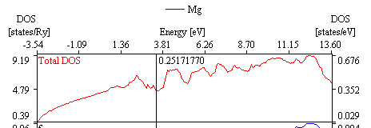
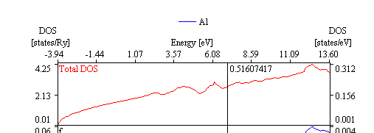
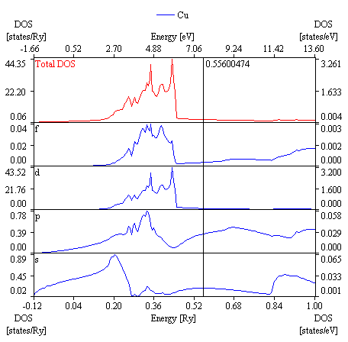
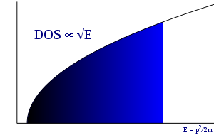
DOS Examples
For a free electron gas in 3 dimensions, with the “particle in a box” problem gives:
For periodic boundary conditions:
The number of states in a sphere in k-space goes as V ∝ k³
The Density of States (states/eV) is then ∝ V/E ∝ E^{1/2}
This is good for simple metals, but fails for transition metals
✓
✓
E= ℏ²k² /2m = (ℏ² /2m) (k_{x}²+k_{y}²+k_{z}²)
k_{x}= (2π/L) n_{x}; n_{x}=0,± 1,± 2,± 3,…
X
http://mits.nims.go.jp/matnavi/

Slide 5
Occupancy: the Fermi-Dirac Distribution
As fermions, electrons obey the Pauli exclusion principle. Thus the energy distribution of occupied states (DOS) is given by the Fermi-Dirac (F-D) function,
The temperature dependence of this distribution is typically not important for field emission and photoemission, but is critical for thermionic emission
For T=0, this leads to full occupancy of all states below E_{F} and zero occupancy for all states above E_{F}

Slide 6
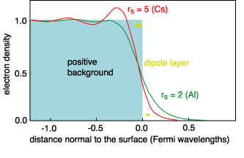
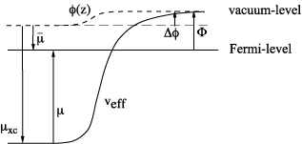
Surface Barrier
The work function is the energy required to extract an electron from the surface
This has two parts, the electrostatic potential binding the electrons in the bulk, and the surface dipole which occurs due to “spill-out” electrons
surface
Φ = φ(+∞)−µ = Δ φ − µ.
bulk
http://www.philiphofmann.net/surflec3/surflec015.html#toc36

Slide 7
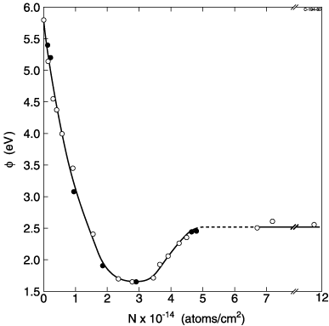
Surface Barrier
This surface dipole portion can be modified by adsorbates
We use alkali metals to reduce the workfunction of cathodes
  Cs on Ag
  Cs on W
  Cs-O on GaAs
Adsorbates can also raise φ
  This is the motivation behind laser cleaning of metal cathodes
Note that different faces of a crystal can have different surface dipoles, and therefore different workfunctions
Workfunction change upon the adsorption of K on W(110)
R. Blaszczyszyn et al, Surf. Sci. 51, 396 (1975).
Workfunctions of metals have values between about 1.5 eV and 5.5 eV.

Slide 8
Three Step Model of Photoemission in Metal
Excitation of e⁻ in metal
  Reflection (angle dependence)
  Energy distribution of excited e⁻
2) Transit to the Surface
e⁻-e⁻ scattering
Direction of travel
3) Escape surface
Overcome Workfunction
Reduction of Φ due to applied
  field (Schottky Effect)
Integrate product of probabilities over
all electron energies capable of
escape to obtain Quantum Efficiency
Vacuum level
Φ
hν
Φ’
Empty States
Φ
Energy
Filled States
Laser
Medium
Vacuum
Krolikowski and Spicer, Phys. Rev. 185 882 (1969)
M. Cardona and L. Ley: Photoemission in Solids 1, (Springer-Verlag, 1978)

Slide 9
Step 1: Absorption of Photon
Optical absorption length and reflectivity of copper
The optical skin depth depends upon wavelength and is given by,
The reflectivity is given by the Fresnel relation
in terms of the real part of the index of refraction,
where k is the imaginary part of the complex index of refraction,
and λ is the free space photon wavelength.

Slide 10
Step 1 – Absorption and Excitation
Fraction of light absorbed:
I_{ab}/I = (1-R)
Probability of absorption and electron excitation:
N(E) is the Density of states. The above assumes T=0, so N(E) is the density of filled states capable of absorbing, and N(E+ω) is the density of empty states for the electron to be excited into.
Only energy conservation invoked, conservation of k vector is not an important selection rule (phonon scattering and polycrystalline)
We assume the matrix element connecting the initial and final state is constant (not energy dependent)

Slide 11
W.E. Pickett and P.B. Allen; Phy. Letters 48A, 91 (1974)
Density of States for Nb
Large number of empty conduction band states promotes unproductive absorption
Density of States for Lead
Pb 6p valance states
Lack of states below 1 eV limits unproductive absorption at higher photon energies
NRL Electronic Structures Database

Slide 12
Step 2 – Probability of reaching the surface w/o e⁻-e⁻ scattering
e⁻ mean free path can be calculated
  Extrapolation from measured values
  From excited electron lifetime (2 photon PE spectroscopy)
  Comparison to similar materials
Assumptions
  Energy loss dominated by e-e scattering
  Only unscattered electrons can escape
  Electrons must be incident on the surface at nearly normal incidence => Correction factor C(E,v,θ) = 1

Slide 13
Step 2 – Probability of reaching the surface w/o e⁻-e⁻ scattering
In the near-threshold regime, an e⁻-e⁻ event is unlikely to leave either electron with energy sufficient to escape
  Treat scattering as a loss mechanism
  Can ignore other scattering mechanisms
Assume the probability, S, of an excited electron of energy E > E_{f} interacting with a valence electron of energy E₀ < E_{f} and imparting energy ΔE is proportional to:
  The number of electrons, N(E₀), with energy E₀.
  The number of empty states, N(E₀ + ΔE), with energy E₀ + ΔE.
  The number of empty states, N(E – ΔE) with energy E – ΔE.
Again, we assume the matrix elements connecting these states are not energy dependent, so that the probability depends only on the DoS
S(E,E₀,ΔE) ∝ N(E₀) N(E₀ + ΔE) N(E – ΔE)

Slide 14
Step 2 – Probability of reaching the surface w/o e⁻-e⁻ scattering
To obtain the total probability of scattering for an electron of energy E by an electron of energy E₀, we must integrate over all possible energy transfers, ΔE:
S(E,E₀) ∝
The total scattering probability of an excited electron is obtained by integrating over all possible “valence” electron energies, yielding
S(E) ∝
The lower limit of integration represents the kinematic limitation that E + E₀ ≥ 2E_{f}.

Slide 15
Step 2 – Probability of reaching the surface w/o e⁻-e⁻ scattering
The lifetime of the excited state, τ(E), is inversely proportional to this scattering probability: τ(E) ∝ 1/S(E)
The scattering length, λ_{e}(E), is related to the lifetime by the velocity. We assume a free electron-like velocity, using E_{f} as the zero of energy for metals and the bottom of the conduction band for semiconductors:
λ_{e}(E) = ν(E) τ(E) =
λ₀ is a constant that is chosen so that the e-e scattering length (the length over which the intensity of unscattered electrons is 1/e of the initial intensity) matches a known value of the electron’s mean free path at a single energy for a given material.

Slide 16
Step 2: Transport to the Surface
F_{e-e}: Probability electron at depth s, absorbs a photon and escapes without scattering.
Assume the electron-electron scattering length
can be averaged over energy:
Krolikowski & Spicer, 1970
This assumes N(E) = constant (more on this later)
Dave uses F_{e-e} instead of T(E,ω)
E_{m}= Energy at which λ₀ is known

Slide 17
Step 2 – Probability of reaching the surface w/o e⁻-e⁻ scattering
The probability that an electron created at a depth d will escape is e^{-d/λe}, and the probability per unit length that a photon is absorbed at depth d is (1/λ_{ph}) e^{-d/λph}. Integrating the product of these probabilities over all possible values of d, we obtain the fraction of electrons that reach the surface without scattering, F_{e-e}(E,ω),

Slide 20
Step 3: Escape Over the Barrier
θ
Escape criterion:
While photoemission is regarded quantum mechanical effect due to quantization of photons, emission itself is classical. I.e., electrons do not tunnel through barrier, but classically escape over it.
This is analogous to Snell’s law in optics

Slide 21
Step 3 - Escape Probability
Criteria for escape:
Requires electron trajectory to fall within a cone defined by angle:
Fraction of electrons of energy E falling with the cone is given by:
For small values of E-E_{T}, this is the dominant factor in determining the emission. For these cases:
This gives:
θ

Slide 22
EDC and QE
At this point, we have N(E,ω) - the Energy Distribution Curve of the emitted electrons:
EDC(E,ω)=(1-R(ω))P(E,ω)F_{e-e}(E,ω)D(E)
To obtain the QE, integrate over all electron energies capable of escape:
More Generally, including temperature:
D. H. Dowell et al., Phys. Rev. ST-AB 9, 063502 (2006)

Slide 23
Photo-Electric Emission
Elements of the Three-Step Photoemission Model
Step 1: Absorption of photon
Step 2:
Transport to surface
Step 3: Escape over barrier
Fermi-Dirac distribution at 300degK
Escape criterion:
Electrons lose energy
by scattering, assume
e-e scattering
dominates,
F_{e-e} is the probability
the electron makes it to the
surface without scattering
hω
hω
φ_{eff}
hω−φ_{eff}
θ
Bound electrons
Emitted electrons
E
E+hω
E_{F}+φ_{eff}-hω
E_{F}
E_{F}+φ_{eff}
E_{F}+hω

Slide 24
Derivation of QE
If we assume N(E)=constant, and a
approximate F-D with
step function since k_{B}T<<E_{F} :
The QE is then given by:
D. H. Dowell, K.K. King, R.E Kirby, J.F. Schmerge and J. Smedley, "In situ cleaning of metal cathodes using a hydrogen beam," PRST-AB 9, 063502 (2006)

Slide 25
QE for a metal
Step 3: Escape over the barrier
E is the electron energy
E_{F} is the Fermi Energy
φ_{eff} is the effective work function
Step 1: Optical Reflectivity
~40% for metals
~10% for semi-conductors
Optical Absorption Depth
~120 angstroms
Fraction ~ 0.6 to 0.9
Azimuthally isotropic
emission
Fraction =1
Fraction of electrons within max internal angle for escape, Fraction ~0.01
Step 2: Transport to Surface
e-e scattering (esp. for metals)
~30 angstroms for Cu
e-phonon scattering (semi-conductors)
Fraction ~ 0.2
Sum over the fraction of occupied states which are excited with enough energy to escape,
Fraction ~0.04
QE ~ 0.5*0.2*0.04*0.01*1 = 4x10⁻⁵

Slide 26
“Prompt”
Metals have very low quantum efficiency, but they are prompt emitters, with fs response times for near-threshold photons:
To escape, an electron must be excited with a momentum vector directed toward the surface, as it must have
The “escape” length verses electron-electron scattering is typically under 10 nm in the near threshold case. Assuming a typical hot electron velocity of 10⁶ m/s, the escape time is 10 fs.
(this is why the LCLS has a Cu photocathode)
  W.F. Krolikowski and W.E. Spicer, Phys. Rev. 185, 882 (1969)
  D. H. Dowell et al., Phys. Rev. ST Accel. Beams 9, 063502 (2006)
  T. Srinivasan-Rao et al., PAC97, 2790

Slide 27
Vacuum Arc deposited
Nb Substrate
Deuterium Lamp w/ monochromator
2 nm FWHM bandwidth
Phi measured to be 3.91 V

Slide 28
D. H. Dowell et al., Phys. Rev. ST-AB 9, 063502 (2006)

Slide 29
Three Step Model of Photoemission - Semiconductors
Excitation of e⁻
  Reflection, Transmission, Interference
  Energy distribution of excited e⁻
2) Transit to the Surface
  e⁻-phonon scattering
  e⁻-defect scattering
  e⁻-e⁻ scattering
  Random Walk
3) Escape surface
Overcome Workfunction
Multiple tries
Need to account for Random Walk in cathode suggests Monte Carlo modeling
Empty States
Vacuum level
hν
Φ
No States
Energy
Filled States
Laser
Medium
Vacuum

Slide 30
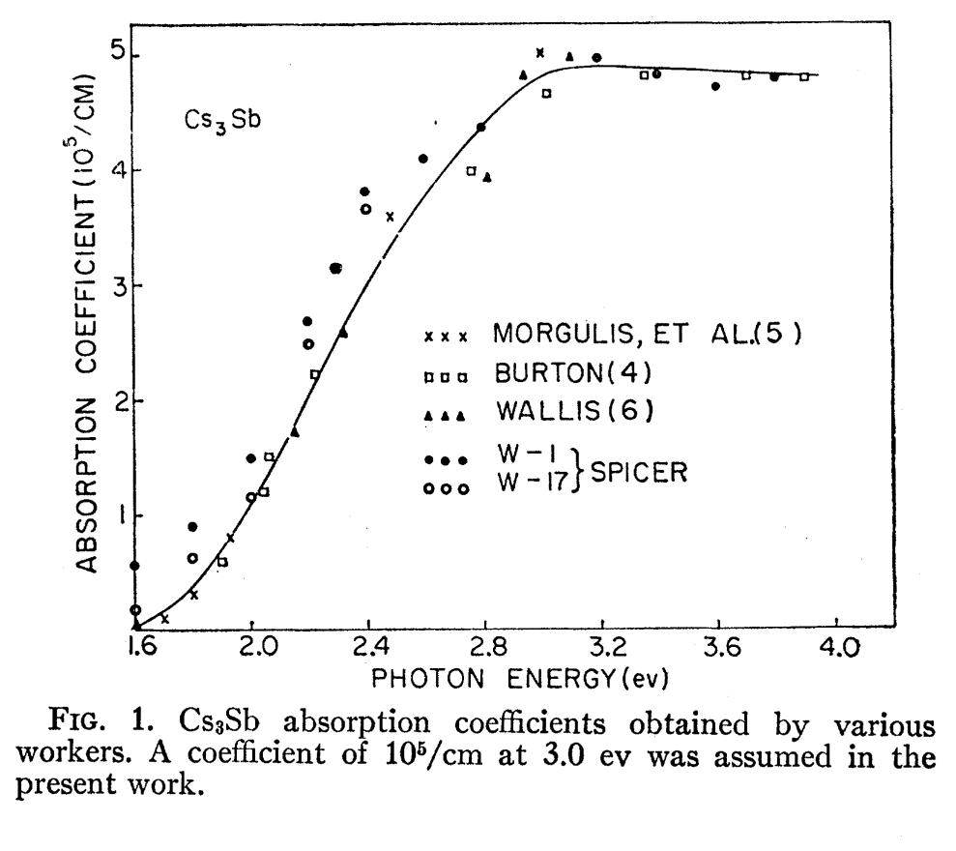
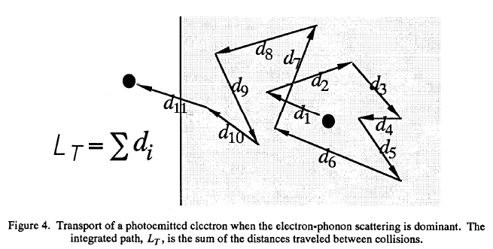
Cs₃Sb (Alkali Antimonides)
Work function 2.05 eV, E_{g}= 1.6 eV
Electron-phonon scattering length
~5 nm
Loss per collision ~0.1 eV
Photon absorption depth
~20-100 nm
Thus for 1 eV above threshold, total path length can be ~500 nm (pessimistic, as many electrons will escape before 100 collisions)
This yields a response time of
~0.6 ps
Alkali Antimonide cathodes have been used in RF guns to produce electron bunches of 10’s of ps without difficulty
D. H. Dowell et al., Appl. Phys. Lett., 63, 2035 (1993)
W.E. Spicer, Phys. Rev., 112, 114 (1958)

Slide 31
Assumptions for K₂CsSb Three Step Model
1D Monte Carlo (implemented in Mathematica)
e⁻-phonon mean free path (mfp) is constant
  Note that “e⁻-phonon” is standing in for all “low energy transfer” scattering events
Energy transfer in each scattering event is equal to the mean energy transfer
Every electron scatters after 1 mfp
Each scattering event randomizes e⁻ direction of travel
Every electron that reaches the surface with energy sufficient to escape escapes
Cathode and substrate surfaces are optically smooth
e⁻-e⁻ scattering is ignored (strictly valid only for E<2E_{gap})
Band bending at the surface can be ignored
k-conservation unimportant (uncertainty principle)

Slide 32
Parameters for K₂CsSb Three Step Model
e⁻-phonon mean free path
Energy transfer in each scattering event
Emission threshold (E_{gap}+E_{A})
Cathode Thickness
Substrate material
Parameter estimates from:
Spicer and Herrea-Gomez, Modern Theory and Applications of Photocathodes, SLAC-PUB 6306
Basic Studies of High Performance Multialkali Photocathodes; C.W. Bates
http://www.dtic.mil/dtic/tr/fulltext/u2/a066064.pdf

Slide 33
A.R.H.F. Ettema and R.A. de Groot, Phys. Rev. B 66, 115102 (2002)

Slide 34
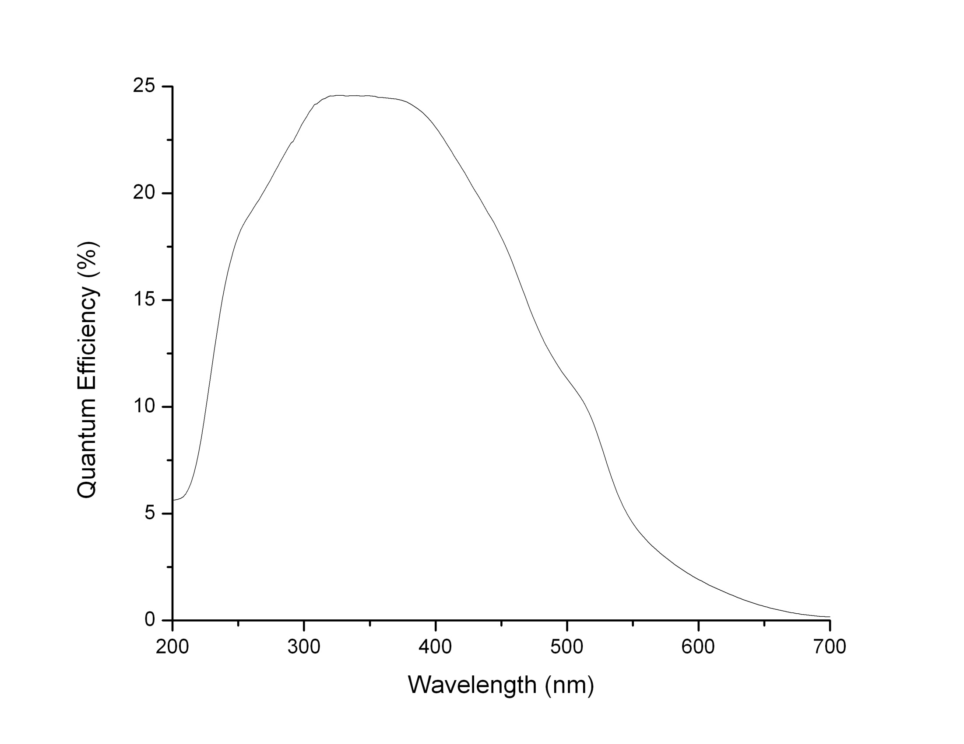
Spectral Response – Bi-alkali
In “magic window”
ω < 2E_{g}
Unproductive absorption
Onset of e-e
scattering
T. Vecchione, et al, Appl. Phys. Lett. 99, 034103 (2011)

Slide 35
Laser Propagation and Interference
Laser energy in media
Calculate the amplitude of the Poynting vector in each media
Not exponential decay
563 nm
Vacuum
K₂CsSb
200nm
Copper

Slide 36
Monte Carlo for K₂CsSb
Data from Ghosh & Varma, J. Appl. Phys. 48 4549 (1978)

Slide 39
Spatial Variation of QE for a Thin K₂CsSb Cathode

Slide 40
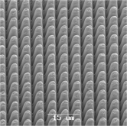
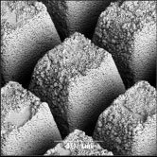
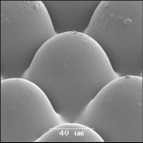
Parameters, and how to affect them
Reflectivity depends on angle of incidence and cathode thickness. Though already small, structuring of the photocathode can further reduce loss due to reflection.
R. Downey, P.D. Townsend, and L. Valberg, phys. stat. sol. (c) 2, 645 (2005)

Slide 41
Parameters, and how to affect them
Reflectivity depends on angle of incidence and cathode thickness. Though already small, structuring of the photocathode can further reduce loss due to reflection.
Increasing the electron MFP will improve the QE. Phonon scattering cannot be removed, but a more perfect crystal can reduce defect and impurity scattering:
A question to consider: Why can CsI (another ionic crystal, PEA cathode) achieve QE>80%?
Large band gap and small electron affinity play a role, but, so does crystal quality.
R. Downey, P.D. Townsend, and L. Valberg, phys. stat. sol. (c) 2, 645 (2005)
T.H. Di Stefano and W.E. Spicer, Phys. Rev. B 7, 1554 (1973)

Slide 42
Concluding Thoughts
As much as possible, it is best to link models to measured parameters, rather than fitting
  Ideally, measured from the same cathode
Whenever possible, QE should be measured and modeled as a function of wavelength. Energy Distribution Curves would be wonderful!
Spicer’s Three-Step model well describes photoemission from most metals tested so far, and provides a good framework forsemiconductors
The model provides the QE and EDCs, and a Monte Carlo implementation will provide temporal response
A program to characterize cathodes is needed, especially for semiconductors (time for Light Sources to help us)
Thank You!

