Slide 1
Ceramic/Kovar 8” Tube Design
Jason McPhate
Experimental Astrophysics Group
Space Sciences Laboratory
University of California, Berkeley

Slide 2
Design Criteria
Accommodate 8” square MCPs and 8.66” square window
Employ standard imaging tube materials and techniques
Alumina/Kovar brazed assembly
Thick-film ceramic hybrid anode
Baseline design with 2X 1.2mm thick MCPs and inter-MCP spacer
Allow flexibility in design to accommodate changes in this default stack. But not multiple stack heights with single brazed assembly
Large surface area and pressure environment require internal support
This implies a required close match between internal component stack height and brazed assembly stack height.
HV inputs should cause minimal perturbation to internal stack
Avoid undue stress of MCPs while keeping fabrication as inexpensive as.
Lots of volume means many getters → Heat activated.
Places for about 20 getter strips
Compatible with imaging tube and bialkali photocathode process steps.

Slide 3
Simplified Tube Fabrication Flow

Slide 4
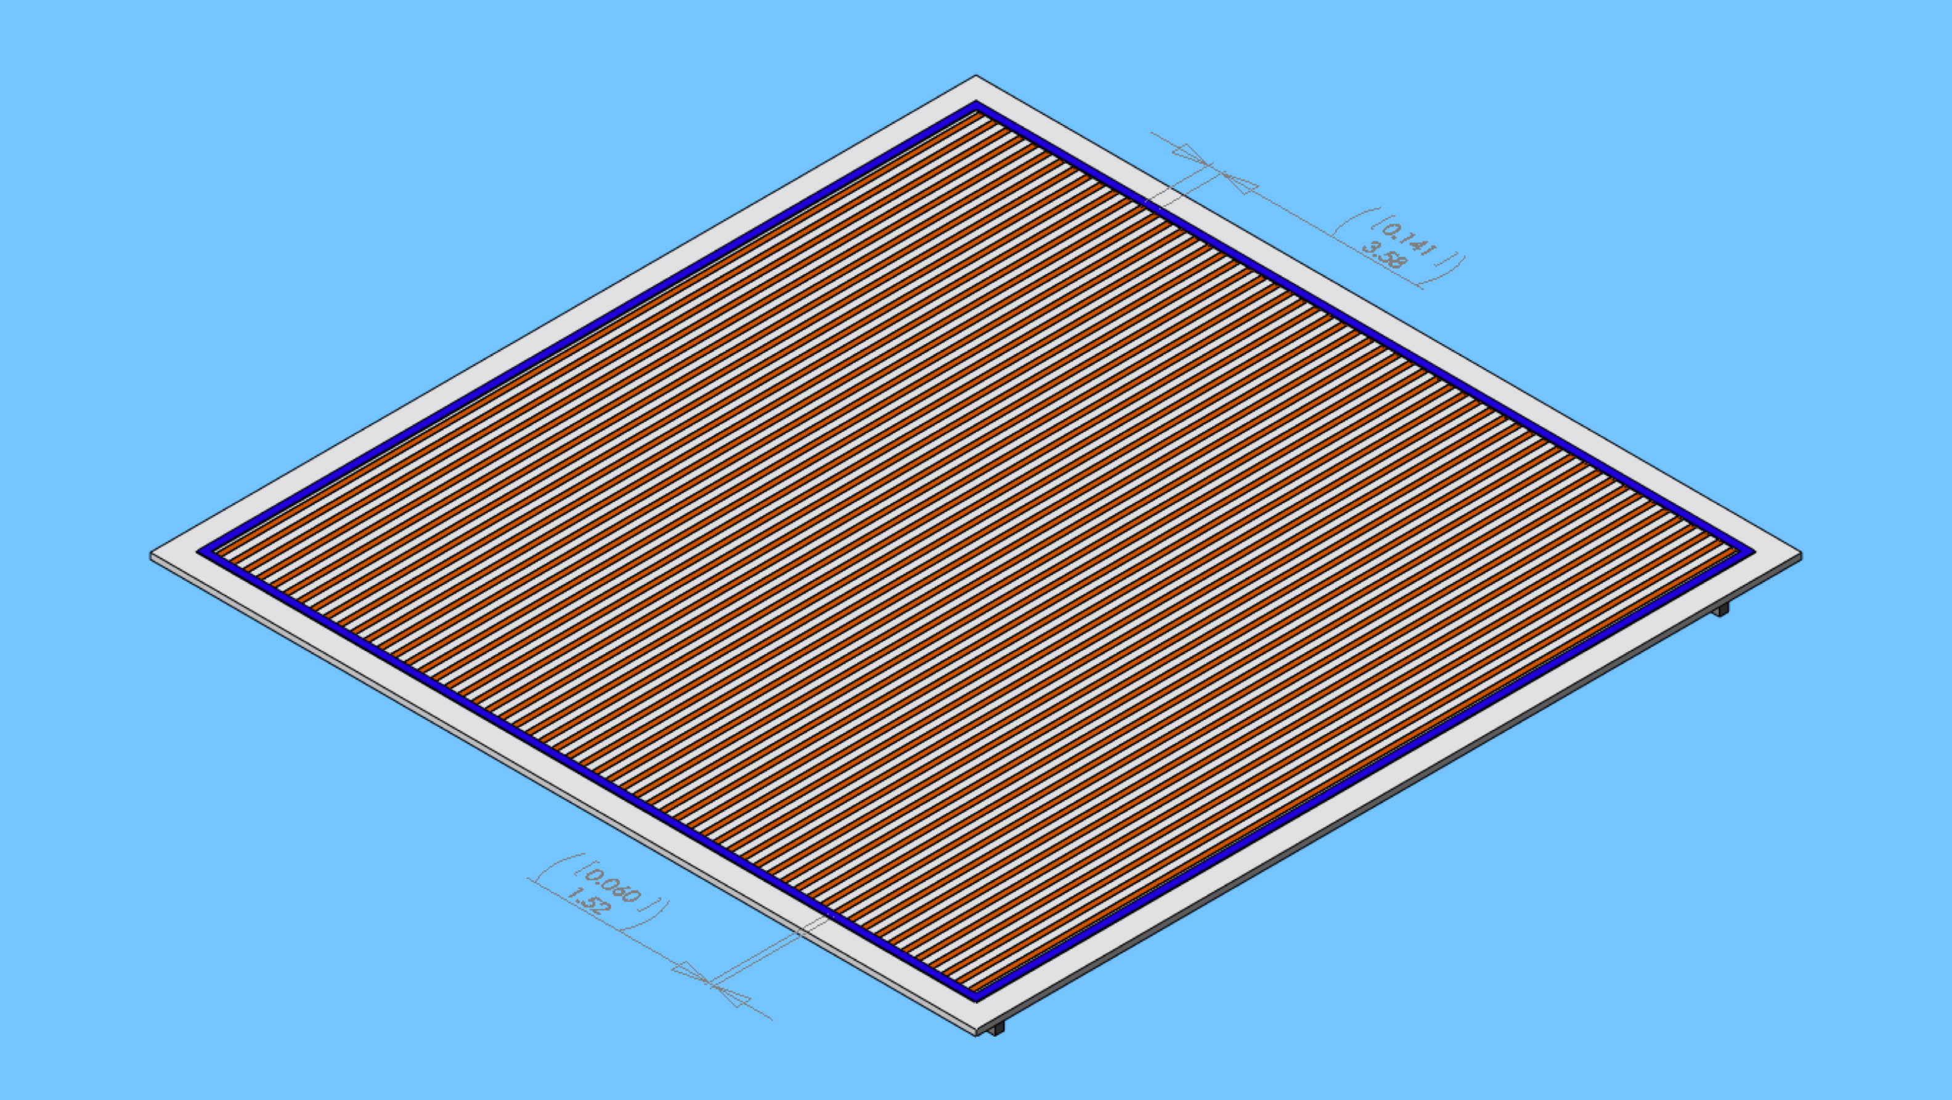
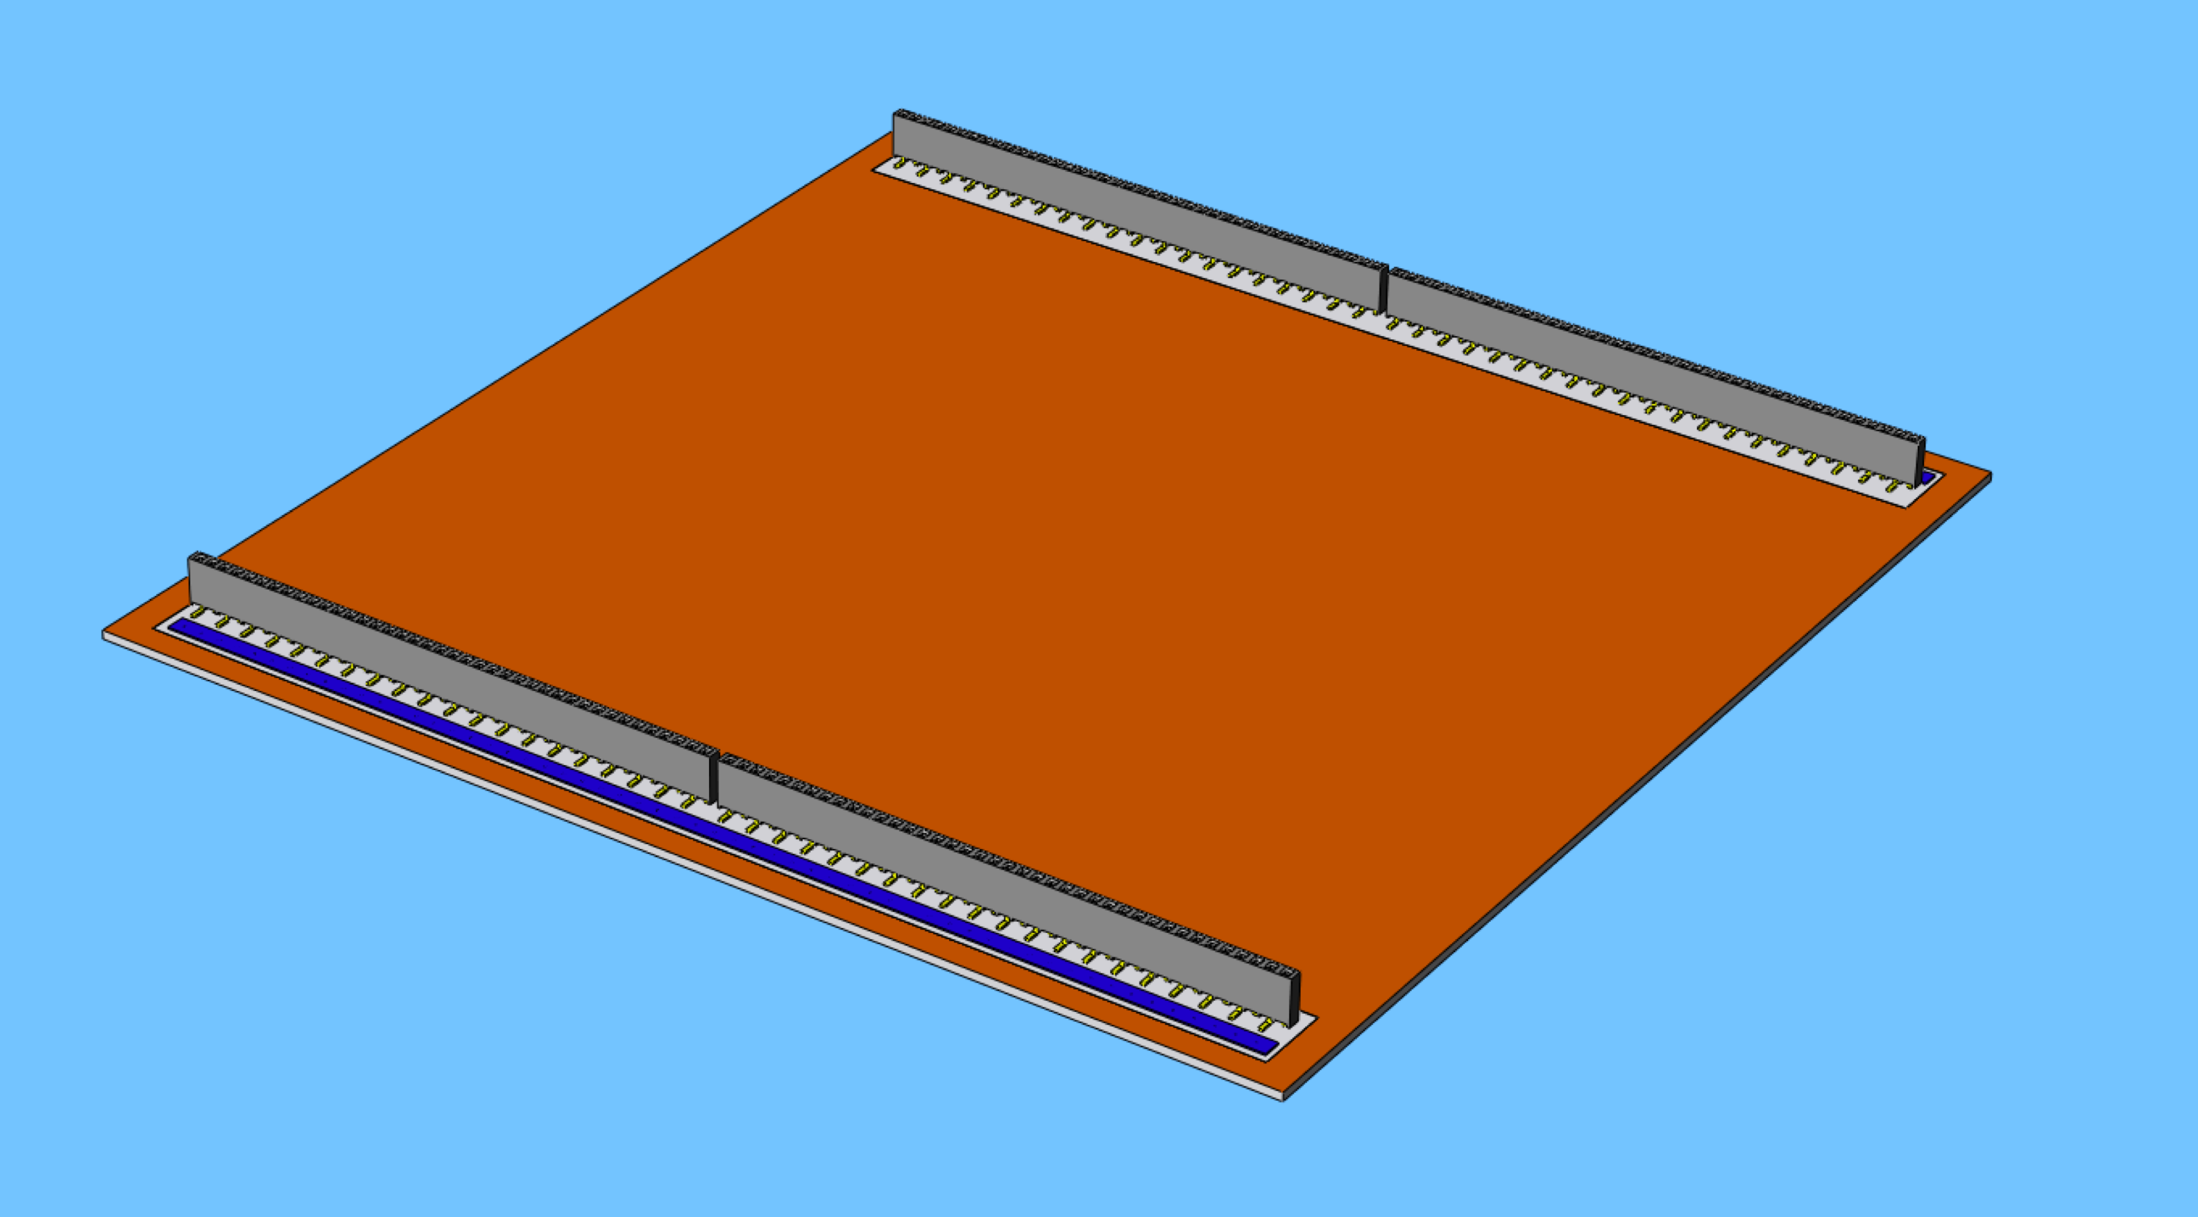
Ceramic/Thick-film Anode
.060” laser cut, alumina substrate with signal vias
Vias filled with conductive Au paste (hermetic)
Strips screened on inside (Au, .060” wide on .141”)
Ground plane outside (Au or Pd-Ag)
Insulating glass (blue) added over vias as a redundant seal and as braze run-out barrier around active area.
Air fired at ~850°C after each screening

Slide 5
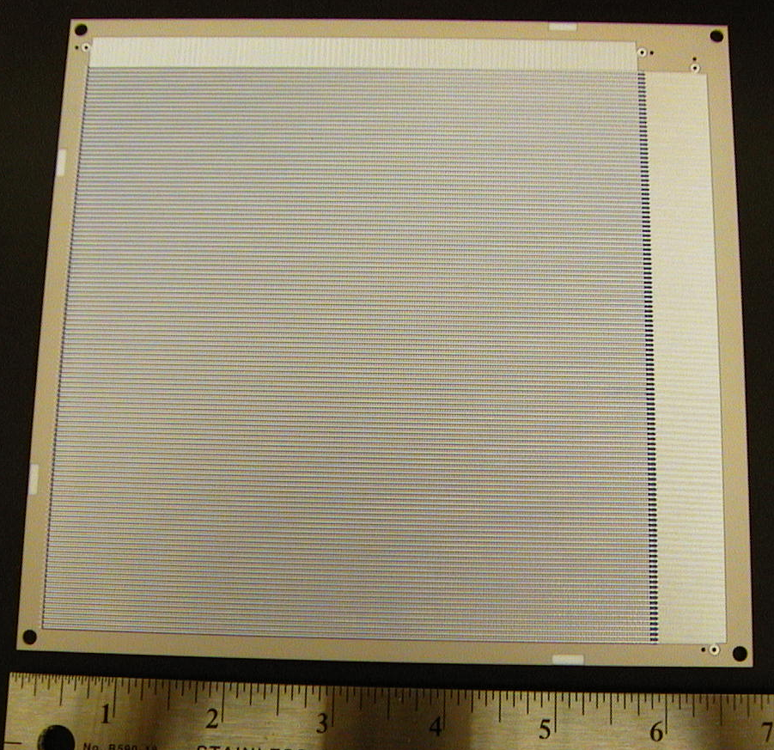
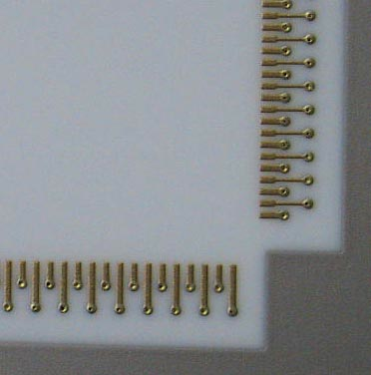
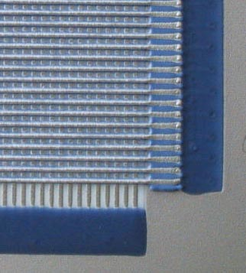
Thick-film Anode Examples
Exterior, connector pads and vias
14cm x 14cm stripline anode on alumina substrate
Interior, strip lines and blue glass
Back
Front
14 cm x 14 cm stripline anode on alumina substrate
Sealed hermetic vias allow signals
to be brought to the outside

Slide 6
Brazed Body Assembly (BBA)
Matches window size – 8.66” on a side
Could be a bit smaller or larger active area
Alternating slices of Alumina and Kovar
One Kovar slice for each HV contact needed inside (Cathode, MCP1 In, MCP1 Out, MCP2 In, MCP2 Out) with external tabs for contact
Kovar slices are thin (.010”) as they do not support the interior stack
Alumina slices have internal tabs to register/constrain MCP/spacer stack (.020” clearance)
Alumina thicknesses to place Kovar slices appropriately relative to the interior stack HV points
Window seal flange is a stamped Cu (or Cu plated Kovar) trough for indium sealing alloy
Stack brazed into an assembly (air or vacuum braze)

Slide 7
Anode–BBA Union
Pre-braze verification of Anode
Electrical testing
Leak checking
Pre-braze verification of BBA
Hi-Potting
Leak checking
Vacuum braze Anode to BBA
More leak checking
Fill window seal flange with indium alloy
Load getters
Final leak check
Ready for MCP/spacer load

Slide 8
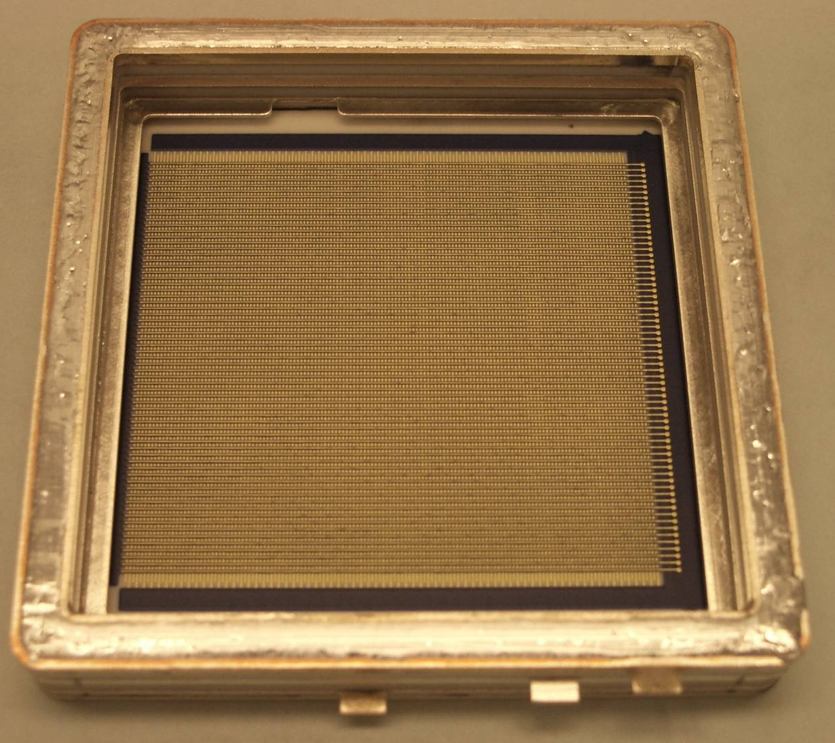
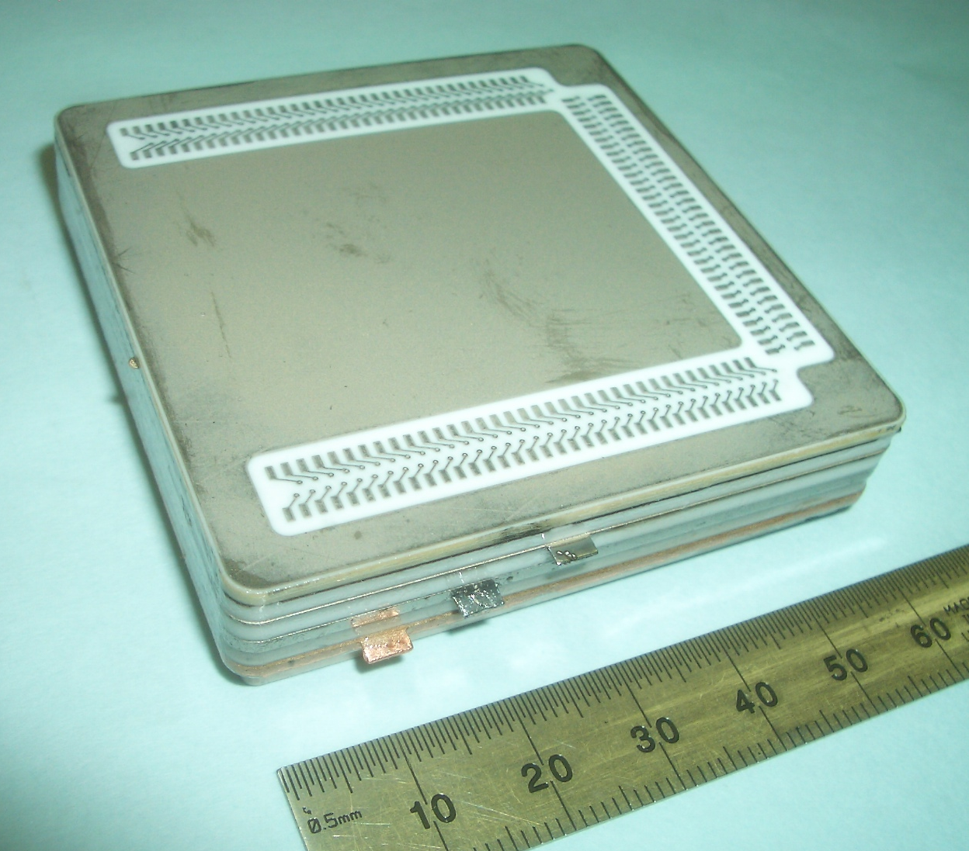
The Planacon A “Large” Square Imaging Tube Device
Planacon BBA–Anode brazed assembly ready for MCP load.
Back of Planacon showing connector pads.
The LAPD 8” Tube is only 16X the area of a Planacon!!

Slide 9
Tube Assembly Process
MCPs and spacers loaded in air
Internal HV connections made
Window and windowless tube loaded into UHV chamber
Test MCP performance and scrub MCPs
Shoot cathode
Transfer window to tube and seal
Test performance again
Break vacuum
Test in air (verify no leak)
It’s a tube! (It should be so easy.)

Slide 10
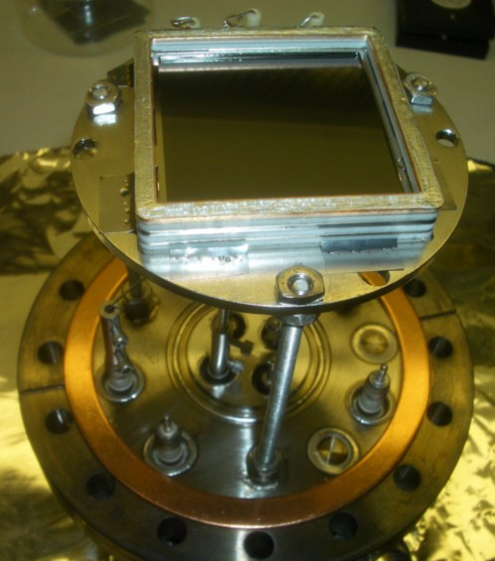
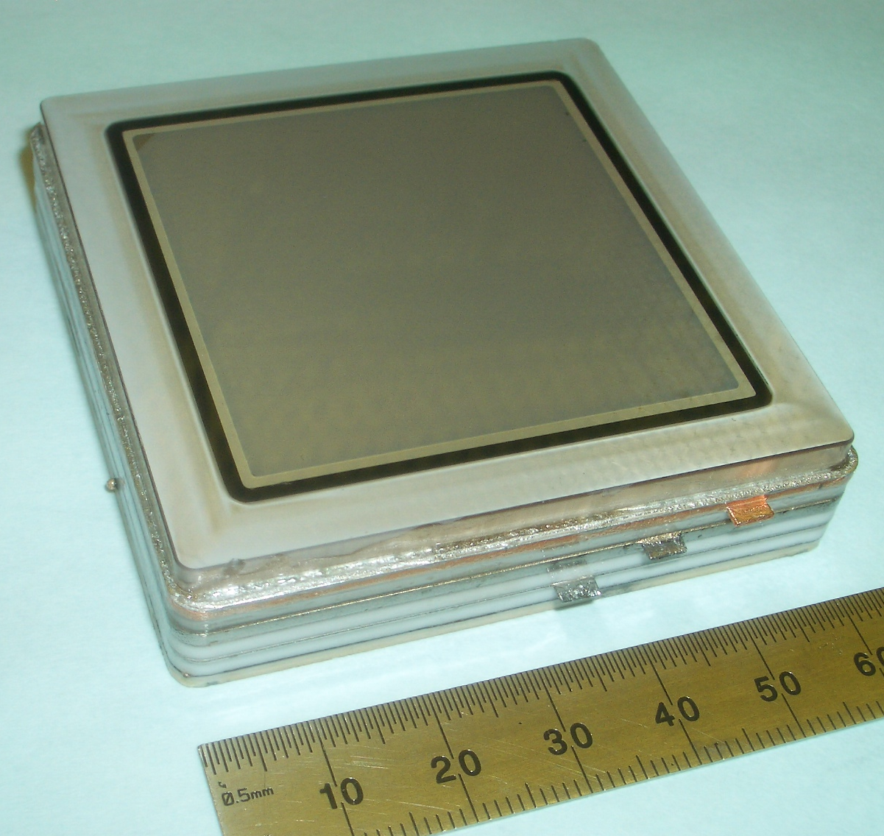
More Planacon Photos
Sealed Planacon device.
Planacon with MCPs on processing platform ready for installation in UHV process chamber.

Slide 11
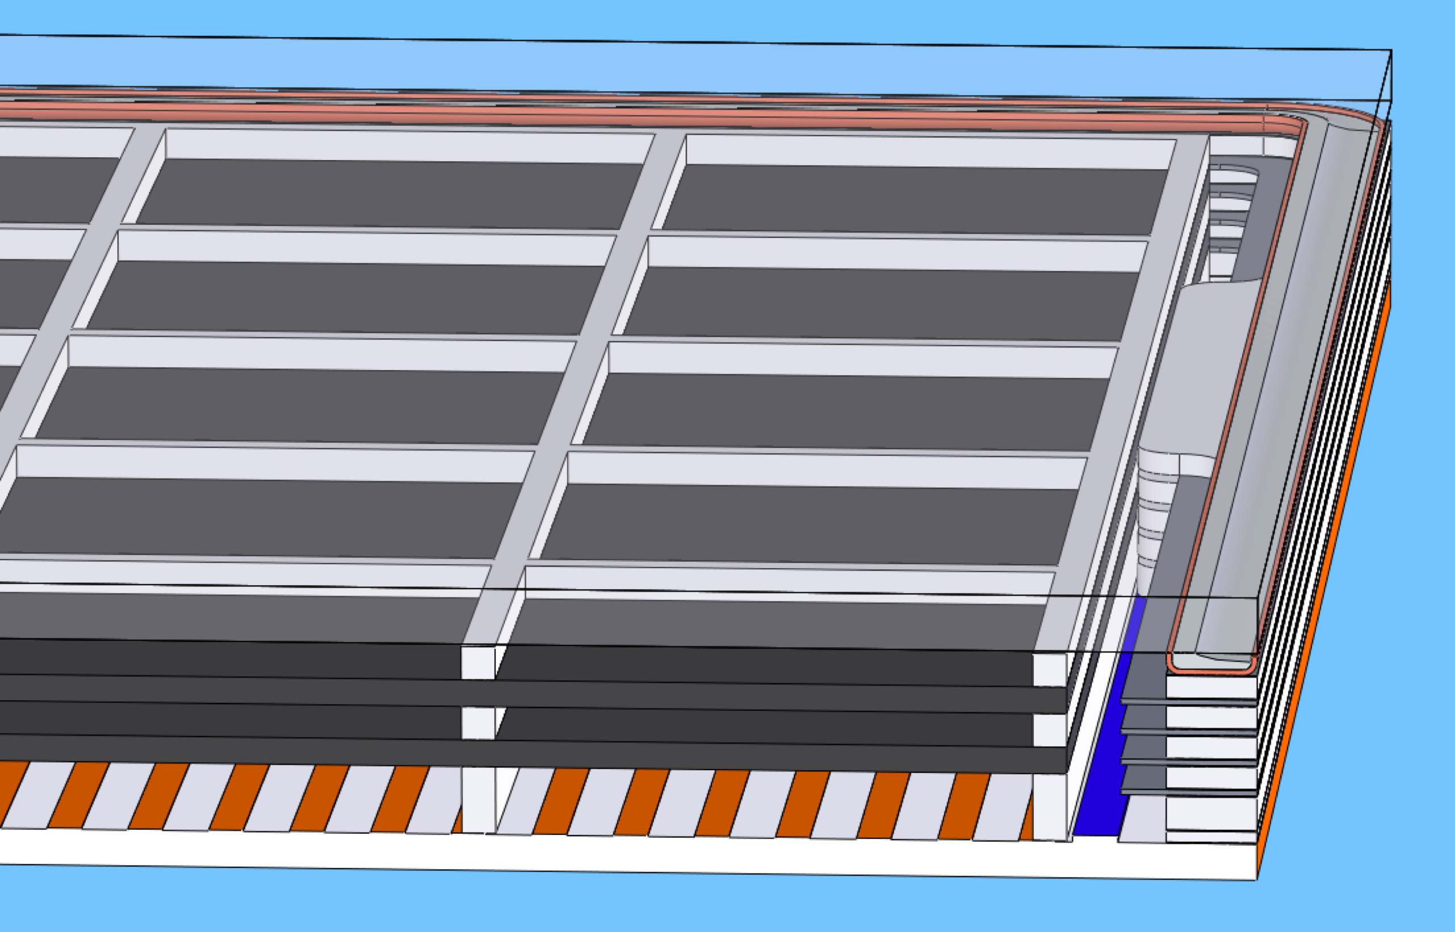
Final Assembly
Current Design Stack
2X 1.2mm MCPs
3mm rear field spacer
1.5mm inter-MCP spacer
1.5mm window spacer
Finished height .499” with window (.401” without)

Slide 12
Some Details not yet in the Design
Getters
Getter strips will be spot welded to the Kovar layers around the periphery.
Kovar layers will have alternating notches to allow better access
Tabbed Spacers
Tabs on edges of spacers (outside MCP area) aligned with notches in Kovar layers.
Metalize surfaces of spacers.
Allows electrical contact from Kovar to stack without placing shim into stack.

Slide 13
Some Concerns & Issues
Leaks
Require ≤ ~10⁻¹⁰ std. cc/sec (He leak testing)
BBA has lots of total joint length → More places to leak
Within industry capabilities with good process control
Desired part flatness may require lapping/grinding (added cost).
Anode–BBA braze has similar concerns, but also achievable
Stack height tolerances
Internal stack slightly shorter (~.002”) than external to ensure window seal (done at elevated temp)
Want to avoid post braze machining of seal flange

Slide 14
Future Work
Refinement of design
Better getter placement access – alternating cutouts in Kovar pieces.
More attention to internal venting/pumping
Is it possible to eliminate some braze joints?
Flatness of piece parts
What do we need? Typically require ≤.002” for smaller assemblies, likely over-kill here.
What is the natural state of the alumina in these sizes?
Quotes on components and processes

