Slide 1
Incom Inc. Capillary Array Technology Status of 32.8 mm Ф and (200mm)² MCP’s

Slide 2
Topics
Large Area Capillary Arrays – Fabrication & Attributes
Finishing Goals & Challenges
Finishing Process Technology
Wire Saw vs. ID Saw
Grind & Polish
Cleaning Challenge
Incom Orders & Delivery Schedules
Other Developments
Integral Mounting Pads™
Thermal Surface Finishing
Glass Framed Arrays
Photonic Band Gap Structures for Particle Acceleration
X-ray Optics
Notes:
MIMIC = micro molding in capillaries
Stamping = micro- contact printing (mCP), replica molding,

Slide 3
Capillary Fabrication
Hollow Core
No core to remove
Finish & cleaning challenges
Frugal
Primary strategy
Solid Core
Etch removal of core
Established process
Low cost – suitable for certain applications
Secondary option

Slide 4
Process Benefits & Challenges
Hollow Core ‘A’
Large Area (200mm²)
100-10µ capillary “d”
Unlimited block fabrication L/d
Finishing & Cleaning limited wafer L/d
>1,200µ thick wafers – current finishing limit (60:1)
<1,000:1 – Cleaning (20 mm thick)
Solid Core ‘B’
Large Area (200mm²)
100-6µ capillary “d”
Unlimited block fabrication L/d
Finishing & Etch limited wafer L/d
>800µ thick wafers – current finishing limit (40:1)
<100:1 – Etch limit (2 mm thick)
Incom Inc. - Confidential

Slide 5
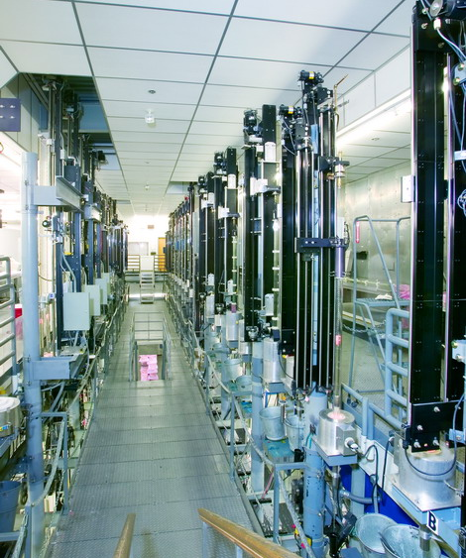
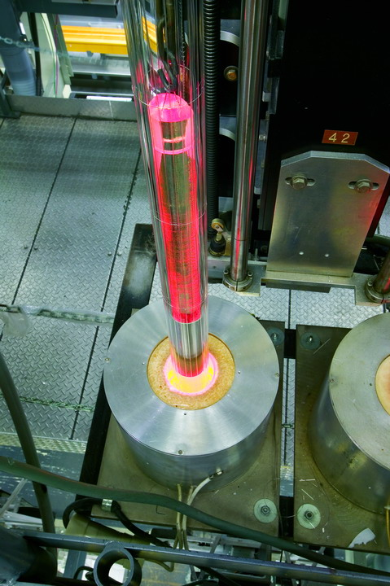
Incom Inc. - Confidential

Slide 6
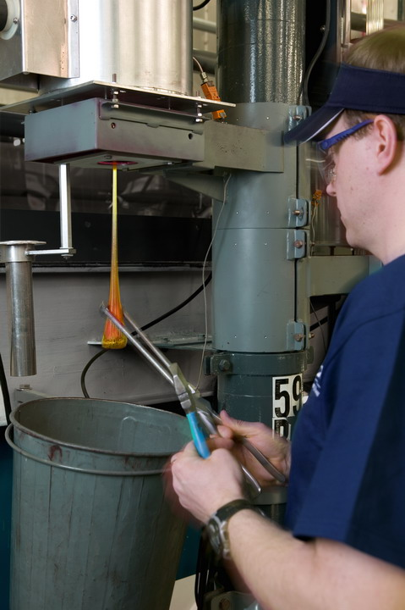
Incom Inc. - Confidential

Slide 7
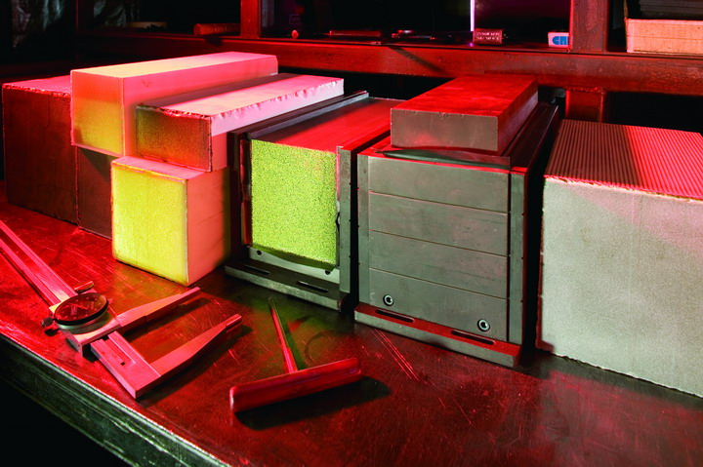
Incom Inc. - Confidential

Slide 8
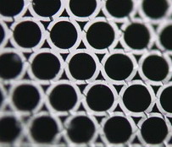
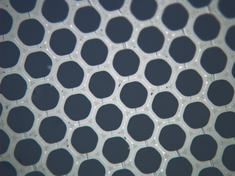
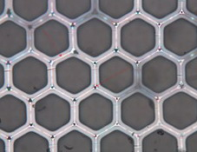
Capillary Process
Left - showing close packed capillary arrays with large interstitial gaps; Center –Middle: showing fused capillary array, filled interstitial gaps and round capillary, and Right: showing capillary with closed interstitial gaps forming hex shaped capillary.
Incom Inc. - Confidential

Slide 9
Hollow Core “Block”
ETD-2886 Block B10320
Fused 1/28/2010
9" x 9" x 16“
Incom’s largest to date
Cracked post fusion!
Block cut behind crack
Forward section used for 4”X4” development wafers
Aft section being held for 8”X8” wafers
Incom Inc. - Confidential

Slide 10
Block Slicing Challenge: Particulates
Source: From cutting
Glass, broken off and lodged at the entrance
Smaller bits that enter into capillaries?
Cutting slurry including other material carried by coolant (swarf)
Mechanisms for Adherence of Particles
Physically lodged
Covalent bonding
Electrostatic
Oppositely charged particle/surface
Van der Waals
Intermolecule attraction, between a dipole and an induced dipole
Comparatively weak
Capillary Forces
Surface tension of liquid bridge between particle and surface
Incom Inc. - Confidential

Slide 11
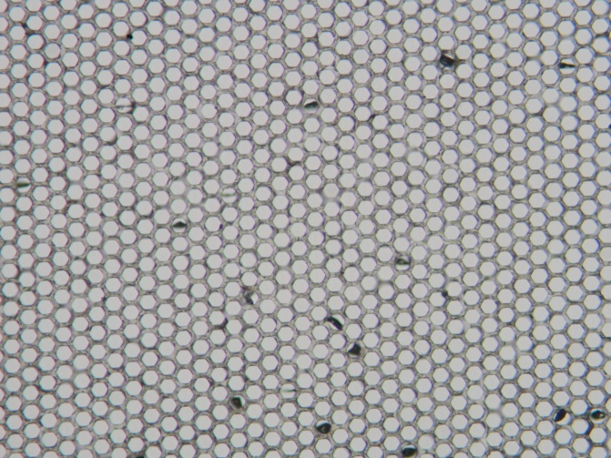
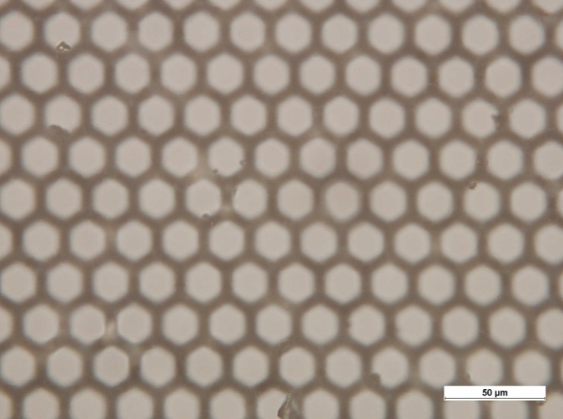
Cutting debris can be capillary material lodged inside the capillary or particulate that adheres to the walls
(Left) As-cut 20 µm capillary, with particle lodged inside capillaries. (Right) As-cut 20 µm capillary, with debris on the walls of the capillaries.
Incom Inc. - Confidential

Slide 12
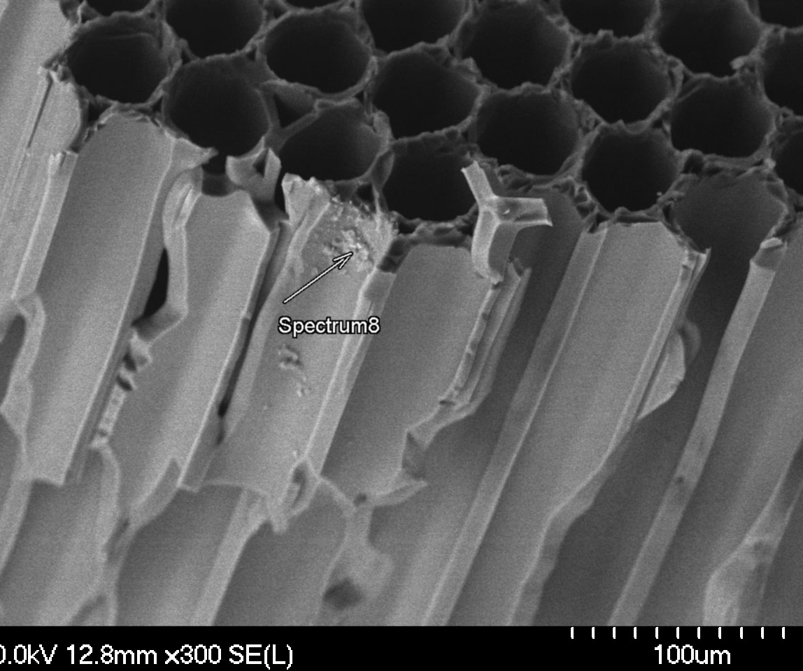
Cutting Debris – Tramps Carried by Swarf
(L) Wire-cut, (R) SEM/EDX analysis showing iron containing debris
Adhered particulate is extremely difficult to remove, once it has dried onto the capillary surface.
Incom Inc. - Confidential

Slide 13
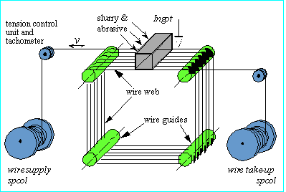
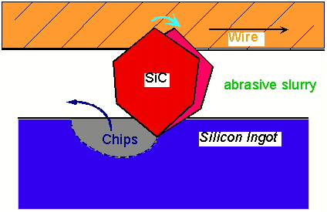
Wire Saw
Credit: http://www.winter-dtcbn.de
Incom Inc. - Confidential

Slide 14
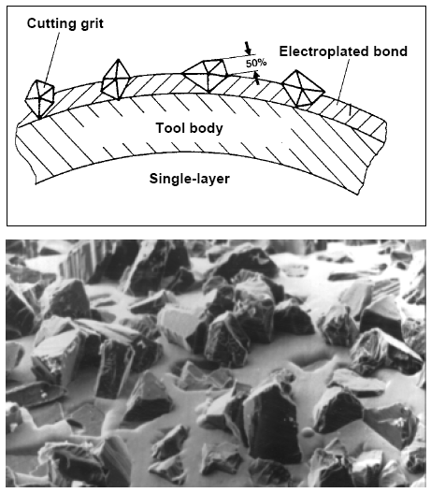
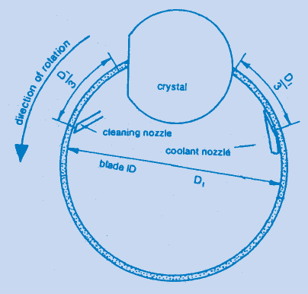
ID Saw
Credit: http://www.winter-dtcbn.de
Incom Inc. - Confidential

Slide 15
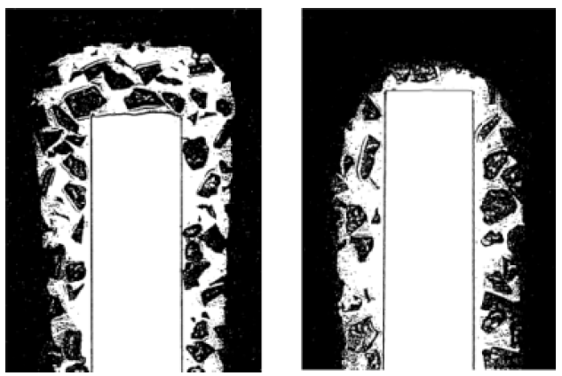
ID Saw Blade
(L) New ID Saw Blade, (R) Old ID Saw
Credit: http://www.winter-dtcbn.de
Incom Inc. - Confidential

Slide 16
Wire Saw vs. ID Saw
I. Kao (PI), and V. Prasad, J. Li, M. Bhagavat, Department of Mechanical Engineering, SUNY Stony Brook, NY 11794-2300 - NSF Grant DMI-9634889 (1996--1999).
Incom Inc. - Confidential

Slide 17
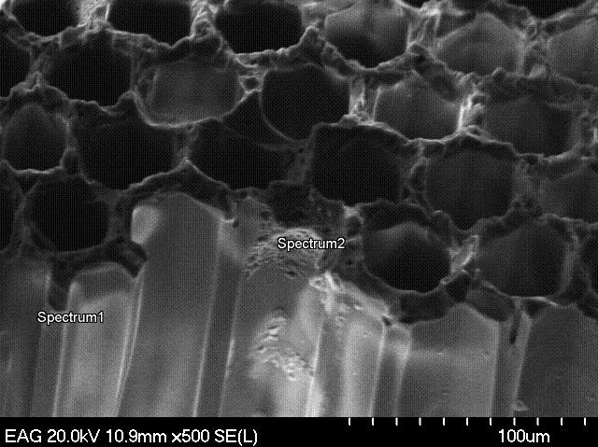
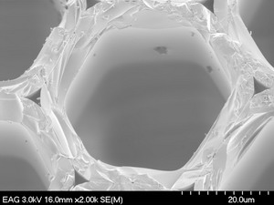
Challenge of Adhered Particles
(L) Wire saw surface finish and contamination. (R) SEM image showing adhered particles on inside of capillary. Note rough ‘as-ground’ surface, and interstitial gaps between adjacent capillary.
Incom Inc. - Confidential

Slide 18
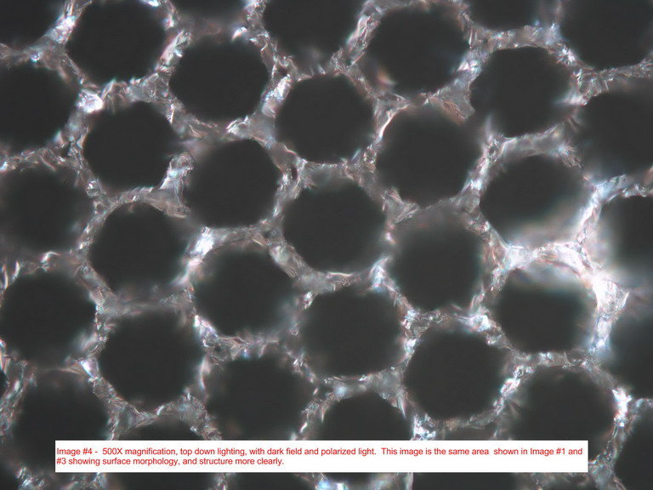
Grinding and Polishing
Loose abrasive ground capillary. Different cutting operations cause different levels of damage that must be removed by grinding. Typically, .005” - .006” of material is removed from each surface during grinding.
Incom Inc. - Confidential

Slide 19
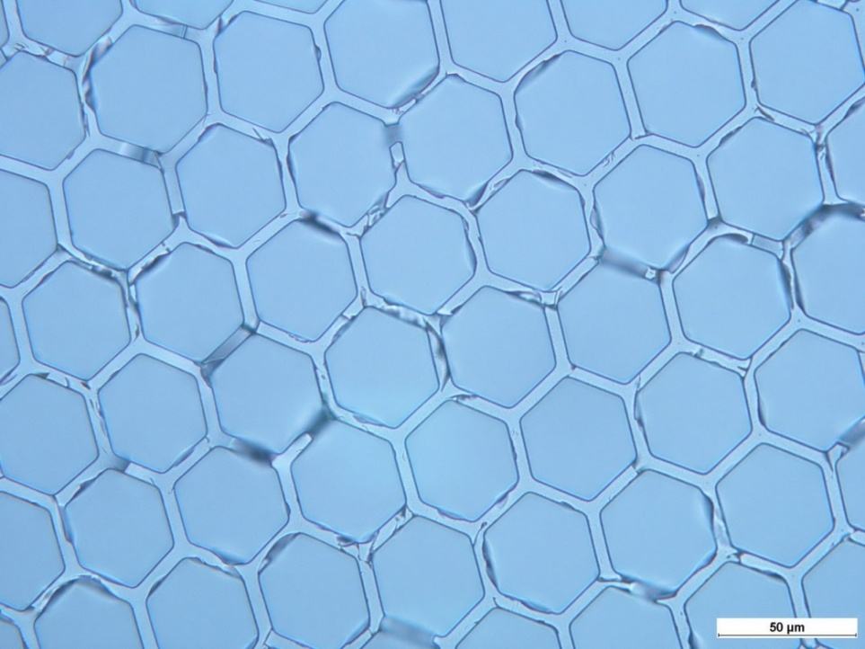
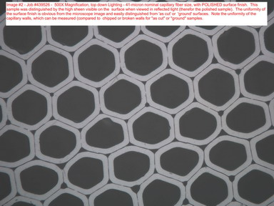
Final Polish
(Left) Incomplete polished capillary array (.001" removed). (Right) Complete polished capillary array (.002" removed).
Incom Inc. - Confidential

Slide 20
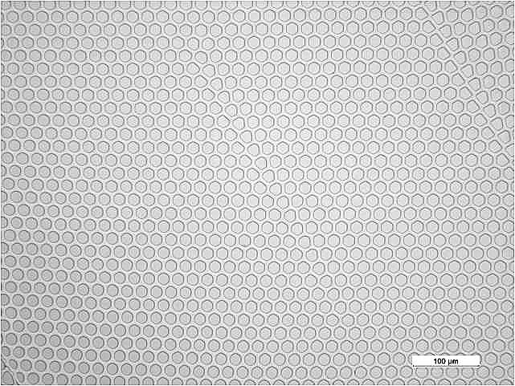
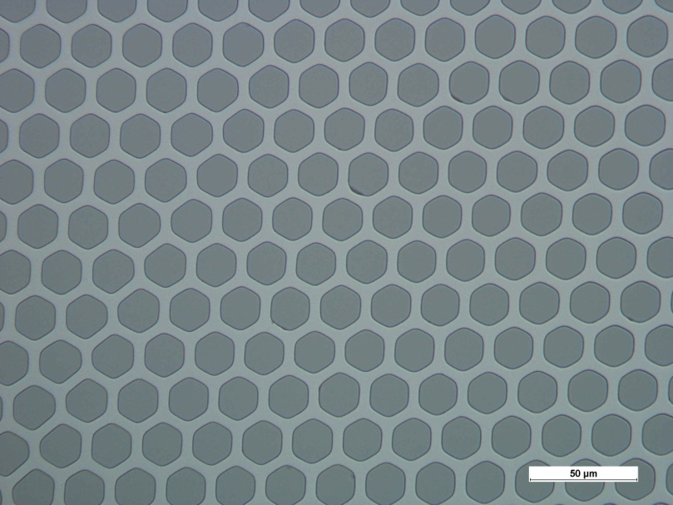
20 µm Wafers After Final Finish & Clean

Slide 21
Argonne Order Status
Status | Order # | Part # | Description | Order Qty
Open | 50119 | 300-2734-D | 32.8 mm Ф | 44
Partial Open | 50070 | 300-2734-D | 32.8 mm Ф | 8
Open | 49398 | 300-2672-A | 8”X8” | 30
Open | 49315 | 300-2640-B | 10µ | 25
Partial Closed | 50070 | 300-2734-D | 32.8 mm Ф | 35
Closed | 50104 | 300-2734-D | 32.8 mm Ф | 22
Closed | 49718 | 300-2734-D | 32.8 mm Ф | 43
Closed | 49316 | 300-2630-B | 40µ | 34
Closed | 49261 | 300-2627-A |  | 2
Closed | 49260 | 300-2620-A |  | 10
Closed | 49215 | 300-2592-A |  | 8
Closed | 49214 | 300-2591-A |  | 2
Incom Inc. - Confidential

Slide 22
Plan ‘A’ (hollow core) Schedule
Action | WK 1 | WK 2 | WK 3 | WK 4 | WK 5 | WK 6 | WK 7 | WK 8
Wire saw
CNC Form/Cut square oversize
Clean
Grind & Polish (Sub.)
CNC Final form
Clean
Inspect
Packaging
The "realistic" Plan "A" schedule is expected to take eight (8) weeks. Uncertainty with subcontractor production schedules for wire saw (2 weeks) and grind & polish (3 weeks) is included in the ‘realistic’ schedule. ‘Optimistic' turnaround at the “subcontractors” would reduce deliver to 6-7 weeks. The “realistic” schedule would give a wafer completion date of August 8th.
Incom Inc. - Confidential

Slide 23
Plan ‘B’ (solid core) Schedule
Action | 16-Jul | WK 1 | WK 2 | WK 3 | WK 4 | WK 5 | WK 6 | WK 7
Block Fabrication (5 weeks)
Wire saw
CNC Form/Cut square oversize
Grind & Polish (Sub.)
CNC Final form
Etch
Inspect
Packaging
The block for "Plan B" is currently being fabricated and is expected to be available Friday, July 16. Since that block is 'standard fiber optic' finishing time is estimated at 6-7 weeks. This would lead to an estimated ship date of the end of August at the earliest and roughly September 10th at the latest.

Slide 24
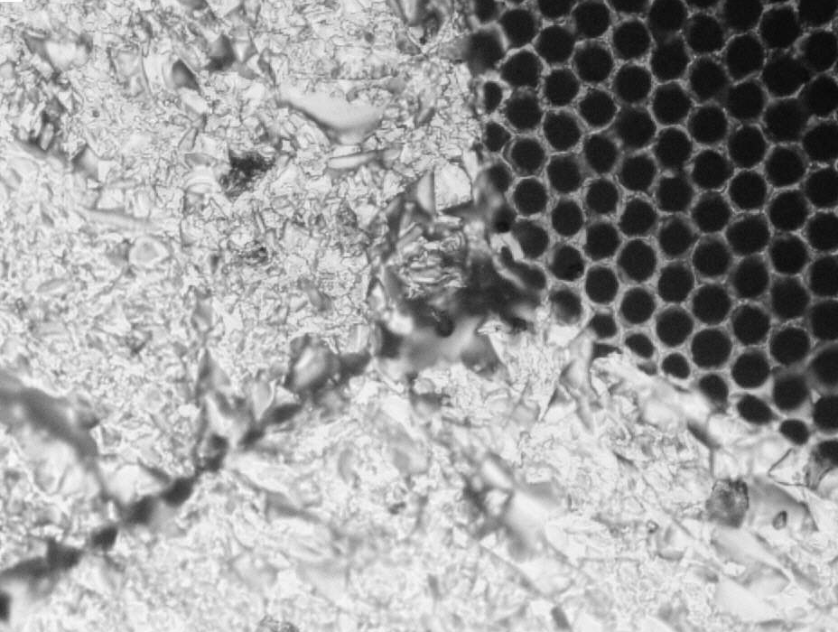
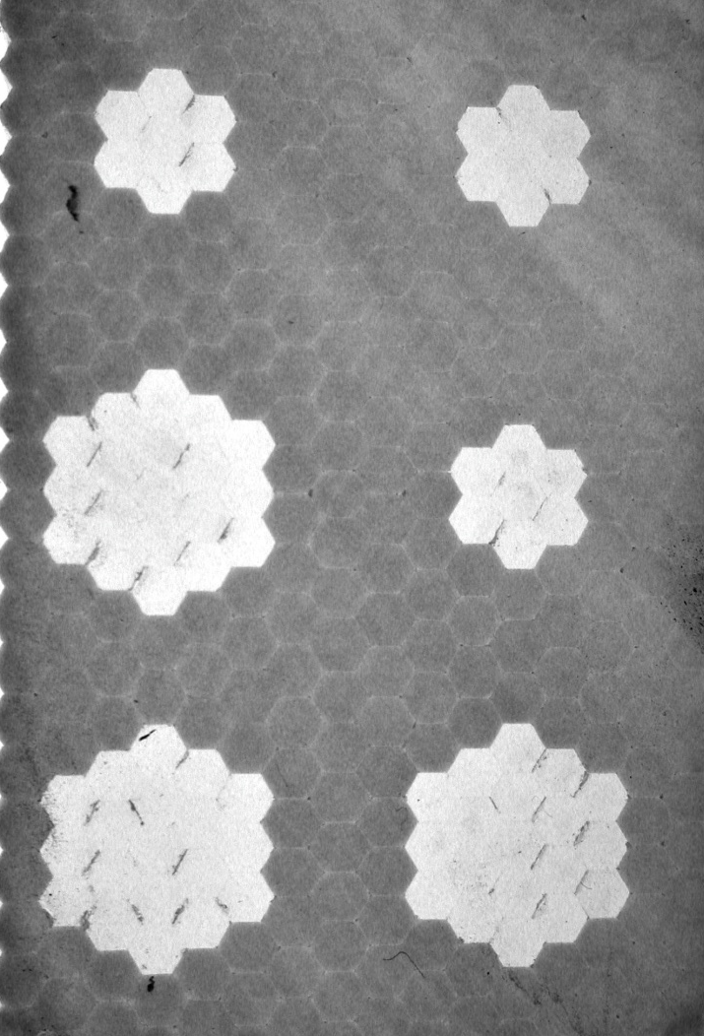
Integral Mounting Pads (IMPS™)
Incom Inc. - Confidential

Slide 25
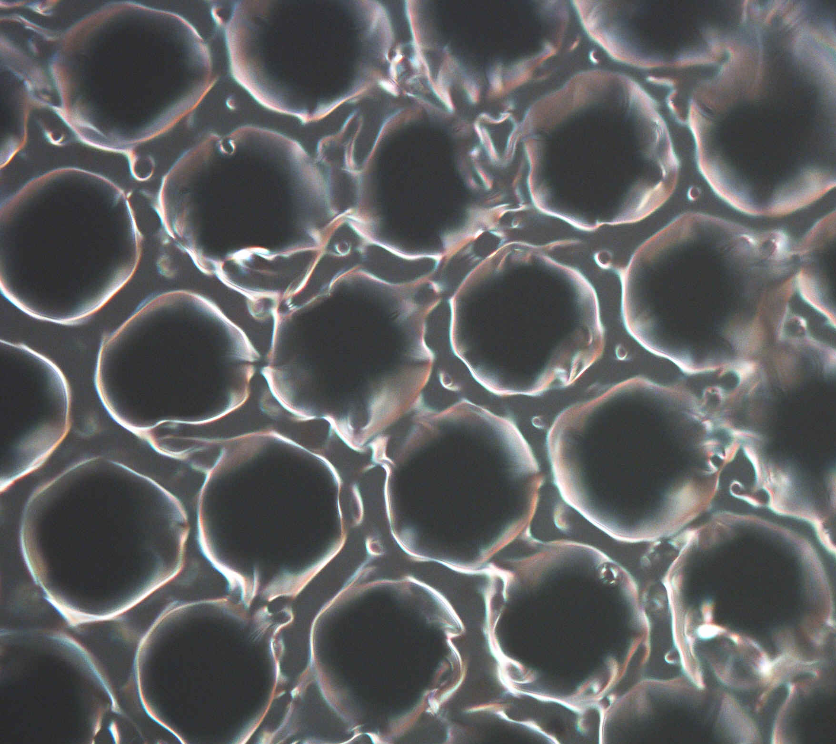
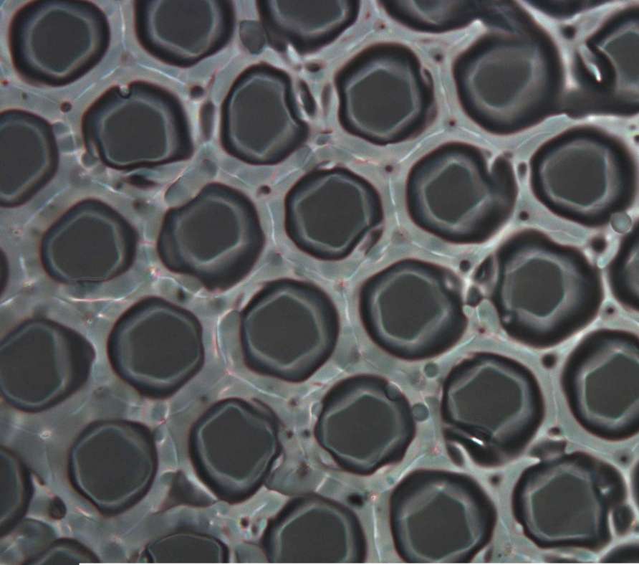
Thermal Surface Finishing
(L) 500X magnification, ID = 40 microns, top down 'dark field' lighting showing leveling of the surface and rounding of the sharp surface edges. (R) bottom up lighting showing narrowing or necking down of the capillary, creating a funnel shape at the surface. Typical Capillary appears to even smaller, with typical ID = 36 microns.
Incom Inc. - Confidential

Slide 26
Glass Framed Arrays
Incom Inc. - Confidential

Slide 27
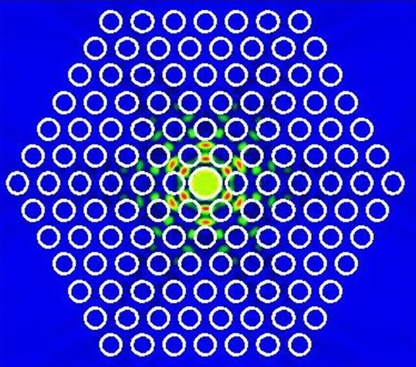
Photonic Band Gap Structures for Particle Acceleration
Incom Incorporated (Charlton, MA) and Stanford Linear Accelerator Center (SLAC) collaborated to fabricate PBG structures from borosilicate glass that serve as TM₀₁ cavities and couplers when properly driven by lasers and will allow tests of basic concepts for PBG accelerators.
Incom Inc. - Confidential

Slide 28
Contact
Michael Minot
978-852-4042
Incom Inc.
mjm@incomusa.com
MinoTech Engineering Inc.
mjminot@minotecheng.com
Incom Inc. - Confidential

Slide 29
Cleanliness Requirements Vary Depending on the Application
Occluded wells
Fully vs. partially blocked
% occluded
Multi boundaries
Type of contaminant
Particulate
Filler
Water
Hydrocarbons
Incom Inc. - Confidential

Slide 30
Capillary Products
Customer | Capillary Size (µm) | Thickness (mm) | L/d | Overall dimensions
“A” | 20 | 1.2mm | 60:1 | 24.8mm Diam
Argonne | 20 | 1.2mm | 60:1 | 8” x 8”
GA | 100 | 17.8mm | 178:1 | 6” x 2.5”
Incom Inc. - Confidential

