Slide 1
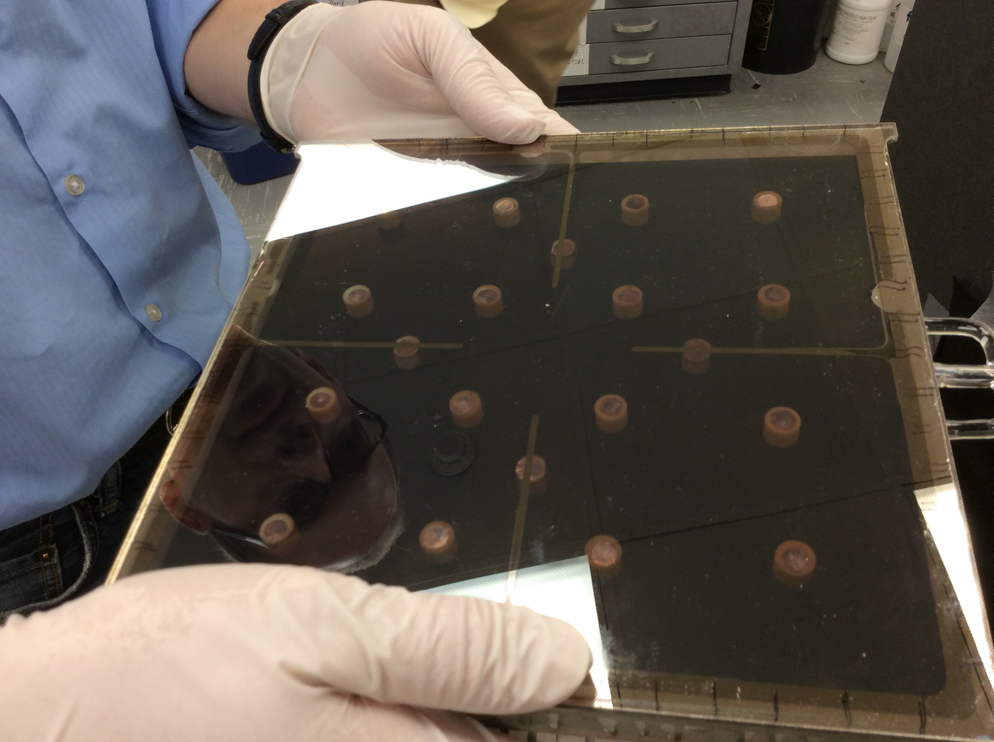
My take on the results from two cesiation trials

Slide 2
First cesiation, Tile 10, Summer 2016
Mar 26
June 27
July 11
Aug 19
Mar 31
Tile 10 sealed and taken out
of Margherita
G.P Review
Ampule broken
Visual Cue of
Cesium having
Arrived on the
window
Tile 10
Flame Sealed!
Seal = 0 days
Open to air = @~70 days
Cesium exposure = @101 days
Flame sealed = @147 days
Second cesiation, Tile 13, Fall 2016
Sept 30
Oct 25
Nov 16
Seal = 0 days
Cesium exposure = @26 days
Flame seal = @48 days
Tile 13 Sealed
First cesium
exposure
Tile 13
Flame Sealed!

Slide 3
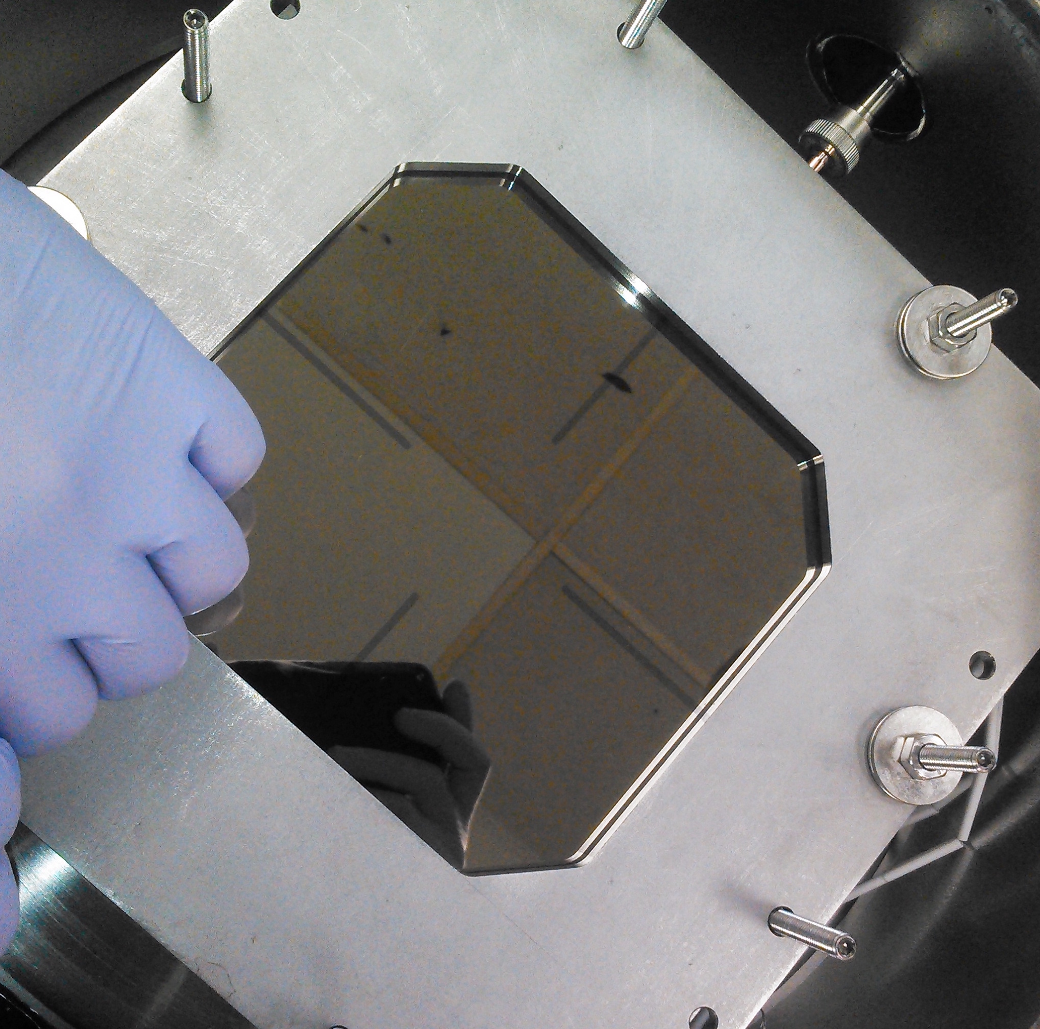
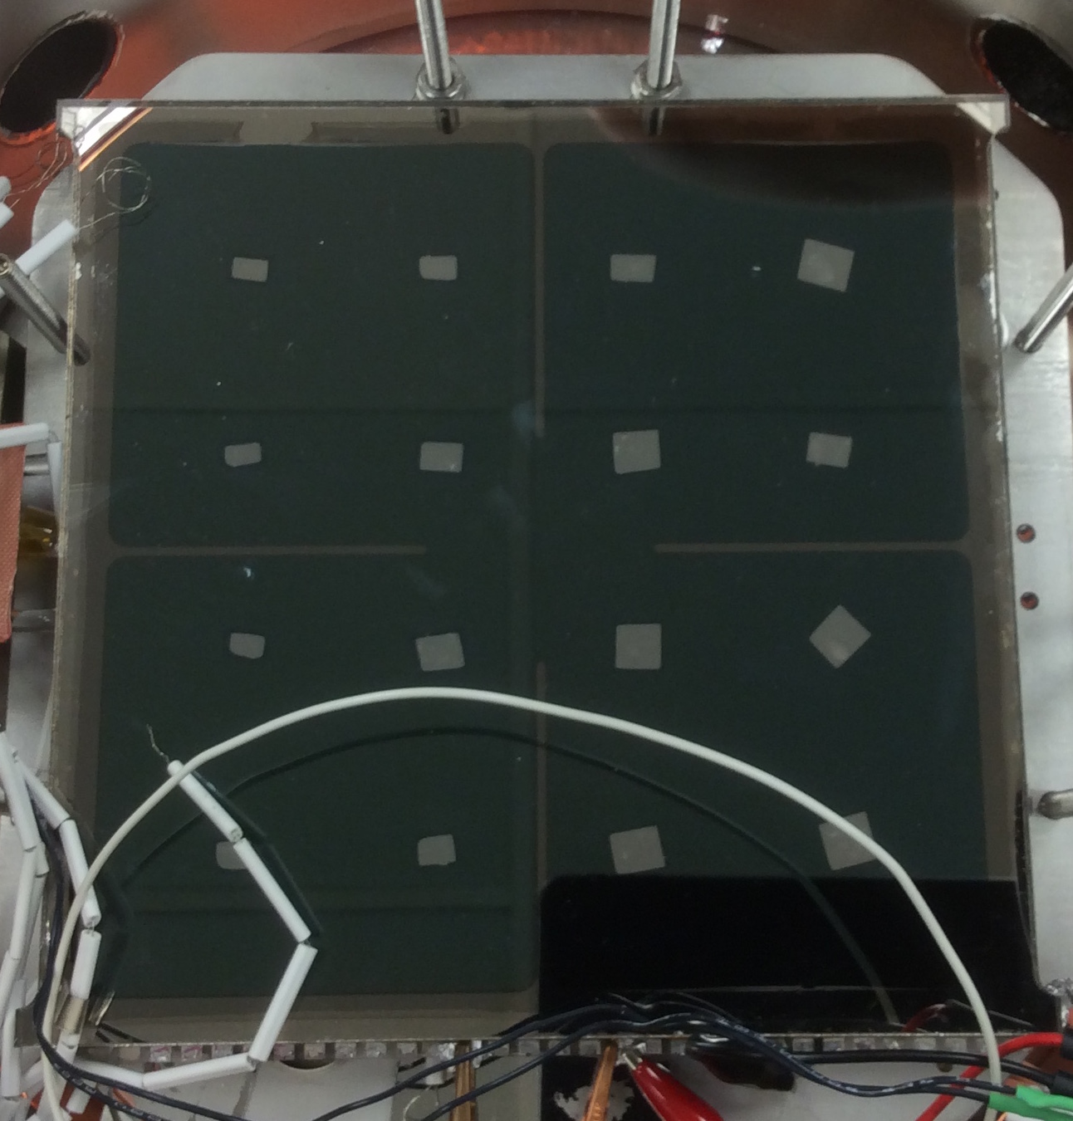
Visual change tile 1
Before
After

Slide 4
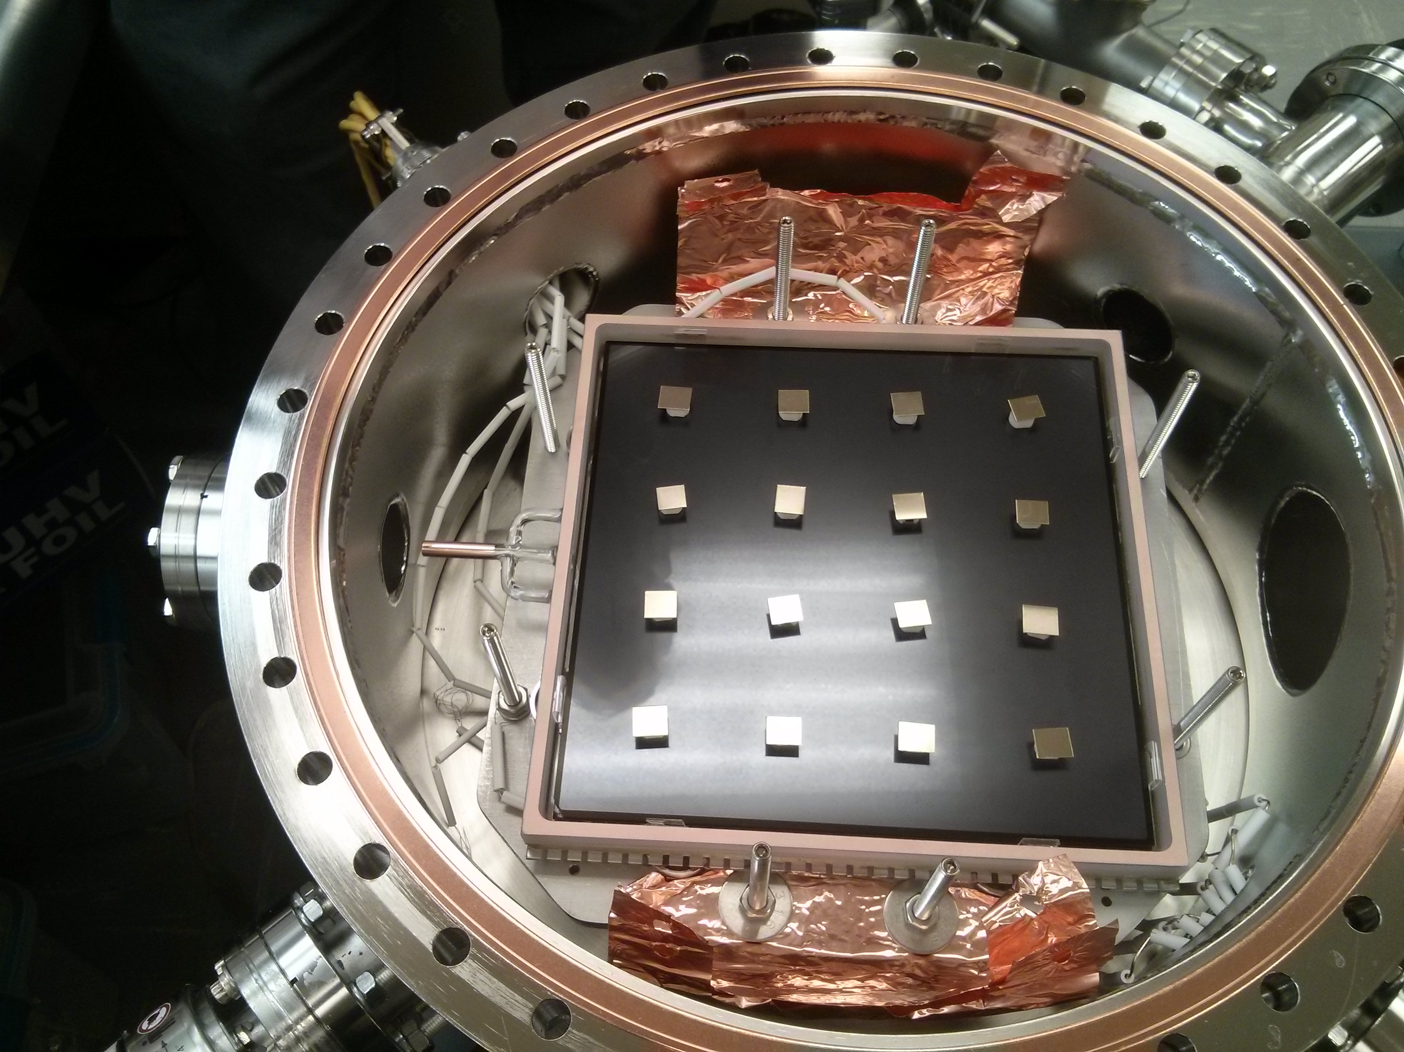

Slide 5
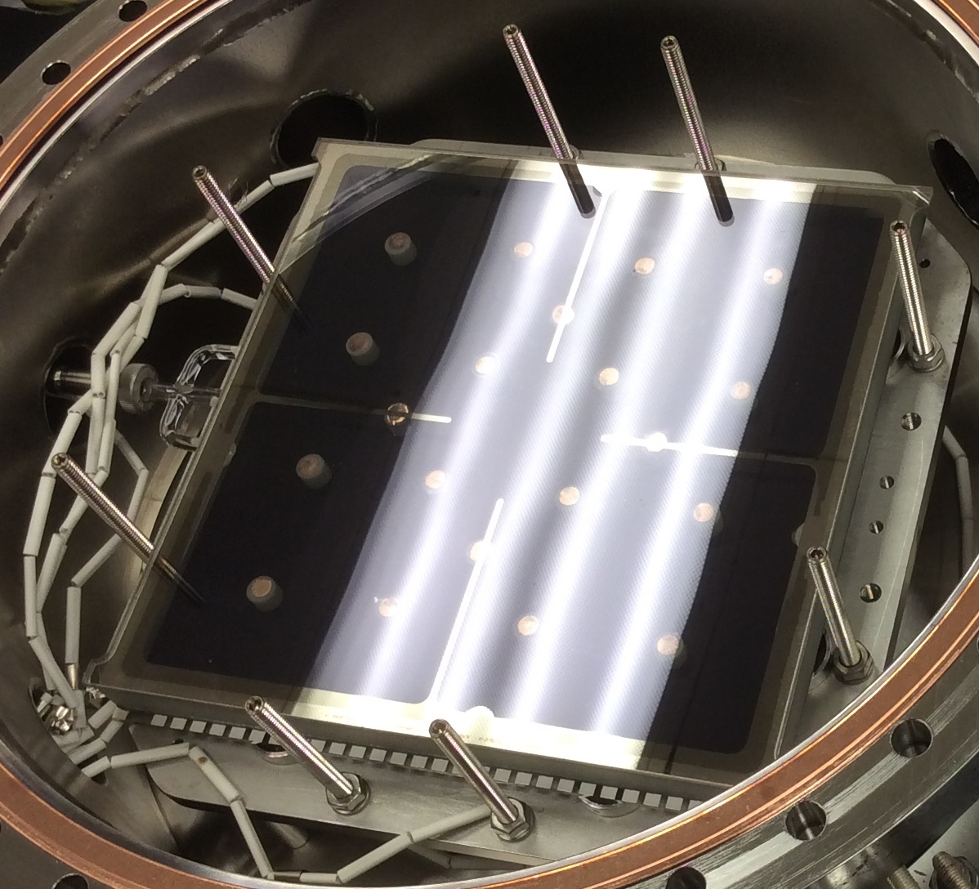
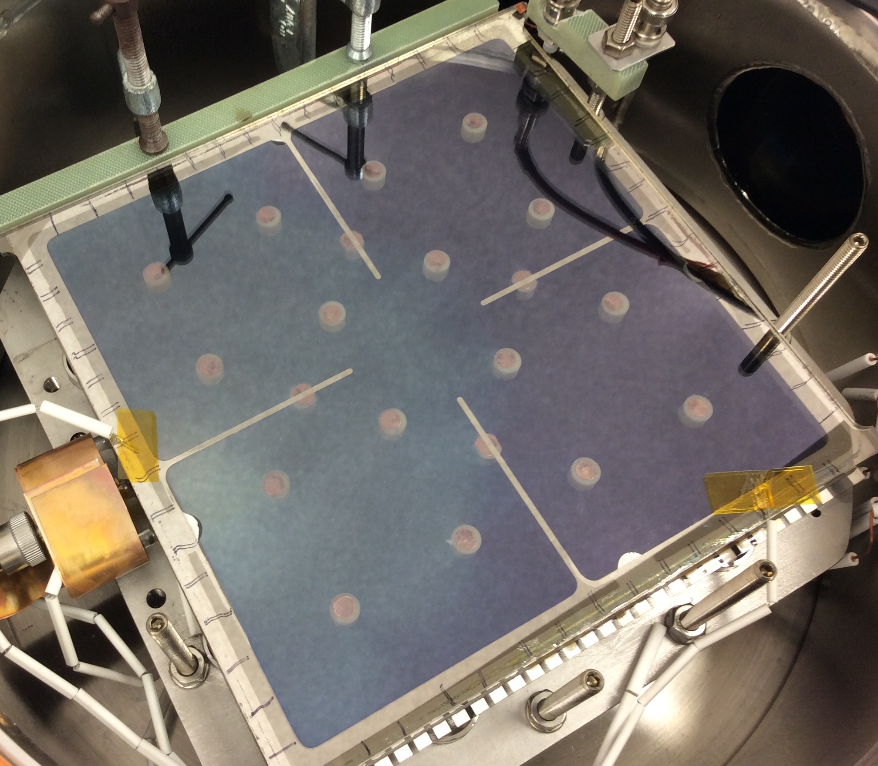
Visual change tile 2

Slide 6
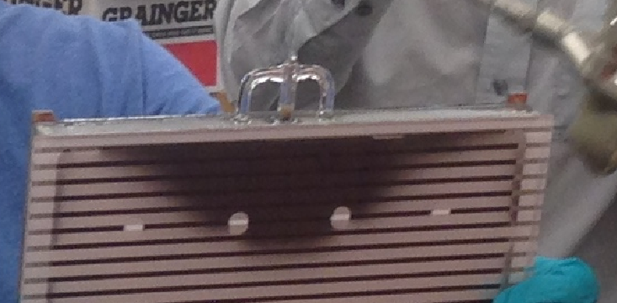
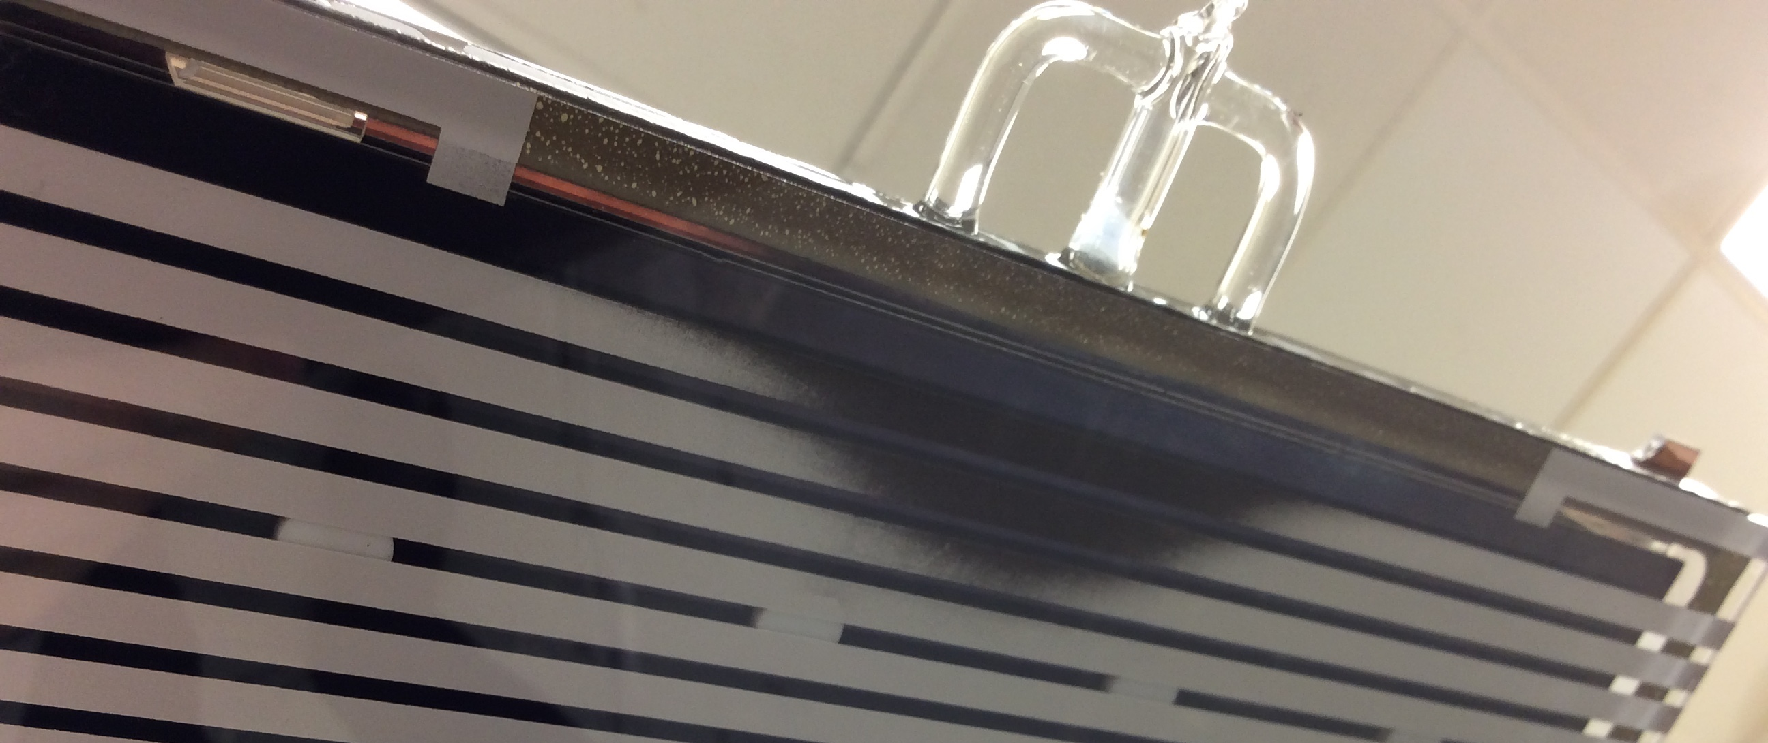

Slide 7
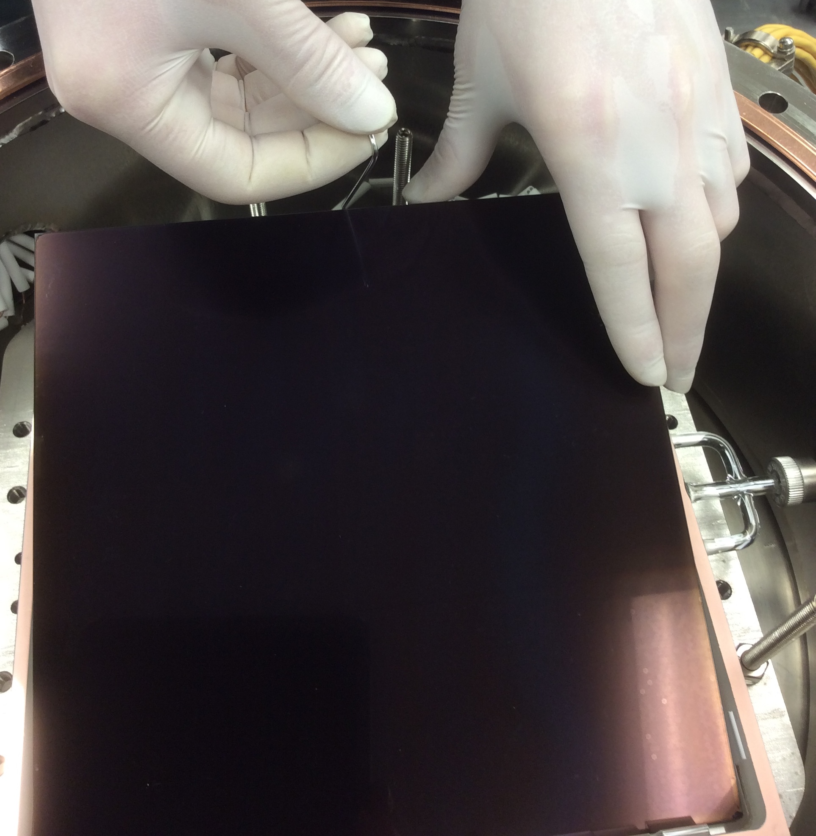
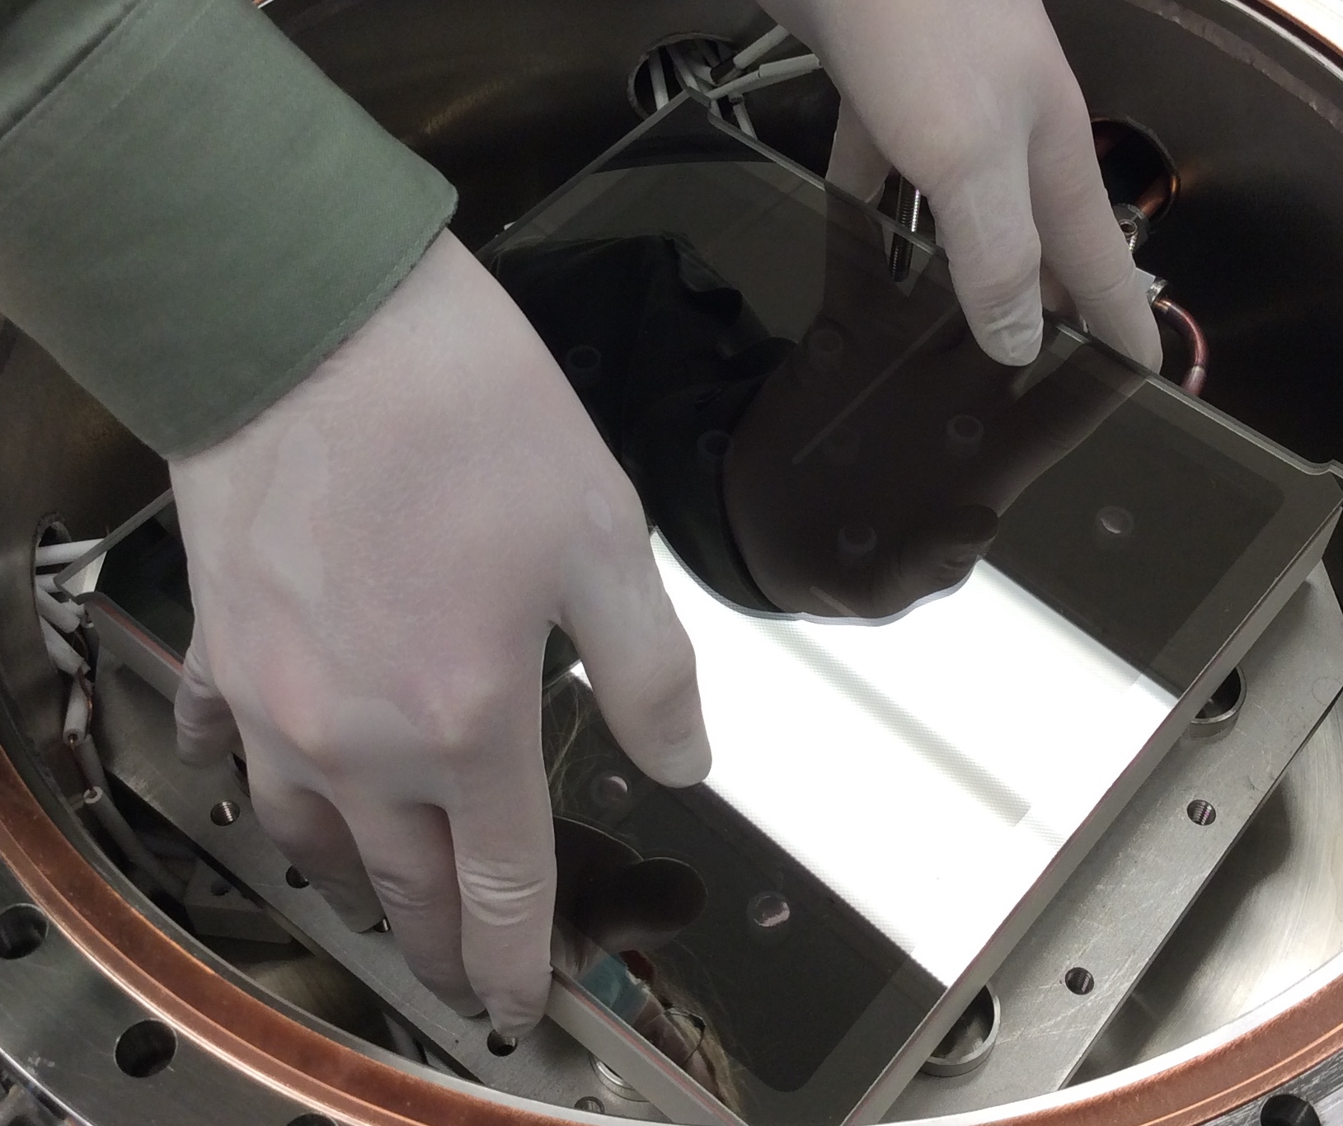
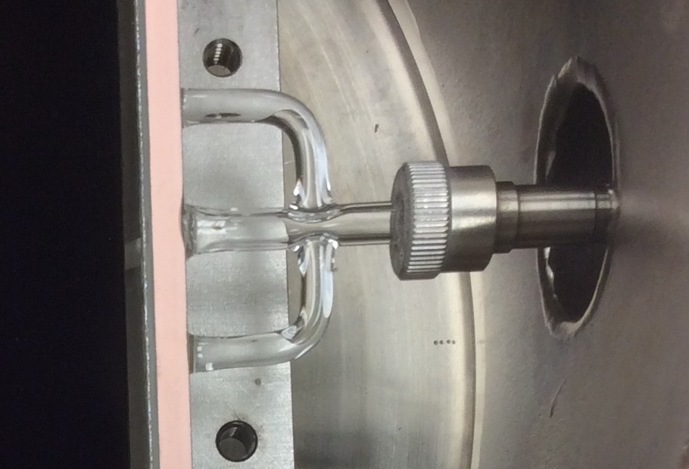
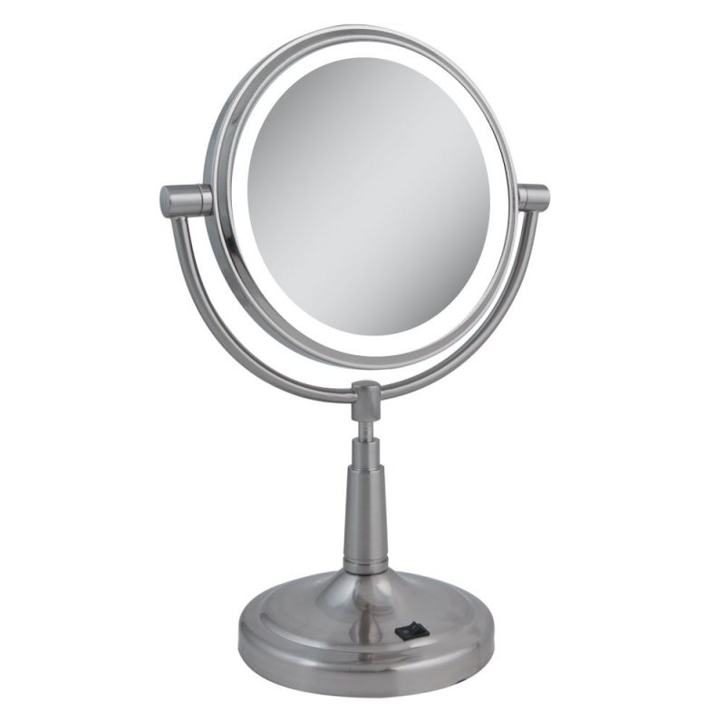
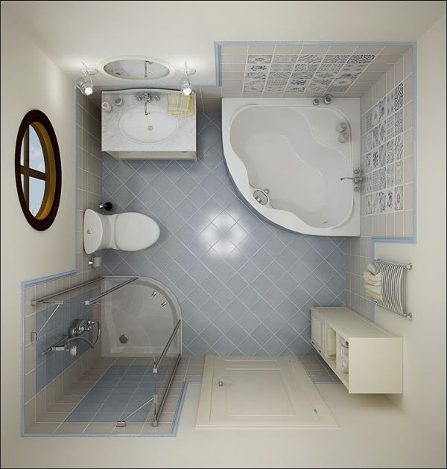

Guiding cesium through a straw into a small bathroom and condensing it on a vanity mirror
Antimony window
= 400 cm² S.A.
2x 8’’ MCPs
= ~8x10⁴ cm² S.A.
Tube is ~1/4’’ diameter
= 0.3 cm² cross section

Slide 8
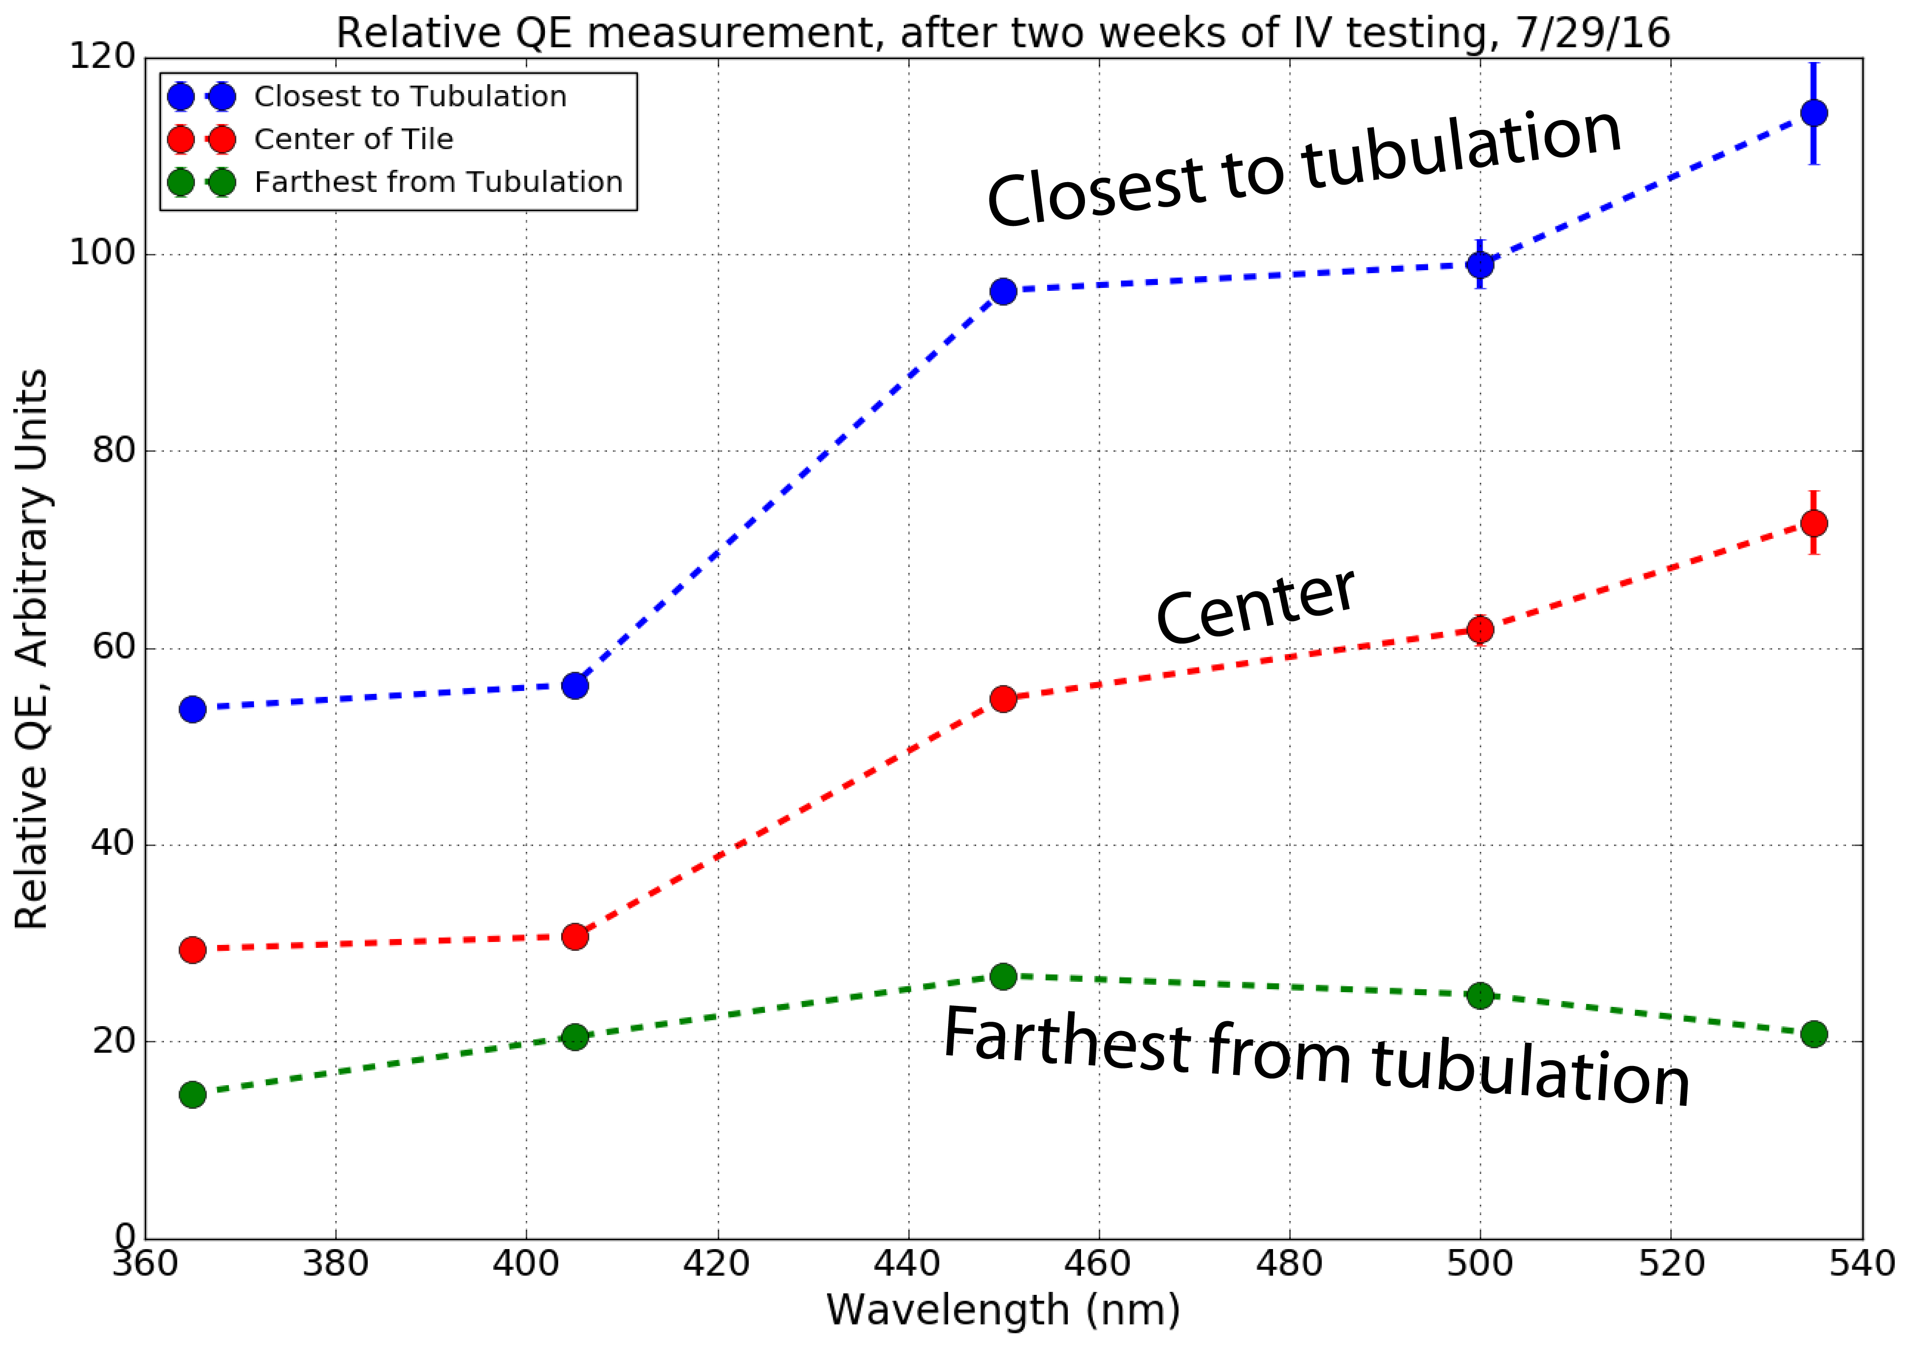
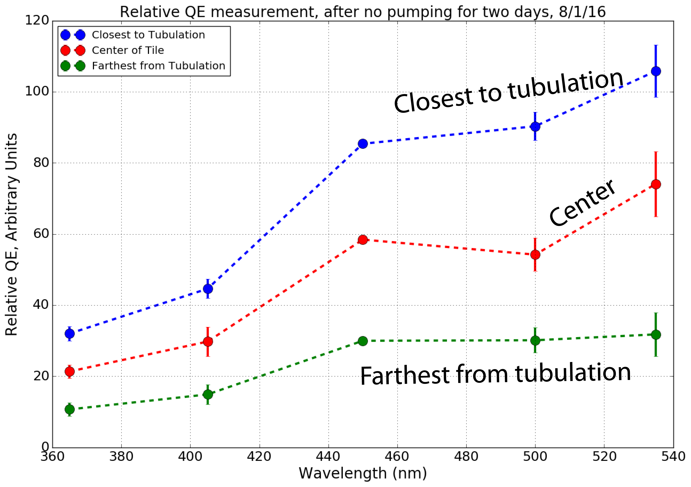
First tile
Before
After
A few days go by in a saturated cesium environment
Not totally conclusive, want more evidence of reaching the far end of the tile …

Slide 9
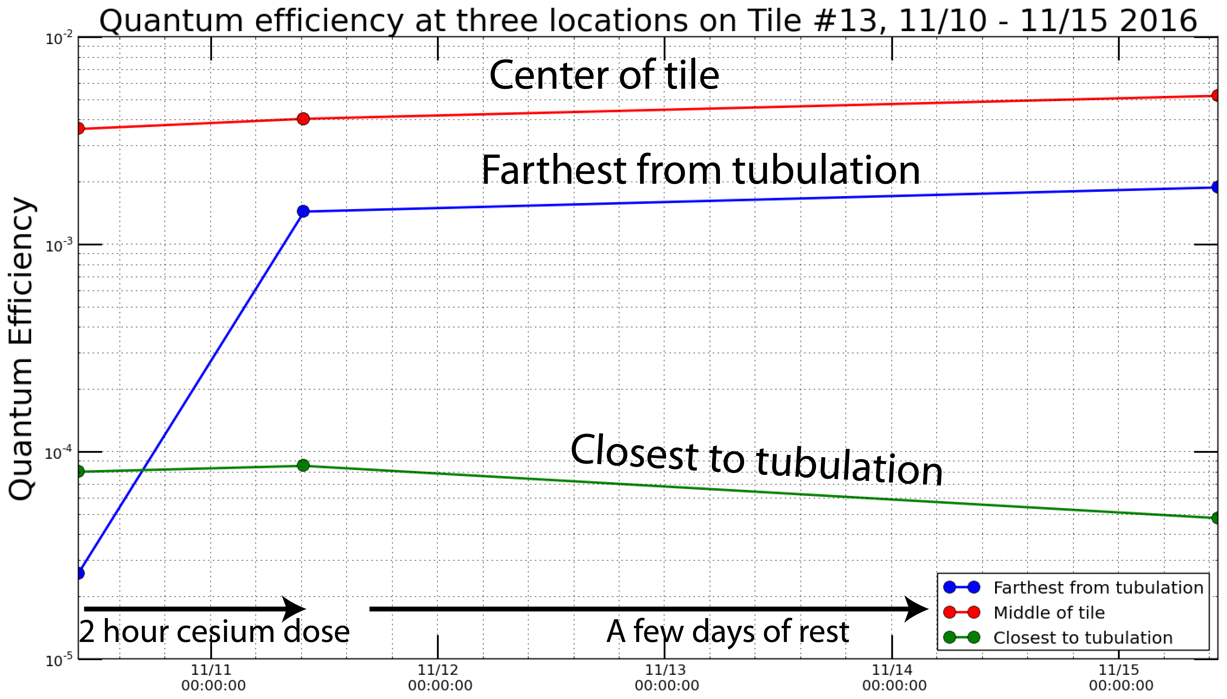
Second tile
Hotter configuration: 190C instead of 140C on J-Tube

Slide 10
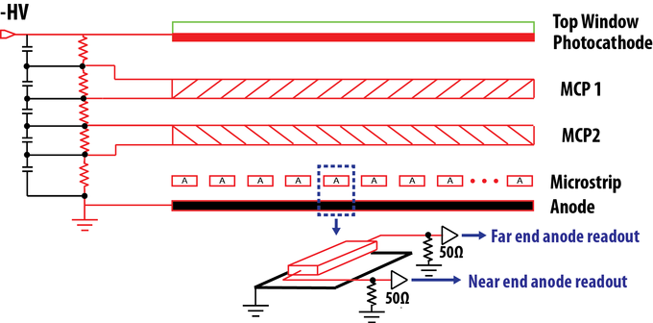
What happens over long periods of time?
1) Photoresponse changes
2) Stack resistance changes

Slide 11
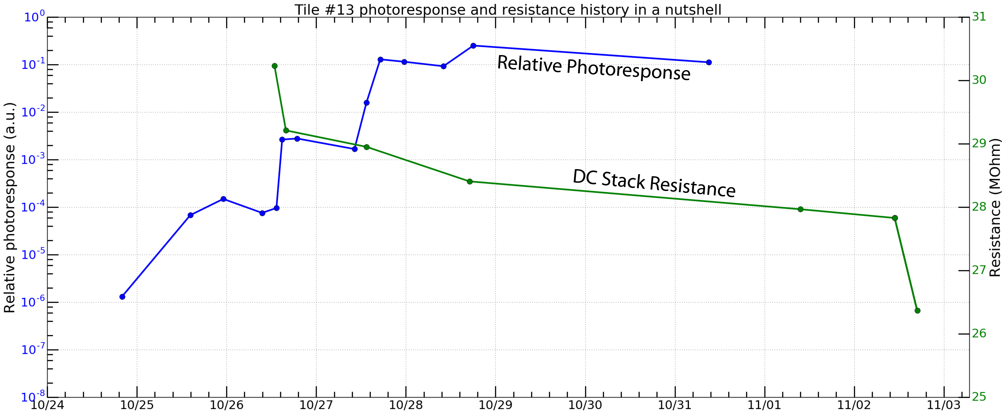

Slide 12
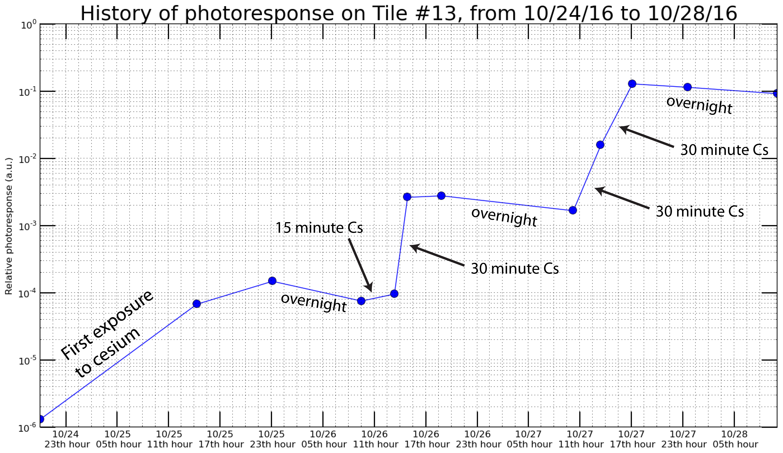

Slide 13
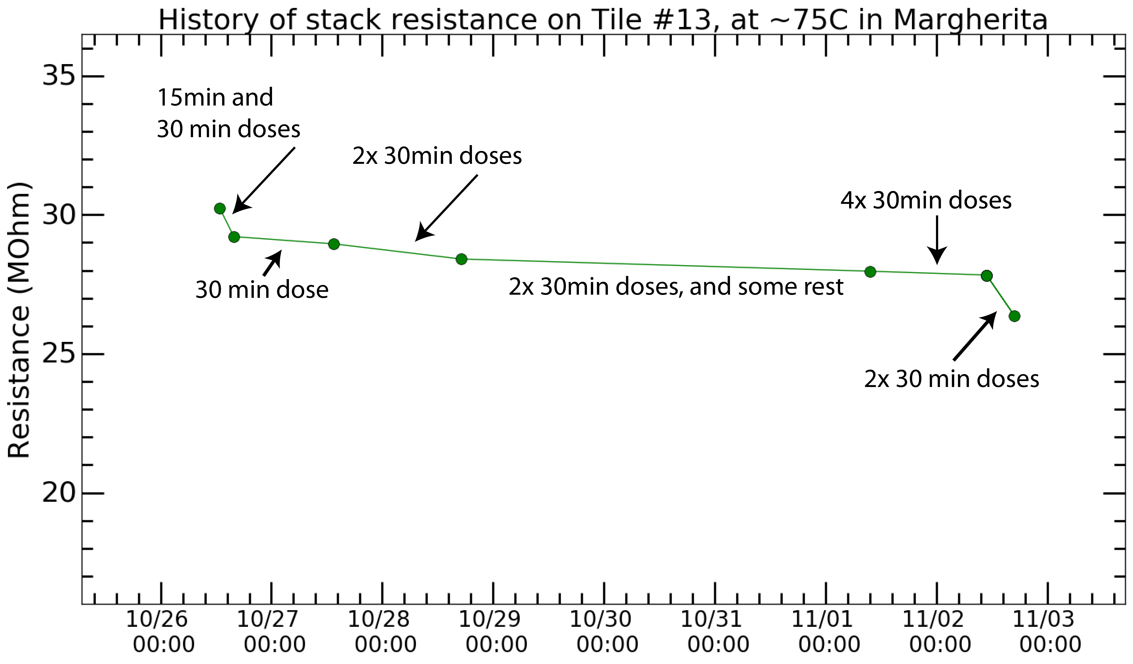

Slide 14
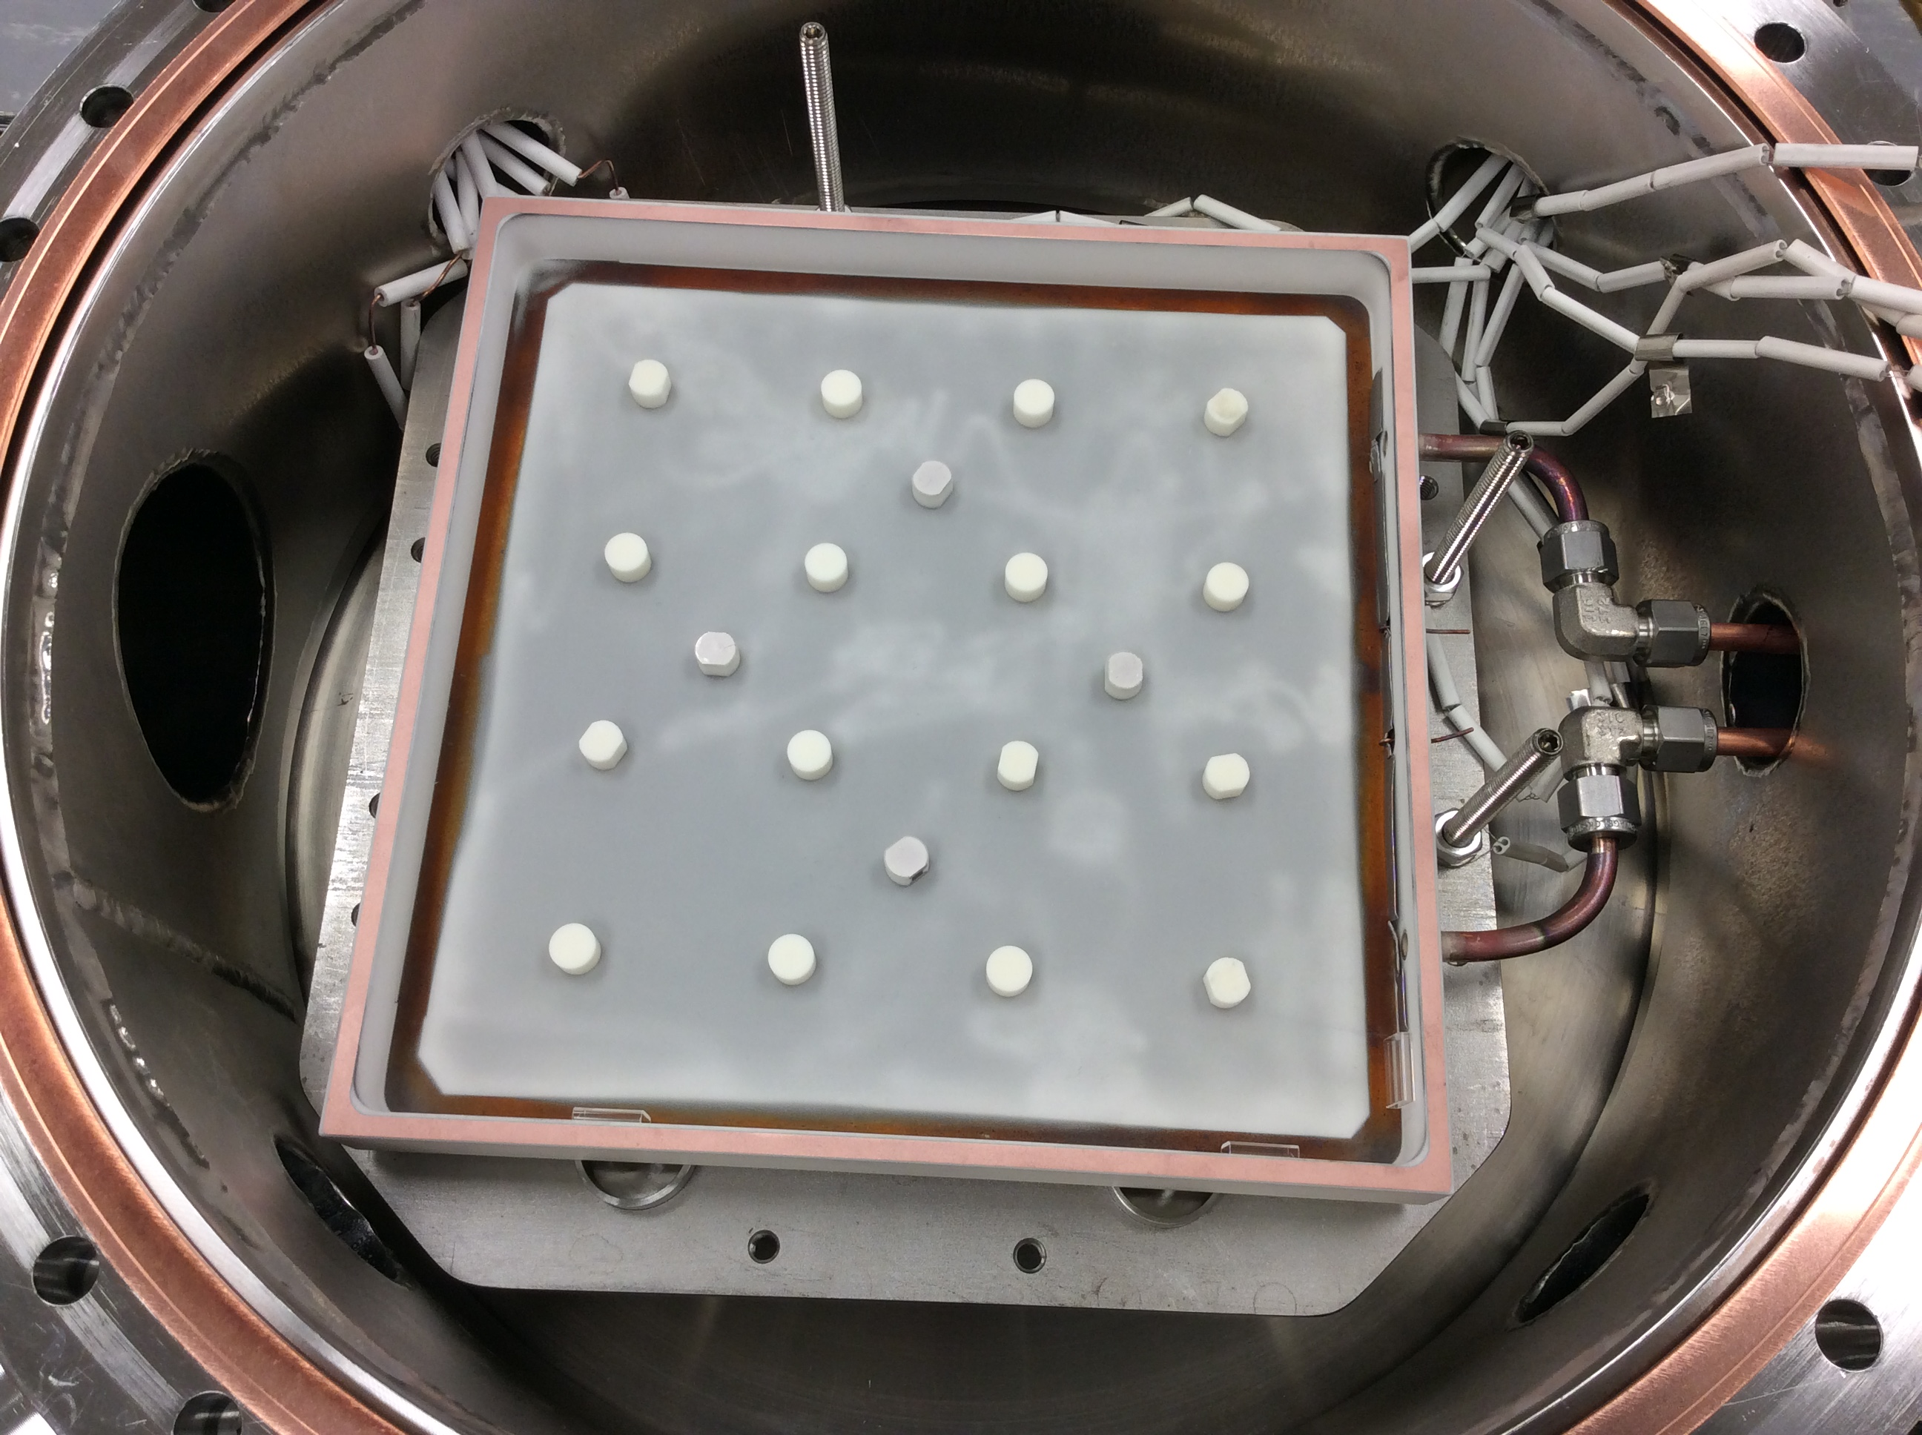
Moving forward
More trials: we’ve only done two
Same or different procedure?
Better monitoring of QE (2D stage)
Understanding MCPs
New materials (K2CsSb)

Slide 15
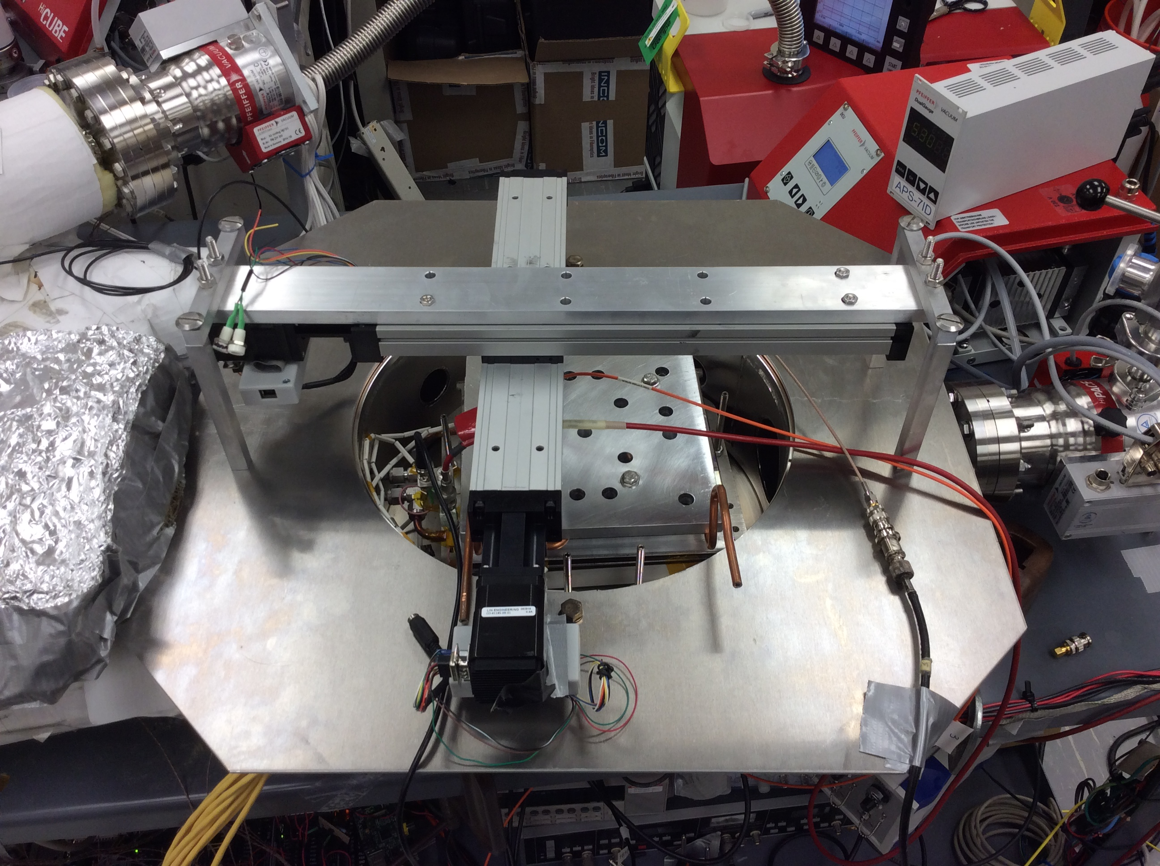

Slide 16
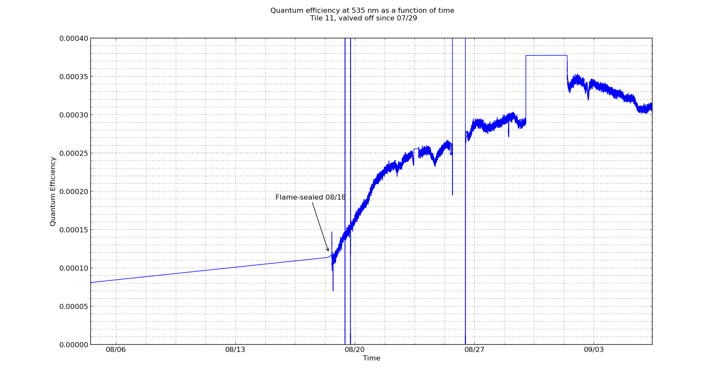

Slide 17
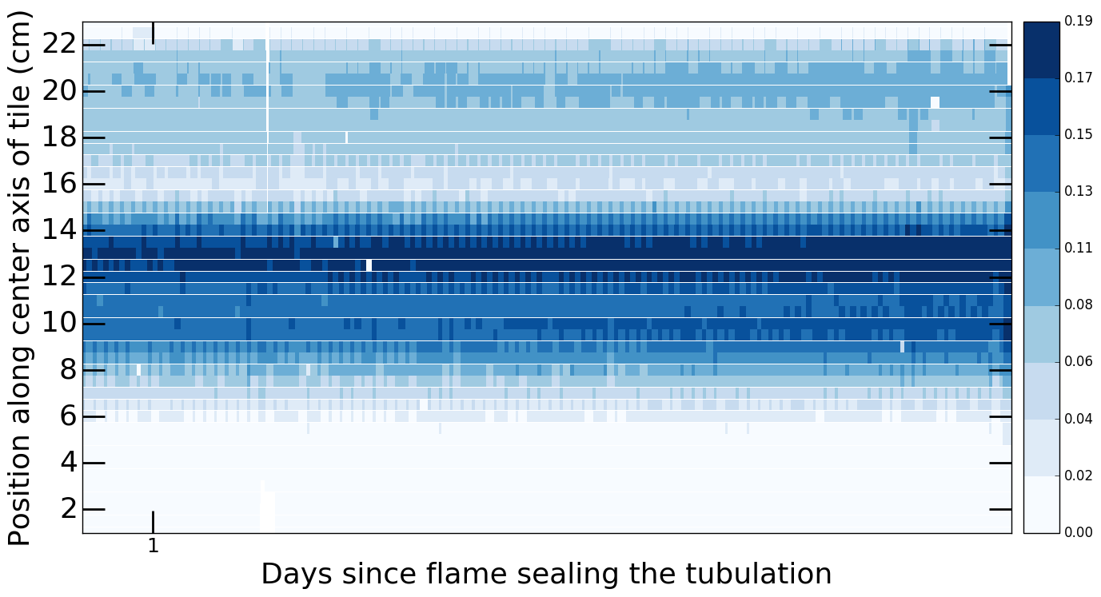

Slide 18
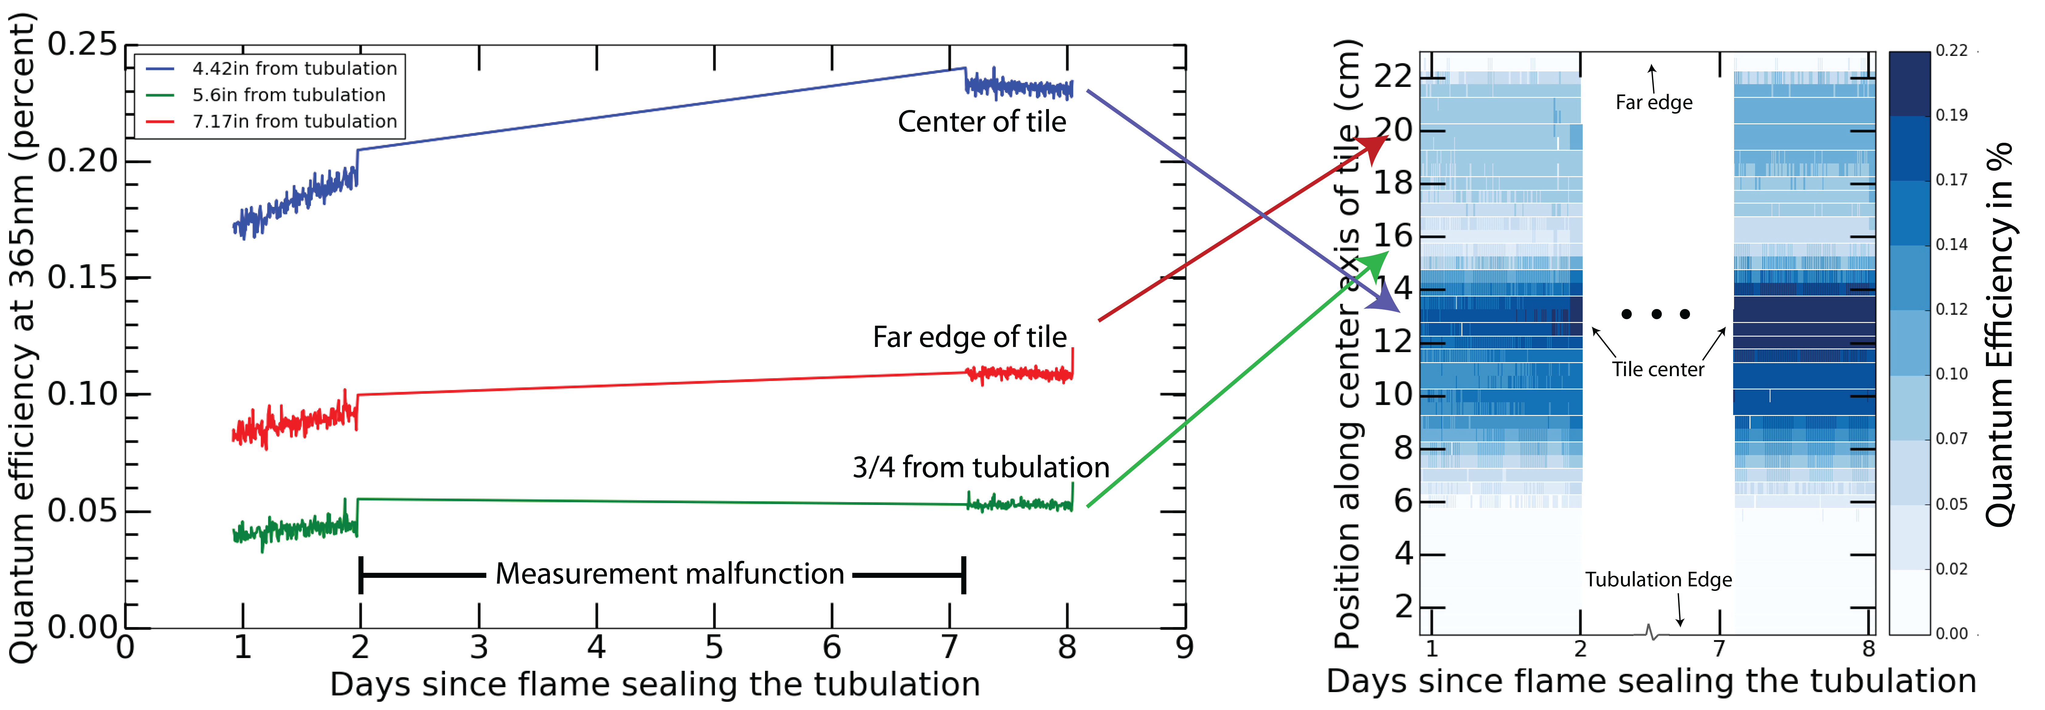

Slide 19
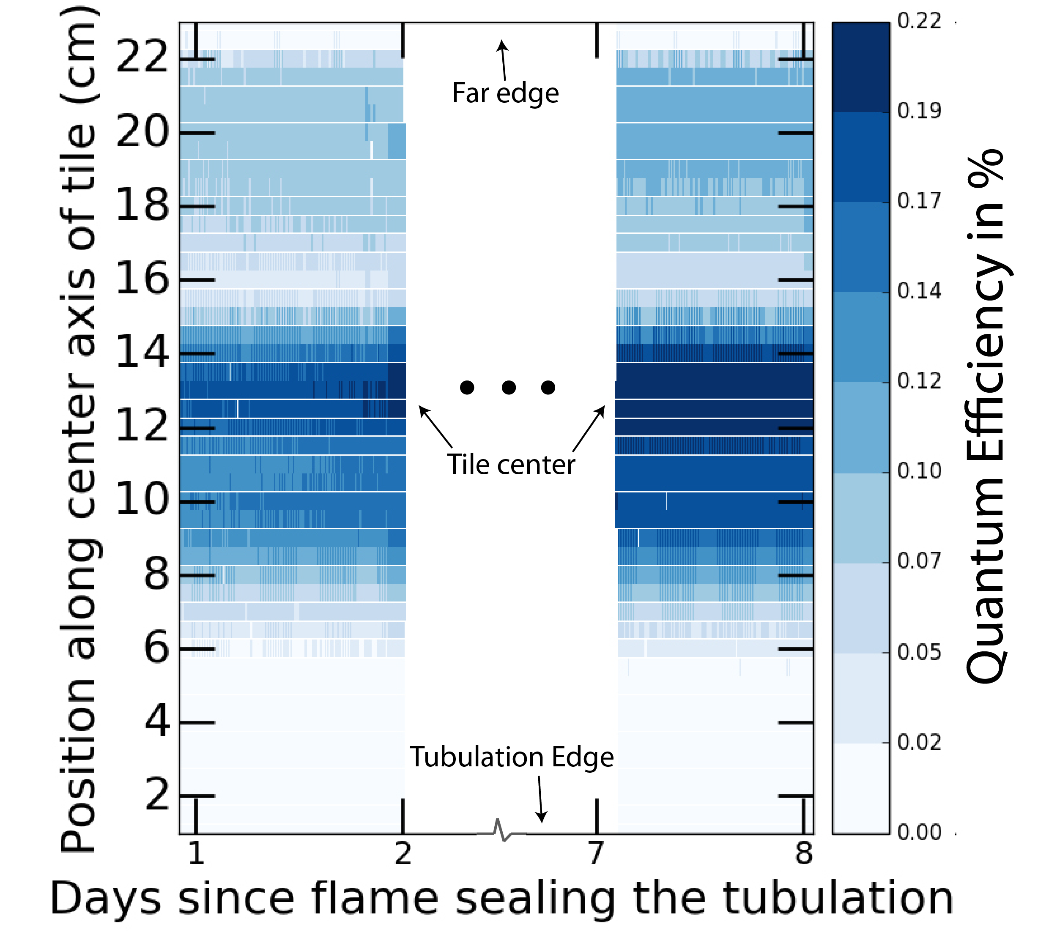

Slide 20
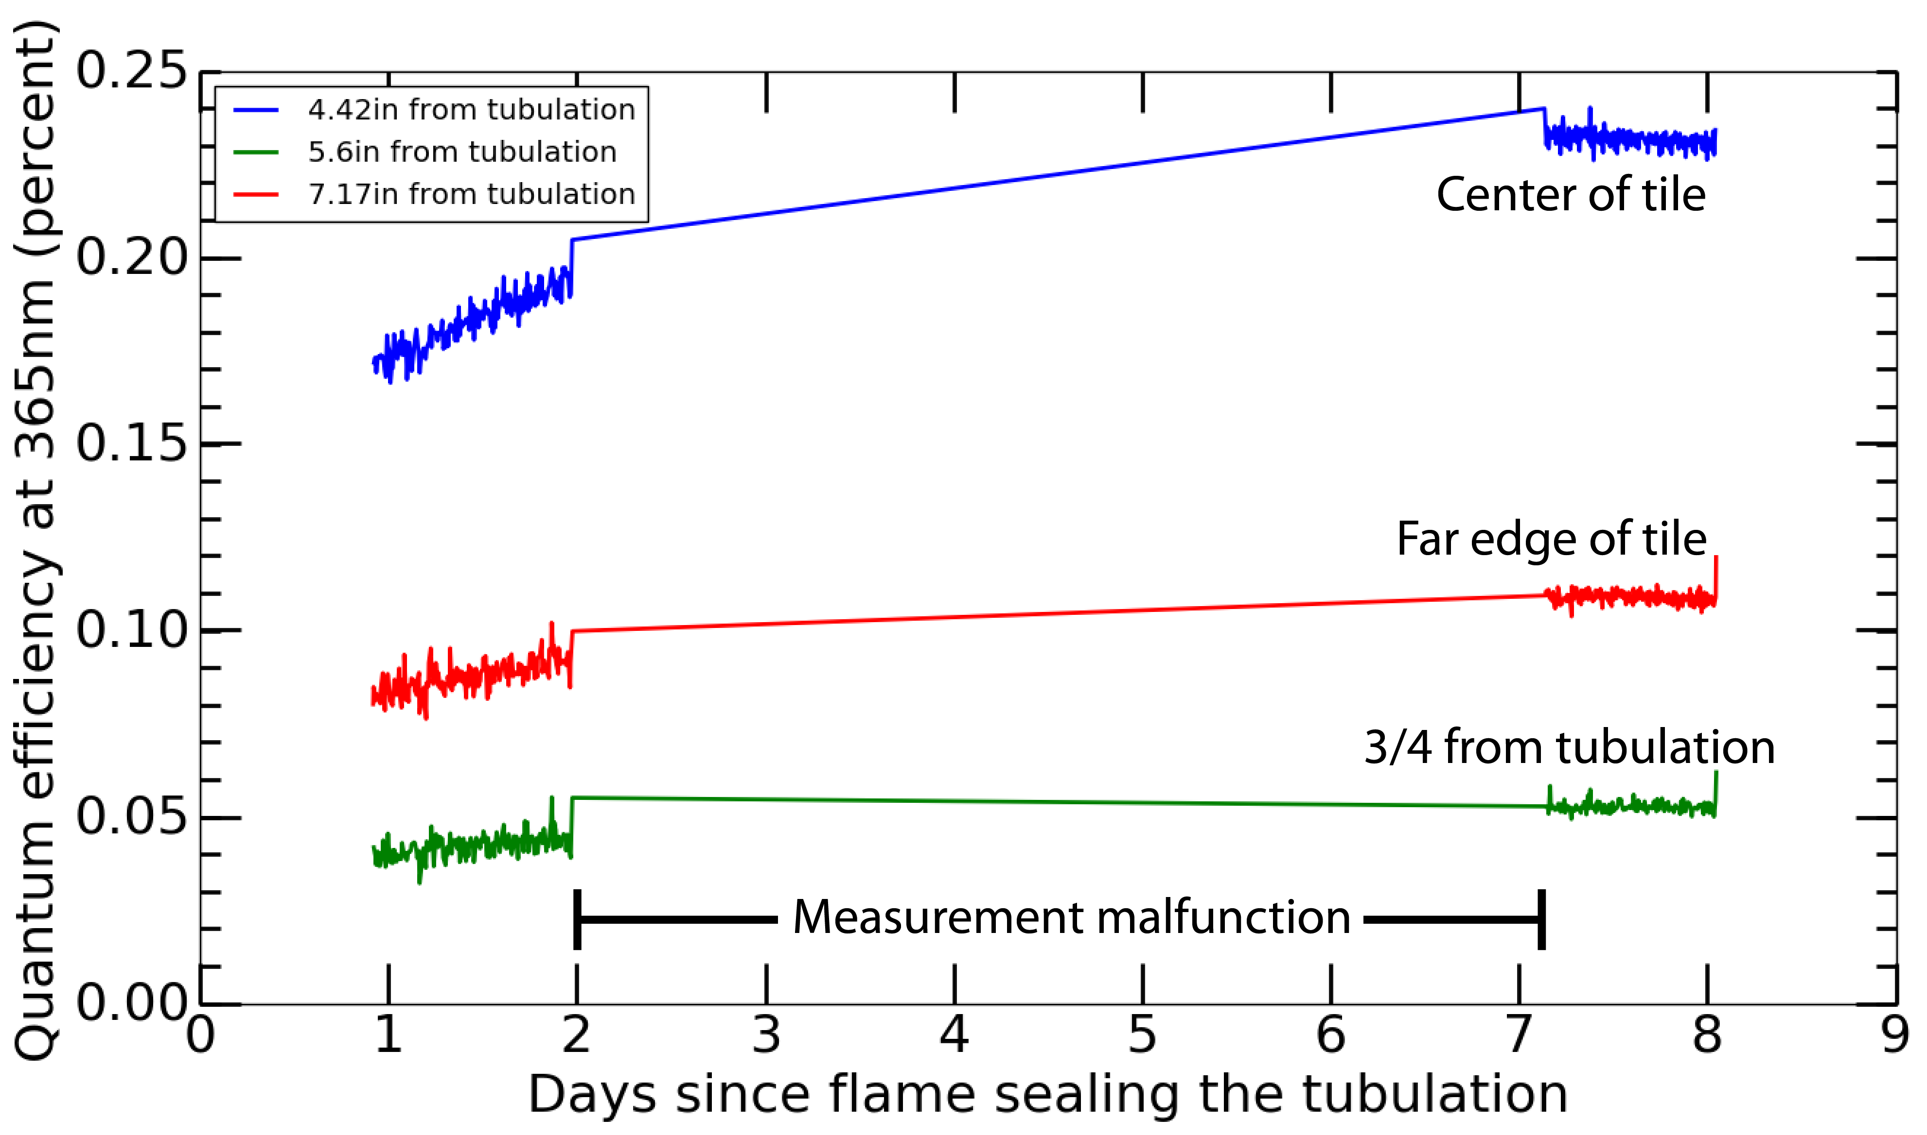

Slide 21
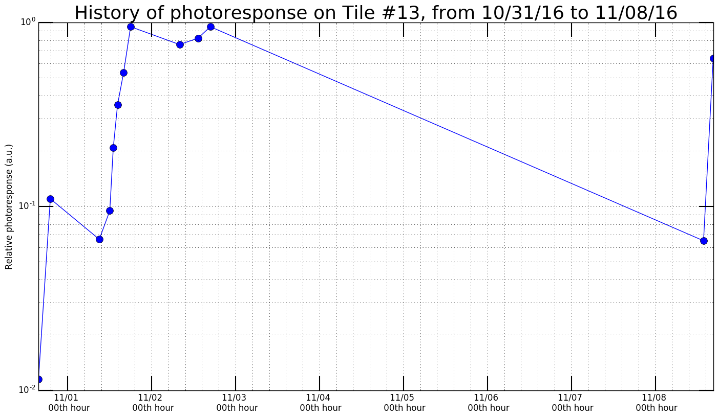

Slide 22
