Slide 1

Inside-Out LAPPD’s for the Large Hadron Collider
Todd Seiss

Slide 2
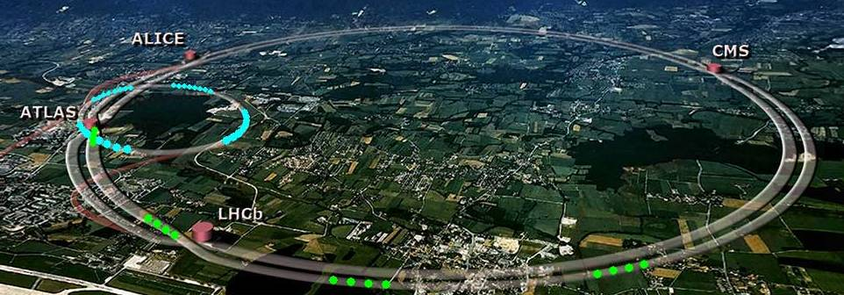
The Large Hadron Collider
Proton collider
Collisions have tiny chance to produce interesting new particles
Two general purpose detectors: ATLAS and CMS

Slide 3
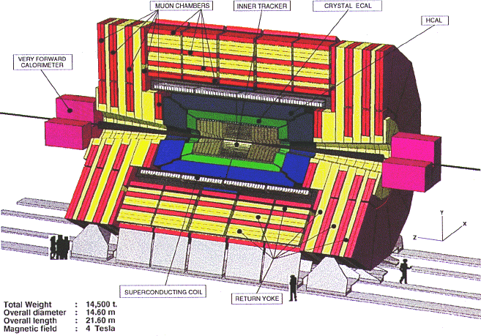
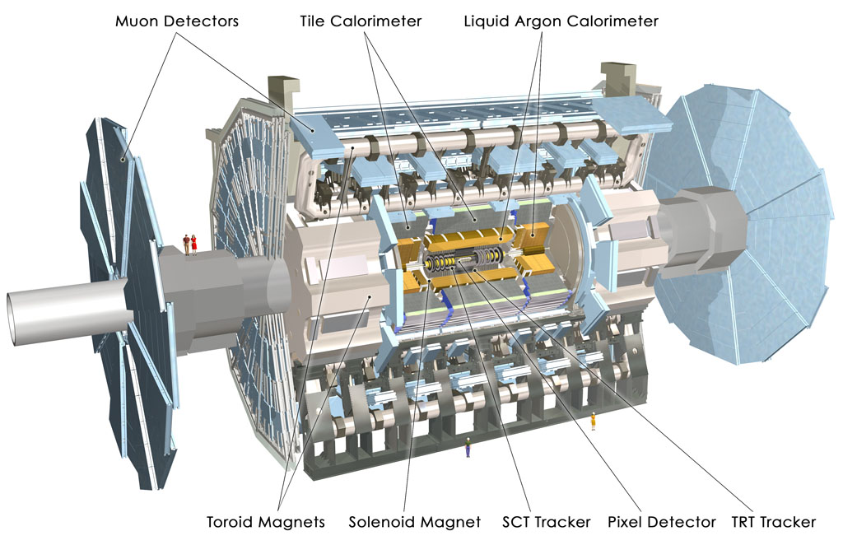
ATLAS and CMS
ATLAS
CMS

Slide 4
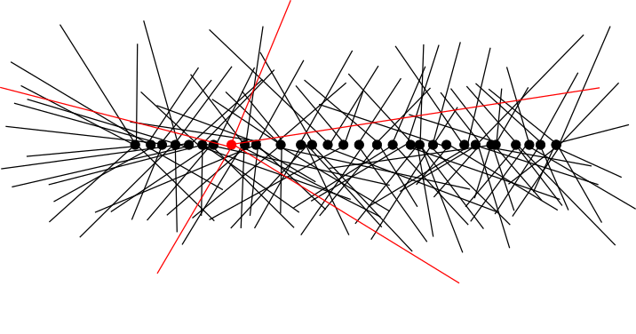
Interaction Region
Beams made of bunches of protons
Roughly 200 events per bunch crossing after upgrade
Hundreds of particles per event
Need to be able to tell events apart with hundreds or thousands of particles around.

Slide 5
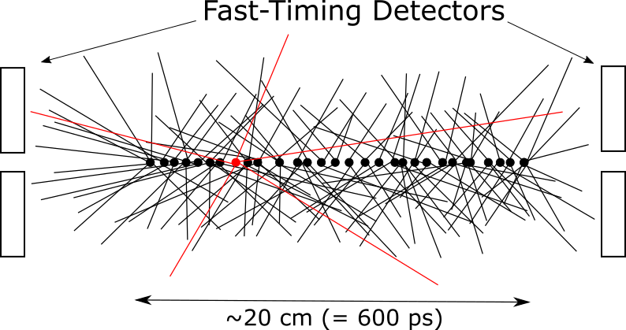
Fast-Timing
Timing on the order of 10’s of picoseconds allows us to tell apart different events
Not done currently at LHC
LAPPD’s can do this!
  (Glass window in front of
  detector. Charged
  particles passing through
  produce light for LAPPD)

Slide 6
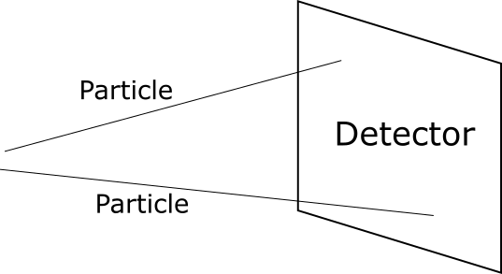
Problem: Too Many Particles!
Detector with large area totally overwhelmed with all the particles around in LHC collisions
Several particles hitting different parts of the detector would produce messy signals

Slide 7
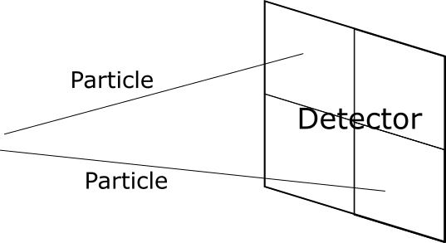
Solution: Segmentation
Need to segment detector so a particle hitting in one region doesn’t affect the whole detector. Decouples different parts of detectors.
For LAPPD, do this with pads, small square areas that read the electron pulse only directly above it.
Easy to do with inside-out configuration!

Slide 8
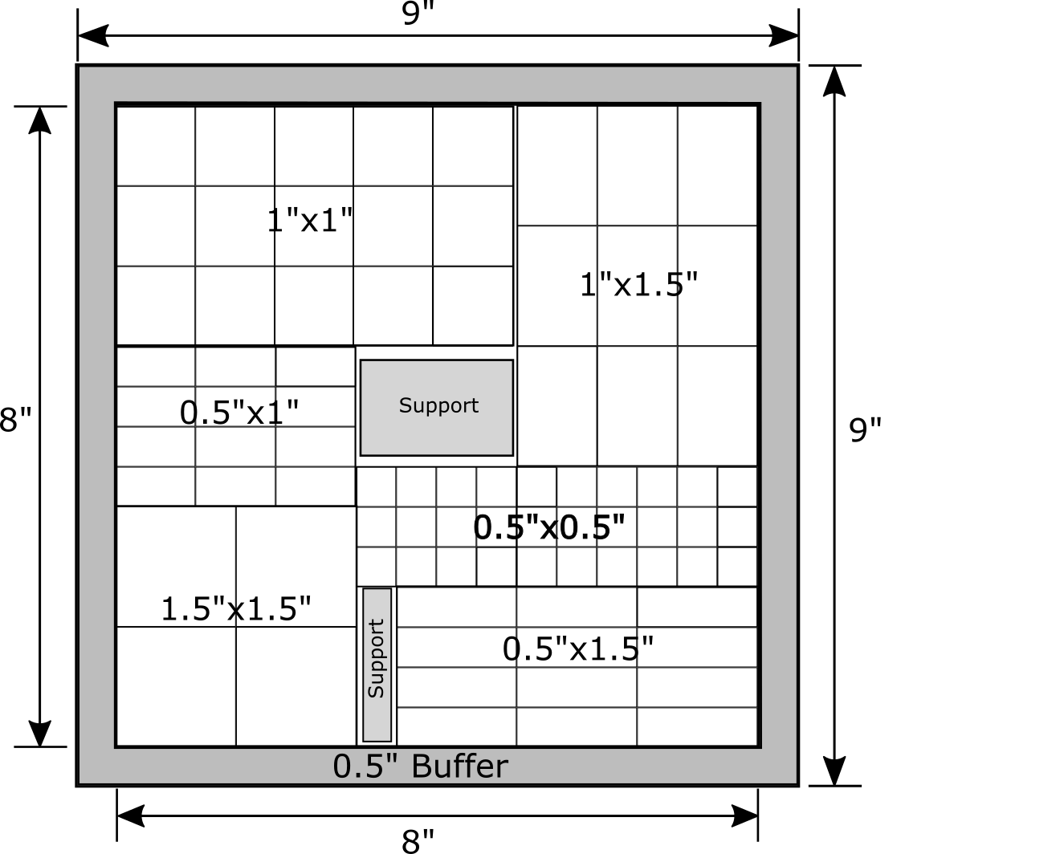
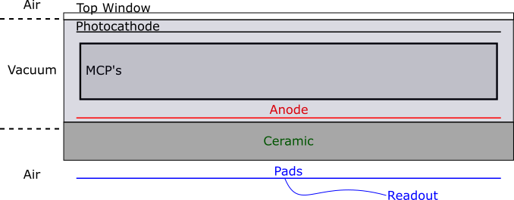
Testing Pads in Inside-Out
Test Board: Printed Copper Pads

Slide 9
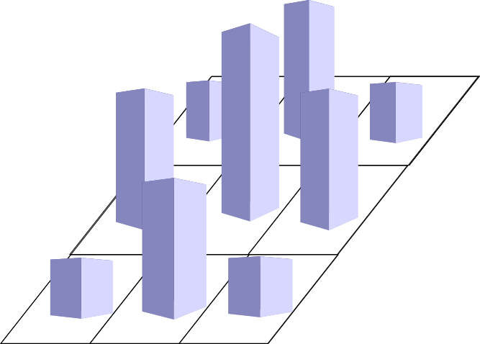
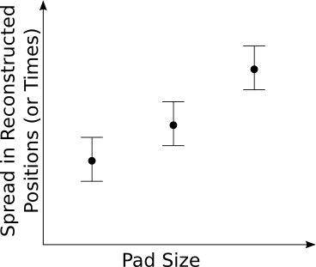
My Project
See how well the segmentation works
Compare time/position resolution to what is required at the LHC
I will soon be taking and analyzing data!
Mock-Up Plots

Slide 10
Conlcusion
Inside-out LAPPD has real applications
Can’t do segmentation without it. Would needs lots of readout channels running from vacuum to air

