Slide 1
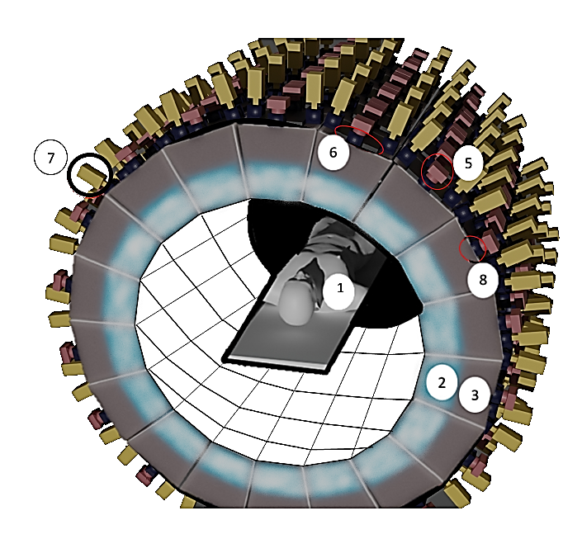
FIG. 1

Slide 2
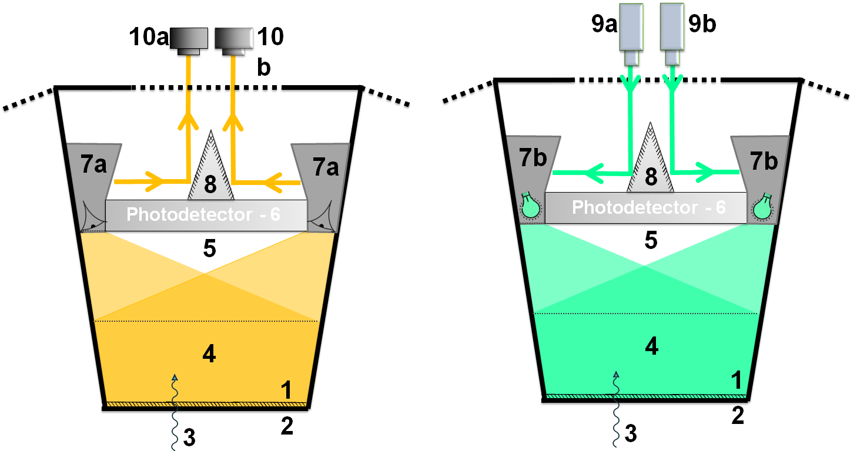
FIG. 2
Photodetector - 6
Photodetector - 6

Slide 3
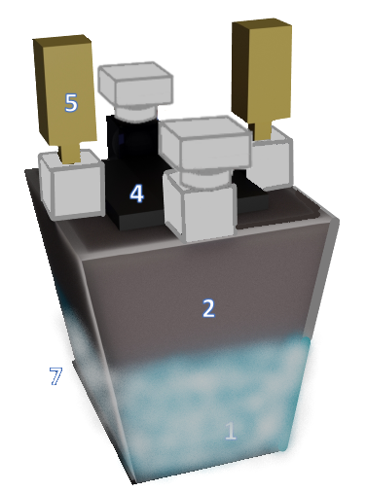
FIG. 3
6
5
3
4
2
7
1

Slide 4
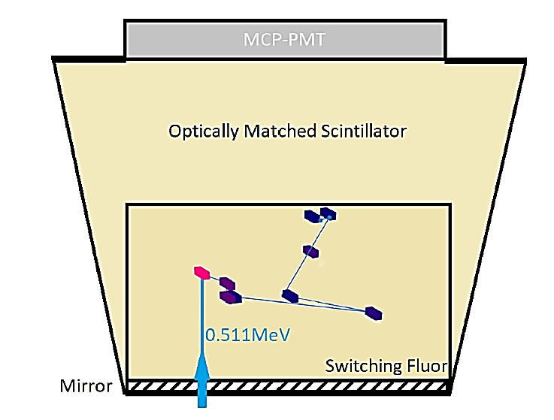
FIG. 4
FT-Photodetector
Optically Matched Volume
Switchillator (TM)
0.511MeV Incoming gamma ray

Slide 5
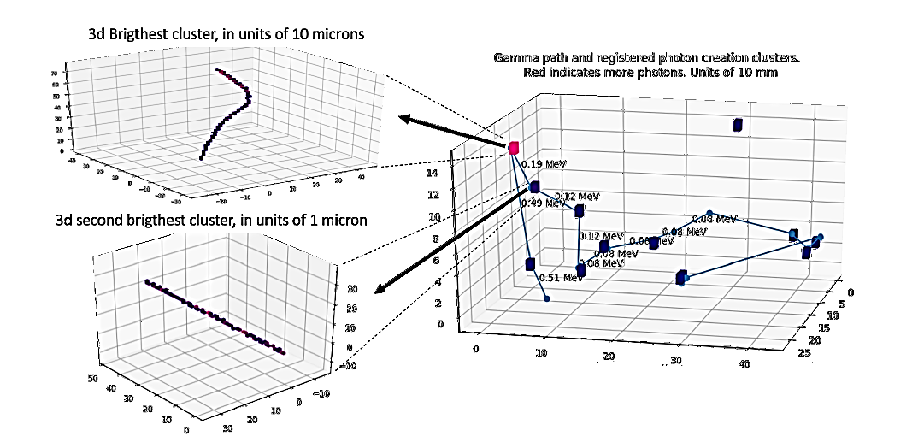
FIG. 5

Slide 6
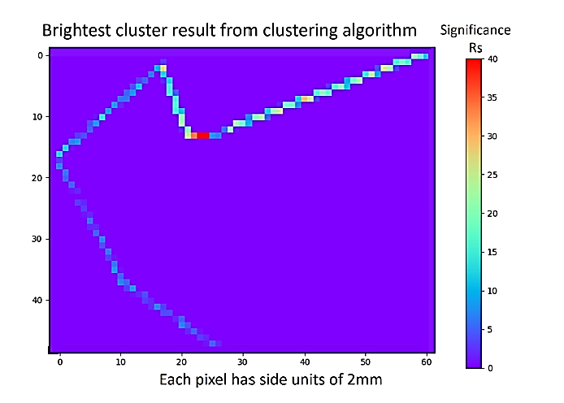
FIG. 6

Slide 7
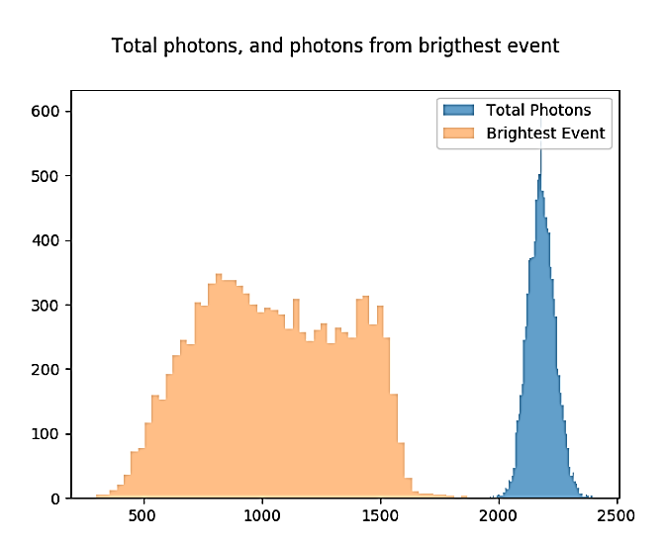
Section: 511 Gamma Energy Deposition
FIG. 7
Scintillation photons from the most energetic Compton scatter and from the entire sequence of scatters in a liquid scintillator by a 511keV gamma, 10000 events.
Total photons emitted from scatters
Photons from most energetic scattter
Counts
Number of Photons

Slide 8
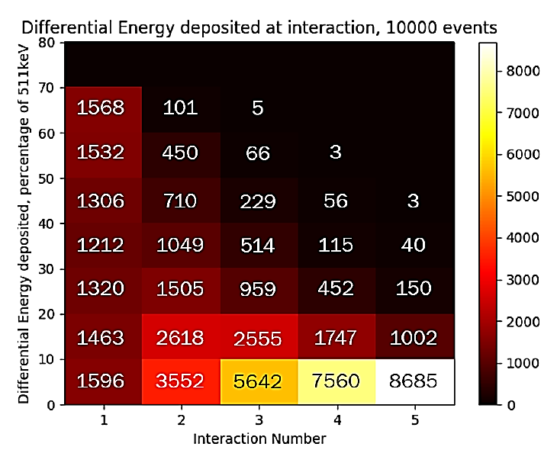
Section: 511 Gamma Energy Deposition
FIG. 8

Slide 9
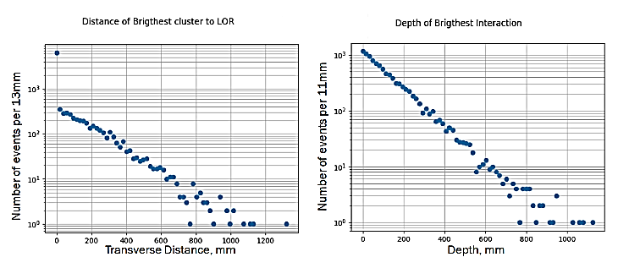
Section: 511 Gamma Energy Deposition
FIG. 9
Most energetic energy deposition

Slide 10
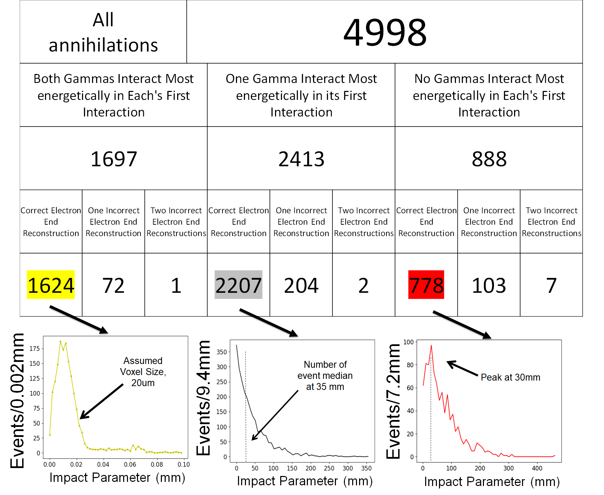
Both Gammas interact most
energetically in each’s first interaction
One Gamma interacts most
energetically in its first interaction
No Gammas interact most
energetically in each’s first interaction
FIG. 10

Slide 11
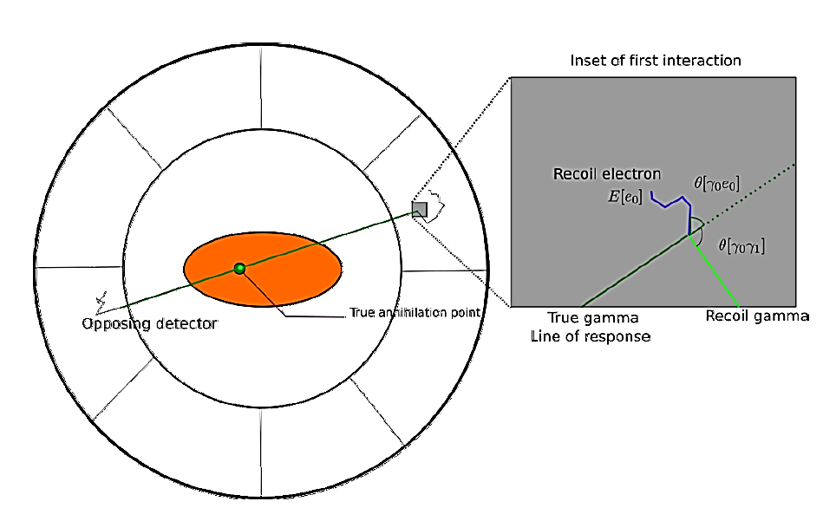
FIG. 11

Slide 12
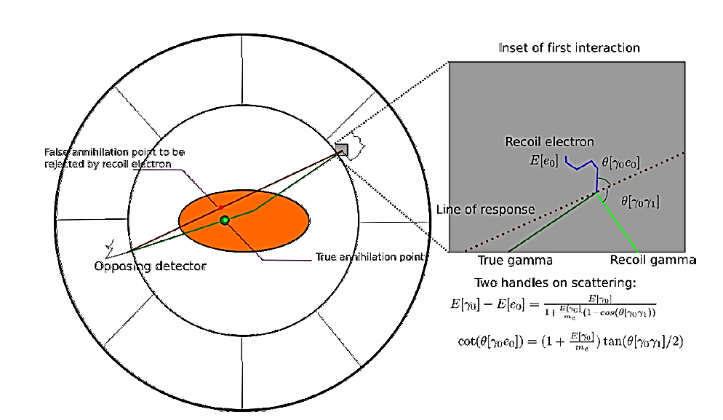
FIG. 12

Slide 13
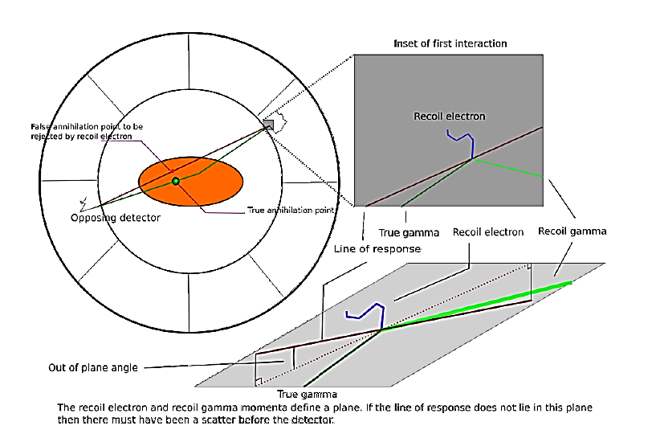
FIG. 13

Slide 14
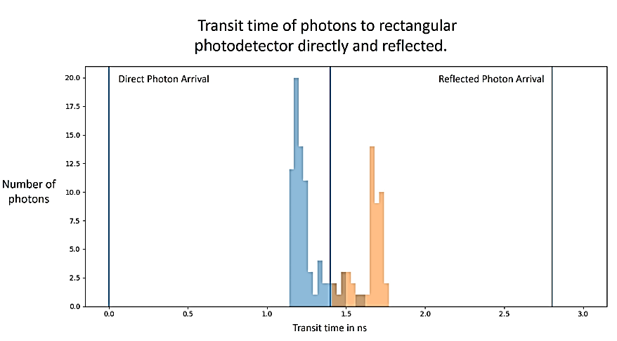
FIG. 14

Slide 15
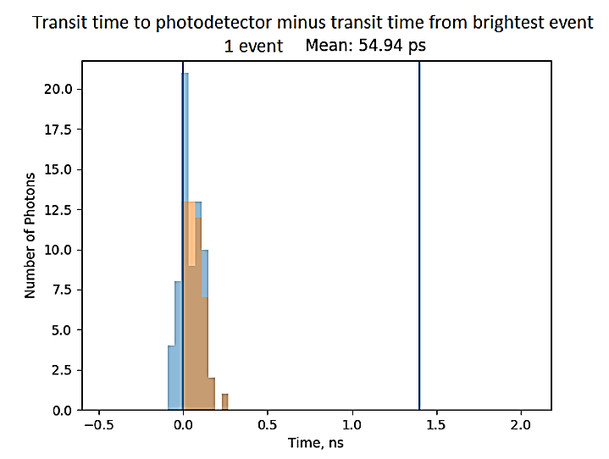
Section: Timing resolution
FIG. 15

Slide 16
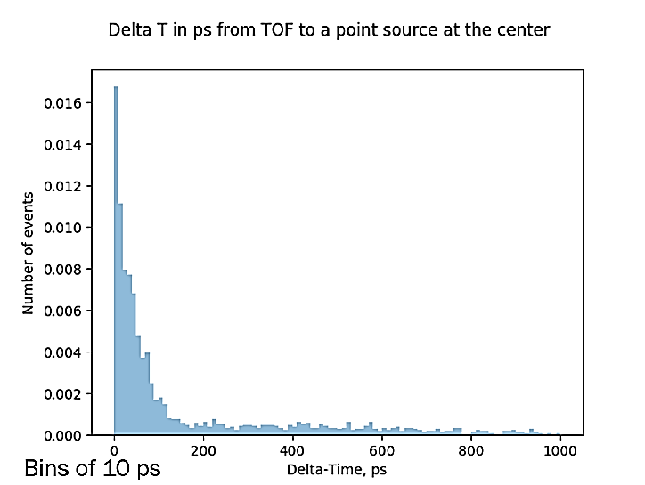
Section: Timing resolution
FIG. 16
Time of Flight resolution for an infinitely fast scintillator given a point source on the main axis of the detector.

Slide 17
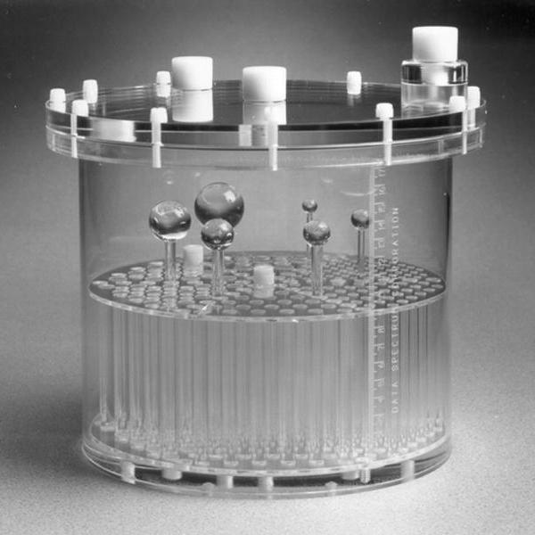
FIG. 17
Rod Height: 8.8 cm
Interior diameter: 21.6 cm

Slide 18
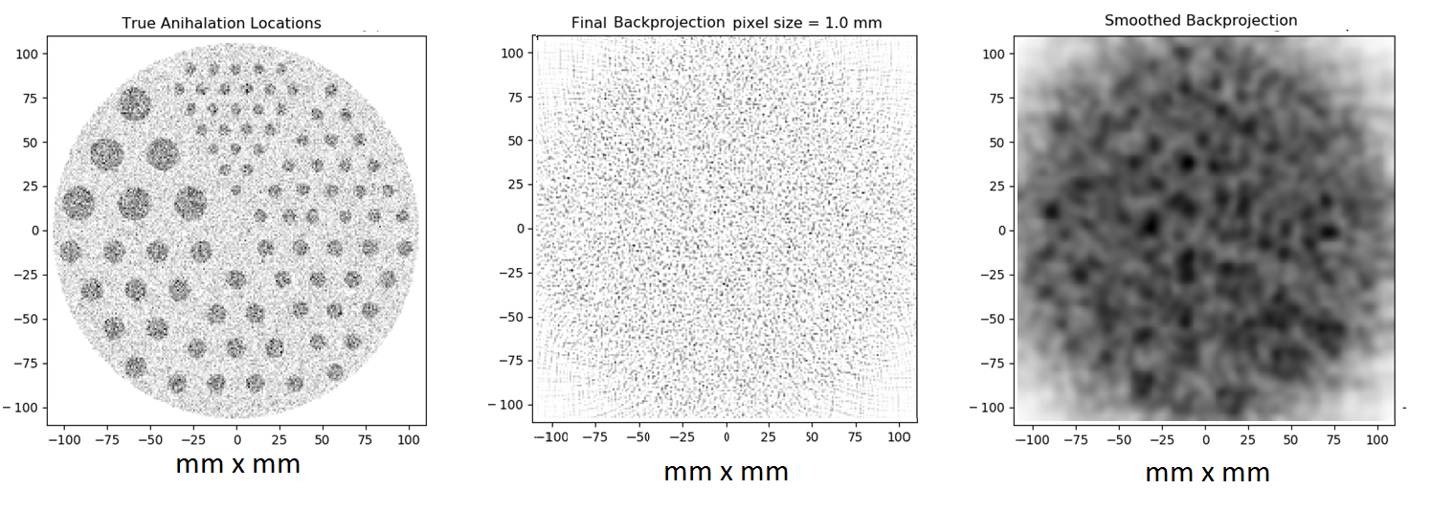
FIG. 18
100x DOSE REDUCTION
Generated Annihilations
Back-projected Image
Smoothed Back-projected Image

