Slide 1
Aerogel Structures for Photocathodes
Michael Pellin
Argonne Distinguished Fellow
Director, Materials Science Division
Thomas Prolier, Jeff Elam, Alex Martinson
Stacey Standridge (NU), Joe Hupp (NU)
1st Workshop on Photo-cathodes: 300nm-500nm
July 20-21, 2009: University of Chicago

Slide 2
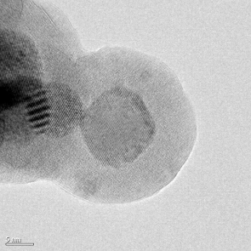
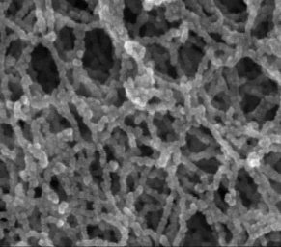
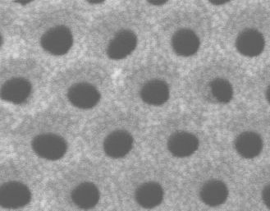
Atomic Layer Deposition (ALD)
Layer-by-layer thin film synthesis method
Atomic level control over thickness and composition (even on very large areas)
Precise coatings on 3-D objects
Some unique possibilities for morphology control

Slide 3
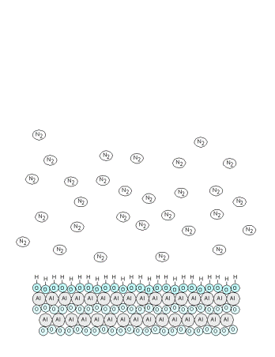

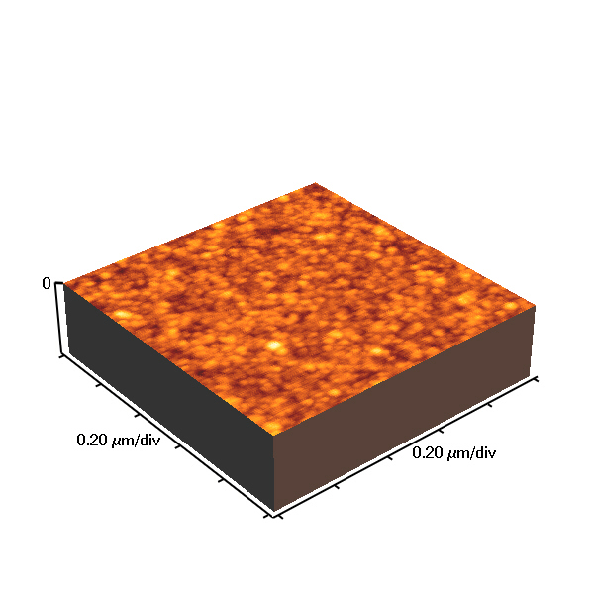
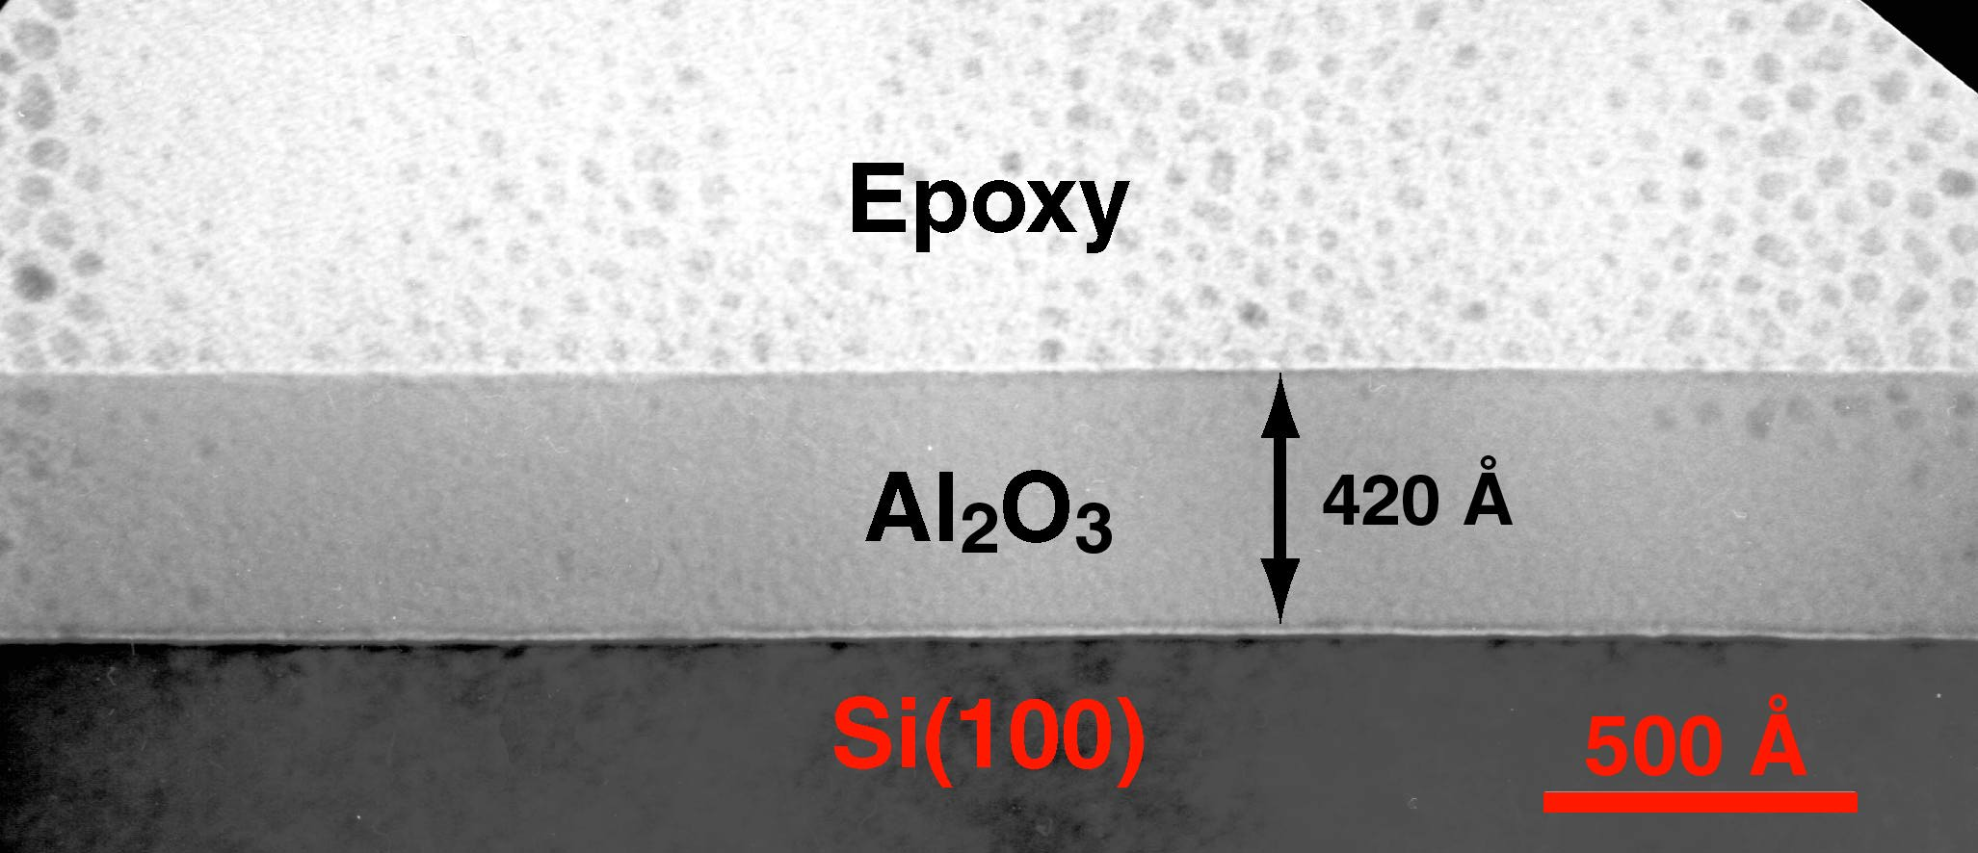

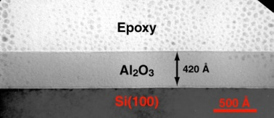
ALD Reaction Scheme
Ellipsometry
Atomic Force Microscopy
ALD involves the use of a pair of reagents.
  each reacts with the surface completely
  each will not react with itself
This setup eliminates line of site requirments
Application of this AB Scheme
  Reforms the surface
  Adds precisely 1 monolayer
Pulsed Valves allow atomic layer precision in growth
Viscous flow (~1 torr) allows rapid growth
  ~1 μm / 1-4 hours
4000
3500
No uniform line of sight requirement!
Errors do not accumulate with film thickness.
μm’s in 1-3 hrs
Pinholes seem to be removed.
Single Cell, 9 cell, re-entrant, in situ
3000
2500
Thickness (Å)
2000
1500
1000
500
0
Seagate, Stephen Ferro
0
500
1000
1500
2000
2500
3000
RMS Roughness = 4 Å (3000 Cycles)
ALD Films Flat, Pinhole free
AB Cycles
Flat, Pinhole-Free Film
Film growth is linear with AB Cycles

Slide 4
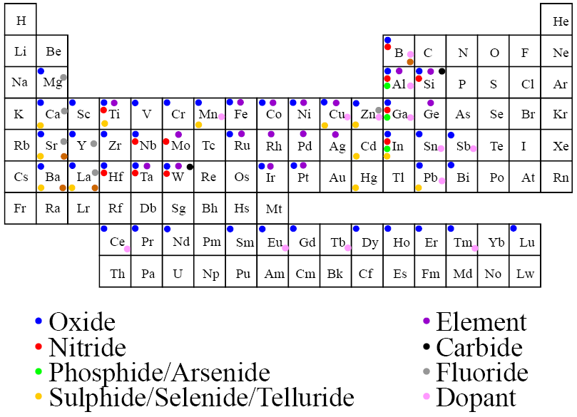
ALD Thin Film Materials

Slide 5
Why Aerogels?
Dark Current vs Signal
-> everywhere the same
radius of curvature
Readily fabricated
Extraordinary surface area and amplifying ability
Pseudo-1D e⁻ transport (with many cross links)
High porosity → improved efficiency
Multi-component ALD → allows biasing, recharging, efficient electron emission
aerogel
TCO
e- emitter
Notes:
Aerogels are easily fabricated. The low density ones involve forming a silica gel, setting the gel once deposited on a substrate with ammonium hydroxide, then the substrate undergoes supercritical CO2 extraction to leave the aerogel structure. The CO2 extraction is an industrial process often used in the pharmaceutical industry. It allows the removal of fluid without hydrostatic forces, thus leaving the low density, delicate aerogel structure intact.
The aerogel has a huge surface area for its mass, thus there exists an interesting possibility to amplify electrons with this material. The open area ratio is very close to 1.

Slide 6
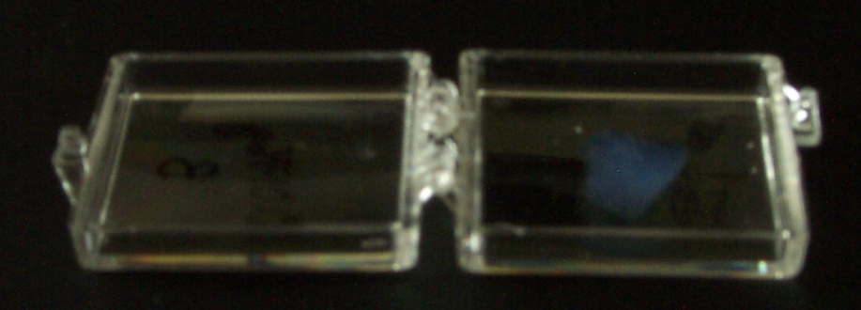
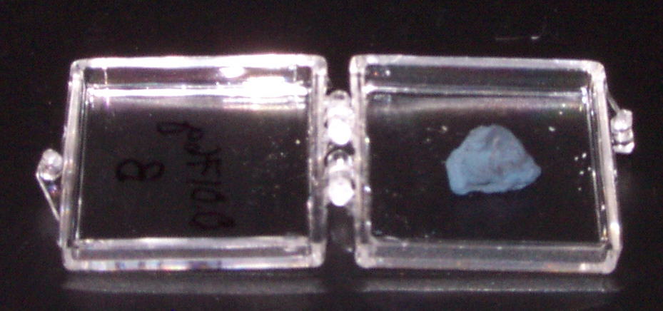
Silica Aerogel Coated with ZnO
Before Coating
Weight = 0.0176 g
After Coating
ALD Coating Conditions:
19 Cycles DEZ/H₂O
3 nm ZnO Coating
10 Torr, 100 s Exposures
T=177 °C
Weight = 0.1122 g
Weight Increase
=537%
Notes:
Here is an example of what can be done. At top is a silica aerogel, after just 3 nm synthesis of a ZnO coating on every internal surface of the aerogel, the mass has increase >500%. This is a testament to the high surface area.

Slide 7
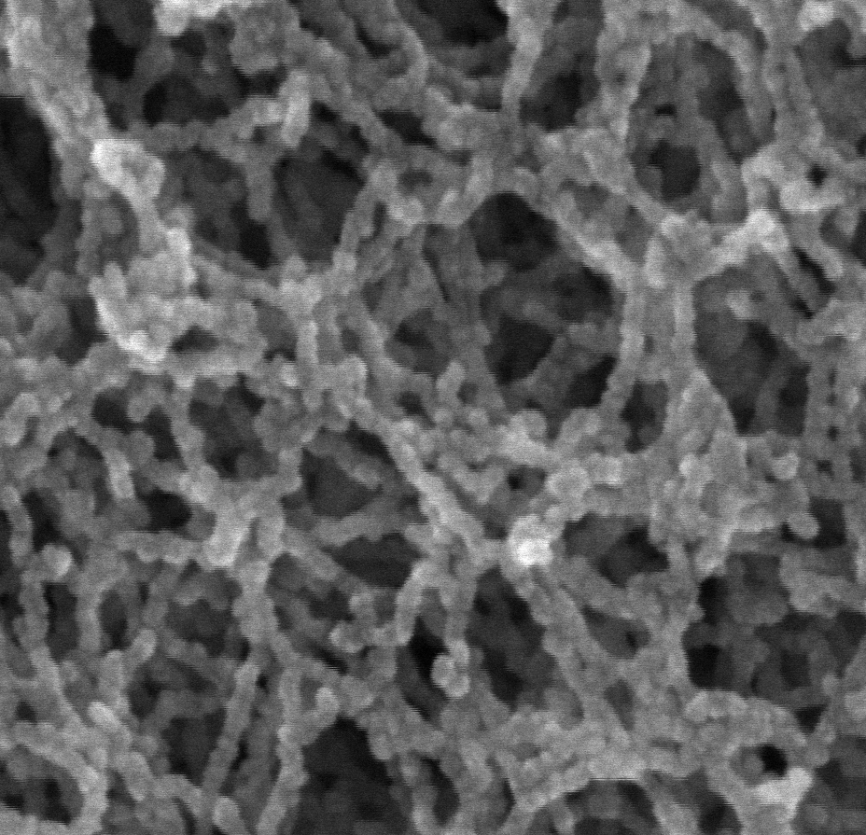
Aerogel Photoelectrodes:
High TCO loading (=conductance)
Continuous coating by ALD (conductivity measurements and SEM)
Growth on TCO platforms
High porosity
TCO
Aerogel film
Lower manufacturing cost than other PV technologies
Non-vacuum, low temperature fabrication
Very tolerant to impurities (no clean room necessary) – light absorption and charge separation occur close to interface
Inexpensive, abundant, benign materials (e.g. TiO₂, ZnO)
Robust nanoscale process
8 nm ZnO on Aerogel
Notes:
Here is an example of an aerogel photoelectrode. This consist of a 10 micron thick aerogel sitting on a quartz substrate with a Transparent Conducting Oxide (ITO) coated on the top surface to seal it.

Slide 8
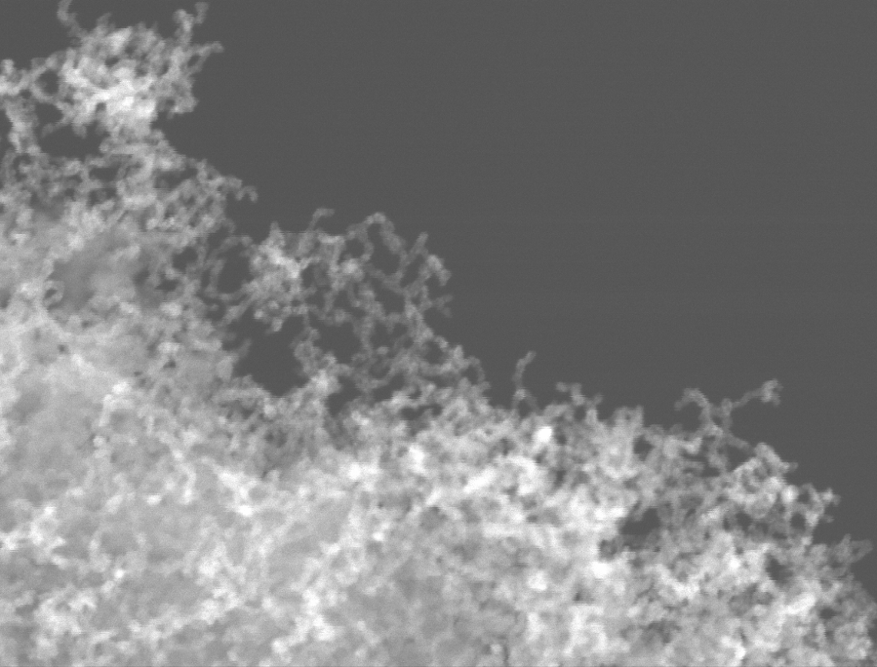
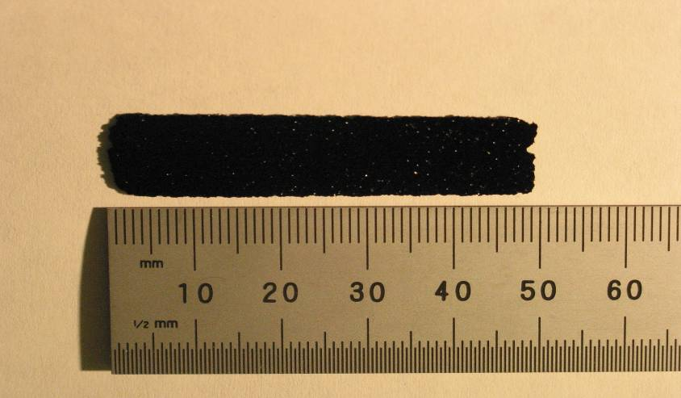
Carbon Aerogels
Density = 0.082 g/cc
Surface area=214 m²/g
Manufacturer=Southern Research Institute
10 nm filaments
150 nm
Aerogel Coating Conditions:
Nucleation Layer: 0.2 nm Al₂O₃
2 Cycles TMA/H₂O 5 Torr
600-300-600-300 s
T=200 °C
2) Metal Layer: 4 nm W
15 Cycles Si2H6 (5 Torr)/WF6 (10 Torr)
600-300-600-300 s
T=200 °C
Notes:
C aerogels have low density, high surface areas. Here we deposit on these substrates, with the same deposition cycle times demonstrated for silica aerogels. Here the substrate can be conducting. For this example Tungsten is coated on the aerogel.

Slide 9
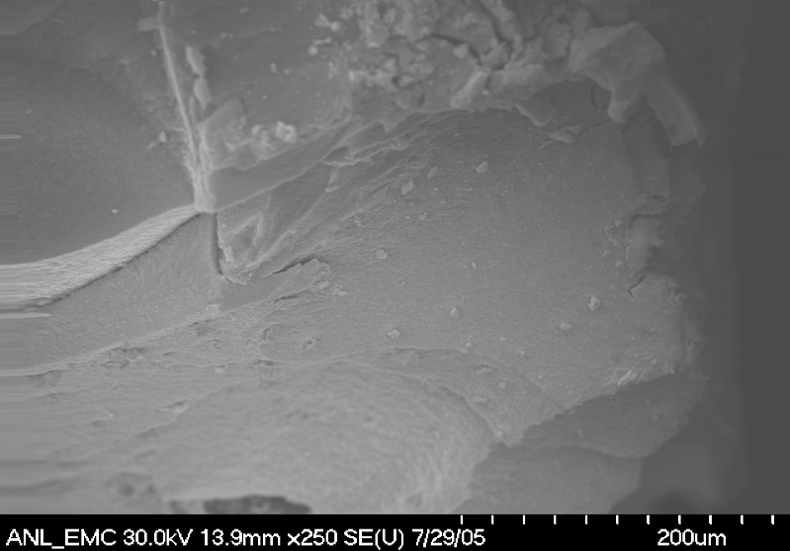


EDAX Maps of 10 nm ALD C-Aerogel
Cross section
Of ALD Coated and cleaved 1 mm thick
C-Aerogel:
ALD W extends to middle of 1 mm thick carbon aerogel
middle
edge
W
C
Notes:
Good news: EDAX maps show depositon and penetration of W through a 1 mm thick smaple.

Slide 10
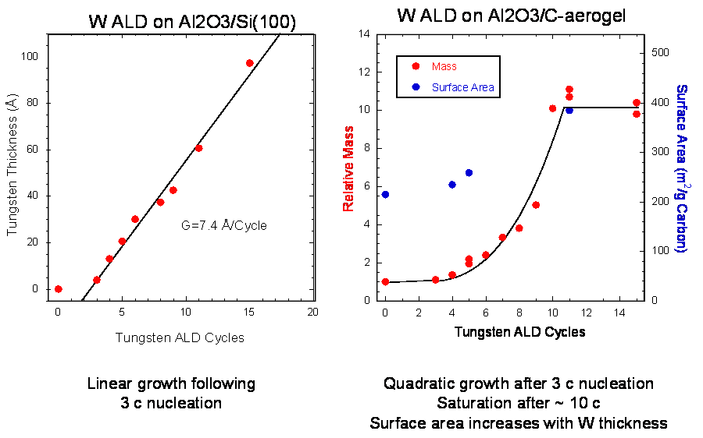
W Growth on C Aerogel
Closed pore volume
Notes:
Growth kintics are interesting. On the left we see a flat surface deposited in parallel with the C aerogel. The long pulse times shorten the nucleation cycle time, without significant increase in deposition rate. W aerogels have surface areas large enough that samples can simply be weighed. Each sample also had surface area measured with N2 adsorption (BET) method. We see three interesting weight regions. Nucleation is followed by quadratic growth which we ascribe to linear growth on increasing surface area. The increase comes from both roughness and area increas ewith aerogel filiment diameter increases. The growth abruptly stops. Here we believe closed pore volume is the culprit with ALD precursors no longer able to access large trapped volumes (N2 and the radeioactive ions can still reach this volume however.

Slide 11
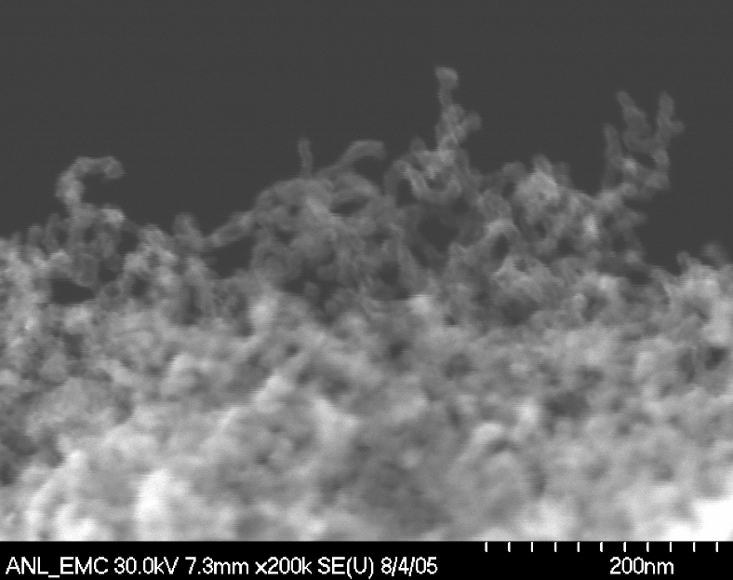
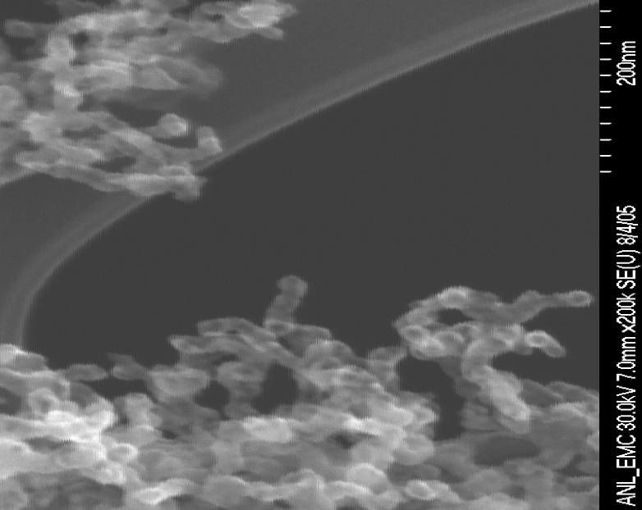
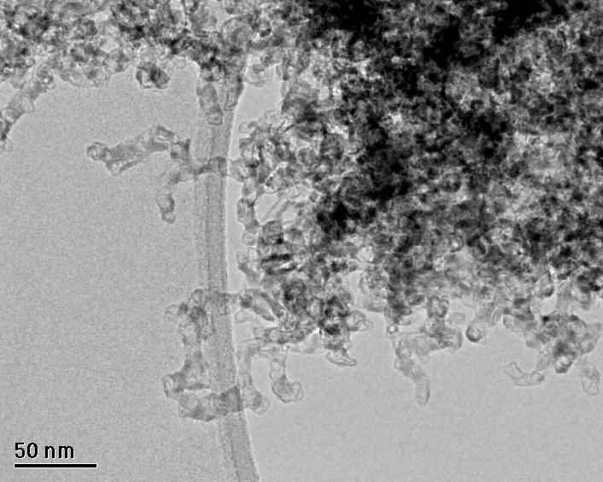
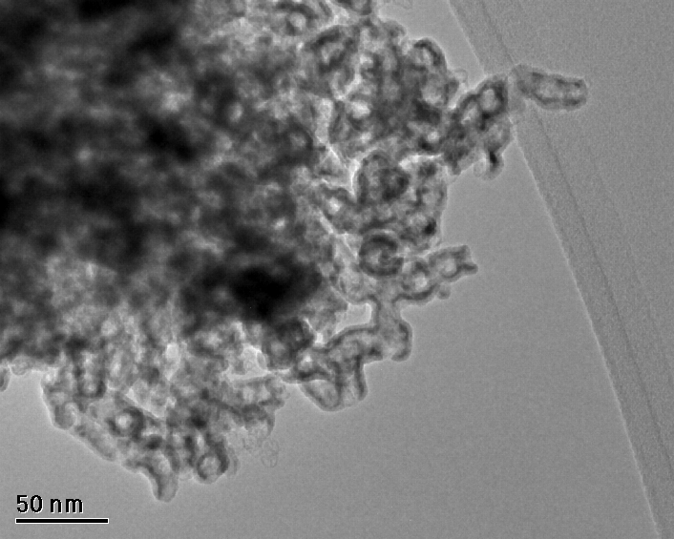
Microscopy of W-Coated Carbon Aerogels
3 c W
7 c W
SEM
80 nm
80 nm
TEM
Aerogel filament diameter increases with ALD W Cycles
Notes:
Microscopy shows the filiment diameter growth respponisble for some of the surface area increase.

Slide 12

Metal-coated aerogels are pyrophoric!
Notes:
Of coarse high surface area active materials would not be suitable for detectors because reactions would quickly oxidize the surface. Here a W coated C aerogel is removed to quickly form the ALD apparatus and the sample is demonstrated to be pyrophoric.

Slide 13
Conclusions: Aerogels
Aerogels are one of many nanostructured materials that may be of interest to the detector community.
Aerogels can be coated allowing the resistivity necessary to provide a kilovolt gradient.
Abundant surface area means amplification should be achieved over relatively thin structures.
Large areas are relatively easy to achieve + the self limiting properties of ALD encourages one to believe that these large areas can be uniformly coated.
Interestingly
  channel plate detectors achieve uniform flight times with very uniform structures
  Aerogels would achieve uniformity with random structure averaging
Remember 2ndary electrons are ejected without memory of their incoming direction.

