Slide 1
Alkali Metal Sources for Photocathodes and their Quantification – Getter Sources vs. Metallic Evaporation Sources
Charlie Sinclair
Cornell University (ret.)

Slide 2
Alkali (Na, K, Rb, Cs) Characteristics
Low melting temperature
High vapor pressure
Very high reactivity with most substances, metals and oxides in particular
Most compounds are hydroscopic
Form alloys with one another that are liquid at room temperature over a broad composition range

Slide 3
Alkali Metal Vapor Pressure
The vapor pressure of all liquid alkali metals is given by:
Log₁₀P(Torr) = A + B/(273 + T(ºC))
MEMTAL |  | A |  | B
Sodium |  | 7.585 |  | -5377
Potassium |  | 7.283 |  | -4453
Rubidium |  | 7.193 |  | -4040
Cesium |  | 7.046 |  | -3830
Metal
A
B

Slide 4
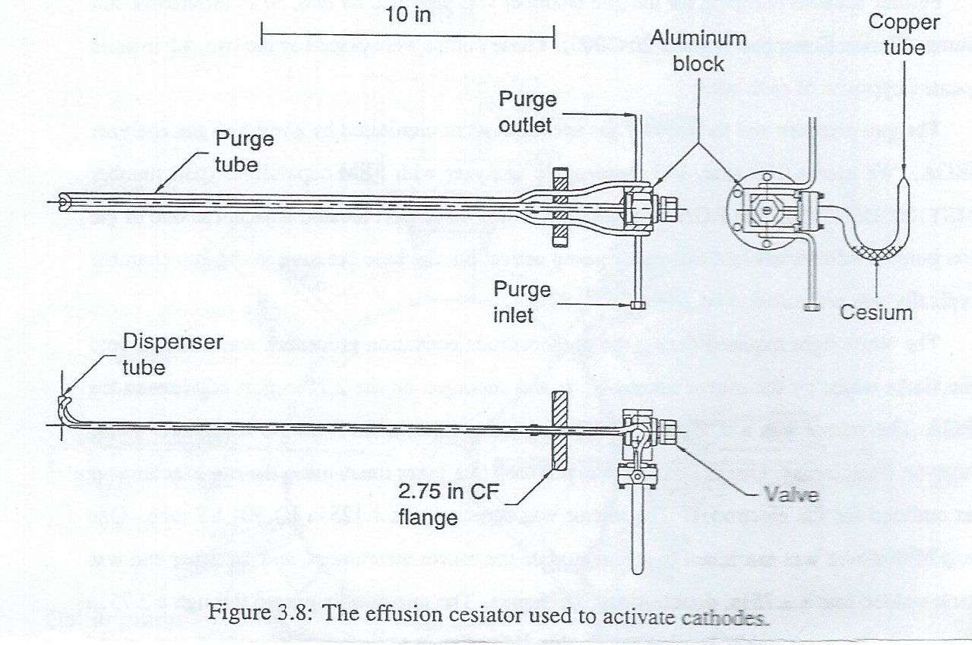
Metallic Cesium Source Construction

Slide 5
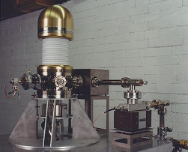
Cesium source on electron gun

Slide 6
Operation of Metallic Cs Source
Maintain delivery tube and nozzle at ~ 250 C, valve at about 230 C, and Cs tube to give desired vapor pressure.
Temperature maintained continuously, resulting in fairly quick response (seconds) to opening the valve
Delivered ~ 1 monolayer (for GaAs cathode) in ~ 1 minute
Used to make uniform QE on 35 mm GaAs by bouncing Cs off heated plate

Slide 7
Quartz Crystal Microbalance
Resonant frequency shifts downward as mass is added. For our 6 MHz crystal, 10 Hz is ~ 100 ngm ~ 1 monolayer of Cs.
Uncertainties are the number of atoms per monolayer, and the sticking coefficient (~1 for alkalis)
Measured at ~ 290 K and 77K, getting same result, implying a sticking coefficient ~ 1

Slide 8
Temperatures for other alkalis
A Cs vapor pressure of 3 to 6 x 10⁻⁴ Torr delivered ~ 1 monolayer/minute, with the Cs reservoir between 90 and 100 ºC
Similar vapor pressures would require reservoir temperatures of ~ 100 to 111 ºC for Rb, ~ 139 to 151 ºC for K, and ~ 211 to 224 ºC for Na, with correspondingly higher valve and delivery tube temperatures

Slide 9
Checking purity and contamination
Use quadrupole residual gas analyzer
SRS 200 amu with electron multiplier is the best instrument on the market
Can see alkalis and impurities easily to very low partial pressures (<10⁻¹³ Torr)
Calibrate with Xenon, which has nine stable isotopes with an abundance ratio of about 300

Slide 10
Langmuir-Taylor hot wire detector
Measure one dimensional beam profile with 50-100 μm precision
The ratio of ions/neutrals leaving a surface at temperature T is:
exp(e(I-φ)/kT)
Suitable wires are W (4.55 ev), Ir (5.27 eV), and Pt (5.65 eV)
Alkali ionization potentials are: Na (5.139), K (4.341), Rb (4.177), and Cs (3.894) eV

Slide 11
Hot Wire Signal
A cesium source delivering 1 monolayer per minute provides about 10¹³ atoms per cm² per second to the delivery area
Cs detection efficiency with a W wire at 1000K is >99.9%
A 1 cm length of 100 μm diameter wire will intercept ~ 10¹¹ e/sec, or 16 nA

Slide 12
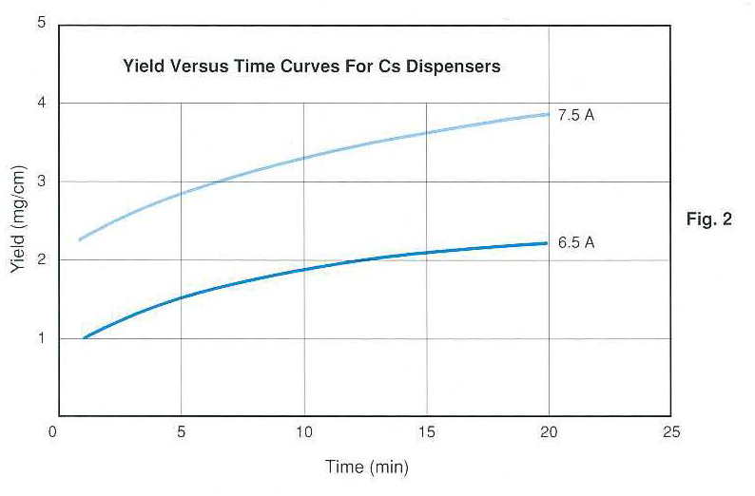
SAES Cs Yield vs. Time

Slide 13
Experience with SAES Cs Sources
Used for more than ten years for making GaAs photocathodes (which require ~ 1 monolayer of Cs per cathode)
Used only short length strips – 25 mm or less
Consistent Cs delivery performance, typically “yo-yo-ing” between 3.00 and 3.25 A
Zero evidence of any harmful contaminants – cathodes had 1/e dark lifetimes > 22,000 hours in actively pumped electron guns

Slide 14
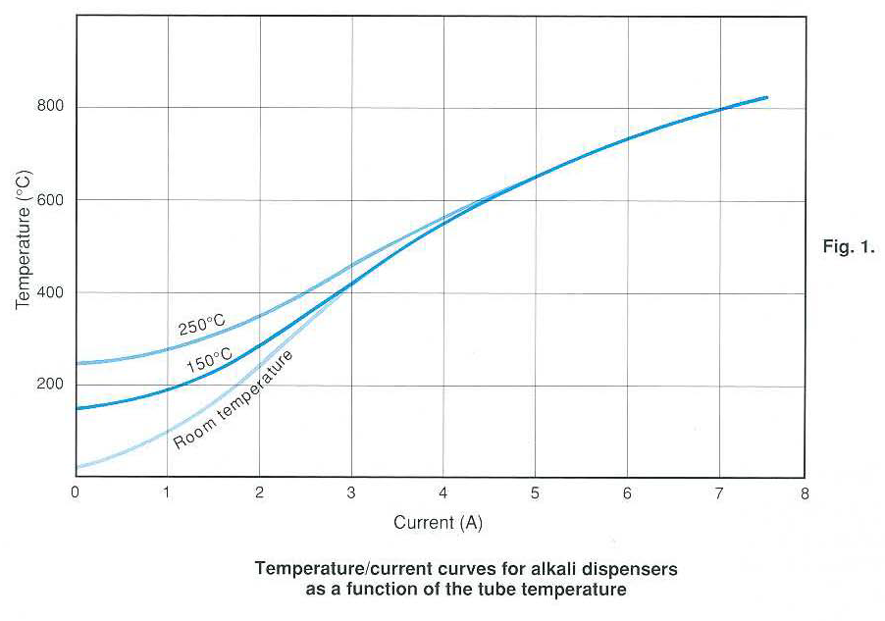
SAES Temperature vs. Current
~ 1 m.l. per minute
“No” Cs

Slide 15
SAES Cs Source Experience, cont’d.
Two strips mounted parallel to each other, in series electrically, gave good QE uniformity on larger area cathodes
Strips can be exposed to atmospheric pressure backfills multiple times, and still be used to deliver clean Cs to cathodes. Venting was to liquid nitrogen boiloff gas, but air (O₂, H₂O, CO₂, etc.) clearly was present.

Slide 16
Transverse Diffusion
Cs on GaAs shows NO surface mobility (Mainz, Jlab, Cornell)
Li on Cu shows NO surface mobility (SLAC)

Slide 17
Valuable References
Photoemissive Materials, by A. H. Sommer, Robert E. Kreiger Publishing Company, 1980
Experimental Innovations in Surface Science, by John T. Yates, Springer-Verlag, 1998
The Physical Basis of Ultrahigh Vacuum, by P. A. Redhead et al., AIP, 1993
Handbook of Materials and Techniques for Vacuum Devices, by Walter H. Kohl, AIP, 1995

