Slide 1
Bandwidths of Transmission Line Anodes
Jean-Francois GENAT
LPNHE Paris
LAPPD Workshop, Chicago, April 26th 2011

Slide 2
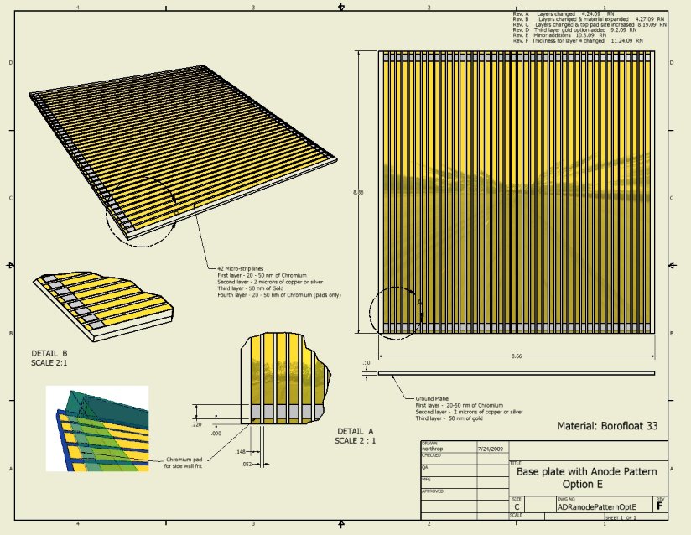
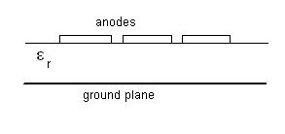
LAPPD 8” x 8” Micro-channel Plates
Micro-strip Lines
Parameters:
- Strip width W
- Inter-strip distance d
- Metal conductivity σ
- Dielectric constant ε _{r}
Jean-Francois Genat, LAPPD Workshop, Chicago, April 28th 2011

Slide 3
Timing resolution
where
Since
whith
and
(Stefan Ritt)
Jean-Francois Genat, LAPPD Workshop, Chicago, April 28th 2011

Slide 4
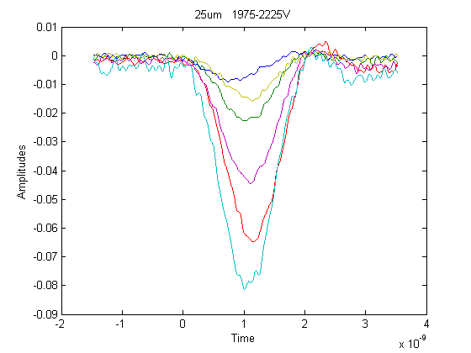
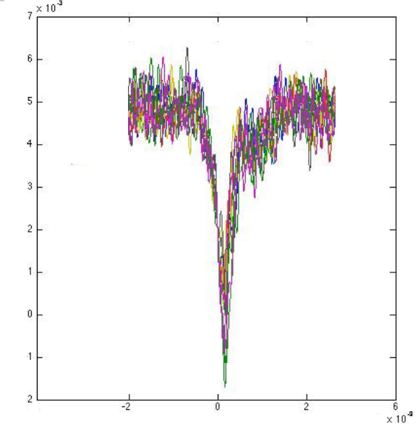
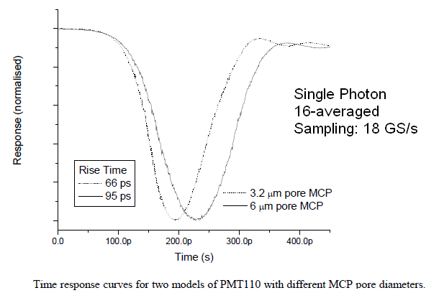
MCP signals
Segmented anodes, Burle-Photonis Glass + ALD MCPs (from Matt Wetstein, ANL)
Rise-time 66ps
abw=5.3 GHz
Jean-Francois Genat, LAPPD Workshop, Chicago, April 28th 2011

Slide 5
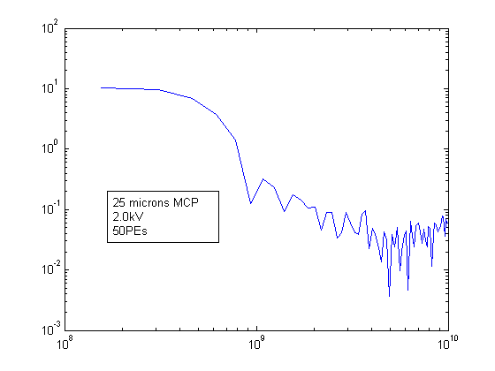
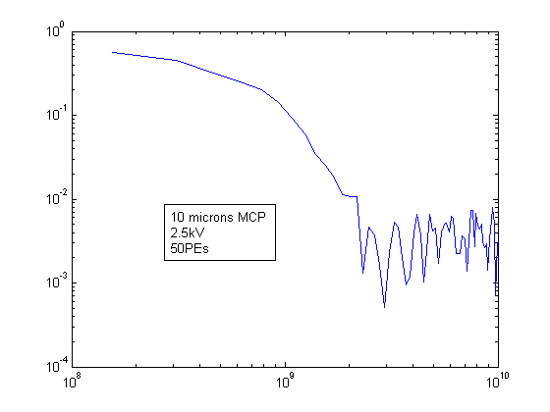
MCP ‘nominal’ signals spectra
25 microns at 2 kV, 50 Photo-electrons
10 microns at 2.5 kV “
Data taken at Argonne
(Ed May’s laser test stand)
Jean-Francois Genat, LAPPD Workshop, Chicago, April 28th 2011

Slide 6
‘Nominal’ Timing resolution (model)
Assume:
SN = 50
f_{s}= 10 GS/s
abw = 1 GHz
T_{r} = .35/abw = 350ps
T_{s} = 1/ f_{s} = 100ps
Jean-Francois Genat, LAPPD Workshop, Chicago, April 28th 2011

Slide 7
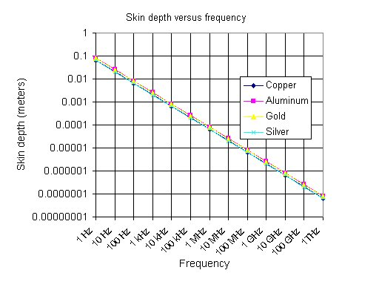
Skin effect
Resistivity and
Skin Depth at 1 GHz
Al 2.8 nΩ.m 2.4 μm
Au 2.4 2.4
Cu 1.7 2.0
Ag 1.6 1.9
No need to have more than 10μm metal (~5 x δ at 1 GHz)
Jean-Francois Genat, LAPPD Workshop, Chicago, April 28th 2011

Slide 8
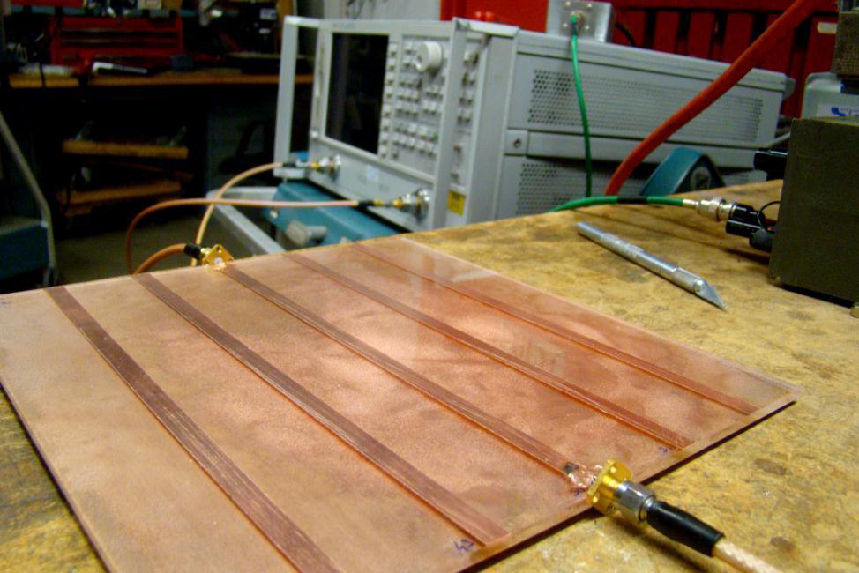
Test plate
Jean-Francois Genat, LAPPD Workshop, Chicago, April 28th 2011
Notes:
8

Slide 9
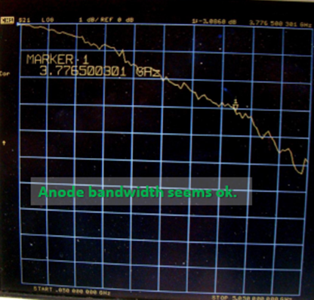
Measured Microstrip Bandwidth
3dB bandwidth is 3.77GHz for a 8” trace
This measured bandwidth agrees with the simulations using HFSS (Mentor-Graphics)
Jean-Francois Genat, LAPPD Workshop, Chicago, April 28th 2011
Notes:
9

Slide 10
Transmission Lines Bandwidths
Two main factors for losses:
- Resistance of the metal traces vs 50 Ω: metal conductivity, skin effect, as
- Dielectric losses: complex dielectric constant
The Borofloat glass loss tangent is unknown at 10 GHz, but we measured it at 3.77 GHz for
a 8 ’’ long microstrip line.
The loss tangent at 10 GHz can be deduced from this measurement to
Copper
10 GHz
A 5m copper line has a metal induced 3dB bandwidth of 10 GHz
Jean-Francois Genat, LAPPD Workshop, Chicago, April 28th 2011

Slide 11
Examples with Quartz and Alumina
Dielectric losses
Example: f=10GHz, tan(δ)= 6 10⁻⁵ , C=60pF/m, Z₀=50Ω
Quartz
Alumina
The strip length for a 3dB bandwidth is:
At 10 GHz:
Quartz: 58m
Alumina: 35m
Jean-Francois Genat, LAPPD Workshop, Chicago, April 28th 2011
Notes:
11

Slide 12
Thanks !

Slide 13
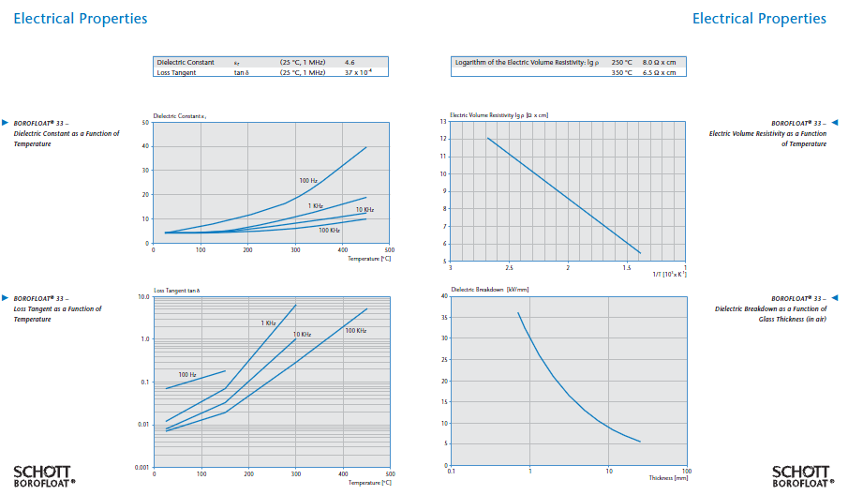
Borofloat 33 properties
Jean-Francois Genat, LAPPD Workshop, Chicago, April 28th 2011
Notes:
13

Slide 14
Dielectric constants
Dielectric constant Loss tangent @ 1 GHz
Quartz 3.8 1.15 10⁻⁵
Beryllia 6.7 1.4 10⁻⁵
Fused Quartz 3.8 5 10⁻⁵
Alumina 96% 10 2.0 10⁻⁴
Alumina 99.5% 9.6 3.0 10⁻⁴ 10 GHz
Glass (Borofloat) 4.6 3.7 10⁻³ 1 MHz 5.0 10⁻³ 3.7GHz
RF ceramic 6.1 3 10⁻³
Jean-Francois Genat, LAPPD Workshop, Chicago, April 28th 2011
Notes:
14

Slide 15
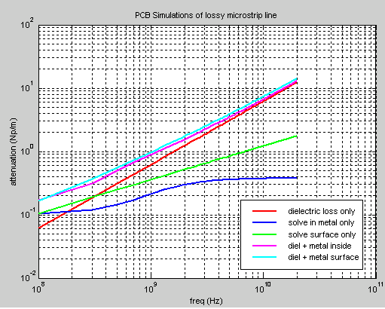
Example: FR4 Microstrip line Losses
Dielectric FR4 losses dominate > 200 MHz
Conductor losses contribute > 5 GHz
Andrew Byers (Tektronix)
Jean-Francois Genat, LAPPD Workshop, Chicago, April 28th 2011
Notes:
15

