Slide 1
Ivan Bazarov
Physics Department, Cornell University
Fundamental processes in III-V photocathodes; application for high-brightness photoinjectors

Slide 2
Contents
Motivation
NEA photoemission
Some practical aspects
Study cases: GaAs, GaAsP, GaN
Summary

Slide 3
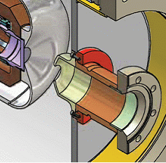
Why are we interested?
Photoinjectors: a photocathode in high electric field (>> MV/m), either DC or RF
Relativistic electrons can be further accelerated in a linac (linear accelerator) without degradation of beam brightness:
CW ultra-bright x-ray sources; high power FELs
Electron-ion colliders and ion coolers
Ultrafast electron diffraction, etc.

Slide 4
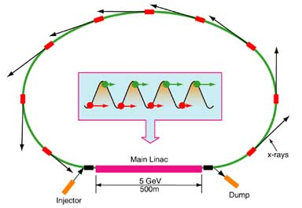
Energy recovery linac
Energy recovery linac: a new class of accelerators in active development
Essentially removes the average current limitation typical to linacs (i.e. P_{beam} >> P_{wall plug})
Average currents 10’s to 100’s of mA can be efficiently accelerated (and de-accelerated)

Slide 5
Cathode figures of merit
QE and photon excitation wavelength
E.g. 1W of 775 nm (Er-fiber λ/2) ⇒ 6.2 mA/% 520 nm (Yb-fiber λ/2) ⇒ 4.2 mA/% 266 nm (Nd-glass λ/4) ⇒ 2.1 mA/%
Transversely cold (thermalized) electron distribution
Directly sets the solid angle of the emitted electrons; an upper limit on achievable beam brightness

Slide 6
Figures of merit (contd.)
Prompt response time
A picosecond response is essential to take advantage of the space charge control via laser pulse shaping
Long lifetime and robustness
Extraction of many 100’s to 1000’s of C between activations are necessary to make the accelerator practical

Slide 7
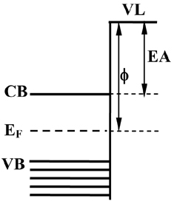
Negative electron affinity
Defined as vacuum level E_{vac} relative to the conduction band minimum
Negative affinity: the vacuum level lies below the CBM ⇒ very high QE possible
NEA:
1) band bending
2) dipole layer

Slide 8
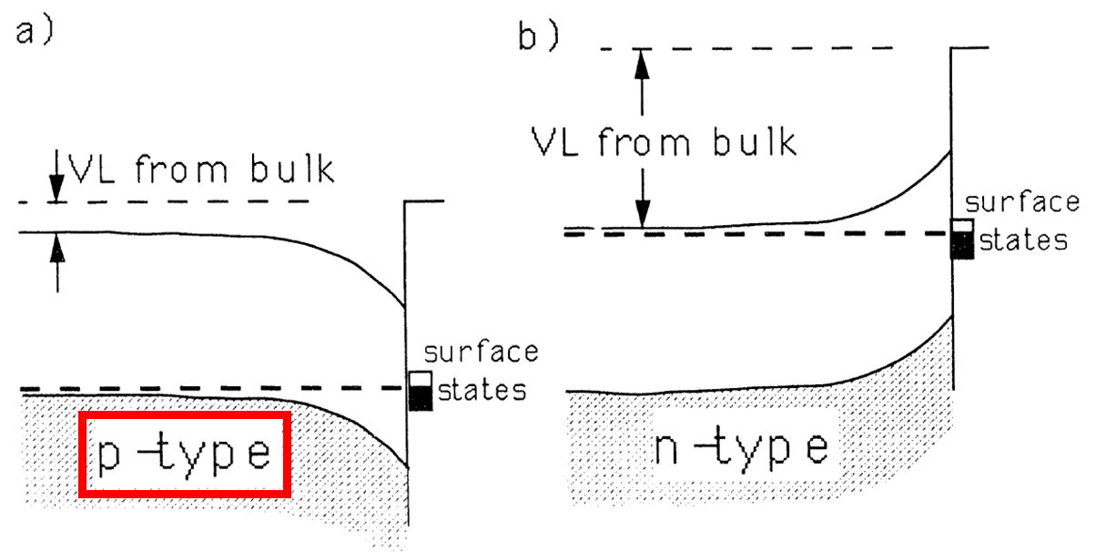
Strong p-doping
~10¹⁹ cm⁻³
Alperovich et al., Phys. Rev. B 50 (1994) 5480: clean p-doped GaAs has Fermi level unpinned and shows little band bending

Slide 9
NEA: Cs ~monolayer
Cs was found to play a larger role for NEA instead: 1) band bending through donor surface states, and 2) dipole surface layer from polarized Cs adatoms
Cs-induced donor-like surface states contribute their electrons to the bulk
Hole depleted region (negatively charged acceptors) lead to band bending region
-
-
+
-
+
p-doped
bulk (neutral)
ionized Cs
-
-
+
+
-
+
+
bb region

Slide 10
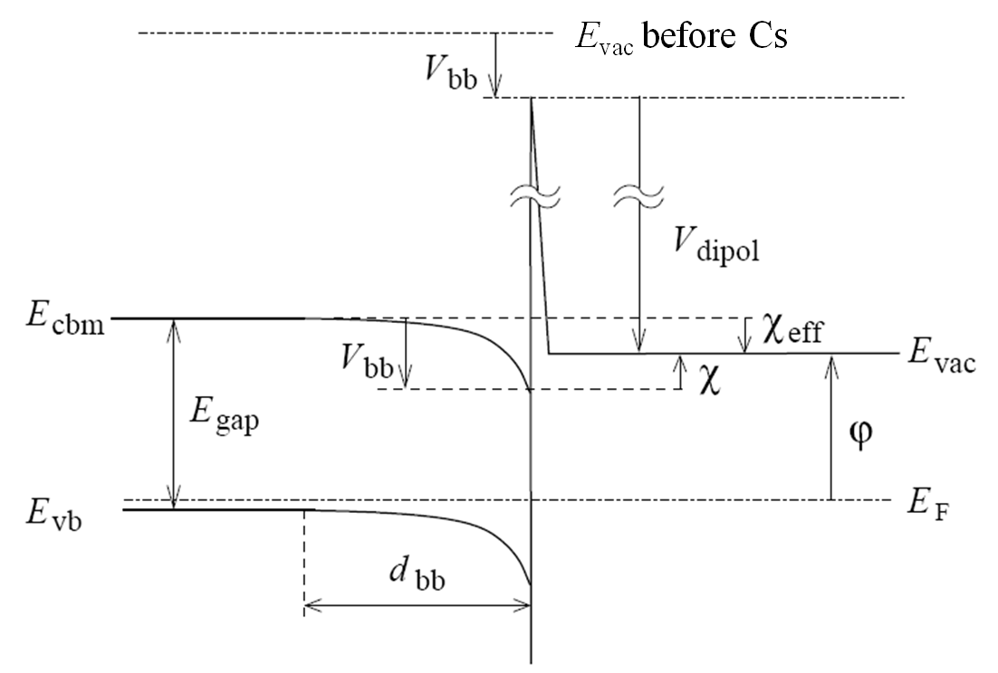
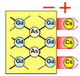
NEA: ~Cs monolayer (contd.)
Majority of Cs atoms become only polarized (not ionized), forming a dipole layer (e- Cs+)
GaAs
E_{gap} = 1.42 eV
Before Cs
χ = 4 eV
After Cs
χ_{eff} ~ -0.1 eV
V_{bb} ~ 0.4 eV
d_{bb} ~ 10 nm

Slide 11
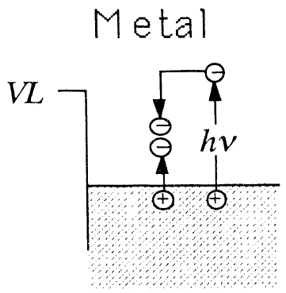
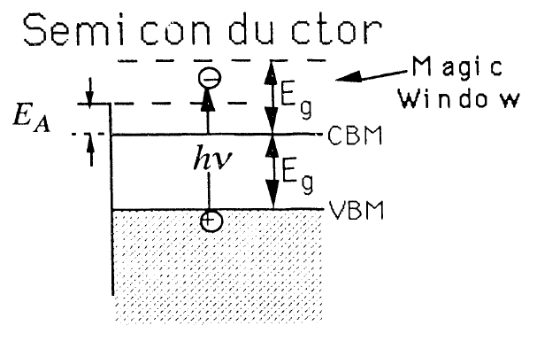
Spicer’s magic window
(1)
(2)
(1) electron-electron scattering: typical of metals, large energy loss per collision
(2) electron-phonon scattering: slowly depletes excessive energy of excited electron (LO phonons in GaAs ~ 35 meV)
“Magic window”: in semiconductors, one needs excess KE > E_{gap} for e–/e– scattering. Thus, electrons excited with E_{vac} < KE < E_{VBM} + 2E_{gap} have excellent chances of escape

Slide 12
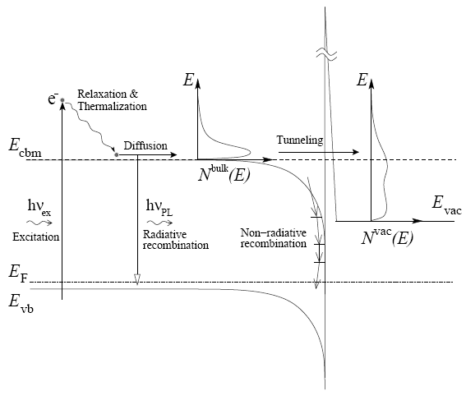
Electron transport processes
CBM thermalization time: 0.1-1ps
Electron-hole recombination: ~ns
Emission time: ∝ 1/(α²D) strong wavelength dependence

Slide 13
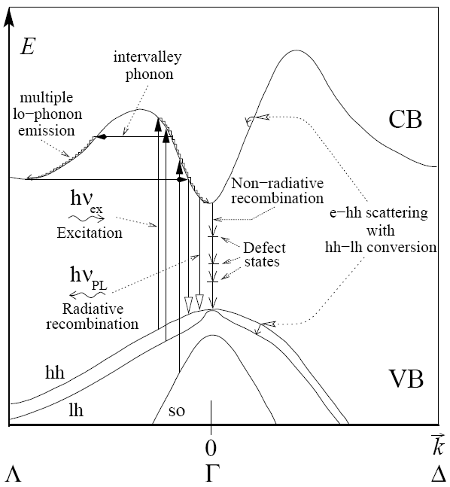
Energy vs. momentum

Slide 14
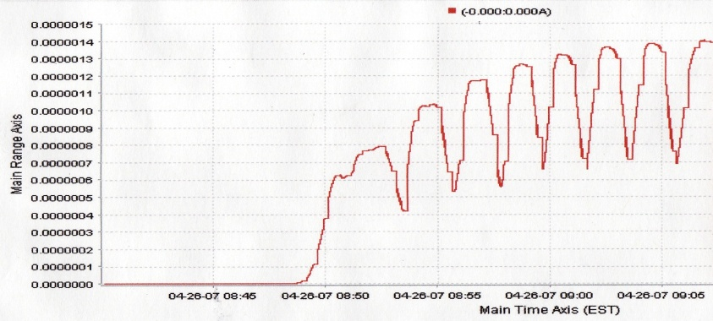
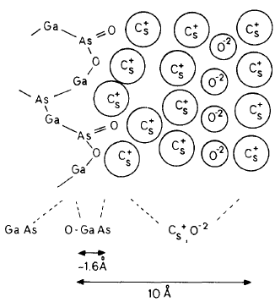
Role of fluorine/oxygen
Routine “yo-yo” activation employs O₂ or NF₃
Further reduction of affinity consistent with a double dipole model
Stabilizes Cs on the surface; no lifetime or otherwise apparent advantage for either gas
Bonded unstable nitrogen is found on Cs-NF₃ activated surfaces (APL 92, 241107)
Yo-Yo Activation
JAP 54 (1983) 1413

Slide 15
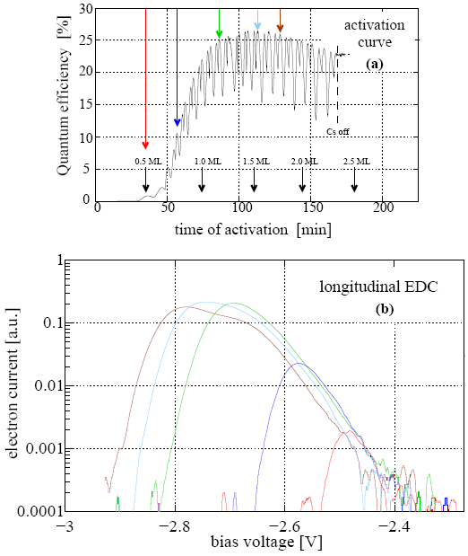
GaAs: Optimal Cs coverage
laser wavelength: 670 nm
Ugo Weigel, PhD thesis

Slide 16
Lifetime matters
H₂O, CO₂ and O₂ can lead to chemical poisoning of the activated layer
Low current (~ 1μA) 1/e lifetimes ~ 100 hours typical in our prep chambers
3-5 times better in the DC gun (low 10⁻¹² Torr vacuum)
High average current (mA’s) lifetime limited by ion backbombardment

Slide 17
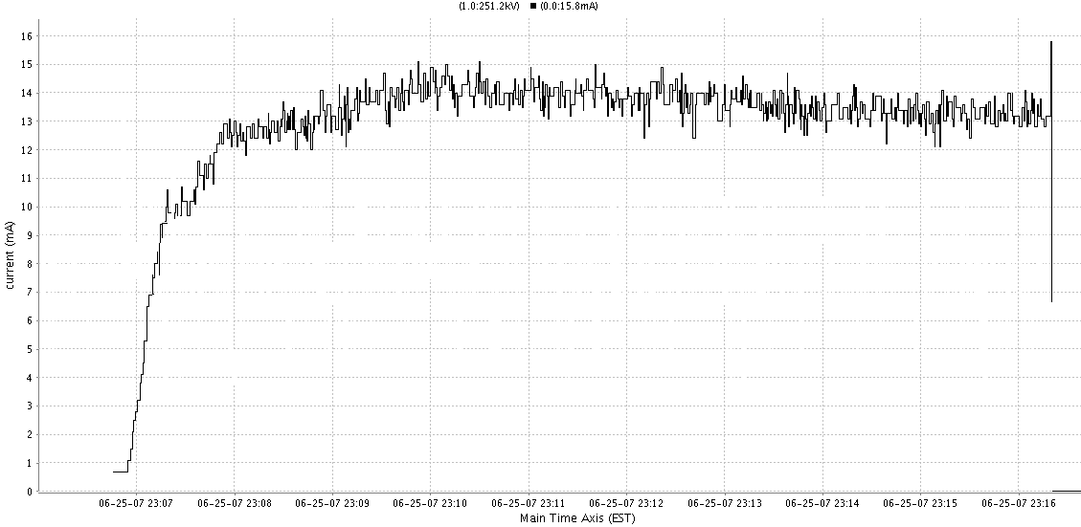
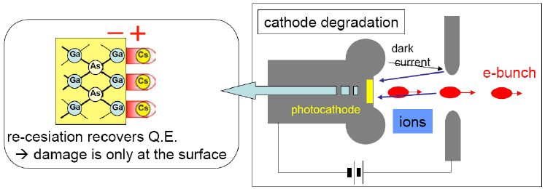
14 mA
10 min
~5 hour lifetime (limited by gas backstreaming from the beam dump), i.e. 20 hours 1/e for 5 mA

Slide 18
Study cases
Our group has been evaluating III-V photocathodes
Transverse energy of electrons (thermal emittance)
Measure the photoemission response time
Materials studied so far
GaAs @ 450-850nm: JAP 103, 054901; PRST-AB 11, 040702
GaAsP @ 450-640nm: Ibid
GaN @ 260nm: JAP 105, 083715

Slide 19
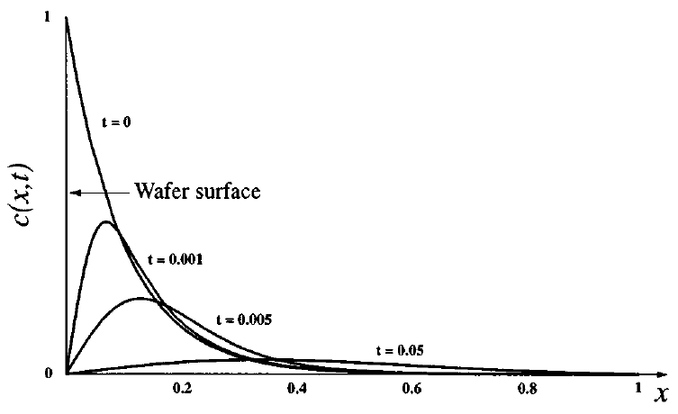
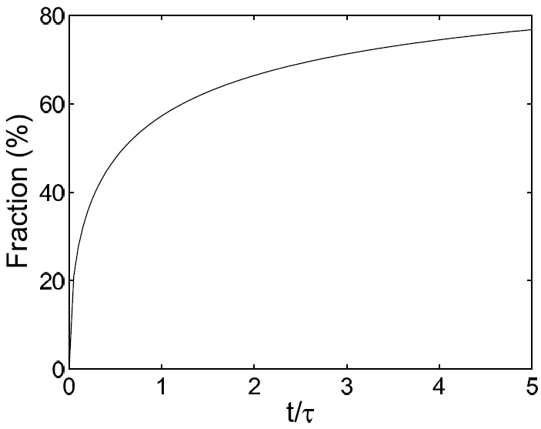
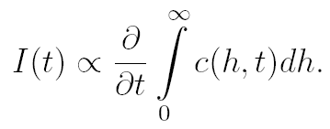
Diffusion model
subject to:

Slide 20
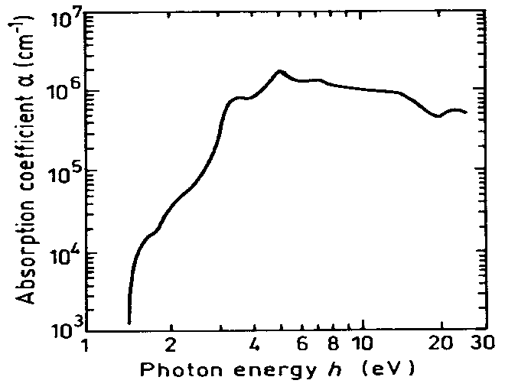
GaAs absorption
response time expected to scale as α^{–2} with wavelength (a lot!)

Slide 21
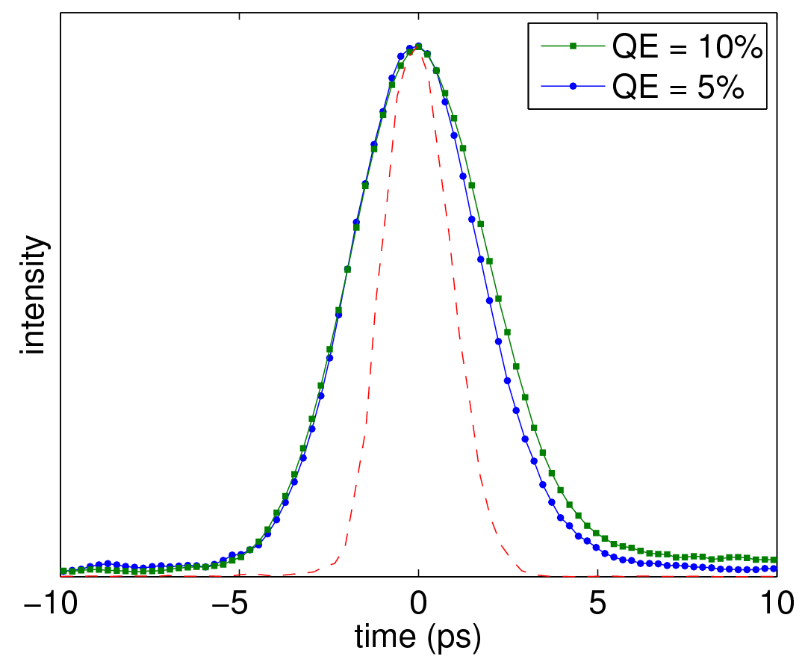
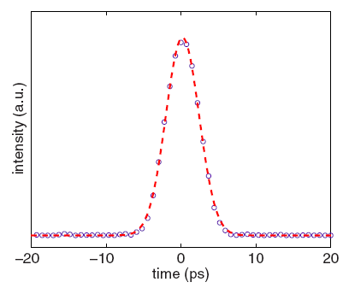
Prompt emitters
GaAs @ 520 nm
GaN @ 260 nm
deflector off
Measurements done by transverse deflecting RF cavity
Limited by 1.8 ps rms resolution dominated by laser to RF synchronization

Slide 22
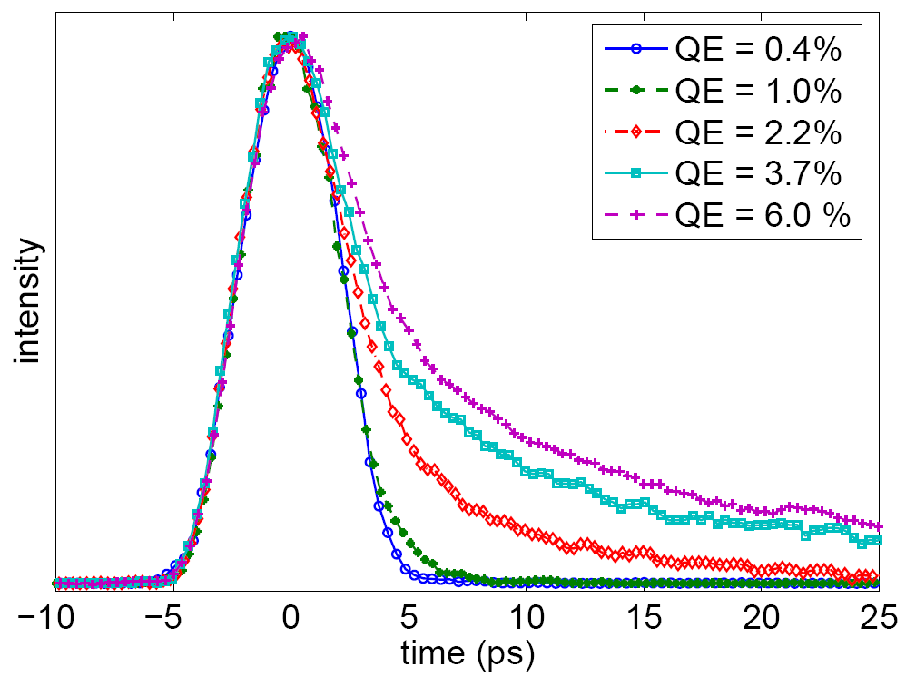
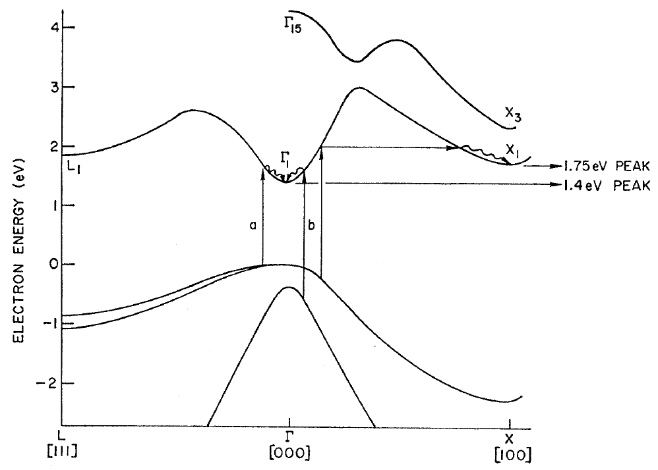
Diffusion tail
GaAsP @ 520 nm
P concentration 45%
Two valleys: Γ (direct) and X (indirect) involved in the process
Strong QE dependency

Slide 23
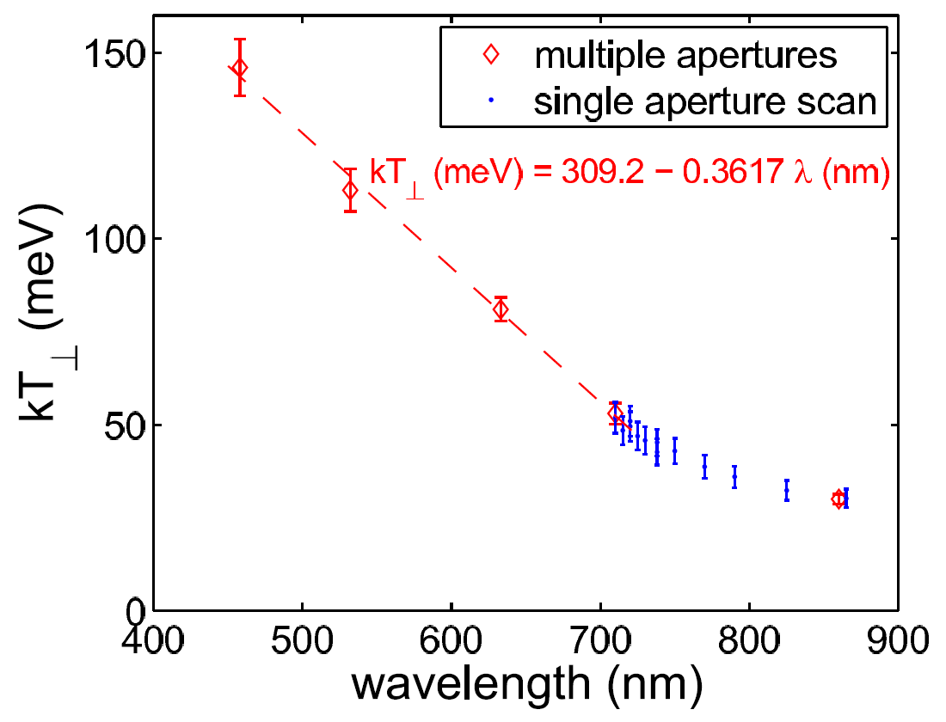
Transverse energy distributions
No surprises for bulk GaAs: cold electrons with a near band-gap excitation
GaAs
Surprisingly large transverse energy spread for GaN and GaAsP:
GaAsP: kT⊥ = 130-240 meV for photons 0-780 meV photons above the band-gap
GaN: kT⊥ = 0.9 eV for photons with 1.4 eV above the band-gap

Slide 24
Summary
Transverse energy of photoelectrons remain poorly understood for III-V semiconductors (other than GaAs)
More carefully controlled experimental data on transverse energy distributions/time response needed
Predictive codes and models need to be developed and benchmarked with experiments
This will allow photocathode engineering with the desired characteristics such as cold electrons with a ps response

Slide 25
Acknowledgements
Bruce Dunham, Xianghong Liu, Yulin Li
Amir Dabiran (SVT)
Dimitry Orlov (Max Planck Institute NP)
Matt Virgo (ANL)

